Slide 1
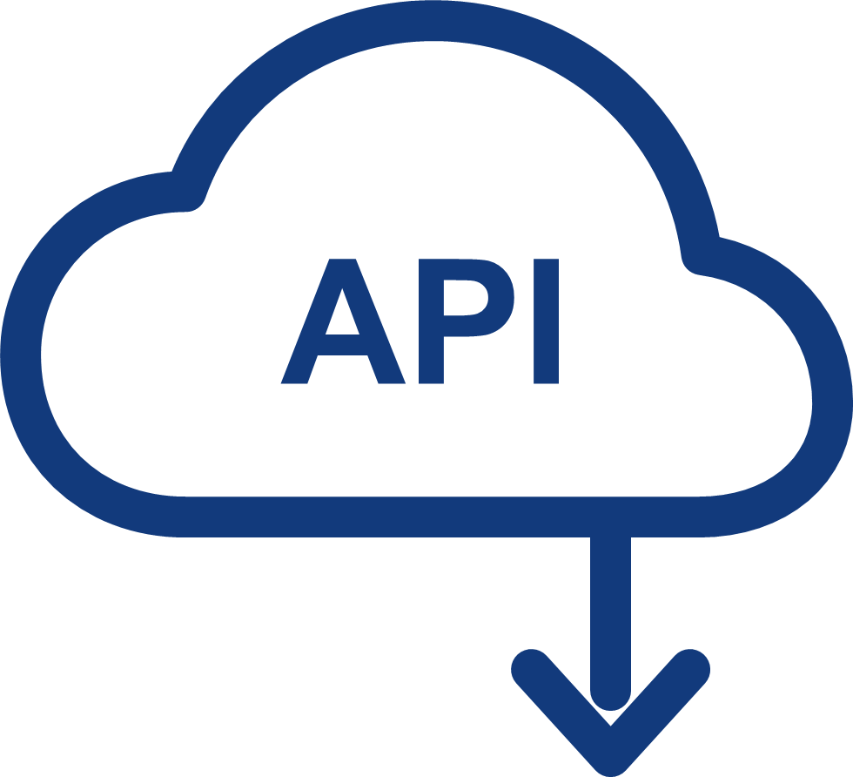

















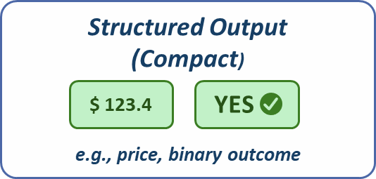
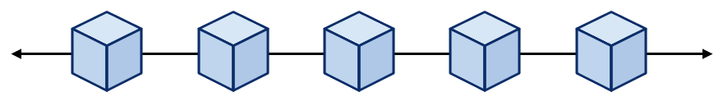



A
Conventional Data Oracle
B
LASO Semantic Oracle
On-Chain
Oracle Network
External Structured Data Source
Oracle Network
(Semantic Layer)
Hybrid Evidence Sources
On-Chain
User
Contract
Oracle Nodes
2
API
(REST/JSON)
User
Contract
Ask Agents (Dispatch Query)
Structured Feeds(Prices, Stats, APIs)
3
Fetch
data
Agent-1
(LLM)
Database
(SQL/NoSQL)
News Articles
1
3
Agent-1
(LLM)
Call oracle
Get answers
5
Collect &Validate
Callback user
Market Data
(Prices, Ticks)
Agent-1
(LLM)
Web Pages
4
1
Return
data
Emit event
Oracle
Contract
Other Feeds
(Weather, loT,
Social,...)
Agent-1
(LLM)
Documents(PDF, Reports)
Aggregate (Consensus)
…
…
Oracle
Contract
4
Return claim & proof
Truth Discovery
Weighted Aggregation
Hybrid Claim
Resolve Conflicts
Blockchain (e.g., Ethereum)
ZK Proof
5
Invoke Contract

Slide 2



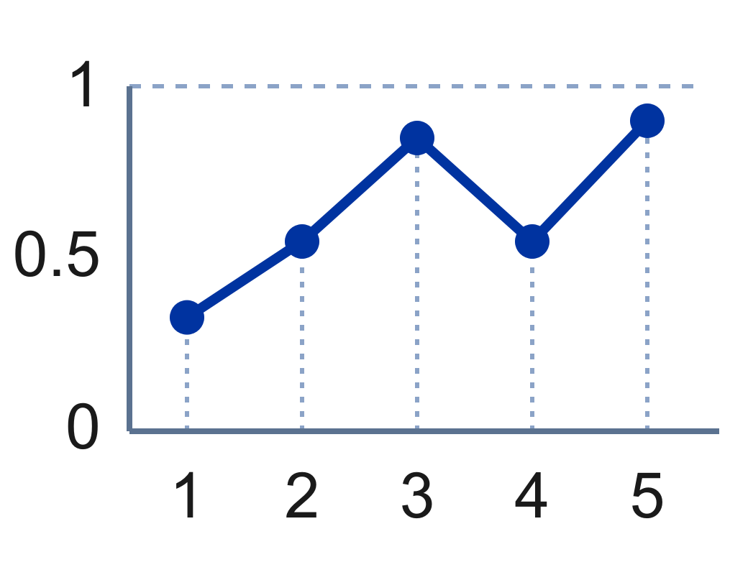
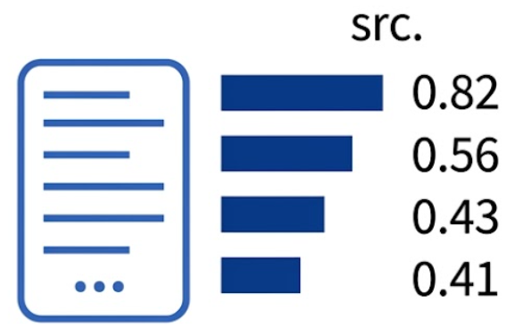
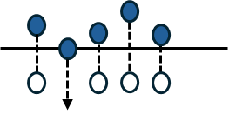

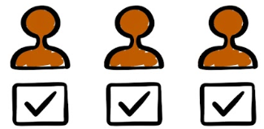

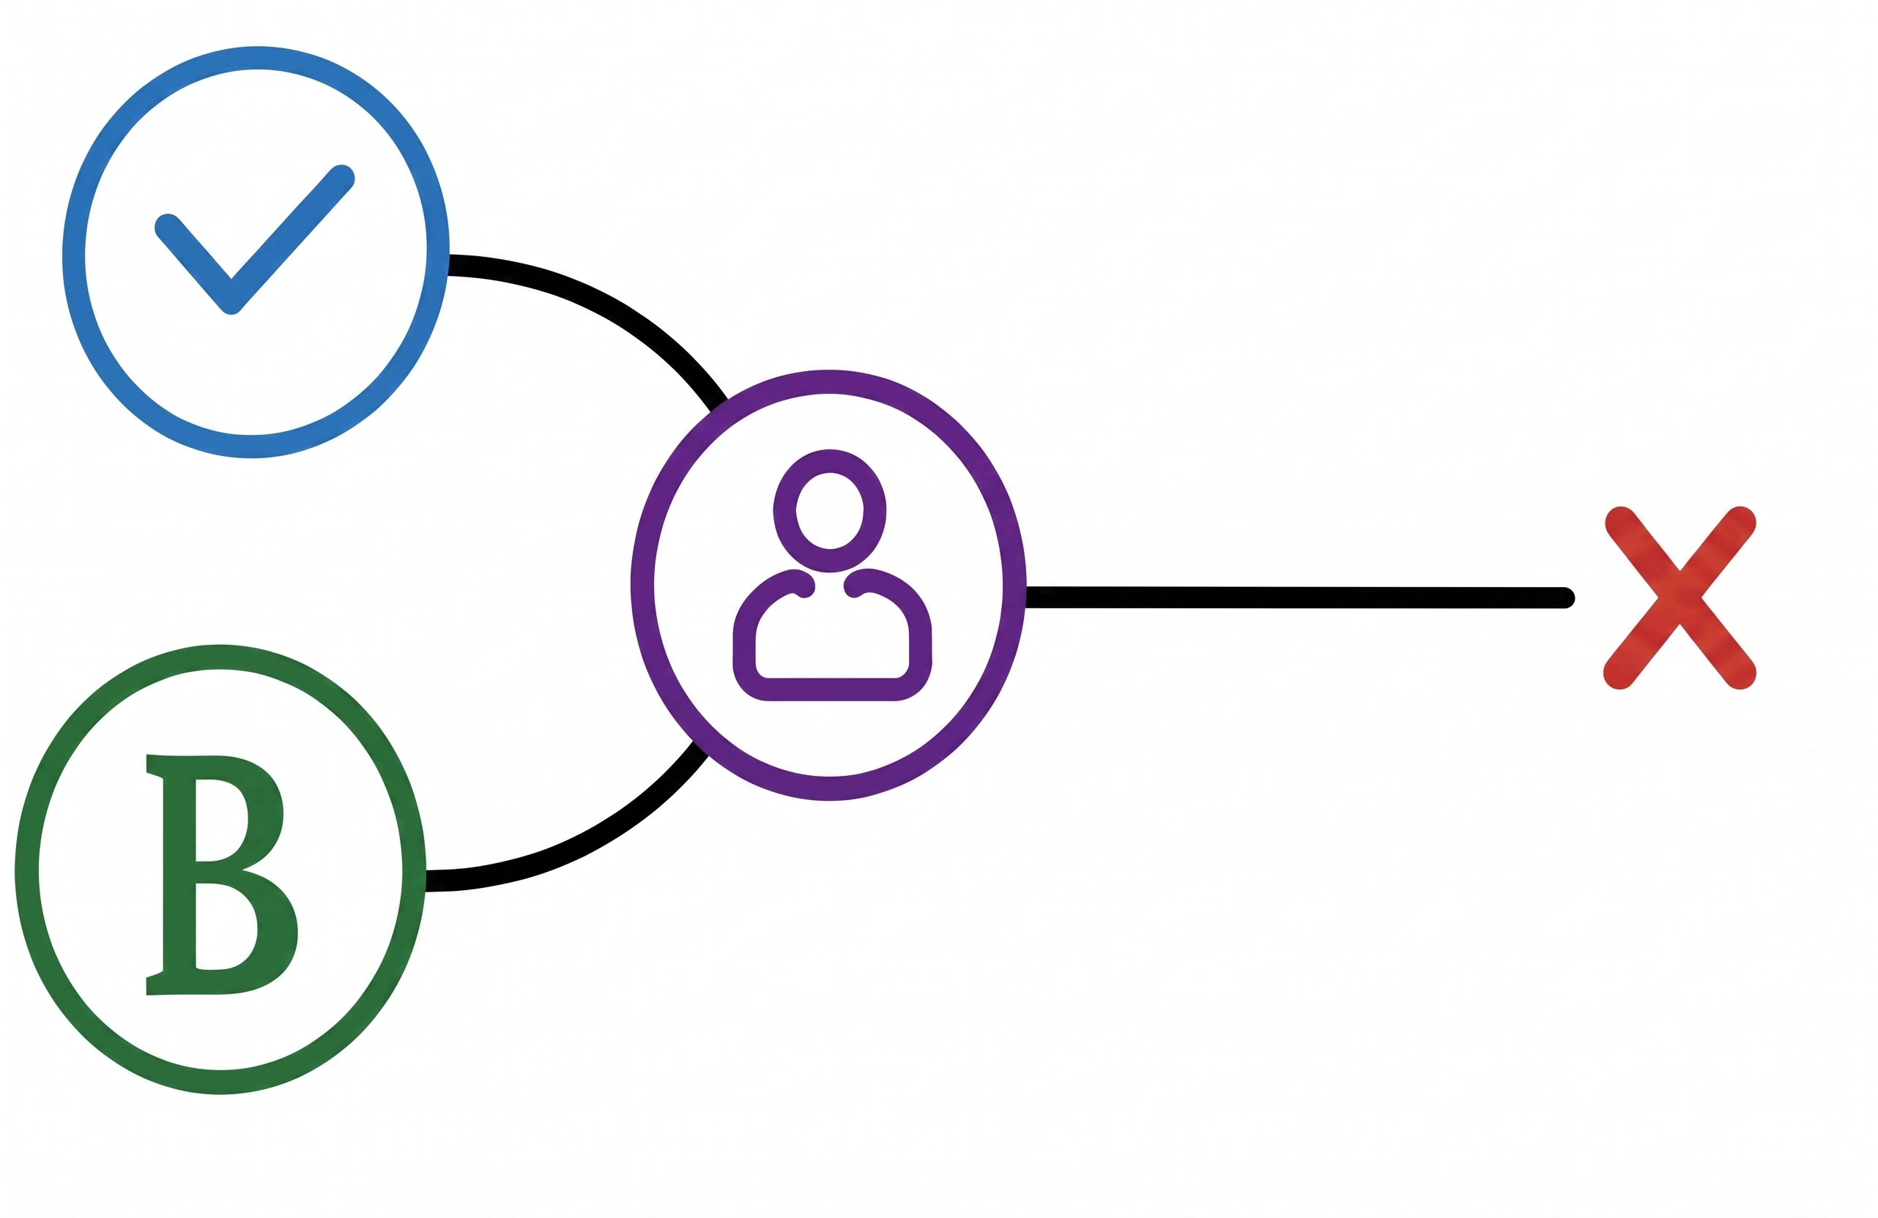
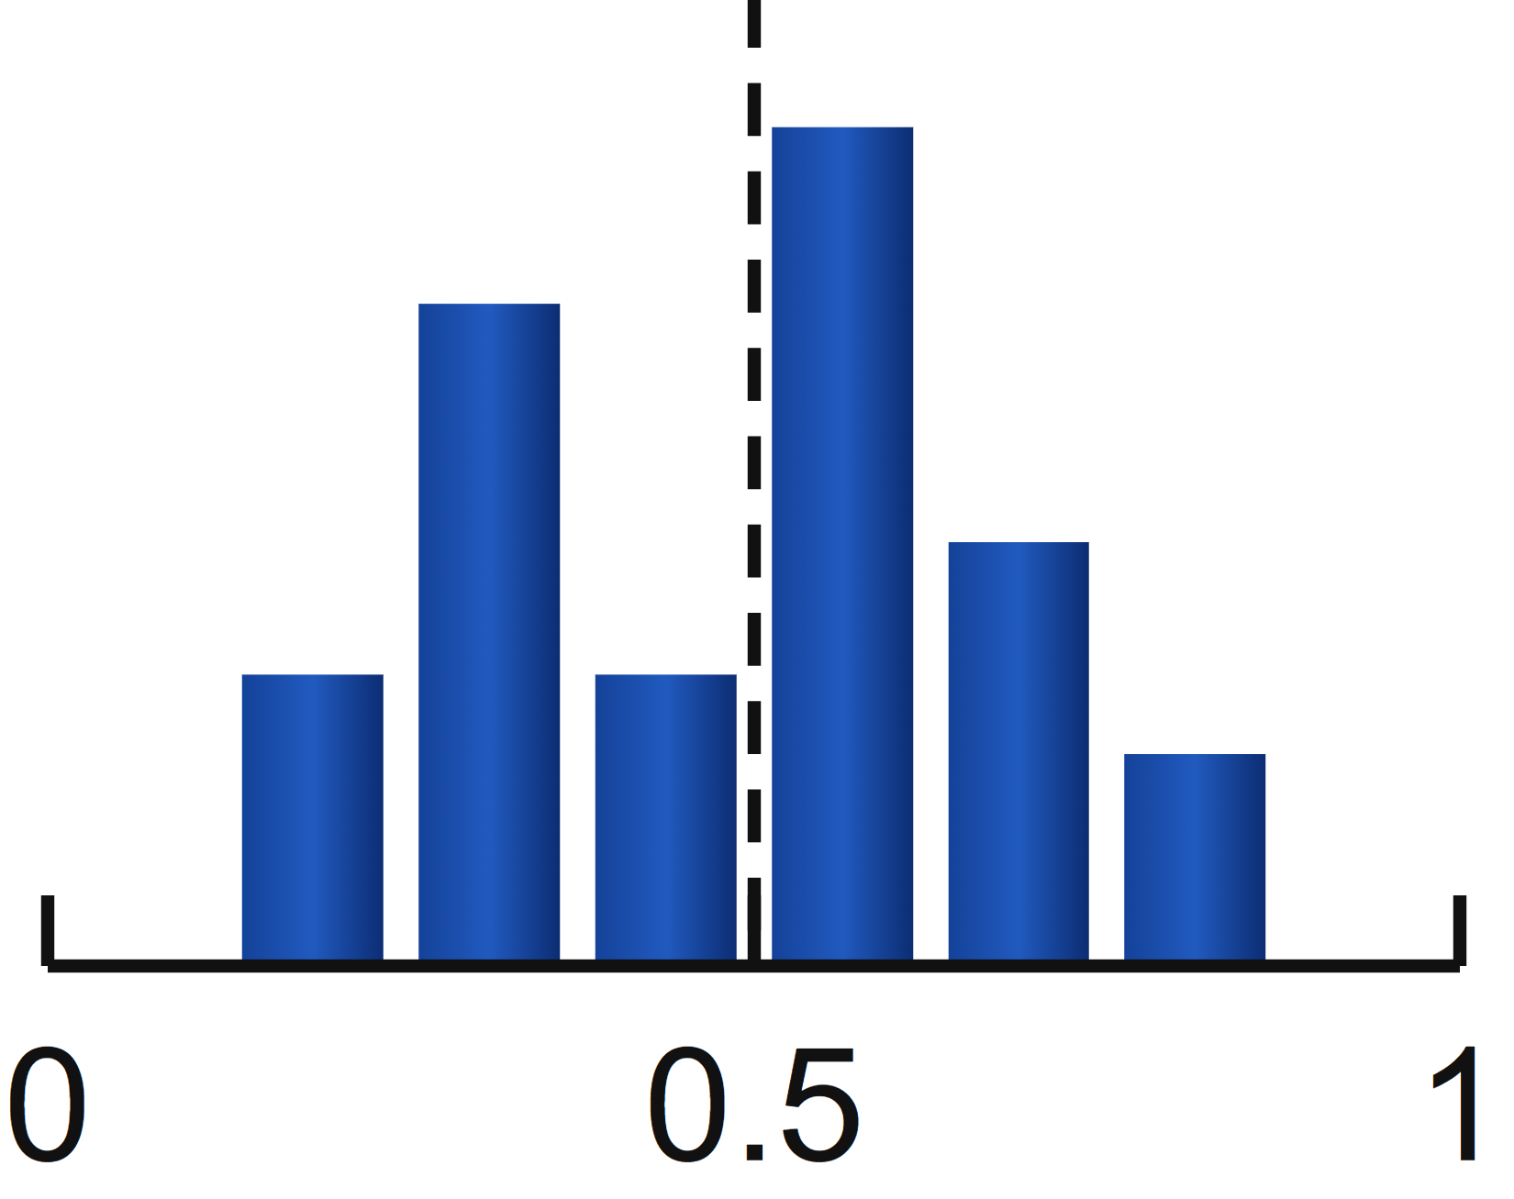
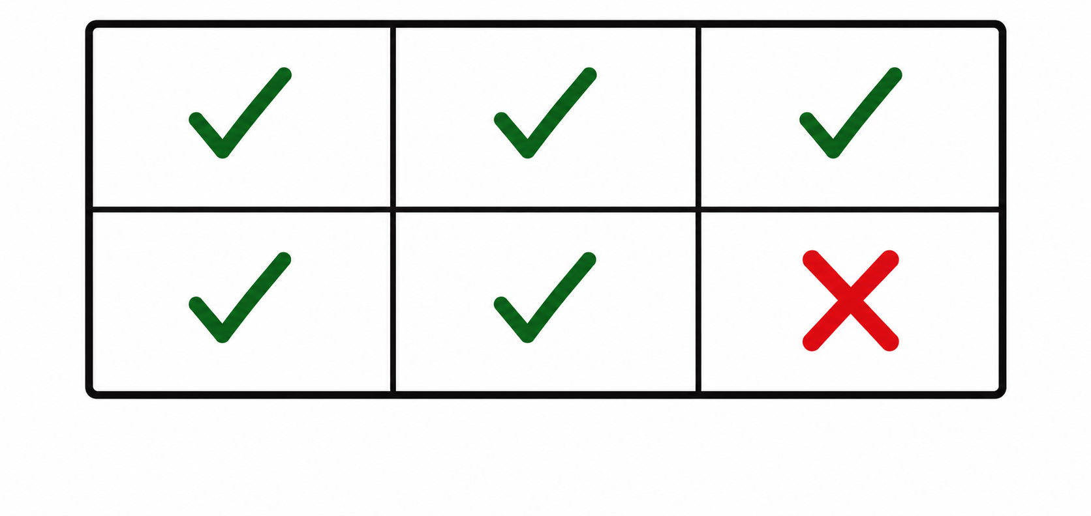


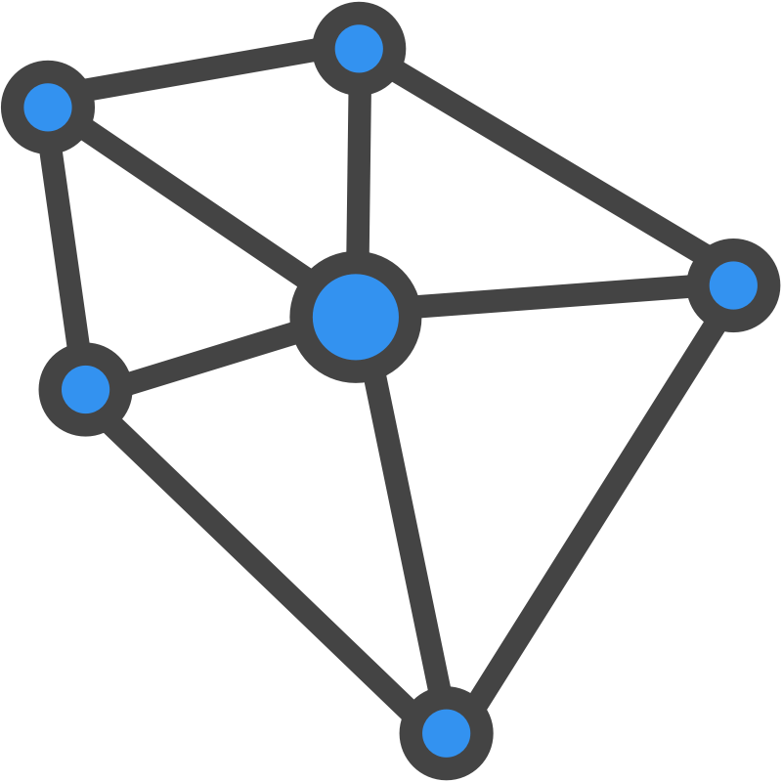

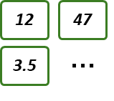

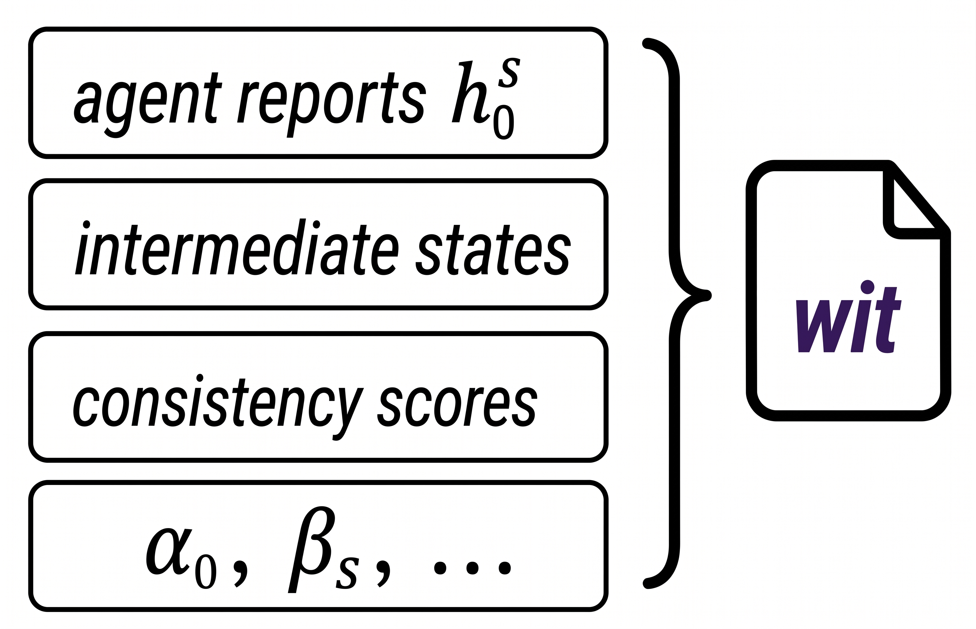
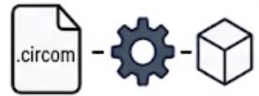


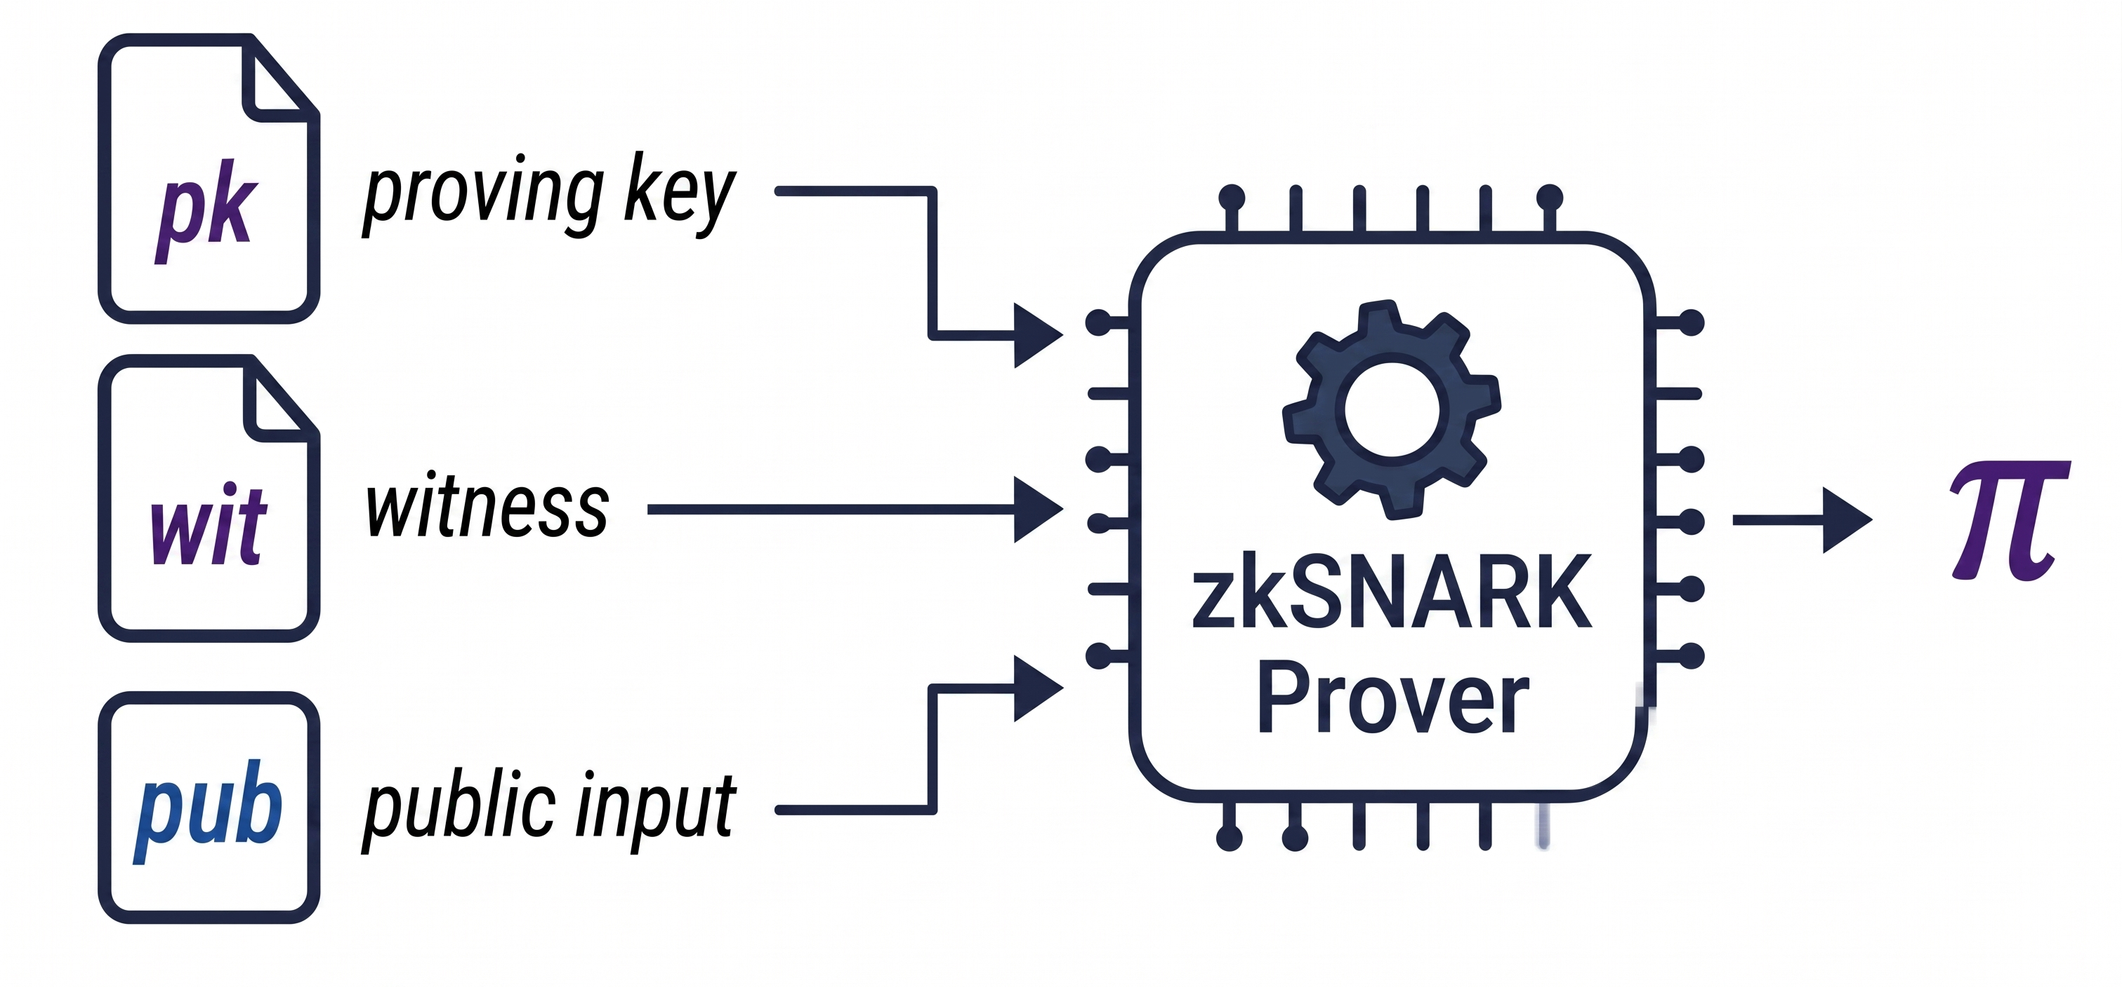
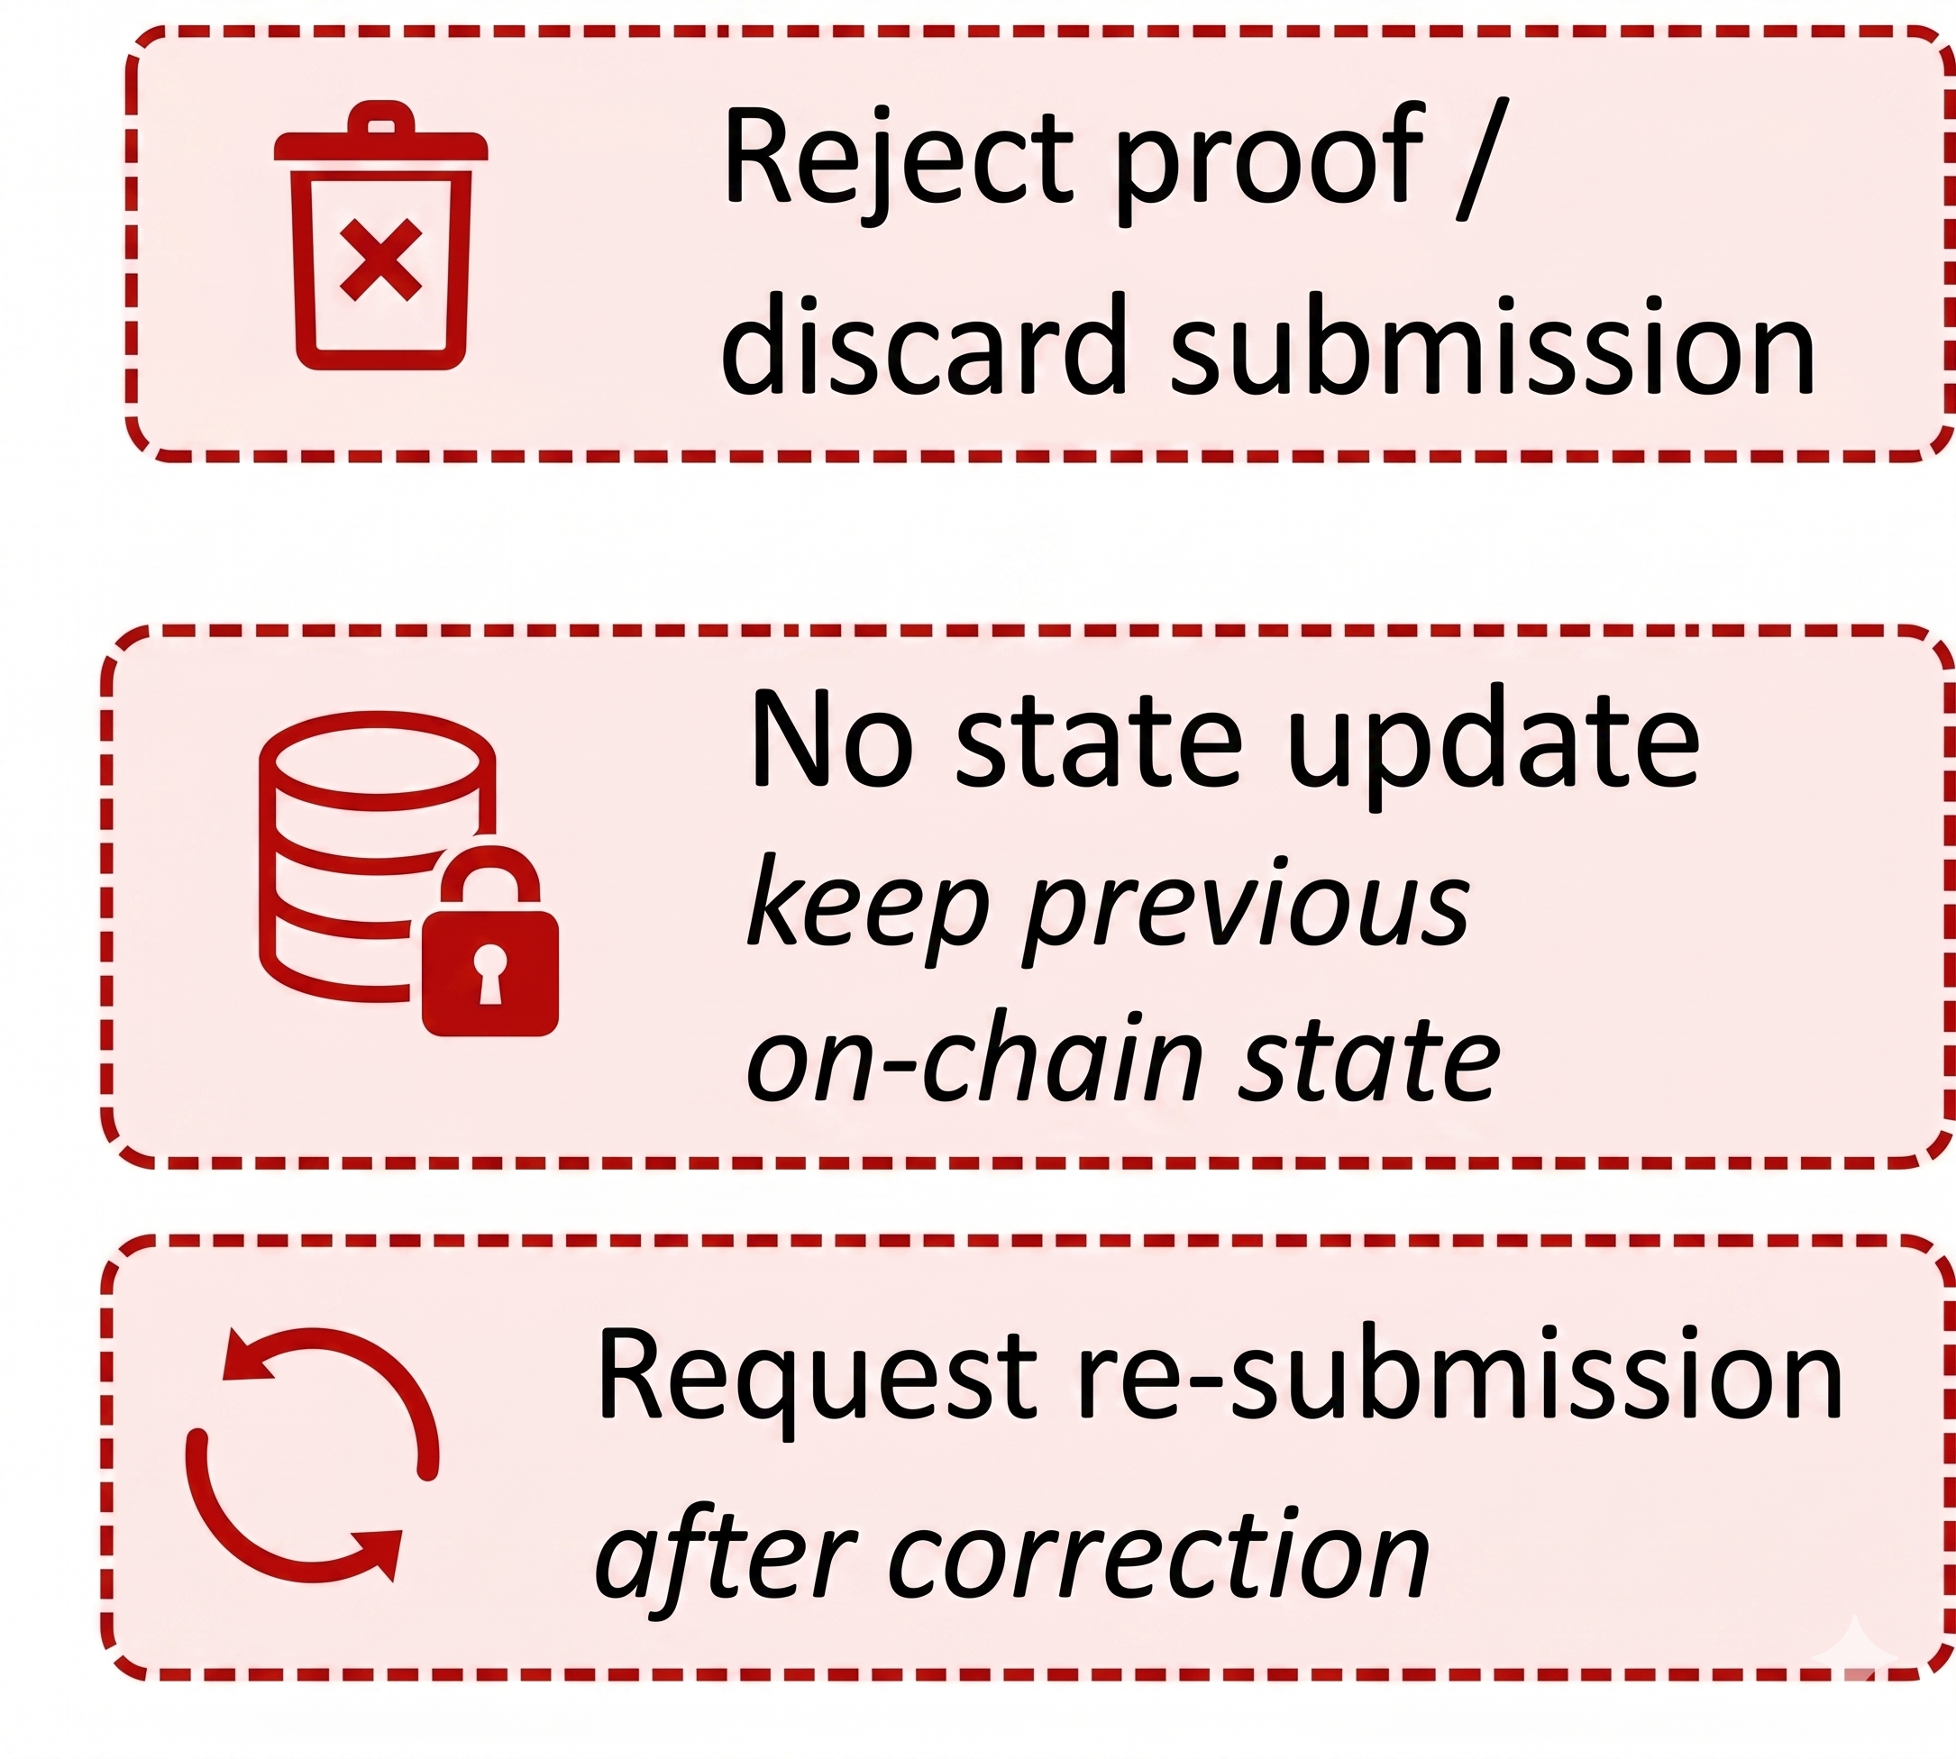
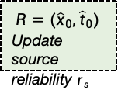
































1
On-Chain Query
2
Dispatch to Oracle Network
Robust Trust Discovery
(Claim Aggregation)
Robust Trust Discovery
(Claim Aggregation)
4
5
Oracle Nodes
$$r_{s}=\frac{α_{s}}{α_{s}+β_{s}}$$
Source Trust Memory (per source $s$)
Circuit Decomposition
Overall Circom Circuit
User Contract
Oracle Contract
$$C=C_{NUM}⋀C_{TXT}⋀C_{REL}$$
Numerical Channel (Value Aggregation)
Numerical reports
Weighted median init
IRLS with Tukey reweight
Numerical
consistency
$$C_{NUM}$$
$$C_{TXT}$$
$$C_{REL}$$
$${\{x}_{s}^{o}\}$$
Numerical
reports
Reliability
gating
SBERT
embeddings
Hybrid affinity
matrix
Numerical consistency
Textual consistency
$$q=(o,r,θ)$$
object,type,params
$$e(q)$$
Emit event
estimate
$$c_{o}^{num}∈[0,1]$$
Robust
numerical
estimation
Numerical
consistency
Trust-aware
voting
Textual
consistency
Object-level
consistency
Epoch-level consistency
Reliability
gating
Low weight
High weight
$$0$$
$$0.5$$
$$1$$
Hybrid Evidence Collection by Multi-Agents
deviation from
3
Filter low-trust sources
Robust start
inliers(high weight)
$${\hat{x}}_{0}$$
Public Input and Witness
outliers (down-weighted)
Public input
Witness
Hybrid Evidence Sources
Oracle Network
(Semantic Layer)
Textual Channel (Claim Selection)
$$pub=(\{{\hat{x}}_{o},{\hat{t}}_{o}\}_{o∈B_{e}},\{r_{s}\}_{s∈S})$$
$$wit=(agent reports, intermediate states,$$
$$consistency scores,Beta−Bernoulli)$$
Textual
claims
Hybrid affinity
matrix
Trust-aware
soft voting
Textual
consistency
Trusted outputs
$${\hat{x}}_{o},{\hat{t}}_{o}$$
$$r_{s}$$
$$h_{o}^{s}$$
Intermediate
computation trace
Consistency
Scores & others
Structured Feeds(Prices, Stats, APIs)
$${\{t}_{i}^{s}\}$$
Reliabilities
Agent reports
$$c_{o}^{txt}∈[0,1]$$
Agent-1
(LLM)
SBERT
embeddings
$$ω_{1}$$
$$ω_{2}$$
$$ω_{m}$$
…
$$0$$
$$0.5$$
$$1$$
numeric
textual
per-source
trust scores
claims
Trusted output
$$A_{o}^{(i,j)}=α∙sim+$$
$$(1−α)∙num$$
weights
Proportional to $r_{s}$
Agent-1
(LLM)
News Articles
Numeric extraction
…
$$∃ wit s.t. C\left(pub,wit\right)=1$$
Proof Generation
Proof Verification
Cross-Batch Reliability Update
Setup/Backend
(Circom+Groth16)
Construct Witness
Agent-1
(LLM)
Object-level
consistency
Epoch-level consistency
Update source reliability
$$b←V_{ERIFY}P_{ROOF}(vk,pub,π)$$
Web Pages
Numerical consistency
Textual consistency
$$(α_{s},β_{s})$$
Trusted setup(CRS)
$$c_{s}^{num}$$
$$c_{s}^{txt}$$
$$c_{s}^{obj}$$
$$\overline{c_{s}}$$
Valid
Invalid
$$α_{s}←α_{s}+η\overline{c_{s}}$$
Store final
trusted result
Agent-1
(LLM)
$$β_{s}←β_{s}+η(1−\overline{c_{s}})$$
Documents(PDF, Reports)
Generate Proof
(Prover)
$$r_{s}=\frac{α_{s}}{α_{s}+β_{s}}$$
$$R=({\hat{x}}_{0},{\hat{t}}_{0})$$
Update source reliability $r_{s}$

