Slide 1





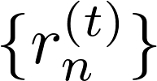

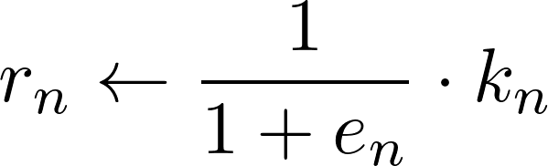





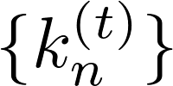







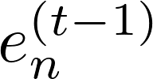


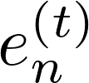





ZKP Verification Layer
Distance Calculation
Reliability update
Input Commitment
Truth Discovery Circuit
ZK Proof(π)
Hybrid Data Joint Grouping
output data
discrete
iteration t
iteration t+1
numeric
Extract discrete and numerical data from complete reply
Evaluation Module
ITERATION
calculate
Distance Calculation
Deviation from Last Iteration
Reliability
update
Agent i
reply
Weighted combination of two factors
Deviation Generation
Stage 1：Data Extraction
Stage 2：Deviation Assessment
Stage 3：Update Reliability

