Slide 1


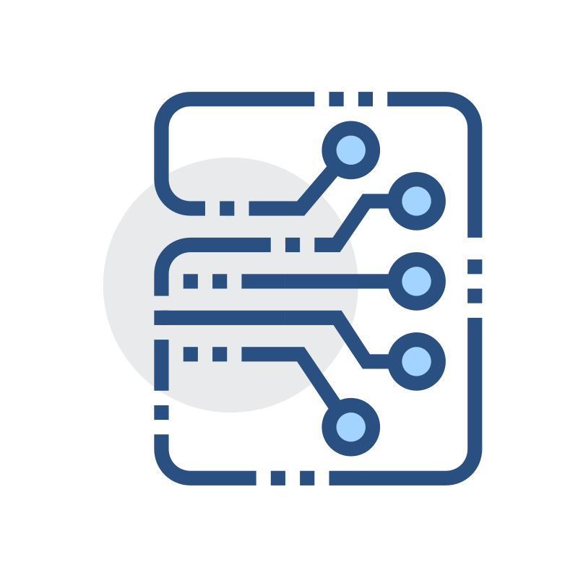








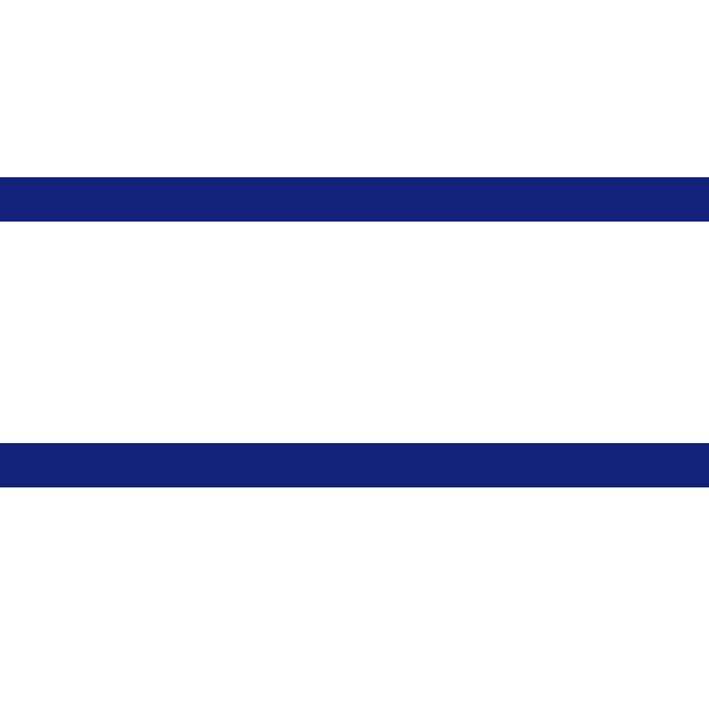




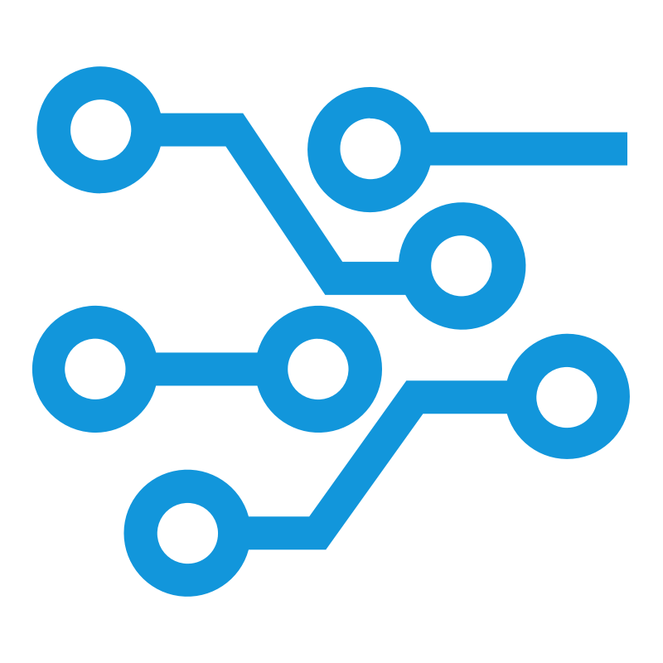






ZKP Verification Layer
Dual-Channel Processing
Reliability update
Input Commitment
Truth Discovery Circuit
ZK Proof(π)
Text Channel
Numeric Channel
source history
output data
Text
iteration t+1
iteration t
Good
Numeric
SBERT Encoding
Gate Filter
Bad
source history
Extract text & numerical data from agent replies
Data Extraction
Weighted Median
calculate
Affinity Matrix
Irls Iteration
Beta-Bernoulli
Update
Soft Voting
Gaussian Consistency
Cross-Channel Consistency Input
Credibility
Agent i
update
Cross-Channel Merge
Stage 1：Data Extraction
Stage 2：Deviation Assessment
Stage 3：Update Reliability

Slide 2

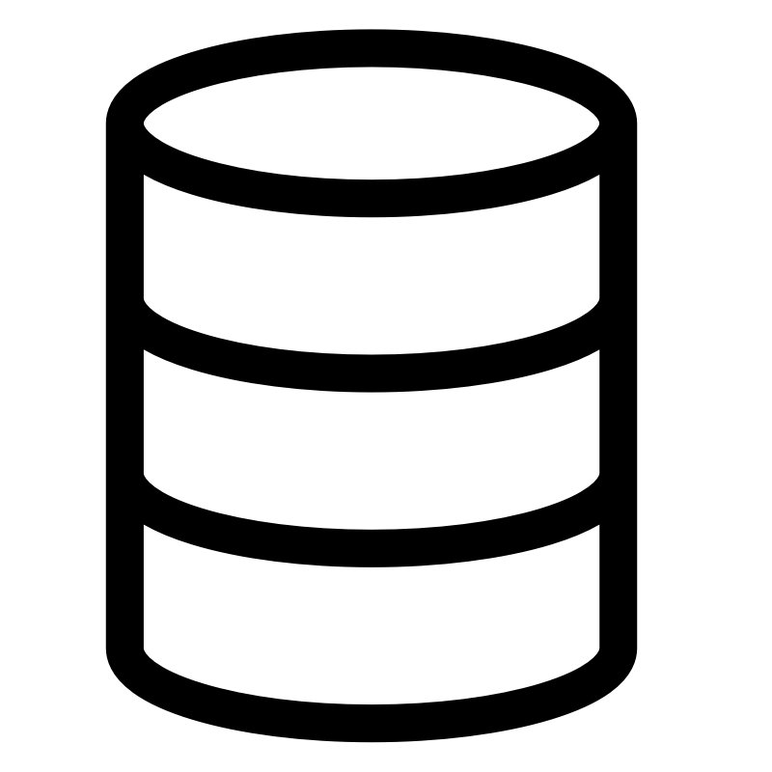


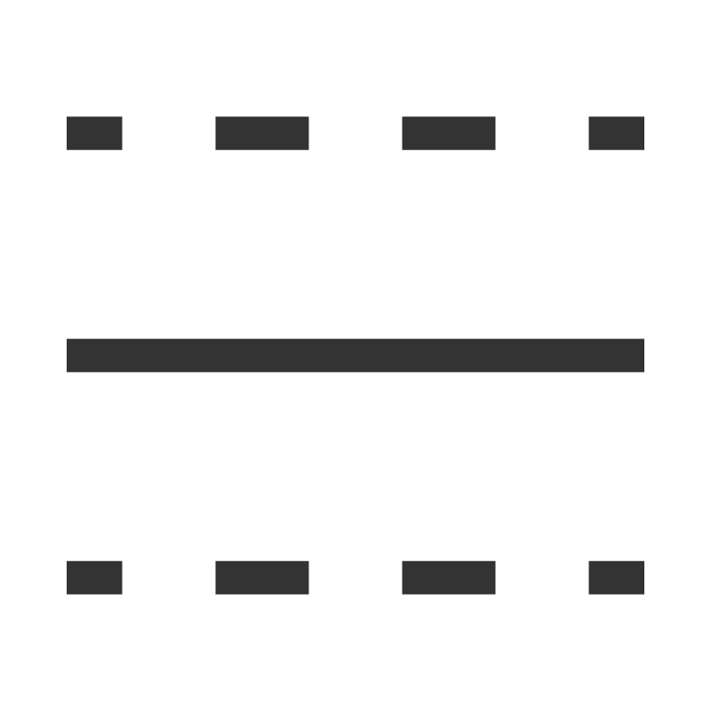
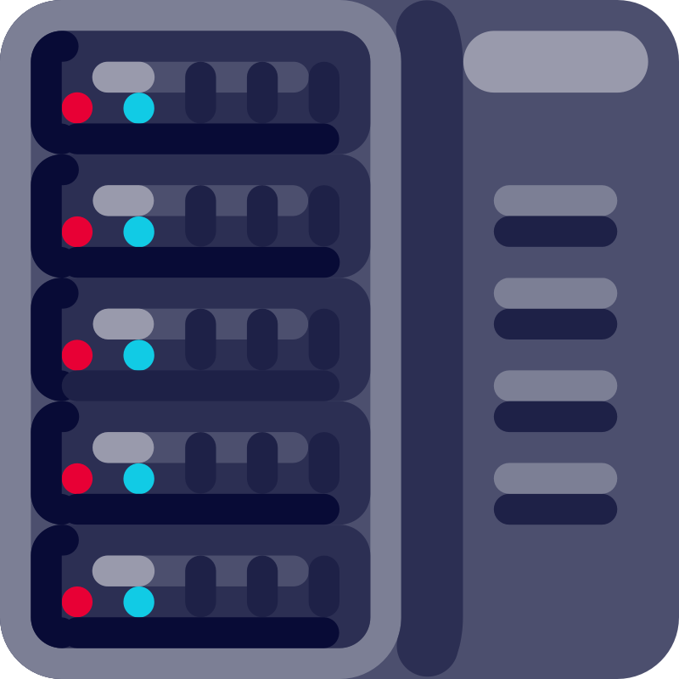












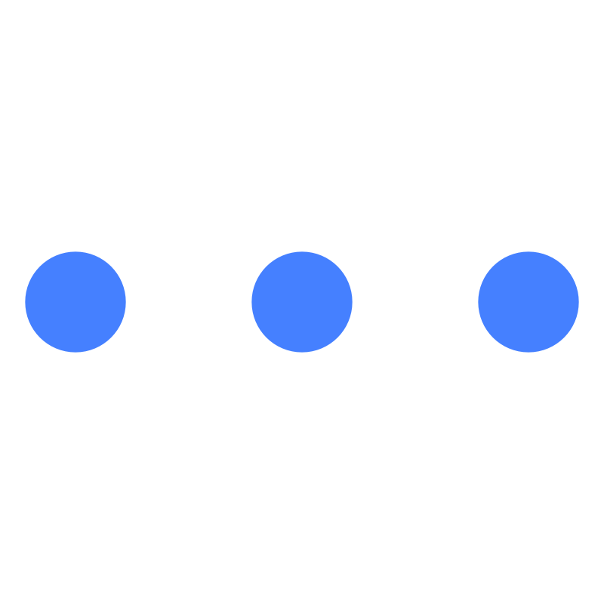


DataSource
DataSource
Thinking
Website
④
③
④
③
Oracle Network
Agent-1
Agent-2
Agent-3
Agent-4
⑤
②
Agent
⑤
TrustWorthiness
Oracle Contract
Block
⑥
Truth Discovery
FactConfidence
①
Block
②
⑥
User Contract
Agent-1 | Agent-2 | Agent-3 | Agent-4
User Contract
Block
Zero-knowledge
proof
⑦
User Contract
①
⑧
Blockchain
Block
Oracle Network
Blockchain
① call oracle
② emit event
③ fetch data
① emit event
② ask agent
③ get answer
④ ret answer
④ ret data
⑤ invoke contract
⑥ callback user
⑤ check truthiness
⑥ consistency
⑦ ret truth
⑧ invoke contract
(a) Data Oracle
(b) Semantic Oracle

