Slide 1
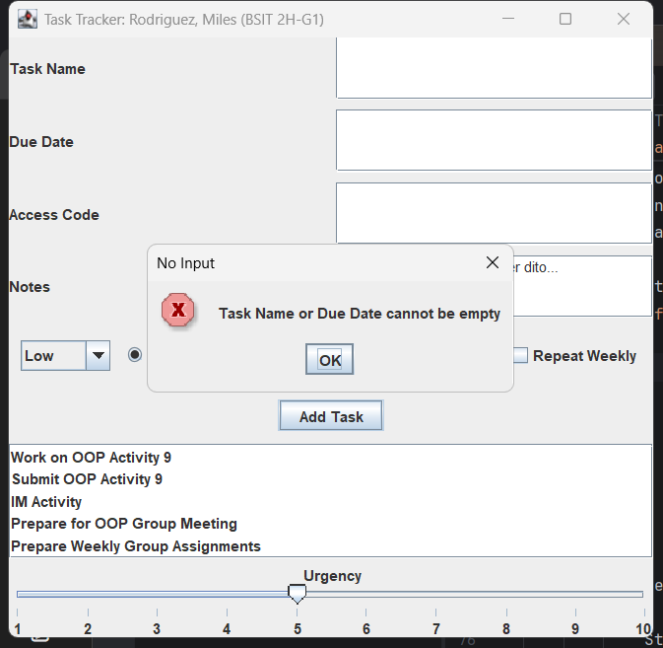
IT 203
Activity 10
GUI with Swing (Part 2)
Screenshot 1
Empty Field Error
Miles Rodriguez
BSIT 2H-G1

Slide 2
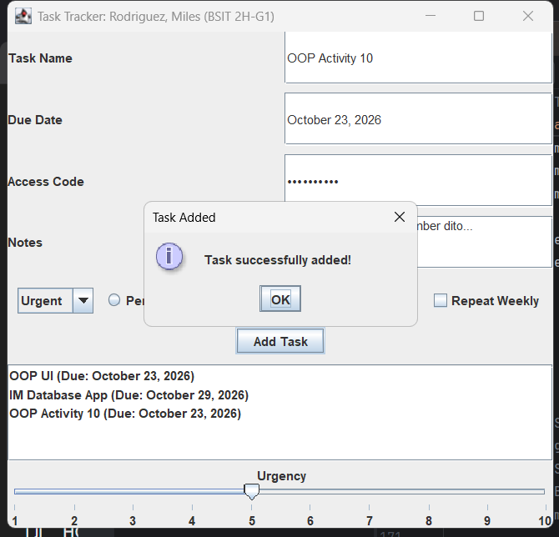
IT 203
Activity 10
GUI with Swing (Part 2)
Screenshot 2
Task Added
Miles Rodriguez
BSIT 2H-G1

Slide 3
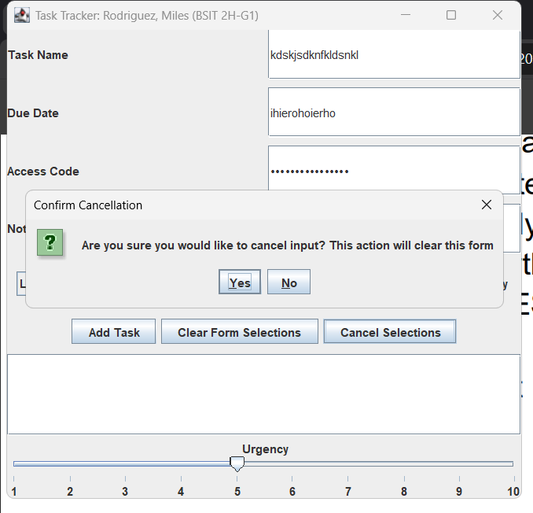
IT 203
Activity 10
GUI with Swing (Part 2)
Screenshot 3
Confirm Cancel
Miles Rodriguez
BSIT 2H-G1

Slide 4
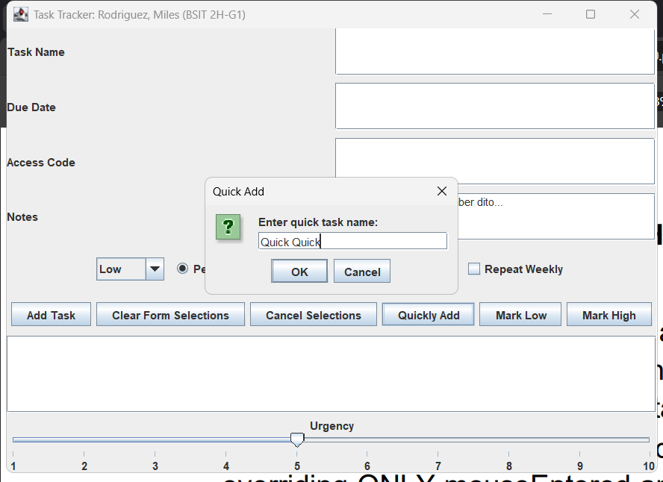
IT 203
Activity 10
GUI with Swing (Part 2)
Screenshot 4
Quick Task Dialog
Miles Rodriguez
BSIT 2H-G1

Slide 5
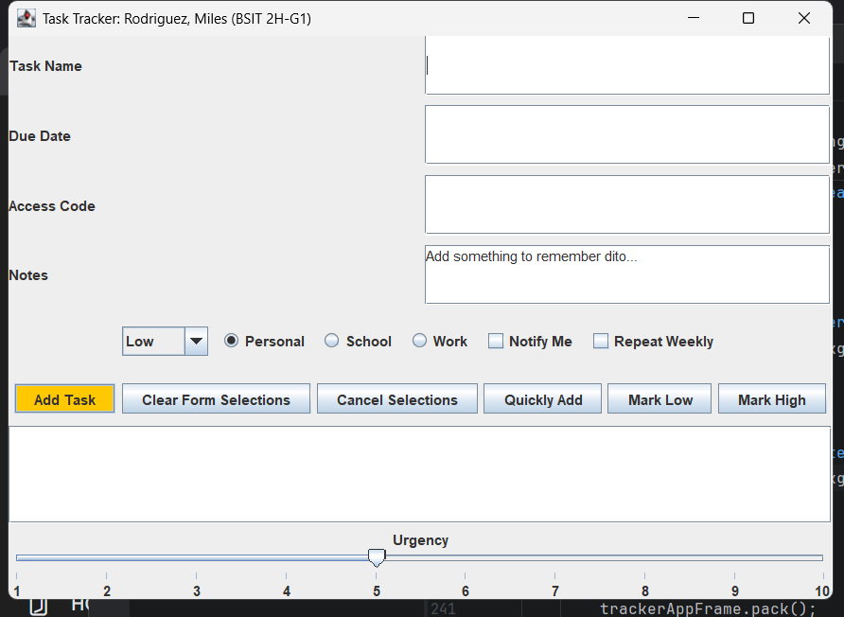
IT 203
Activity 10
GUI with Swing (Part 2)
Screenshot 5
Hover Effect
Miles Rodriguez
BSIT 2H-G1

