Slide 1
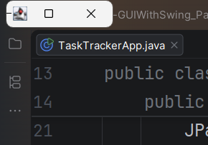

IT 203
Activity 9
GUI with Swing (Part 1)
Screenshot 1
Empty Frame
Original state upon running
Expanded horizontally to show the frame title
Miles Rodriguez
BSIT 2H-G1

Slide 2
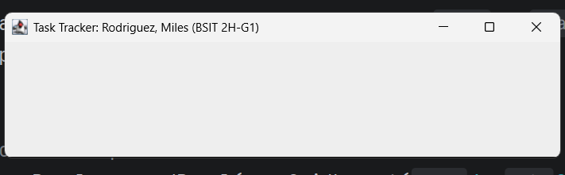
IT 203
Activity 9
GUI with Swing (Part 1)
Screenshot 2
Three Empty Regions
Expanded horizontally and vertically to show the frame title and that no components are added yet
Miles Rodriguez
BSIT 2H-G1

Slide 3
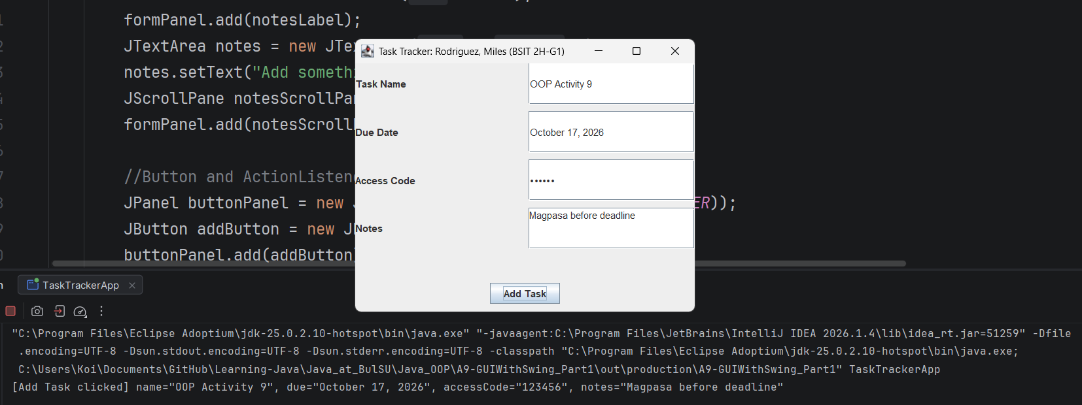
IT 203
Activity 9
GUI with Swing (Part 1)
Screenshot 3
Filled Form + Console
Miles Rodriguez
BSIT 2H-G1

Slide 4
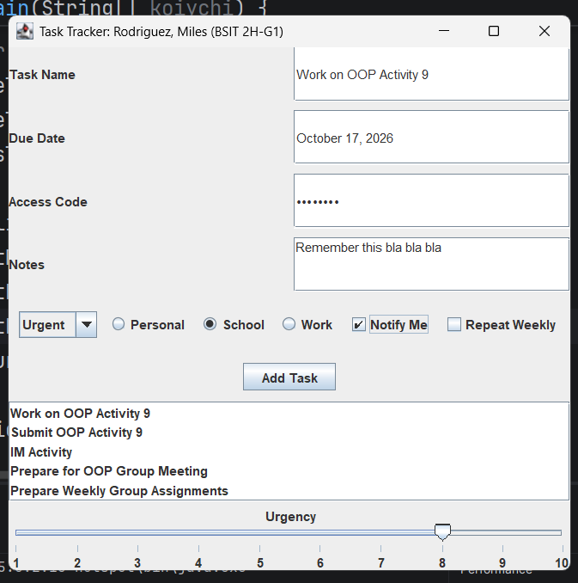
IT 203
Activity 9
GUI with Swing (Part 1)
Screenshot 4
Every Component Visible
Miles Rodriguez
BSIT 2H-G1

