Slide 1
TLS1.3

Slide 2

TLS v1.3 Overview
Improved security
Faster handshake
Full session encryption
New Algorithms
Removed vulnerable ciphers and algorithms
Removed obsolete/insecure features
Improve session resumption
© Copyright 2019 wolfSSL

Slide 3
TLS v1.3 Improved Security
Only Perfect Forward Secrecy (PFS) ciphers allowed
A new key is used for each new TLS session
All handshake messages after ServerHello are now encrypted
Only Authenticated Encryption with Associated Data (AEAD) Ciphers allowed (AES-GCM, ChaCha20/Poly1305, AES-CCM)
Smaller attack surface == increased security
© Copyright 2019 wolfSSL

Slide 4
TLS v1.3 Faster handshake
TLS Handshake takes one round trip instead of two
Client can start sending data immediately after the first reply from the server
Zero round trip time (0-RTT) possible if a previous session exists
Allows sending encrypted data in ClientHello
Less RTTs == faster handshake, less traffic, less power used
© Copyright 2019 wolfSSL

Slide 5
TLS1.3の鍵交換
方式 | 用途 | 前方完全秘匿性
(EC)DHE フルハンドシェーク | 最初のセッション | 有
PSK-only | 事前共有鍵 | 無
PSK with (EC)DHE | 事前共有鍵、セッション再開 | 有
セッション再開はPSKの派生系として統一
PFSの観点からPSK with DHを推奨

Slide 6
フルハンドシェーク

Slide 7
TLSバージョン
Supported Versionsに明示
明示されないバージョンにダウングレードは認めない
Renegotiationの廃止

Slide 8
TLS1.3の暗号スイート
鍵交換はDH系のみに整理。静的RSAの廃止
共通鍵暗号はAEADのみに整理。MACの廃止
ハッシュはHKDFのハッシュアルゴリズムを示す
TLS_AES_256_GCM_SHA384
TLS_AES_128_GCM_SHA256
TLS_CHACHA20_POLY1305_SHA256
TLS_AES_128_CCM_8_SHA256
TLS_AES_128_CCM_SHA256

Slide 9
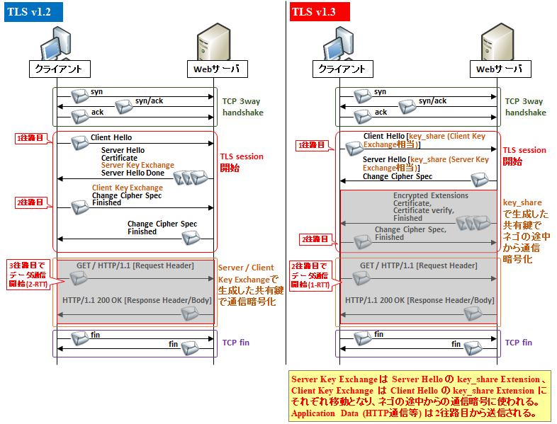
Classic TLS vs v1.3 handshake
旧TLSとTLS1.3のハンドシェーク
クライアント
サーバ
クライアント
サーバ
© Copyright 2019 wolfSSL

Slide 10
Client Hello
Supported Version: TLS 1.3 (0x0304)
Cipher Suite, Key Exchange
and Derivation
Cipher Suites (27 suites)
Cipher Suite: TLS_AES_128_GCM_SHA256 (0x1301)
Cipher Suite: TLS_AES_256_GCM_SHA384 (0x1302)
Cipher Suite: TLS_CHACHA20_POLY1305_SHA256 (0x1303)
Supported Groups (5 groups)
Supported Group: secp521r1 (0x0019)
Supported Group: secp384r1 (0x0018)
Supported Group: secp256r1 (0x0017)
Supported Group: secp224r1 (0x0015)
Supported Group: ffdhe2048 (0x0100)
Ephemeral
Param
Server Hello
Supported Version: TLS 1.3 (0x0304)
Key Share extension
Cipher Suite: TLS_AES_128_GCM_SHA256 (0x1301)
Server
Private
Key
Client
Private
Key
Key Share extension
Client Public Key DH Param
DH Param Server Public Key
(EC)DHE
(EC)DHE
Pre-master Secret
Pre-master Secret
HKDF
HKDF
0-RTT
Handshake
App. Data
0-RTT
Handshake
App. Data
Server/Client-Key/IV
Server/Client-Key/IV

Slide 11
共通鍵署名と鍵導出
MAC：共通鍵による署名
HMAC: Hashアルゴリズムを利用したMAC
HKDF: HMACを使用した鍵導出
message authentication code
hash-based message authentication code
HMAC-based Extract-and-Expand Key Derivation Function
共通鍵
メッセージ
共通鍵
ソルト
メッセージ
共通鍵
メッセージ
Hash
HMAC
共通鍵
ハッシュ
署名
Hash
導出された鍵
署名
MAC
HMAC
HKDF

Slide 12
鍵導出：用途ごとの導出
0
|
v
PSK -> HKDF-Extract = Early Secret
|
+-----> Derive-Secret(., "ext binder" | "res binder", "")
| = binder_key
|
+-----> Derive-Secret(., "c e traffic", ClientHello)
| = client_early_traffic_secret
|
+-----> Derive-Secret(., "e exp master", ClientHello)
| = early_exporter_master_secret
v
Derive-Secret(., "derived", "")
|
v
(EC)DHE -> HKDF-Extract = Handshake Secret
|
+-----> Derive-Secret(., "c hs traffic",
| ClientHello...ServerHello)
| = client_handshake_traffic_secret
|
+-----> Derive-Secret(., "s hs traffic",
| ClientHello...ServerHello)
| = server_handshake_traffic_secret
v
Derive-Secret(., "derived", "")
|
v
0 -> HKDF-Extract = Master Secret
|
+-----> Derive-Secret(., "c ap traffic",
| ClientHello...server Finished)
| = client_application_traffic_secret_0
|
+-----> Derive-Secret(., "s ap traffic",
| ClientHello...server Finished)
| = server_application_traffic_secret_0
|
+-----> Derive-Secret(., "exp master",
| ClientHello...server Finished)
| = exporter_master_secret
|
+-----> Derive-Secret(., "res master",
ClientHello...client Finished)
= resumption_master_secret

Slide 13
鍵導出：KeyとIV
[sender]_write_key = HKDF-Expand-Label(Secret, "key", "", key_length)
[sender]_write_iv = HKDF-Expand-Label(Secret, "iv", "", iv_length)
Record Type | Secret
0-RTT Application | client_early_traffic_secret
Handshake | [sender]_handshake_traffic_secret
Application Data | [sender]_application_traffic_secret_N

Slide 14
TLS1.3 AEAD to Crypt API
Key Derivation(HKDF)
AES-GCM API
Key:
Sender_write_key
nonce:
Sequence number (Record number)
Sender_write_iv
additional data:
opaque_type = application_data; /* 23 */
legacy_record_version = 0x0303; /* TLS v1.2 */
length
Tag: AES-GCM
RFC-5116 5. AEAD Algorithms
Algorithm depend
Key
IV
Auth Tag
Tag from Sender
TLS Record

Slide 15
AES-GCMのAPI
int wcAesSetKey_ (Aes *aes, const byte *key, word32 len, const byte *iv, int dir)
int wc_AesGcmEncrypt (Aes *aes,
byte *out, const byte *in, word32 sz,
const byte *iv, word32 ivSz,
byte *authTag, word32 authTagSz,
const byte *authIn, word32 authInSz)
int wc_AesGcmDecrypt (Aes *aes,
byte *out, const byte *in, word32 sz,
const byte *iv, word32 ivSz,
const byte *authTag, word32 authTagSz,
const byte *authIn, word32 authInSz)

Slide 16
ピア認証
サーバ認証、クライアント認証
(Certificate Request)、Certificate、Certificate Verify
サーバ認証は必須なので、サーバ認証ではCertificate Requestは省略
認証要求側
被認証側
CA証明書
Certificate Request
Blob
Certificate
証明書
CA署名済の
証明書
証明書の正当性チェック
公開鍵で署名をチェック
Certificate Verify
署名
プライベート鍵

Slide 17
PSK、セッション再開
PSK:
別途、どこかで事前に鍵を合意しておく
ピア認証不要のぶん、ハンドシェークが軽い
DH有無の２パターン
DHなし：合意した鍵をそのまま使用（前方秘匿性のリスクあり）
DHあり：DHにより新たな鍵を合意（前方秘匿性のリスクなし）
セッション再開
セッションIDの廃止
セッションチケット必須
PSKの一特殊形として再整理
以前に確立したセッションでセッションチケットの形で鍵合意
PSKにより相手方を認証。公開鍵証明書による認証は省略

Slide 18
PSK: 前方秘匿性なし
Client Hello
Server Hello
PSK ID
PSK ID
PSK
PSK
Pre-shared Secret
Pre-shared Secret
HKDF
HKDF
0-RTT
Handshake
App. Data
0-RTT
Handshake
App. Data
Server/Client-Key/IV
Server/Client-Key/IV

Slide 19
PSK: 完全前方秘匿性あり
Client Hello
Server Hello
Ephemeral
Param
PSK ID
PSK ID
Supported Version: TLS 1.3 (0x0304)
Supported Version: TLS 1.3 (0x0304)
Cipher Suite: TLS_AES_128_GCM_SHA256 (0x1301)
Cipher Suite: TLS_AES_128_GCM_SHA256 (0x1301)
Server
Private
Key
Client
Private
Key
Key Share extension
Key Share extension
Client Public Key DH Param
DH Param Server Public Key
(EC)DHE
(EC)DHE
Pre-master Secret
Pre-master Secret
HKDF
HKDF
0-RTT
Handshake
App. Data
0-RTT
Handshake
App. Data
Server/Client-Key/IV
Server/Client-Key/IV

Slide 20
Client Hello
セッション再開のための
セッションチケット
Supported Version: TLS 1.3 (0x0304)
Cipher Suites (27 suites)
Cipher Suite: TLS_AES_128_GCM_SHA256 (0x1301)
Cipher Suite: TLS_AES_256_GCM_SHA384 (0x1302)
Cipher Suite: TLS_CHACHA20_POLY1305_SHA256 (0x1303)
Supported Groups (5 groups)
Supported Group: secp521r1 (0x0019)
Supported Group: secp384r1 (0x0018)
Supported Group: secp256r1 (0x0017)
Supported Group: secp224r1 (0x0015)
Supported Group: ffdhe2048 (0x0100)
Server Hello
Supported Version: TLS 1.3 (0x0304)
Key Share extension
Cipher Suite: TLS_AES_128_GCM_SHA256 (0x1301)
Key Share extension
Client Public Key DH Param
DH Param Server Public Key
安全な通信チャネル
Session
Ticket
New Session Ticket

