Slide 1
TLSv1.3 Record Layer: Handshake Protocol: Client Hello
Handshake Protocol: Client Hello
Cipher Suites (27 suites)
Cipher Suite: TLS_AES_128_GCM_SHA256 (0x1301)
Cipher Suite: TLS_AES_256_GCM_SHA384 (0x1302)
Cipher Suite: TLS_CHACHA20_POLY1305_SHA256 (0x1303)
...
Extension: key_share (len=71)
Type: key_share (51)
Length: 71
Key Share extension
Client Key Share Length: 69
Key Share Entry: Group: secp256r1, Key Exchange length: 65
Group: secp256r1 (23)
Key Exchange Length: 65
Key Exchange: 04636dc474cfcd3ddfe1f667784............9080fa7dca3136c50…
Extension: supported_versions (len=7)
Type: supported_versions (43)
Length: 5
Supported Versions length: 4
Supported Version: TLS 1.3 (0x0304)
Supported Version: TLS 1.2 (0x0303)
Extension: supported_groups (len=12)
Type: supported_groups (10)
Length: 12
Supported Groups List Length: 10
Supported Groups (5 groups)
Supported Group: secp521r1 (0x0019)
Supported Group: secp384r1 (0x0018)
Supported Group: secp256r1 (0x0017)
Supported Group: secp224r1 (0x0015)
Supported Group: ffdhe2048 (0x0100)
...
サポートする
暗号スイート
鍵交換アルゴリズムの候補と
クライアント側のパラメータ
サポートする
TLSバージョン
サポートする
楕円曲線の種類、DHの鍵サイズ

Slide 2
Handshake Protocol: Server Hello
Handshake Type: Server Hello (2)
Length: 119
Random: 2dd580d4af98f5bdf269917a9e540c4ce8a68397073cae9d5232747e31809e53
Session ID Length: 0
Cipher Suite: TLS_AES_128_GCM_SHA256 (0x1301)
Compression Method: null (0)
Extensions Length: 79
Extension: key_share (len=69)
Type: key_share (51)
Length: 69
Key Share extension
Key Share Entry: Group: secp256r1, Key Exchange length: 65
Group: secp256r1 (23)
Key Exchange Length: 65
Key Exchange: 04ffd20a0e8c5caff368b165ab21bad95d94b7a1ef390009a90f44f2e5dd3fd6b58124aa…
Extension: supported_versions (len=2)
Type: supported_versions (43)
Length: 2
Supported Version: TLS 1.3 (0x0304)
合意した暗号スイート
合意した鍵交換アルゴリズム
(楕円曲線種別を含む)と
サーバ側のパラメータ
合意したTLSバージョン

Slide 3
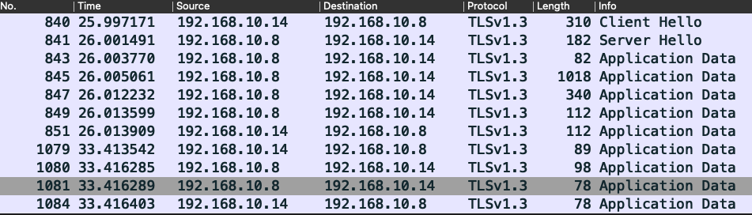
暗号化された
ハンドシェーク

Slide 4
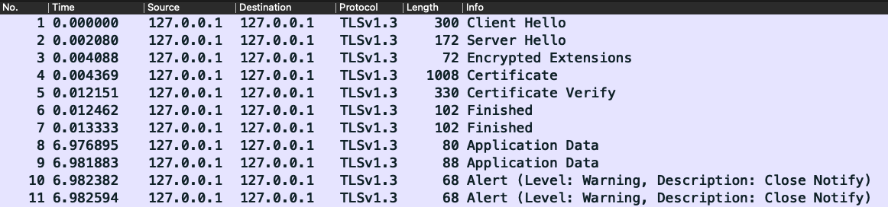
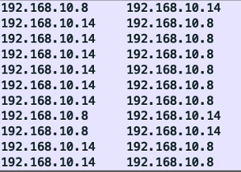

Slide 5
クライアント
サーバ
Client Hello
暗号化される範囲
Server Hello
Encrypted Extension
Certificate
ハンドシェイク
Certificate Verify
Finished
Finished
Application Data
アプリケーションデータ
Application Data
Alert (Close Notify)
切断
Alert (Close Notify)

Slide 6
クライアント
サーバ
Client Hello
Server Hello
Certificate
Server Key Exchange
Server Hello Done
ハンドシェイク
Client Key Exchange
暗号化される範囲
Change Cipher Spec
Enc Handshake Message
Change Cipher Spec
Enc Handshake Message
Application Data
アプリケーションデータ
Application Data
Alert (Close Notify)
Alert (Close Notify)
切断

Slide 7
クライアント
サーバ
TLS1.2 以前の
メッセージ
TLS1.3
TLS1.2 以前の
メッセージ
Client Hello
Client Hello
Server Hello
Server Hello
Client Key Exchange
Encrypted Extension
Certificate
Certificate
Certificate Verify
Server Key Exchange
Finished
Server Hello Done
Change Cipher Spec
Finished
Enc Handshake Message
Change Cipher Spec
Application Data
Enc Handshake Message
Application Data
Alert (Close Notify)
Alert (Close Notify)

Slide 8
クライアント
サーバ
Client Hello
Client Hello
Server Hello
Server Hello
Certificate
Encrypted Extension
Server Key Exchange
Certificate
Server Hello Done
Client Key Exchange
Certificate Verify
Finished
Change Cipher Spec
Encrypted Handshake Message
Change Cipher Spec
Finished
Encrypted Handshake Message
Application Data
Application Data
Alert (Close Notify)
Alert (Close Notify)

