Slide 1

E-Commerce Recommendation Systems
By Andrew Kojo Mensah-Onumah

Slide 2
Techniques to build Recommender systems
Content based recommendation system
Collaborative filtering recommendation system
Hybrid method recommendation system
Based on behaviour of the material content as captured by the features of the users and products
Based on the preference of similar users and similar products. Suitable for datasets without content features
Combines the content and collaborative filtering techniques

Slide 3
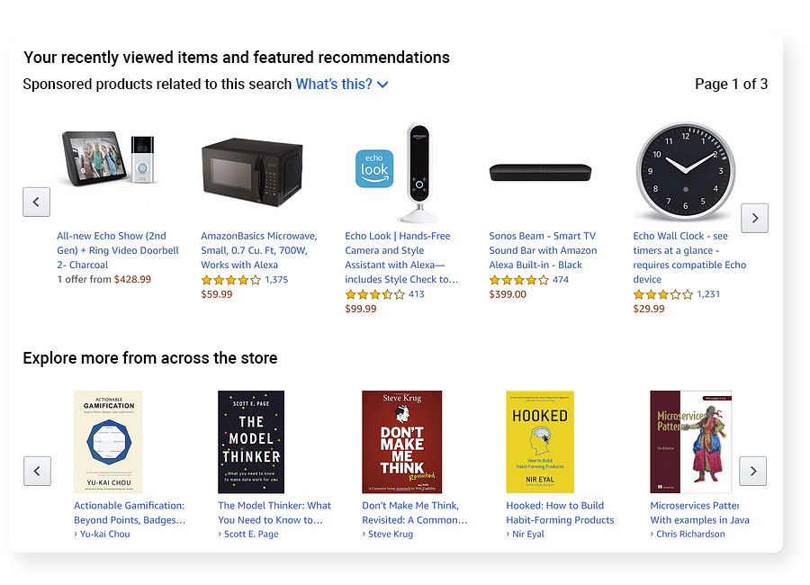
Product recommendation Implementation
Dataset Model
Implement Collaborative filtering techniques.Eg. sparse-based CF, clustering, knn
Build a sparse user-item matrix that contains rows of products interacted by a user
Implement model building
Evaluate on precision and recall
20 million items available
1.4 million users (including bots)
Product and user features are not available
Products and category values have been anonymised

Slide 4
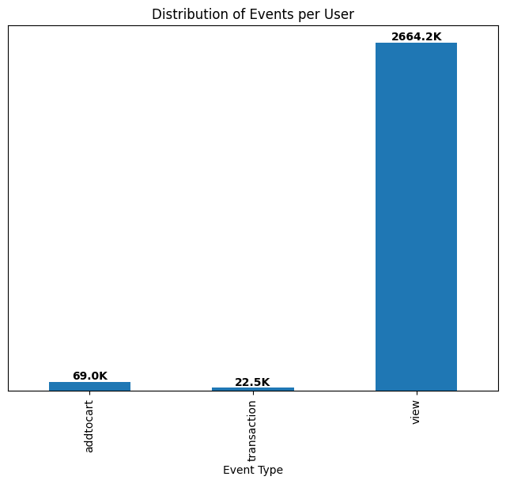
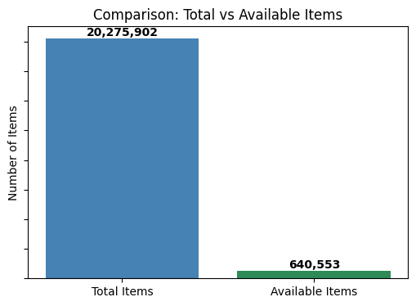
Data Understanding

Slide 5
Product recommendation results
Recommendation based on similar users
New users are recommended the popular products
Continuing users have product recommendations based on similar products chosen by other users
Key takeaways
Different users interact with different items
Human users interact with a limited number of products
User recommendation captures diverse products
Recommendations for user 257597 : [231243, 62549, 194791, 429607, 216305, 396619, 445105, 142466, 174538, 357054]
Recommendations based on similar products
Recommendation is based on products with similar interaction rates (high views, transactions or add-to-carts)
Key takeaways
Users view a lot more products than they add-to-cart or actually buy
There are limited amounts of products interacted with by users
Item recommendation fails to capture connections due to limited interactions

Slide 6
Recommendation
Include an additional web page where users select categories of interest.
Recommend at most 5 items to a user in order to minimise choice overload.
Invest in bot detection and removal (Captcha systems)
Constantly update products with available ones
Focus on popular items & repeat behaviours (add-to-cart & transactions)
Encourage diversity in engagement by surfacing less popular but relevant items.

Slide 7



