Slide 1
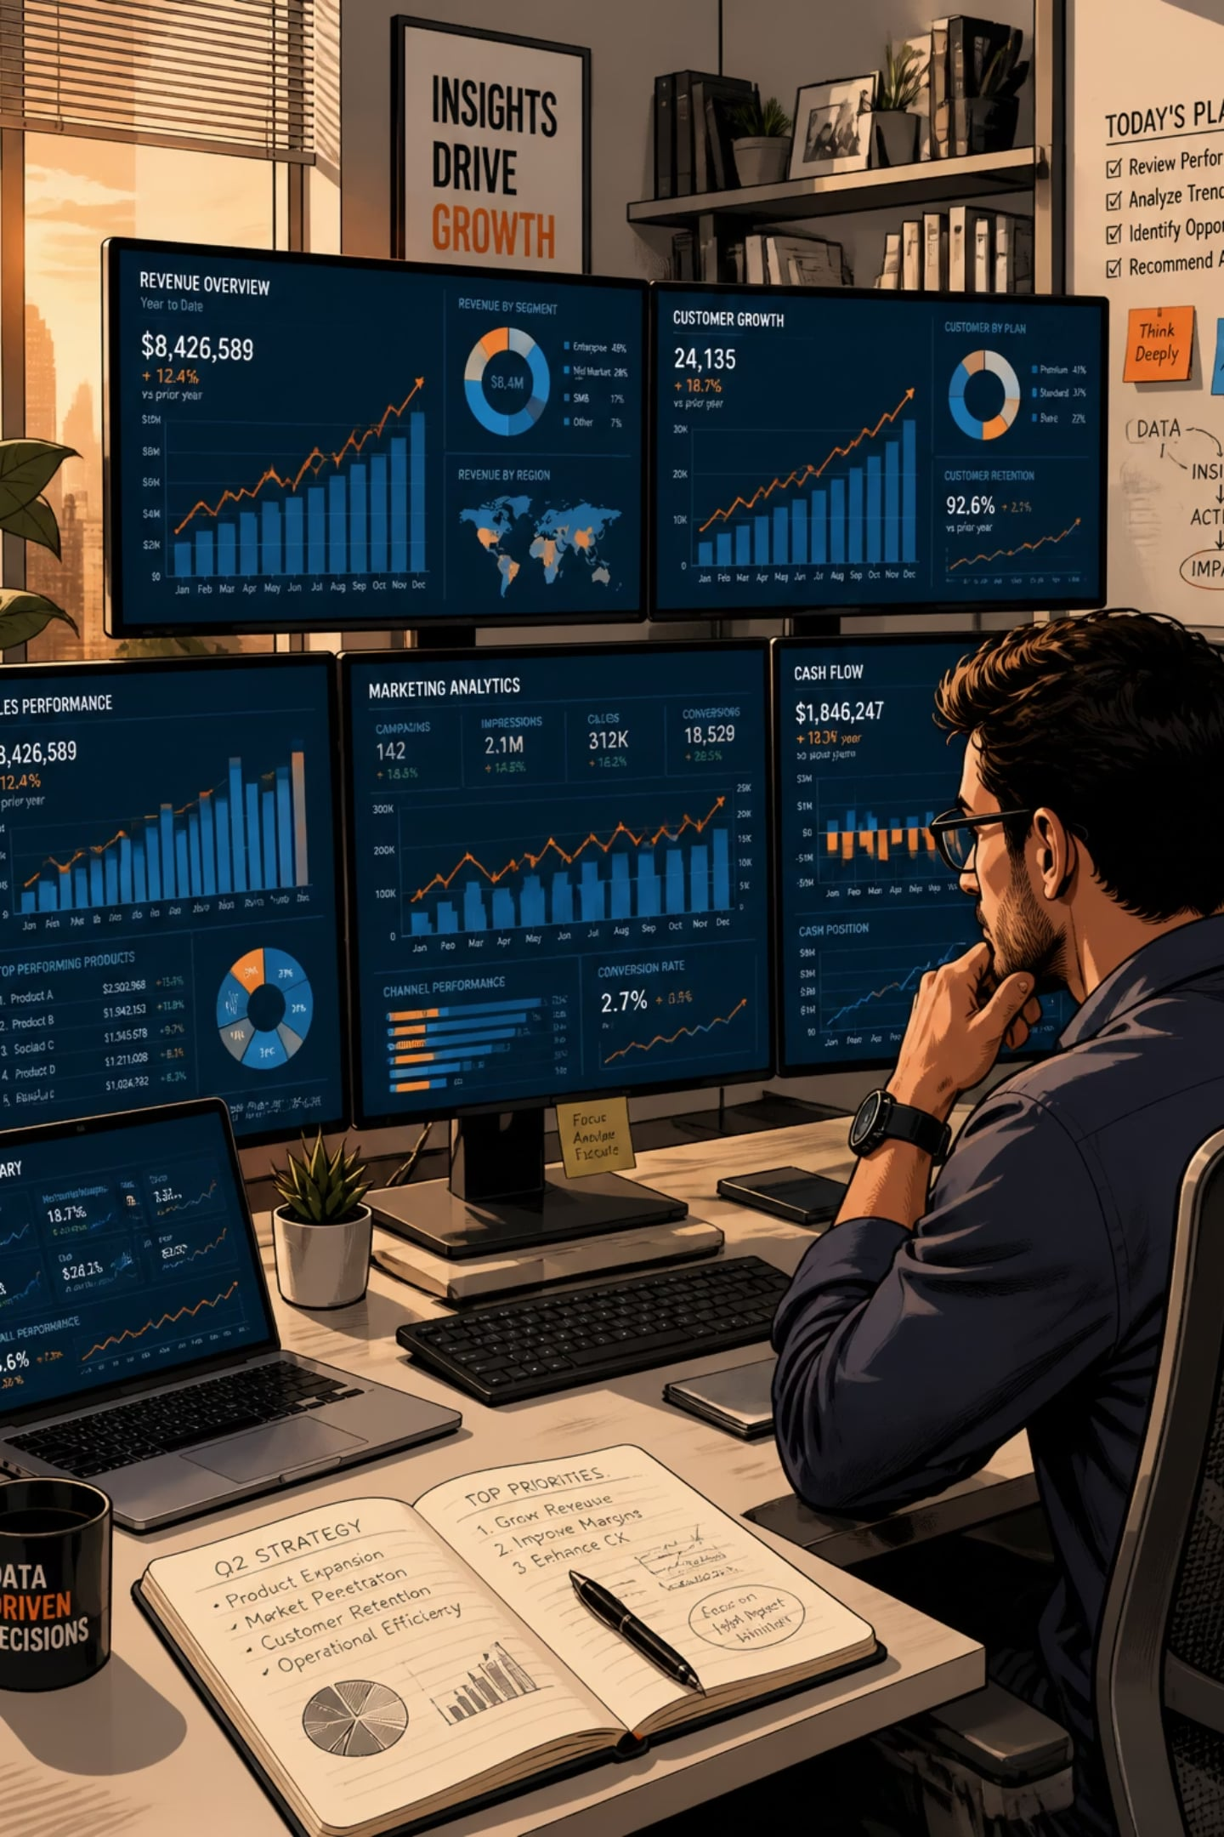
Customer Behavior Analysis
Key findings from analyzing 3,900 customer transactions via SQL and Power BI — who is spending, what they're buying, and where the opportunities lie.

Slide 2
The Numbers at a Glance
3,900
$233K
Customers Analyzed
Total Revenue
$59.76
3.75
Avg. Purchase
Avg. Review Rating
Out of 5

Slide 3
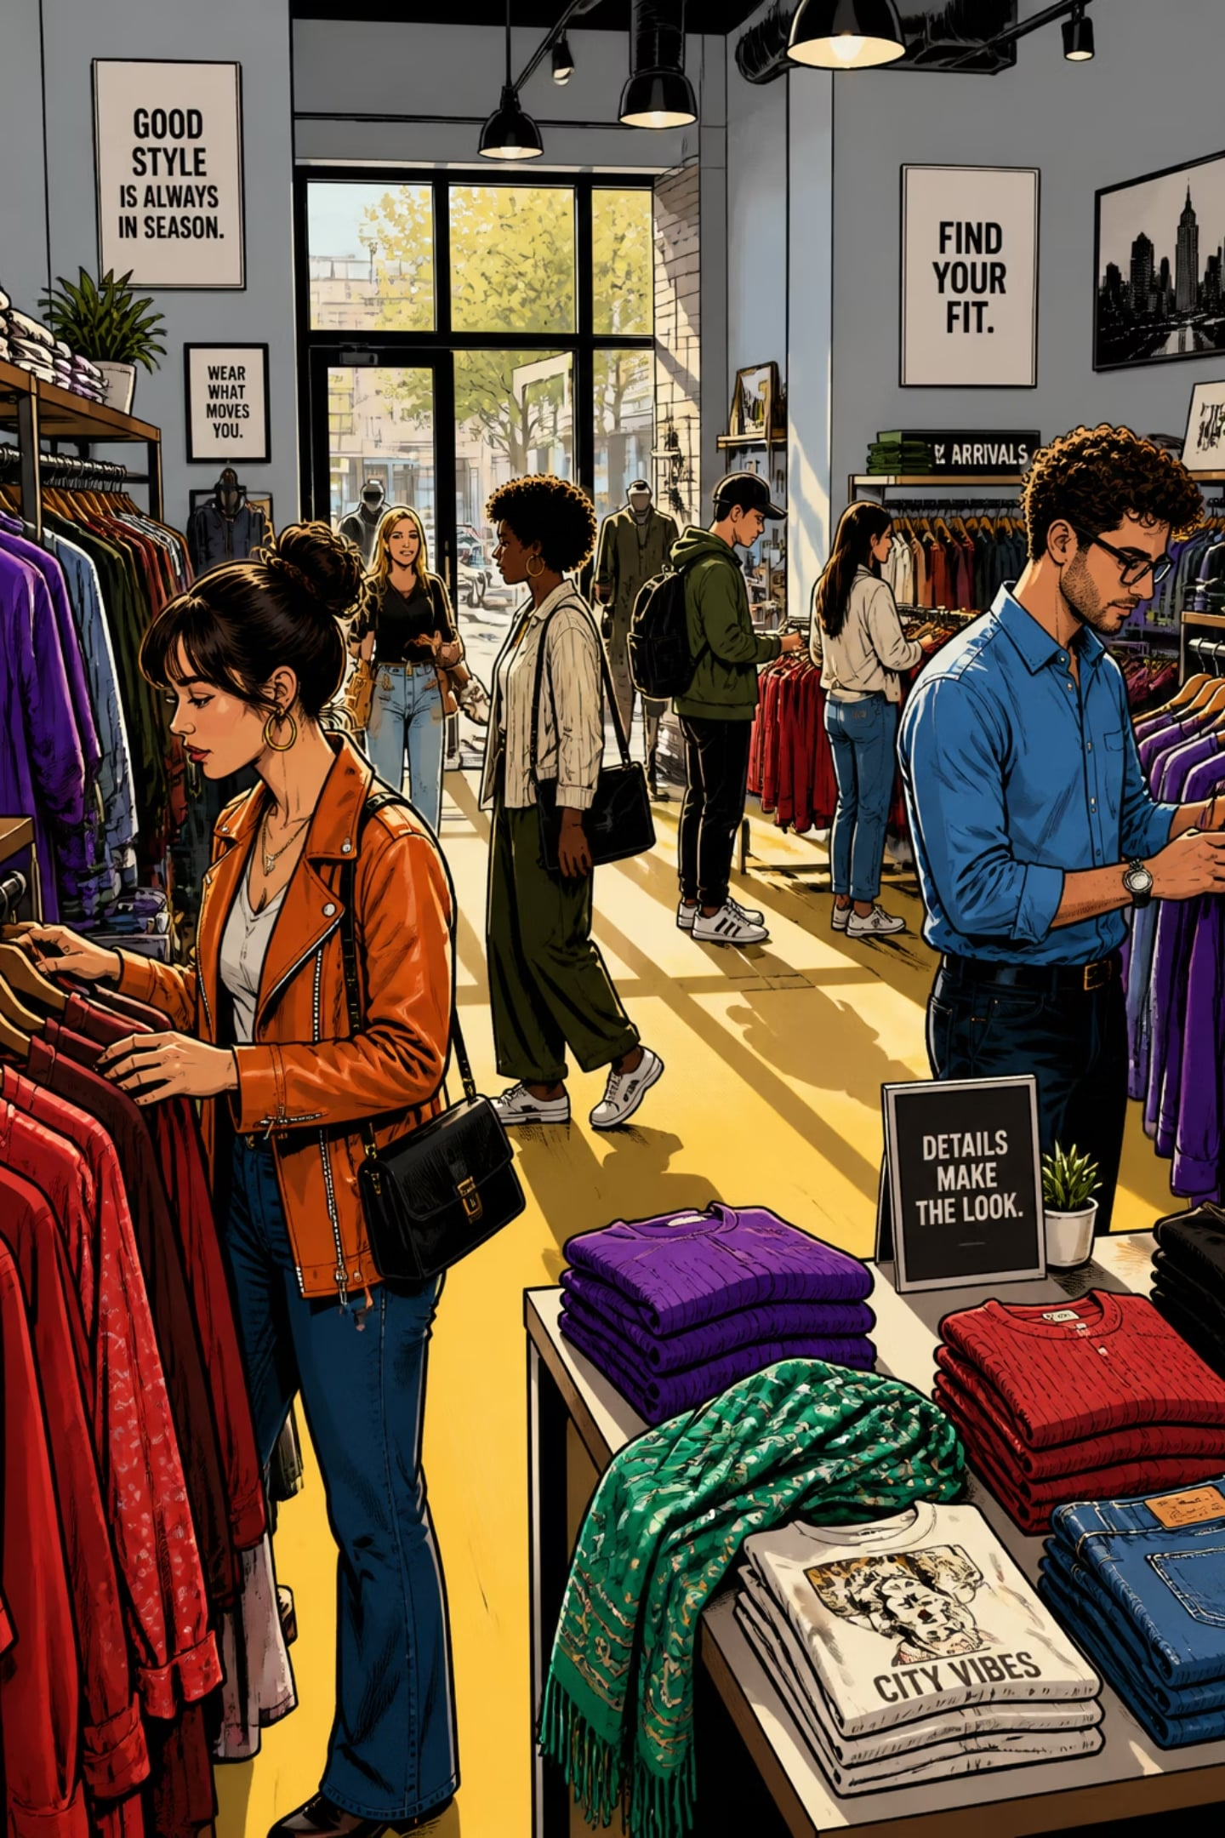
Who Is Spending, and How Much?
Gender Gap Is About Volume, Not Spend
Male customers generated $157,890 vs. $75,191 for females — but this is driven by 2× more male customers (2,652 vs. 1,248). Average spend per transaction is broadly similar across genders.
Revenue Spread Evenly Across Ages
Young Adults lead at $62,143, but the spread between all four age groups is under $7K — the product range appeals broadly, not skewed to one generation.

Slide 4
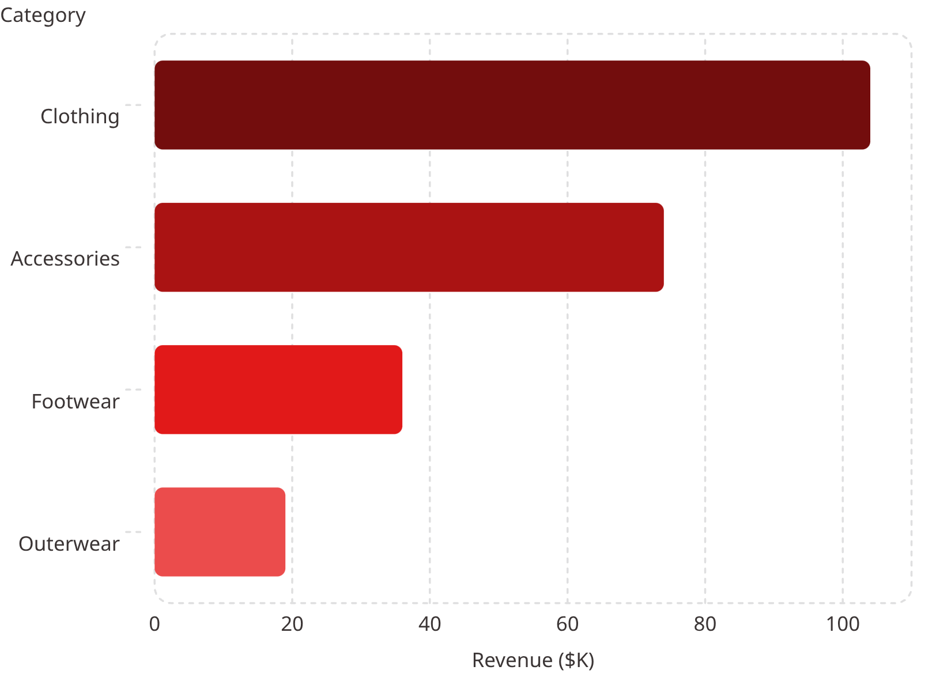
What Are Customers Buying?
Clothing Dominates
Clothing drives roughly $104K in revenue and 3.4M units — more than double Accessories (~$74K / 2.4M units). Outerwear trails at ~$19K.
Most-Loved Products
Gloves (3.86★), Sandals (3.84★), Boots (3.82★), Hats (3.80★), and Skirts (3.79★) top review ratings — worth featuring more prominently.

Slide 5
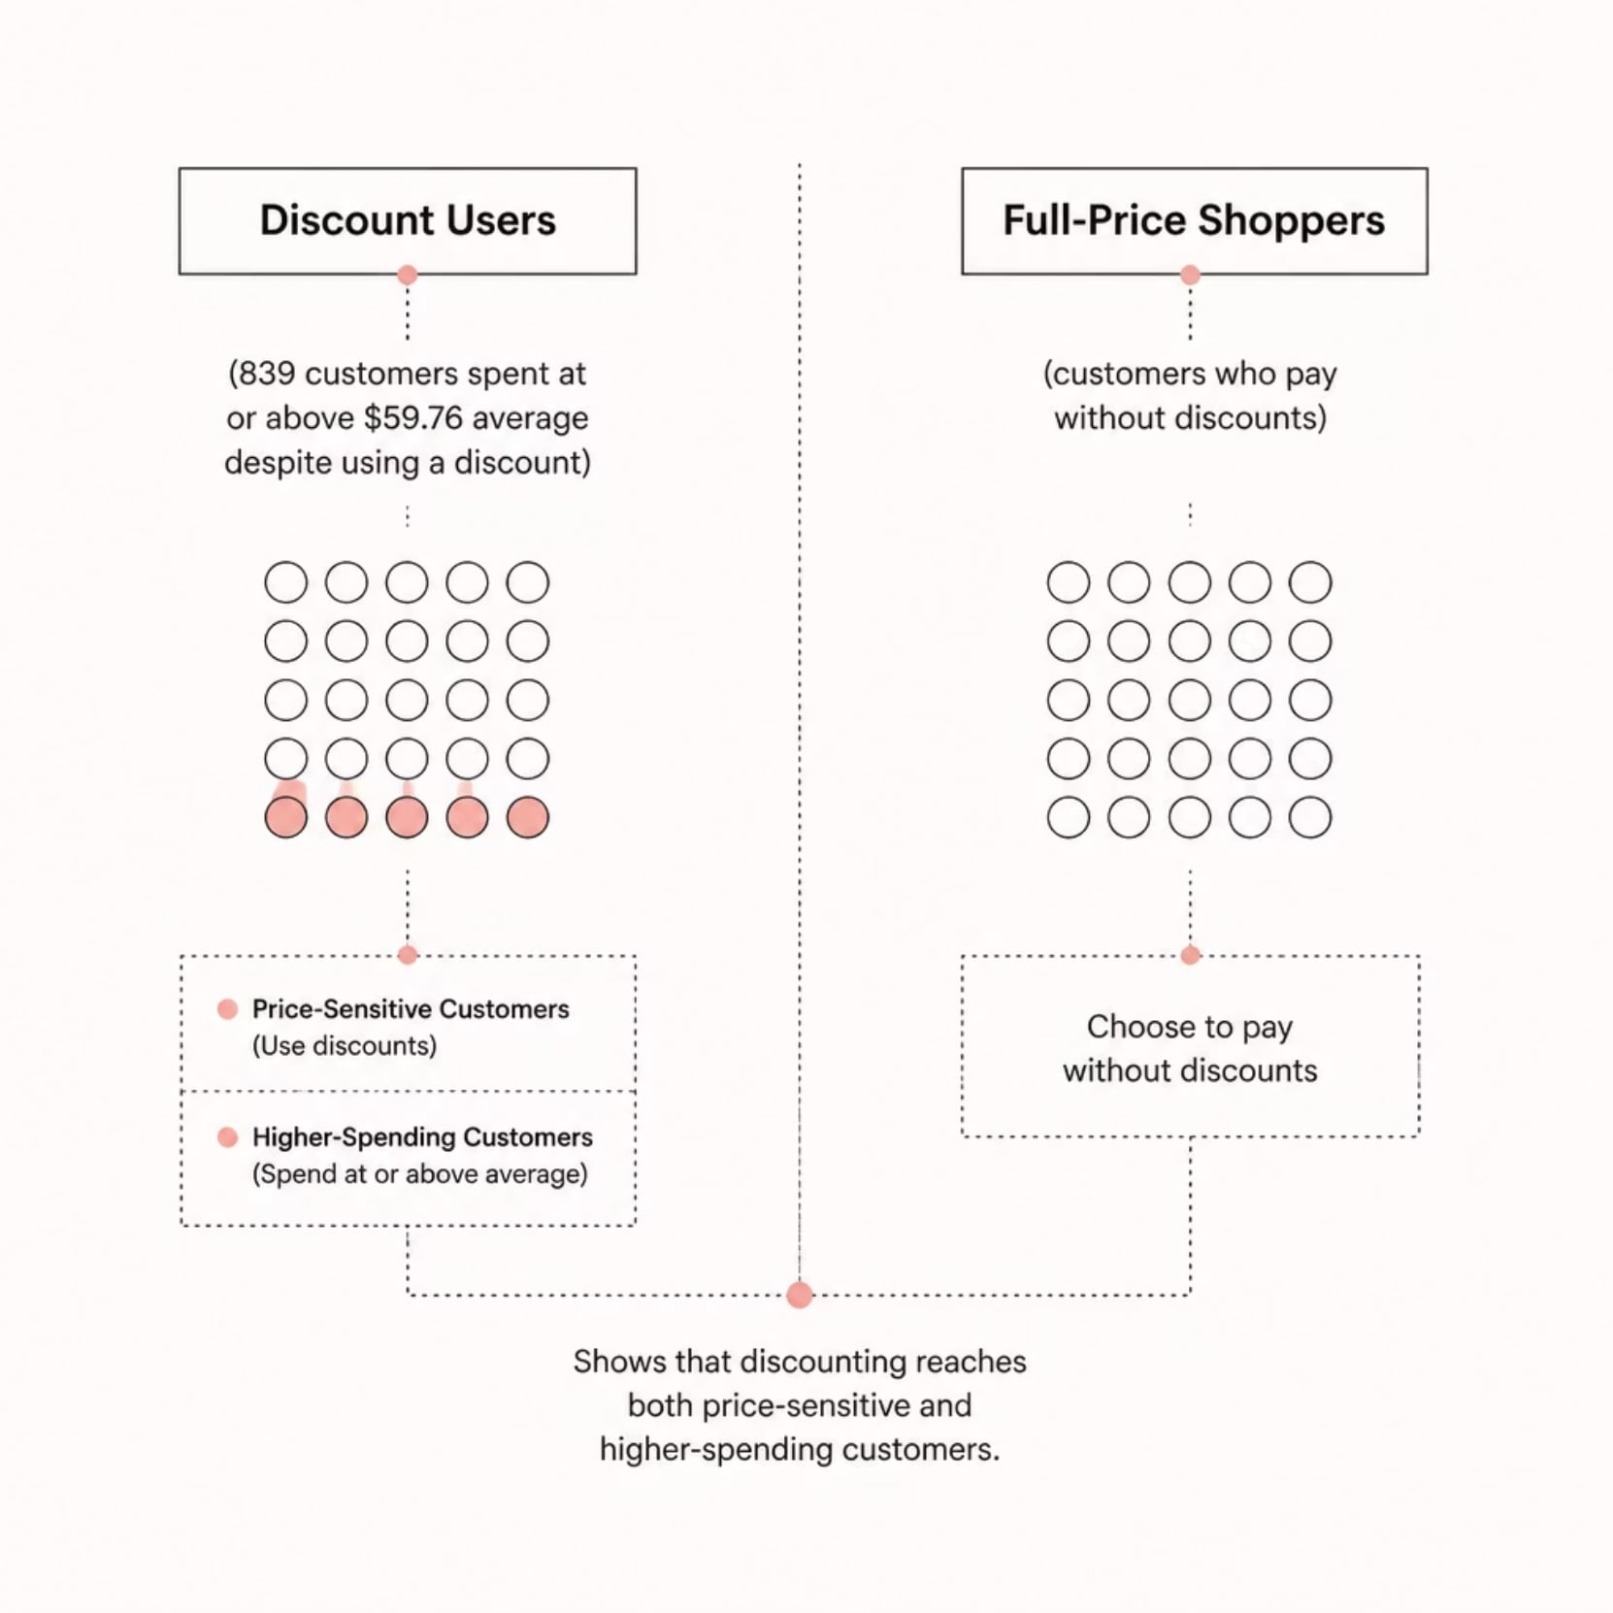

Are Discounts Working as Expected?
Heavy Discount Usage in Key Categories
Hats (50.0%), Sneakers (49.7%), Coats (49.1%), Sweaters (48.2%), and Pants (47.4%) all have ~50% discount-usage rates — almost every other purchase involves a discount.
839 customers used a discount and still spent at or above the overall average of $59.76 — discounting isn't purely cannibalizing full-price sales.

Slide 6
Does Being a Subscriber Change Behavior?
Status
Customers
Avg. Spend
Non-Subscribers
2,847
$59.87
Subscribers
1,053
$59.49
No Spending Difference
Loyal Customers Haven't Converted
Only 7.3% of customers are subscribers, and their spend is nearly identical to non-subscribers. The program isn't currently a spending lever.
Among customers with 5+ previous purchases, 72% are still non-subscribers (2,518 vs. 958). A large pool of loyal customers the program hasn't reached.

Slide 7
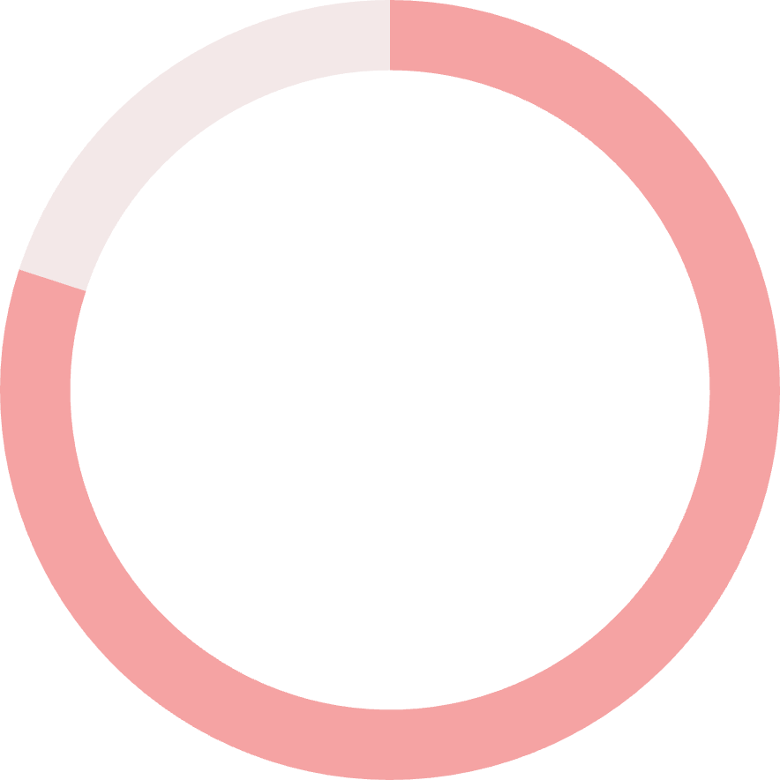
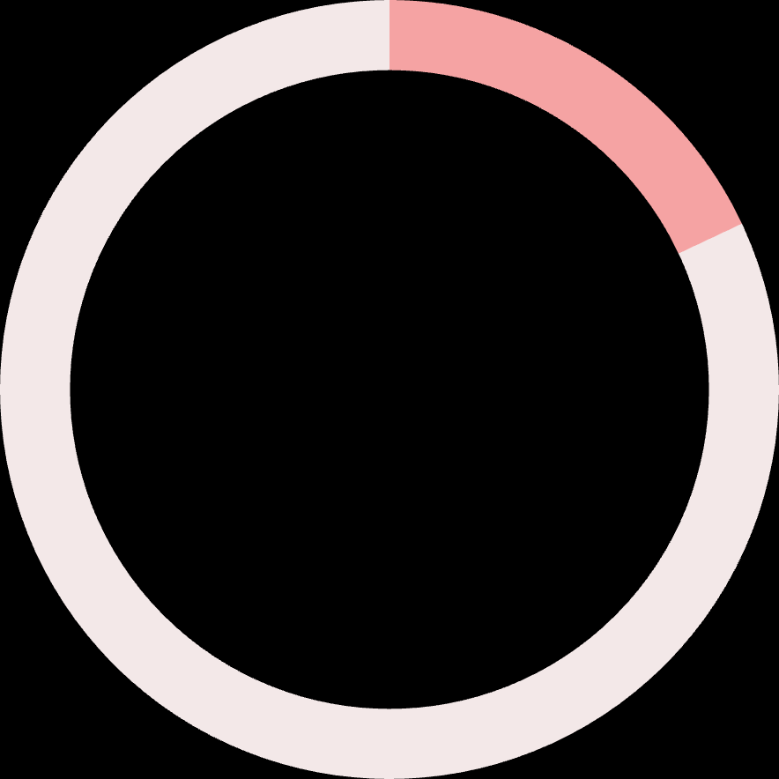

How Loyal Is the Customer Base?
80%
18%
2%
Loyal
Returning
New
More than 10 previous purchases (3,116 customers)
2–10 purchases (701 customers)
Only 1 purchase (83 customers)
Retention is clearly strong — but the tiny 2% New segment suggests the business relies heavily on its existing base rather than bringing in fresh customers.

Slide 8
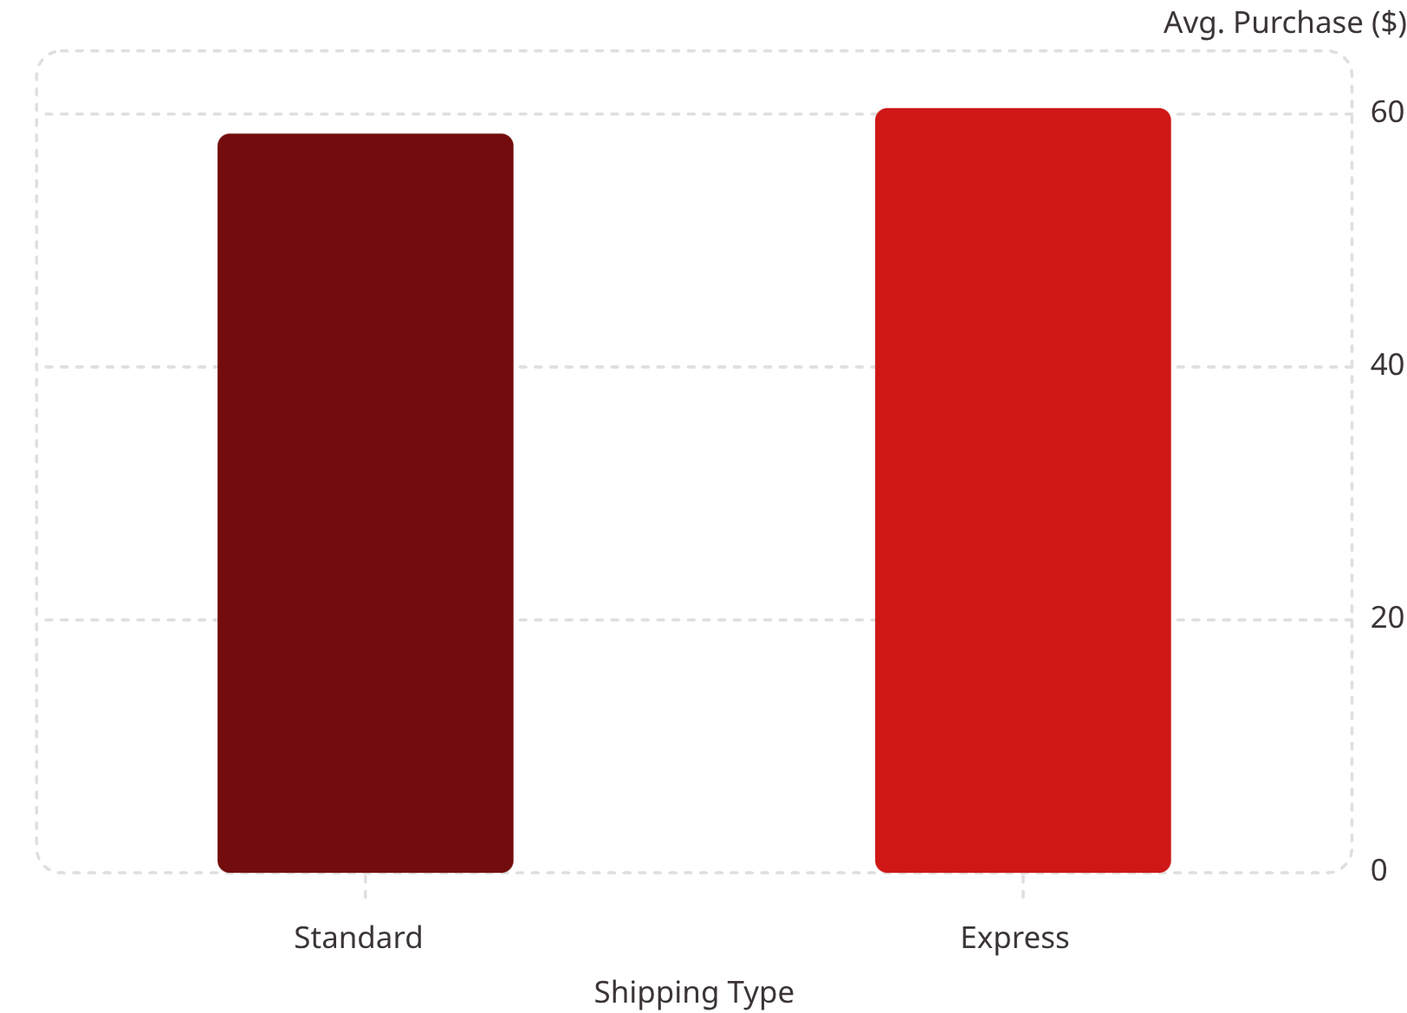
Shipping Choice & Spending
Express Shippers Spend More
Customers who pay for faster shipping average $60.48 vs. $58.46 for Standard — a small but consistent gap suggesting a slightly higher willingness to pay among customers who value speed.

Slide 9
Summary of Key Findings
Area
Key Finding
Revenue by Gender
Male share higher — driven by customer count, not spend-per-order
Revenue by Age
Evenly spread; Young Adults lead marginally
Top Category
Clothing leads in revenue ($104K) and volume (3.4M units)
Best-Rated Products
Gloves, Sandals, Boots, Hats, Skirts (3.79–3.86★)
Discount Usage
~50% of Hats, Sneakers, Coats, Sweaters, Pants sold with discount
Discounts vs. Spend
839 customers spent above average despite using a discount
Subscribers vs. Non
Near-identical avg. spend ($59.49 vs. $59.87)
Repeat Buyers
72% of frequent buyers are still not subscribers
Loyalty Mix
80% Loyal, 18% Returning, only 2% New
Shipping & Spend
Express shippers spend slightly more ($60.48 vs. $58.46)

Slide 10

What This Means for the Business
Convert Loyal Non-Subscribers
72% of frequent buyers aren't subscribed — target them with member-only perks.
Invest in New-Customer Acquisition
Only 2% of the base is "New" — top-of-funnel marketing deserves attention.
Redesign the Subscription Program
Subscriber spend is identical to non-subscribers — perks need a clearer financial benefit.
Use Discounts More Surgically
Discounts reach high spenders too — they can be targeted without sacrificing revenue.
Feature Top-Rated Products
Clothing's dominance and strong ratings on Gloves, Sandals, and Boots make them safe bets for promotions.

