Slide 1
Crime Statistics in UK
Team Maverick
Authors:
Kokane Manoj Bhausaheb,
Aravind SS
Kavipriya Ramasamy,
Srividya Lakshmanan

Slide 2
Problem Statement
Analyze, process, and optimize the handling of crime statistics using Apache Spark to derive actionable insights.
Motivation:
By analyzing crime data, valuable insights can improve public safety, refine law enforcement strategies, and optimize resource allocation.

Slide 3
Design Goals and Features
Efficient data processing for large datasets
Filter, aggregate, and analyze statistics by location, time, and crime type
Identify crime hotspots and temporal trends
Support dynamic reporting and visualization tools
Scalable pipeline for new data integration
Real-time insights for millions of records

Slide 4
Data Source
https://data.police.uk/data/
About data:
Force data
Available in LSOA within force boundaries
Stop-and-Search
Street
Outcome

Slide 5
Tools
Big Data Platforms:
Microsoft Fabric
Apache Spark
Azure Blob Storage
Power BI

Slide 6
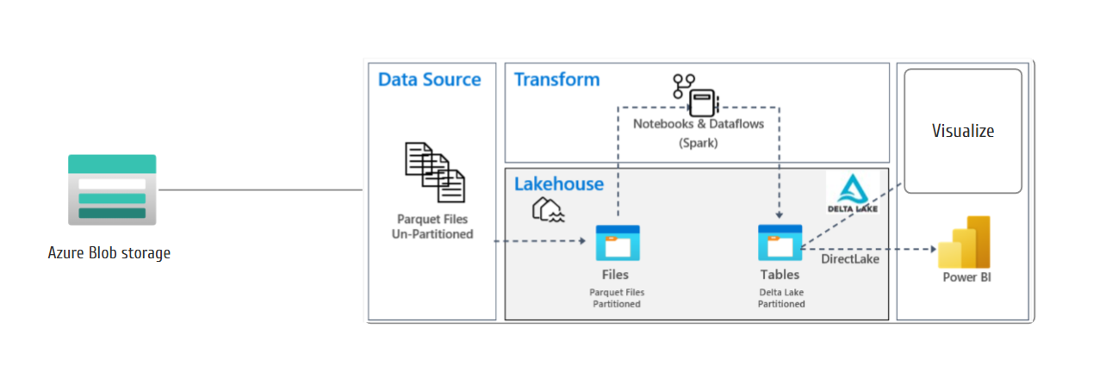
High-Level Design
Microsoft Fabric

Slide 7
Data Ingestion, Transformation and Lakehouse
Force dimension information –Using API
Period Dimension
Actual Crime data : Blob to Lakehouse
Incremental/Full load
Landing-Staging-Reporting
Dimension

Slide 8
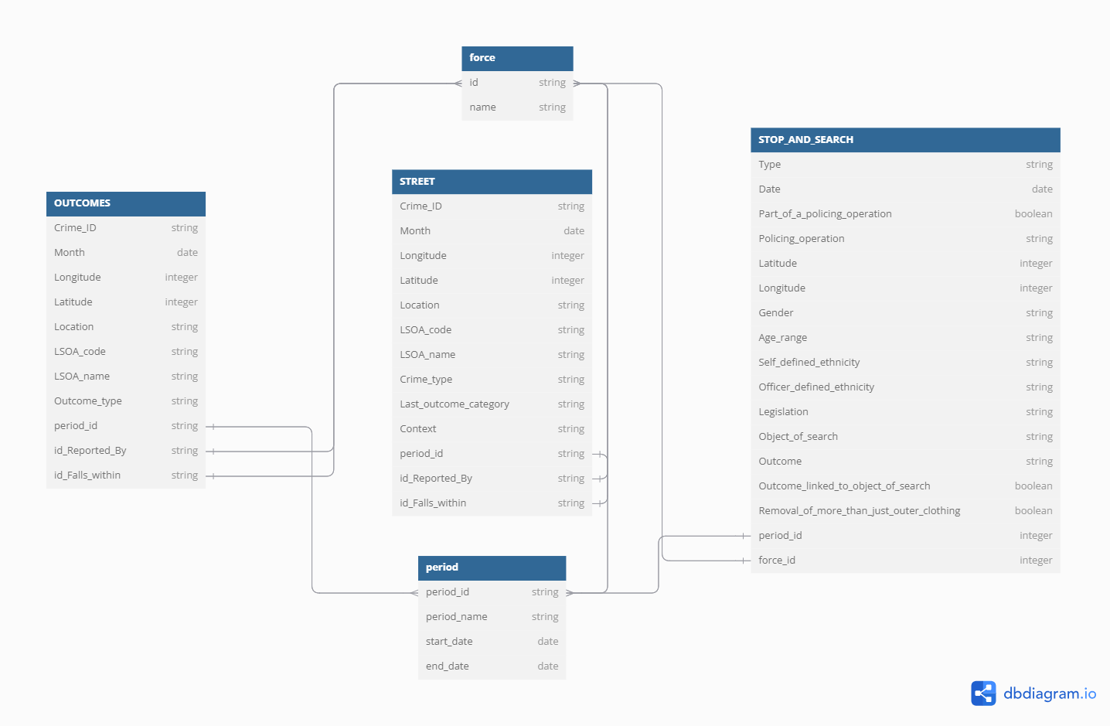
Data Model

Slide 9
Scalability and Performance Metrics
1. Big Data Processing:
Distributed computation with PySpark
Optimized queries with partitioning
2. Storage:
Azure blob storage
2. Runtime:
Incremental load: Few minutes
Full load (3 years): ~1.5 hours
3. Incremental pipeline for historical data and trends

Slide 10
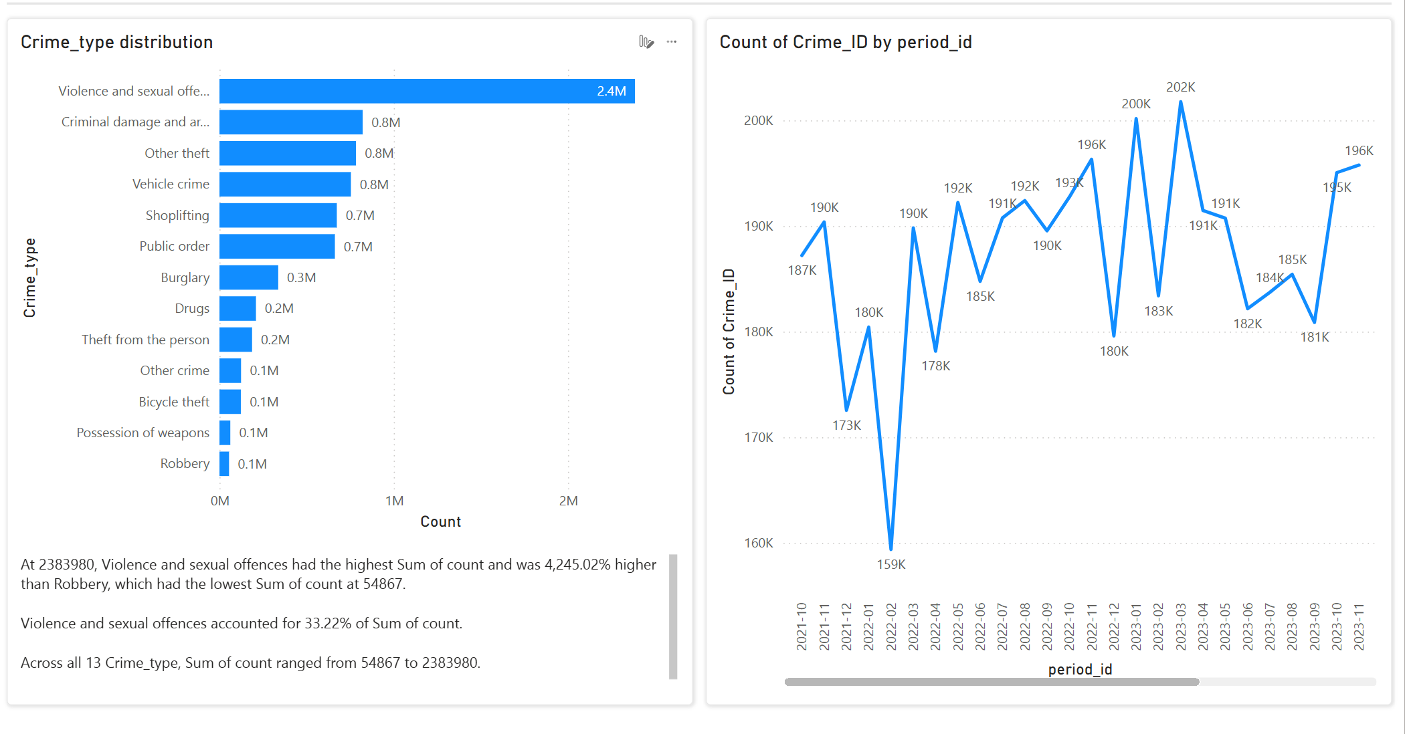
Plots and Analysis

Slide 11
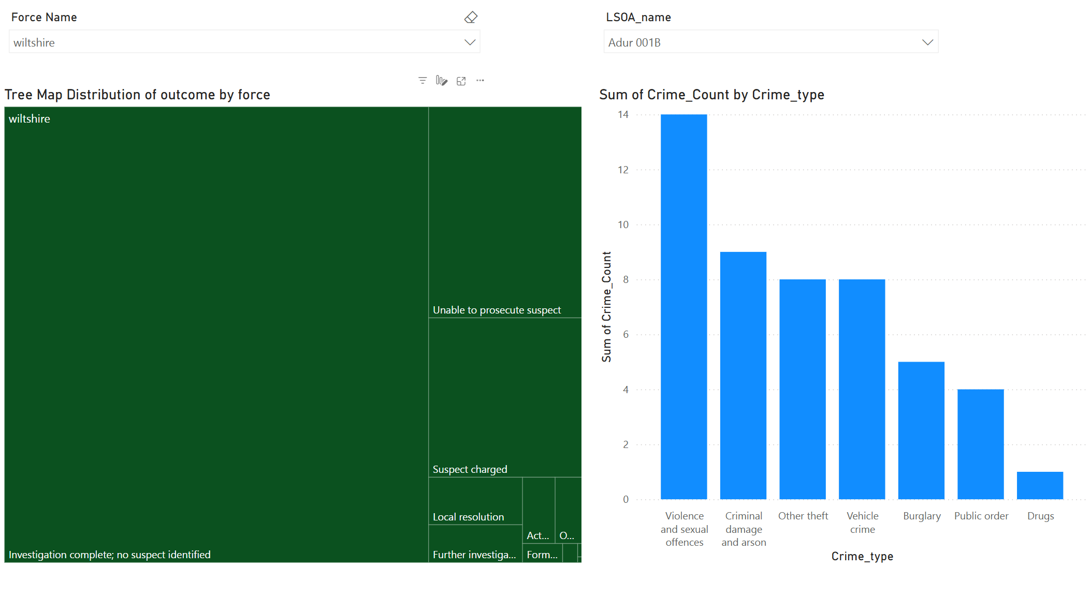
Plots and Analysis

Slide 12
Summary
Insights derived inform policy recommendations for targeted interventions and efficient resource allocation.
Supports incremental data ingestion for real-time updates on trends.
https://github.com/kokanemanoj1/crime-data-uk

Slide 13

Q&A

