Slide 1
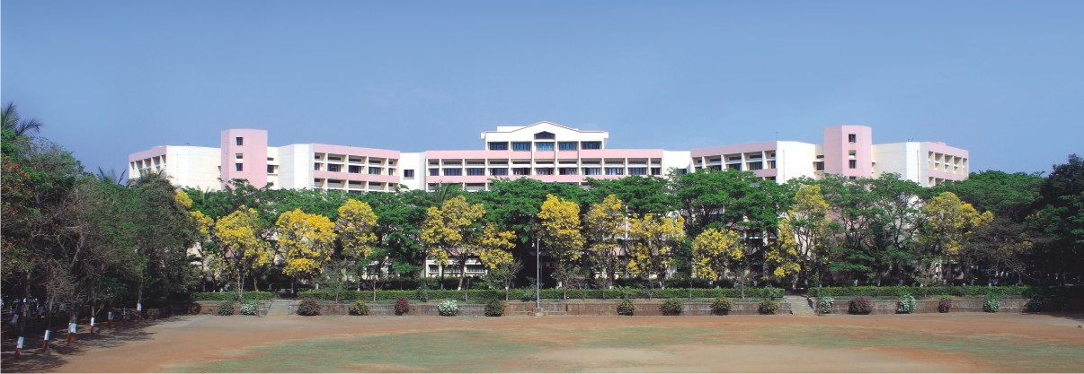

Terrain Suitability Mapping for Eco-Tourism Development Using Satellite Imaging
Presented by: PID 27
Class : TY (B)
Guided by :Prof.M.P.Mahajan
Notes:
NOTE:
To change the image on this slide, select the picture and delete it. Then click the Pictures icon in the placeholder to insert your own image.

Slide 2

Outline
Introduction
Problem Statement
Objectives
Literature Review
Methodology(Block diagram,Proposed approach,Techniques,tools)
Expected Outcomes (Input,Output)
Implementation
Conclusion
References

Slide 3
Introduction
Eco-tourism development requires careful selection of suitable sites to balance tourism growth with environmental conservation.
Traditional methods are time-consuming and limited in coverage
Using satellite imagery, Digital Elevation Models (DEM), and vegetation indices (NDVI), terrain and vegetation characteristics can be analyzed efficiently. Integrating these datasets with AI techniques like Convolutional Neural Networks (CNNs) allows automated classification of land into Suitable and Not-Suitable areas, providing accurate and data-driven guidance for sustainable eco-tourism planning.

Slide 4
Problem Statement
Develop a terrain suitability mapping system for eco-tourism development using satellite imagery to identify suitable locations efficiently. Traditional methods depend on manual surveys and field investigations, which are time-consuming, costly, and difficult to perform over large geographic areas. Therefore, an efficient approach is required to analyze terrain characteristics such as elevation, slope, vegetation, and proximity to water bodies to determine suitable areas for eco-tourism development.

Slide 5
Objectives
To study terrain suitability analysis techniques for eco-tourism using satellite imagery and DEM data.
To collect and preprocess satellite imagery and Digital Elevation Model (DEM) data required for terrain analysis.
To develop a Convolutional Neural Network (CNN) model to analyze terrain features such as elevation, slope, vegetation (NDVI), and proximity to water bodies.
To test and evaluate the model by classifying land areas into highly suitable, moderately suitable, and not suitable categories.
To deploy the system to generate terrain suitability maps that help in identifying potential ecotourism locations.

Slide 6
Literature Review
Sr. no | Title | Authors | Year | Methodology | Advantages | Limitations
1. | High-resolution mapping of global surface water and its long-term changes | J.-F. Pekel, Andrew Cottam | 2010 | Processed over 3 million Landsat images using automated classification to map global surface water dynamics. | Provides 30 m high-resolution, long-term global surface water maps with consistent coverage | Cloud cover, sensor limitations, and mixed pixels can reduce mapping accuracy in some regions.
2 | A Comprehensive Review of Remote Sensing and Artificial Intelligence Integration: Advances, Applications, and Challenges | Lei Ma, Yu Liu | 2023 | Reviews AI methods such as machine learning, deep learning, CNNs, and data fusion techniques applied to remote sensing datasets. | Explains how AI and remote sensing together improve Earth observation analysis. | Some challenges like data scarcity, computational cost, and model interpretability remain unresolved.
3 | Transfer Learning in Earth Observation Data Analysis: A review | Artur Nowakowski,Maria Pia Del Rosso | 2025 | Reviews transfer learning approaches that reuse pre-trained deep learning models for Earth observation image analysis. | Reduces the need for large labeled datasets and improves model performance with limited training samples. | Transfer learning may suffer from domain differences between source and target datasets, reducing accuracy.
4 | Radar versus optical: The impact of cloud cover when mapping seasonal surface water for health applications in monsoon-affected India | Gowri Uday, Bethan V. Purse | 2025 | Compared Sentinel-1 SAR and Sentinel-2 optical imagery to map seasonal surface water in monsoon regions of India. | Sentinel-1 SAR maps water accurately even under cloud cover, providing more complete seasonal water detection. | SAR imagery may misclassify flooded vegetation or rough surfaces, requiring careful processing and validation.

Slide 7
Literature Review
Sr. no | Title | Authors | Year | Methodology | Advantages | Limitations
5 | Developing an ecological zoning framework for post-pandemic coastal tourism recovery: evidence from 5-year remote sensing and tourism data (2019–2024) | Wang Jing, Zhiwei Zhang | 2026 | Used Sentinel-1/2, Landsat, VIIRS nighttime lights, and tourism statistics to evaluate ecological changes and tourism recovery. | Demonstrates how multi-source satellite data can support sustainable tourism planning. | The framework depends on availability and accuracy of tourism-related ground data.

Slide 8
Literature Review
Sr. no | Title | Authors | Year | Methodology | Advantages | Limitations
1. | Use of Satellite Imagery for DEM Extraction, Landscape Modeling and GIS Applications | D. Poli, F. Remondino, C. Dolci | 2004 | DEM generated from satellite stereo images and integrated into GIS for terrain modeling. | Accurate DEM for terrain analysis and landscape modeling. | Older methods; limited automation; does not include vegetation analysis or AI-based modeling.
2 | Analysis of Vegetation Changes Using Satellite Imagery and NDVI | S. T. C. Wirawan, H. P. Chernovita | 2023 | NDVI from satellites used to monitor vegetation health and land cover changes. | Provides a practical method for monitoring vegetation dynamics; simple and widely applicable. | Results can be affected by atmospheric conditions and seasonal variations; limited automation and predictive capabilities.
3 | Leveraging Multi-Temporal Sentinel-1 and Sentinel-2 Satellite Data for Leaf Area Index Estimation With Deep Learning | Clement Wang, Antoine Debouchage | 2024 | Used multi-temporal Sentinel-1 + Sentinel-2 data with deep neural networks to model vegetation dynamics and seasonal variations. | Deep learning captures seasonal patterns and improves prediction compared with single-date imagery. | Requires large training datasets and high computational resources.
4 | Application of Deep Learning, Machine Learning and Multi-Criteria Decision Analysis for Ecotourism Potentiality Assessment: A Case Study of the Sundarban Biosphere Reserve, India | Arup Baidya, Ashis Kumar Saha | 2025 | Integrated Sentinel-2 imagery, vegetation indicators (NDVI), DEM, rainfall, GIS data, and AI models (DLNN and XGBoost) for automated ecotourism suitability mapping | Uses AI-based prediction and vegetation analysis to overcome limitations of traditional tourism assessment methods | Requires high-quality training data and multiple environmental datasets for reliable prediction
5 | Digital Elevation Model Estimation from RGB Satellite Imagery Using Generative Deep Learning | A. Madani | 2025 | Generative deep learning to estimate DEM from RGB images | Provides DEM even without traditional DEM sources | Requires large training dataset; may vary with terrain types

Slide 9
Literature Review
Sr. no | Title | Authors | Year | Methodology | Advantages | Limitations
1. | Deep learning-based classification of hyperspectral data | Yushi Chen, Zhouhan Lin, Xing Zhao, Gang Wang, and Yanfeng Gu | 2014 | Uses stacked autoencoders (deep learning) to extract spectral and spatial features from hyperspectral satellite images for land-cover classification. | Introduces deep learning for hyperspectral satellite data classification using spectral and spatial features. | Focuses on hyperspectral classification rather than eco-tourism suitability mapping.
2 | Remote sensing image scene classification using CNN-CapsNet | Yongsheng Zhang, Hong Zhang, Liangpei Zhang | 2019 | Proposes a hybrid CNN + Capsule Network architecture to extract image features and capture spatial relationships for satellite scene classification. | Combines CNN and Capsule Networks to improve satellite image scene classification accuracy. | More computationally complex and requires higher training resources.
3 | Review on convolutional neural networks in vegetation remote sensing | Teja Kattenborn, Jens Leitloff, Florian Schiefer, Stefan Hinz | 2021 | Conducts a review of CNN-based approaches for vegetation detection and monitoring using satellite and UAV imagery. | Demonstrates CNN-based vegetation detection using satellite imagery and NDVI analysis. | . Focuses mainly on vegetation monitoring rather than full terrain suitability analysis.
4 | Potential suitability mapping evaluation for ecotourism development in Darjeeling Himalayan region of India | Teja Kattenborn, Jens Leitloff, Florian Schiefer, Stefan Hinz | 2023 | Integrated remote sensing, GIS, and multi-criteria decision analysis using elevation, slope,climate,factors for ecotourism suitability mapping | Goes beyond vegetation/hyperspectral classification by producing spatial suitability zones for tourism planning | Relies on expert-based weighting methods rather than fully automated AI prediction.
5 | Spatial Multi-Criteria Site Selection for Ecotourism Suitability Mapping | Ayub Mohammadi , Davood Jamini | 2026 | Combined Sentinel-2, terrain, land use, environmental factors, and machine learning for eco-tourism suitability mapping. | Provides complete terrain suitability analysis rather than only vegetation assessment. | Model accuracy depends on selected environmental criteria and field validation data.

Slide 10
Literature Review
Sr. no | Title | Authors | Year | Methodology | Advantages | Limitations
1. | Study on Ecological and Environmental Suitability of Tourism Resources Development in Lijiang River Basin of Guilin, China | N. Li, J. Y. Wang | 2020 | Uses Remote Sensing (RS) and GIS-based ecological suitability evaluation for tourism resource development. | evaluates tourism development potential while considering ecological and environmental sustainability | the assessment is largely dependent on selected environmental indicators and may not fully incorporate socio-economic or stakeholder perspectives
2 | Geospatial Analysis of Geo-Ecotourism Site Suitability Using AHP and GIS for Sustainable and Resilient Tourism Planning in West Bengal, India | Aditi Acharya | 2022 | Uses Analytic Hierarchy Process (AHP) with GIS and remote sensing data for multi-criteria site suitability analysis of ecotourism zones | Satellite imagery enables large-scale and cost-effective extraction of DEM data for terrain analysis and landscape modeling. | DEM accuracy can be affected by image resolution, sensor errors, and complex terrain conditions
3 | Assessing Sustainable Ecotourism Opportunities in Western Rajasthan, India, through Advanced Geospatial Technologies | Rajeev Singh Chandel | 2023 | Uses GIS and Remote Sensing with weighted overlay analysis of multiple thematic layers to generate ecotourism suitability maps. | integrates multiple geospatial datasets for objective site identification | results depend heavily on data quality and may overlook socio-cultural factors.
4 | An Approach for Mapping Ecotourism Suitability Using Machine Learning: A Case Study of Zhangjiajie, China | Qin Huang | 2024 | Uses machine learning models with multi-source geospatial data to classify ecotourism suitability zones | machine learning improves prediction accuracy and captures complex relationships between variables | requires large, high-quality datasets and the model may be difficult to interpret.

Slide 11
Literature Review
Sr. no. | Title | Authors | Year | Methodology | Advantages | Limitations
5 | New Horizons for Ecotourism in Sikkim: An Integrated MCDA Approach | Deepa Rai | 2025 | Uses Integrated MCDA methods including AHP and DEMATEL with GIS to evaluate multiple environmental and socio-economic factors for ecotourism suitability mapping | MCDA combines environmental, economic, and accessibility factors for balanced decision-making | The study is limited by its reliance on expert judgments in the MCDA framework, which may introduce subjectivity and restrict the generalizability of findings beyond Sikkim.

Slide 12
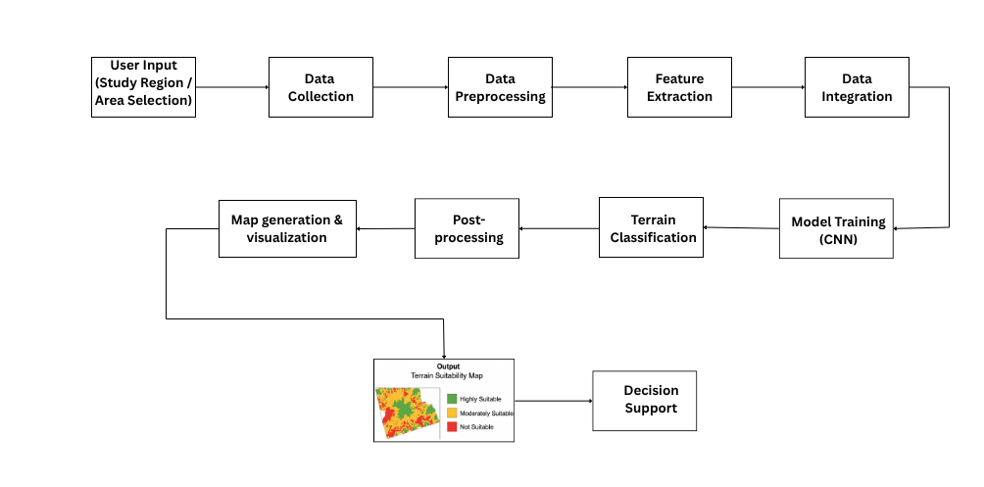
System Architechture
Fig 1.Terrain Suitability Mapping Workflow

Slide 13
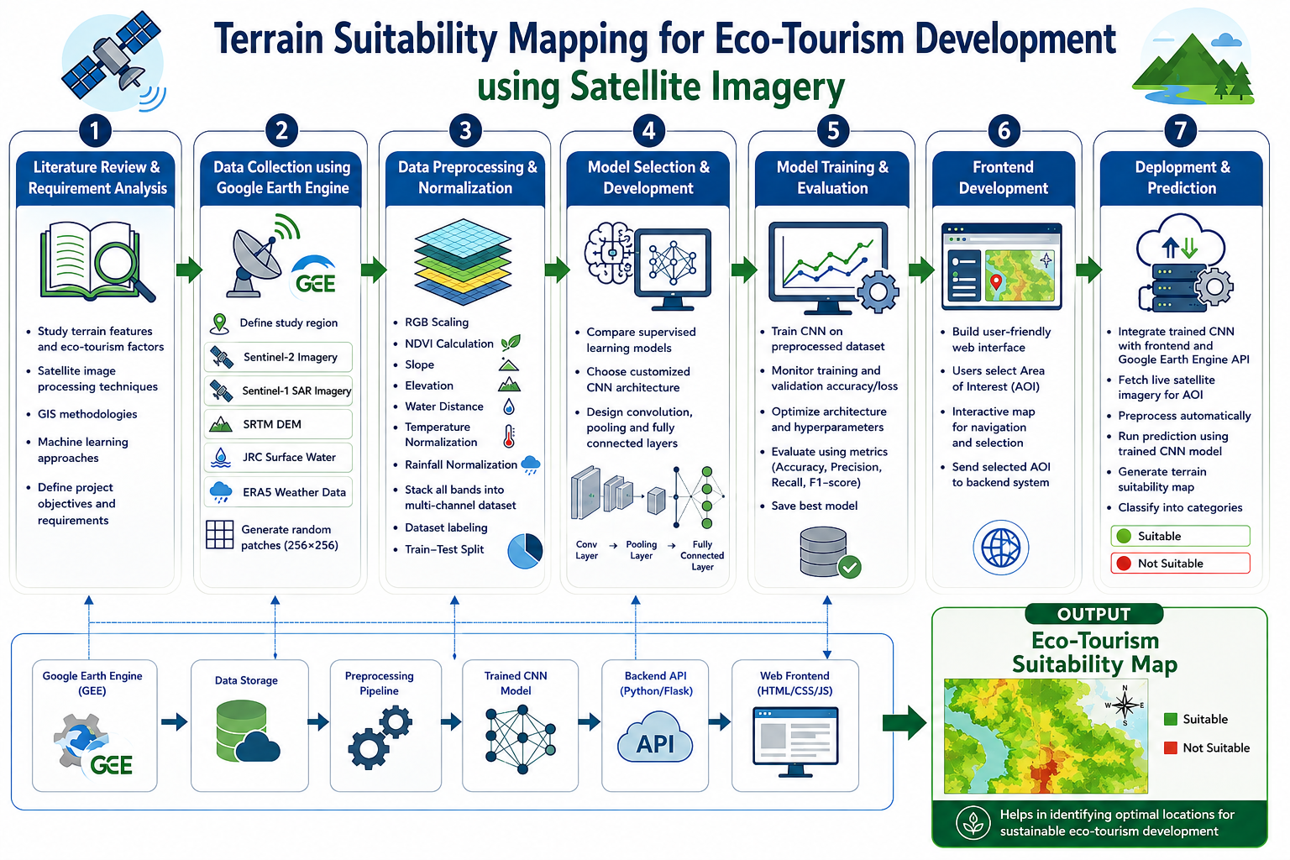
Methodology(Detailed Design)

Slide 14
Methodology
Step 1 – Data Collection
Collect Sentinel-1/2 satellite imagery, SRTM DEM, JRC Surface Water, and ERA5 weather data using Google Earth Engine.
Step 2 – Data Preprocessing
Perform RGB normalization, calculate NDVI, slope, elevation, water distance, temperature, and rainfall, and prepare a multi-channel dataset.
Step 3 – Model Development
Select a suitable CNN architecture and design convolution, pooling, and fully connected layers.
Step 4 – Model Training
Train the CNN, evaluate accuracy and loss, optimize the model, and save the best-performing model.
Step 5 – User Interaction & Prediction
Allow users to select an Area of Interest (AOI) on the map or enter coordinates, then fetch and preprocess live satellite data.
.

Slide 15
Methodology
Step 6 – Map Generation
Generate an eco-tourism suitability map and classify the terrain into Suitable and Not Suitable.

Slide 16
Expected Outcomes
Input:
User-selected Area of Interest (AOI) or Latitude–Longitude Coordinates
Output:
A terrain suitability map generated by the CNN model for the study area.
Classification of each region into Highly Suitable and Not Suitable for eco-tourism development.

Slide 17

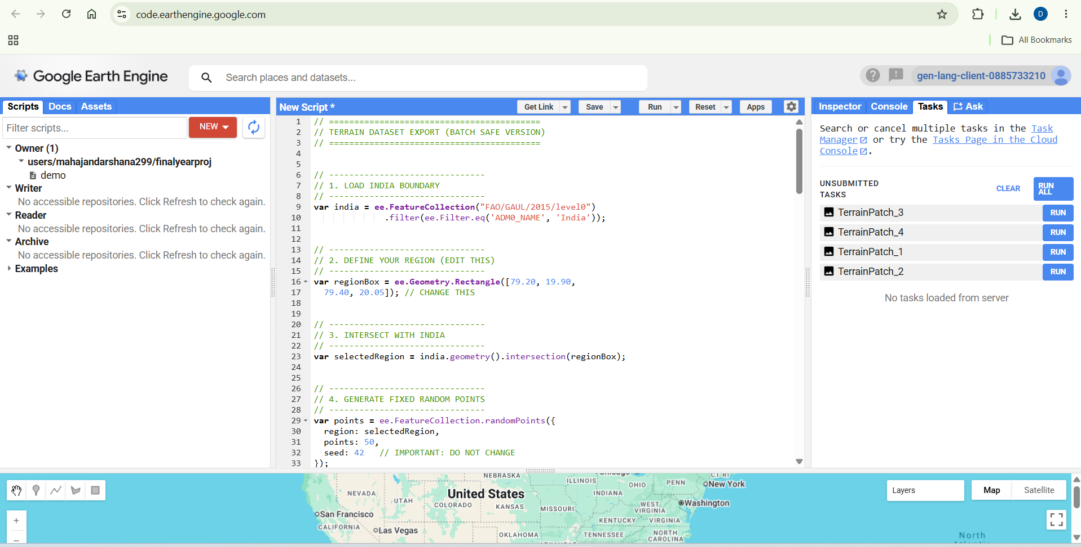
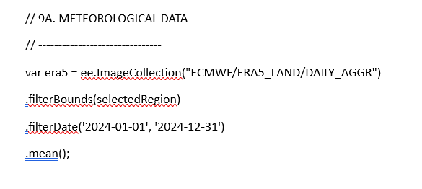
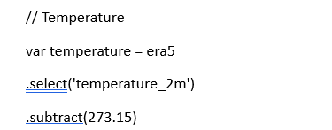
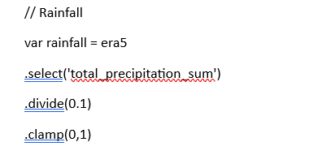
Implementation(Data Collection)
Collected satellite and terrain data from Google Earth Engine using Sentinel-1 & Sentinel-2, SRTM DEM, JRC Surface Water, and ERA5 datasets for vegetation, elevation, slope, water bodies, temperature, and rainfall.

Slide 18
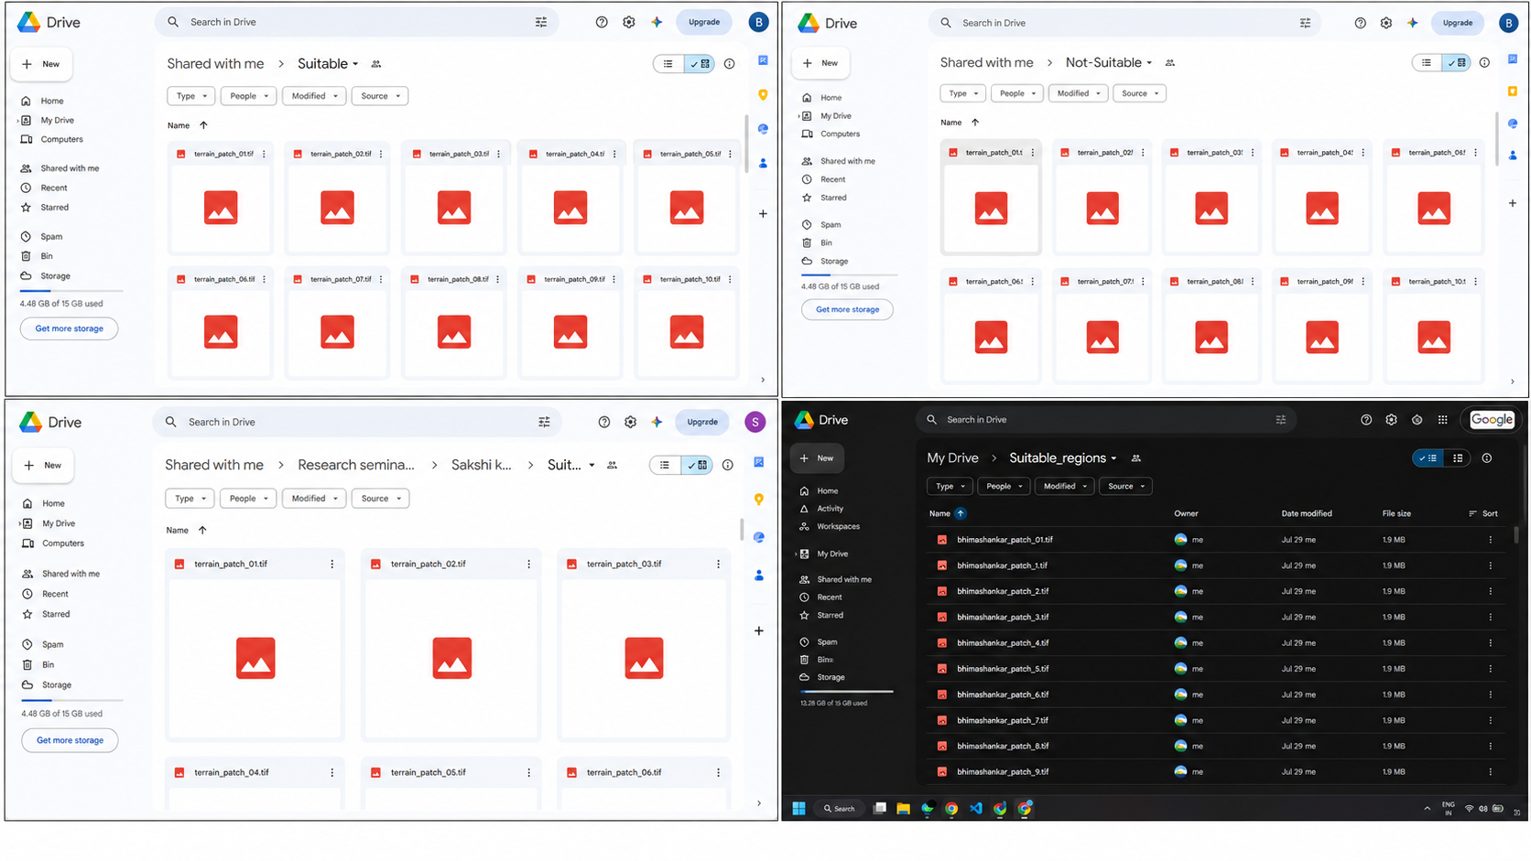
Implementation(Data Collection)

Slide 19
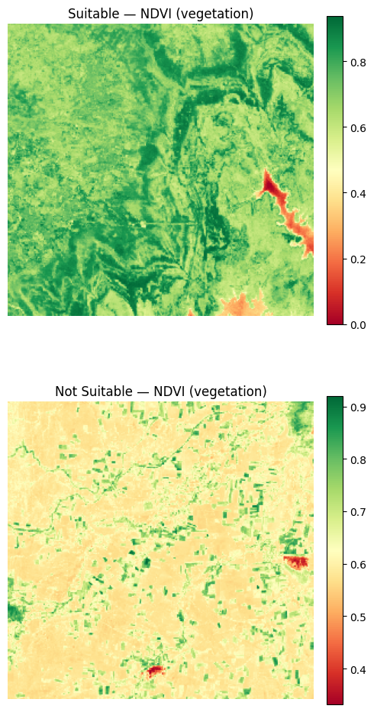
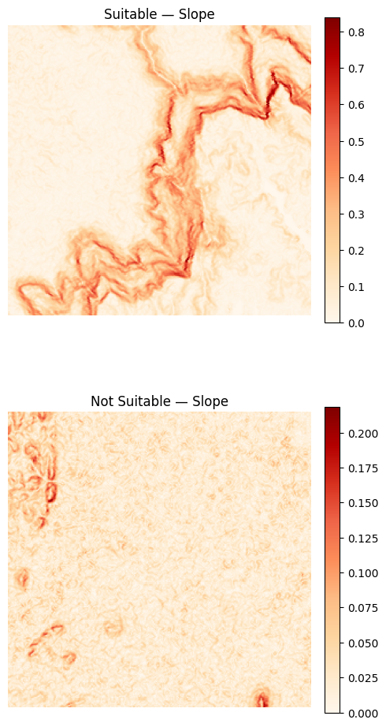
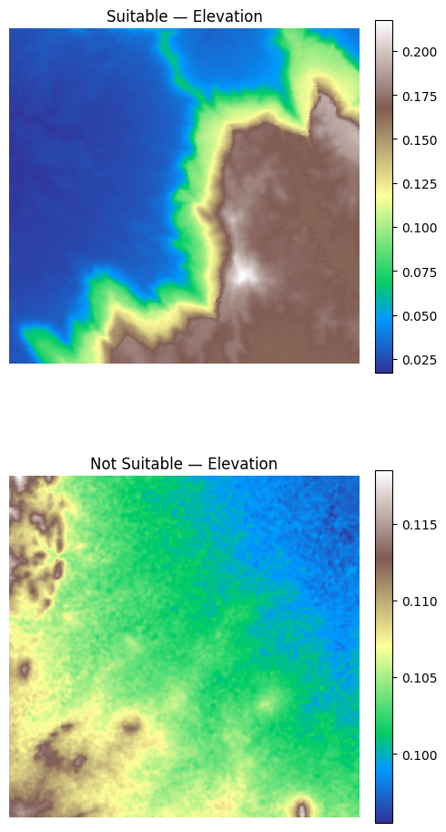
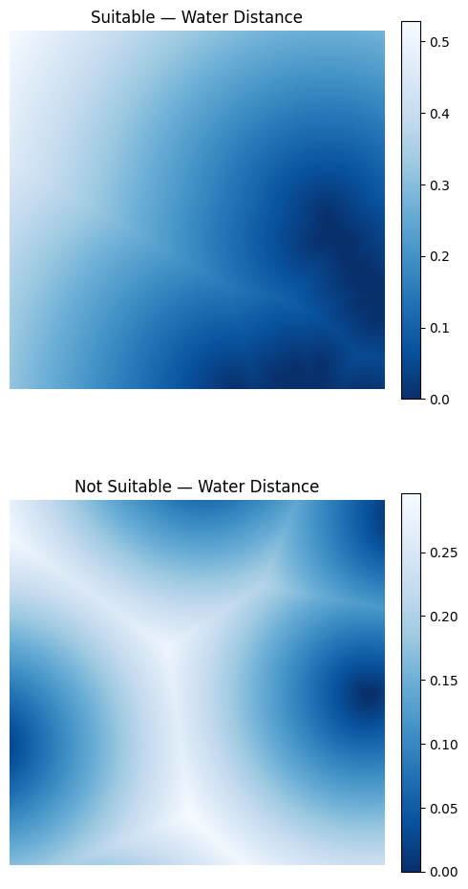
Implementation(Data Analysis)

Slide 20
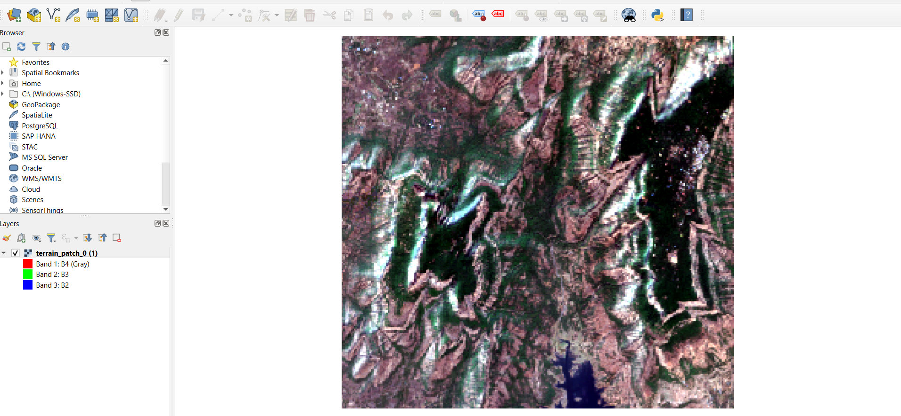
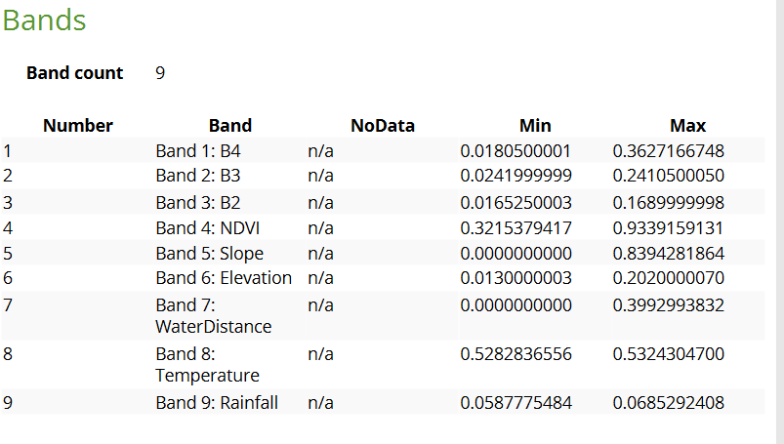
Implementation(Data Preprocessing)
Normalized the RGB bands to bring all values into the same range.
Calculated NDVI, slope, elevation, water distance, temperature, and rainfall layers.
Combined all the layers into a 9-channel dataset for CNN training.

Slide 21
Implementation(Model Development)
Studied different supervised learning models for terrain classification.
Selected a customized CNN architecture for our project.
Developed and tested a simple CNN model using 500 image patches.
Feature | Customized CNN | ResNet-18 | VGG-16
Architecture Complexity | Simple | Moderate | Very Deep
Number of Layers | 3–5 Convolution Layers | 18 Layers | 16 Layers
Training Time | Fast | Moderate | Slow
Memory Requirement | Low | Moderate | High

Slide 22
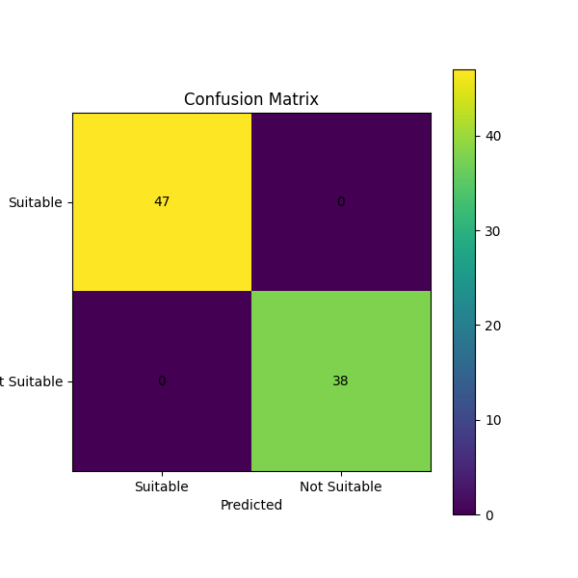
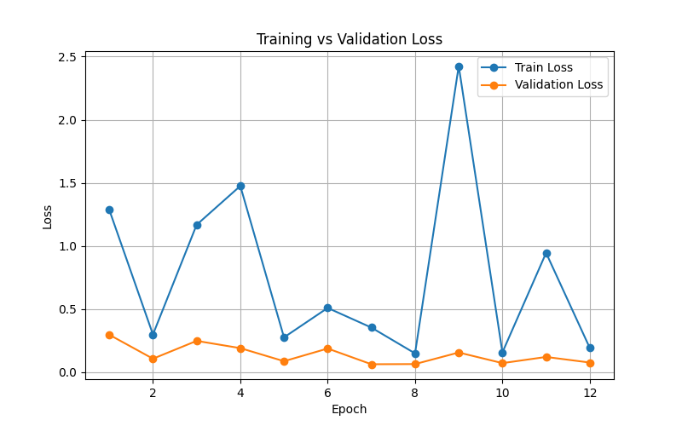
Implementation(Model Development)
Conclusion :
The current model serves as a baseline, and further training, parameter tuning, and evaluation on the full dataset are necessary to enhance its performance and reliability.

Slide 23
Experimental Setup and Simulation
Dataset: 118 geographical regions, 980 image-mask patches
Patch size: 256 × 256 pixels
Input: 11-channel geospatial data
RGB, NDVI, Elevation, Slope, Water Distance, Temperature, Rainfall, SAR VV, SAR VH
Output: 3-class pixel-wise suitability segmentation
Dataset split:
Training: 82 regions / 682 patches
Validation: 18 regions / 153 patches
Testing: 18 regions / 145 patches
Training environment: Google Colab + NVIDIA Tesla T4 GPU
Batch size: 4, Optimizer: Adam, Learning rate: 0.001

Slide 24
Performance Parameters
Parameter | Purpose
Accuracy | Overall correctly classified pixels
Mean IoU | Overlap between prediction and ground truth
Mean Dice | Segmentation similarity
Confusion Matrix | Class-wise prediction errors

Slide 25
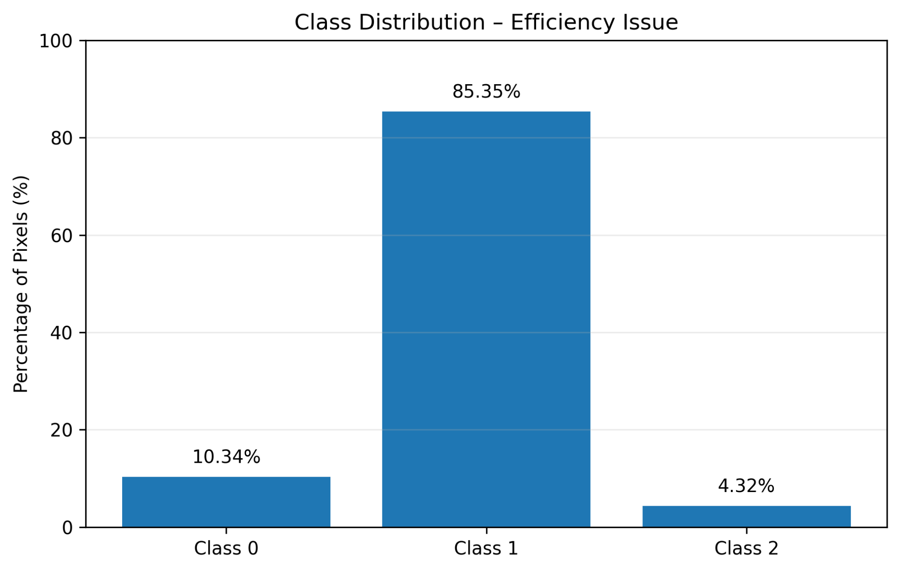
Efficiency Issues
Major Challenge: Class Imbalance
Impact: Minority classes are harder to segment accurately.
Solution tested: Dice + Cross Entropy Loss

Slide 26
Tools And Techniques Used
Category | Tools / Techniques
Data Source | Google Earth Engine
Computing | Google Colab, NVIDIA Tesla T4
Programming | Python
Deep Learning | PyTorch
Data Processing | Rasterio, NumPy
Visualization | Matplotlib
Models | U-Net, Attention U-Net
Loss Functions | Cross Entropy, Dice + Cross Entropy
Optimization | Adam
Evaluation | Accuracy, IoU, Dice, Confusion Matrix

Slide 27
Tools And Techniques Used
Frontend Development :
React 19 + TypeScript
Vite
Tailwind CSS v4
Framer Motion
React Leaflet (maps)
Backend Development:
Node.js + Express
Google Earth Engine
Python / scikit-learn
joblib (model serialization)
Data Sources:
Sentinel-2
Sentinel-1 SAR
SRTM DEM
ERA5 (temperature/rainfall)
JRC Global Surface Water (water distance)

Slide 28
Implementation Status And Model Comparison
Completed
11-channel dataset preparation and validation
Region-wise train/validation/test split
PyTorch Dataset and DataLoader
Multiple segmentation models trained
Different loss functions evaluated
Frontend development is completed
Best-performing configuration identified
Model | Accuracy | Mean IoU | Mean Dice
U-Net + CE | 93.07% | 45.41% | 55.52%
U-Net + Dice CE | 94.15% | 58.02% | 70.22%
Attention U-Net + Dice CE | 92.79% | 52.53% | 64.74%

Slide 29
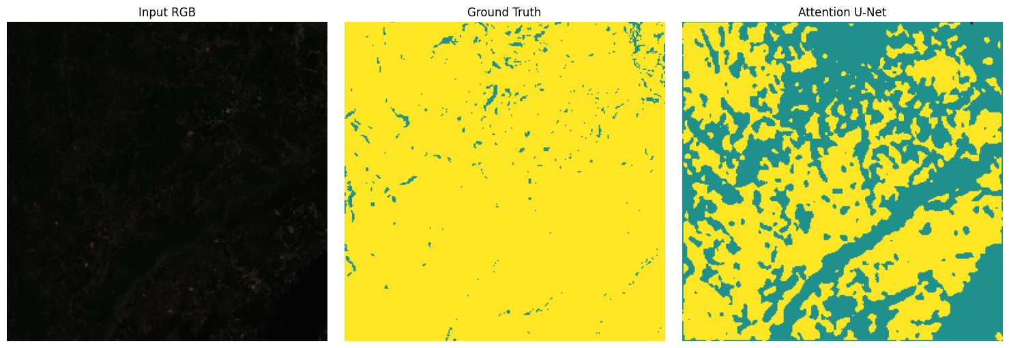
Results And Current Status
Best Model Performance
Accuracy: 94.15%
Mean IoU: 58.02%
Mean Dice: 70.22%
Class | IoU | Dice
Class 0 | 33.50% | 50.19%
Class 1 | 93.93% | 96.87%
Class 2 | 46.63% | 63.60%

Slide 30
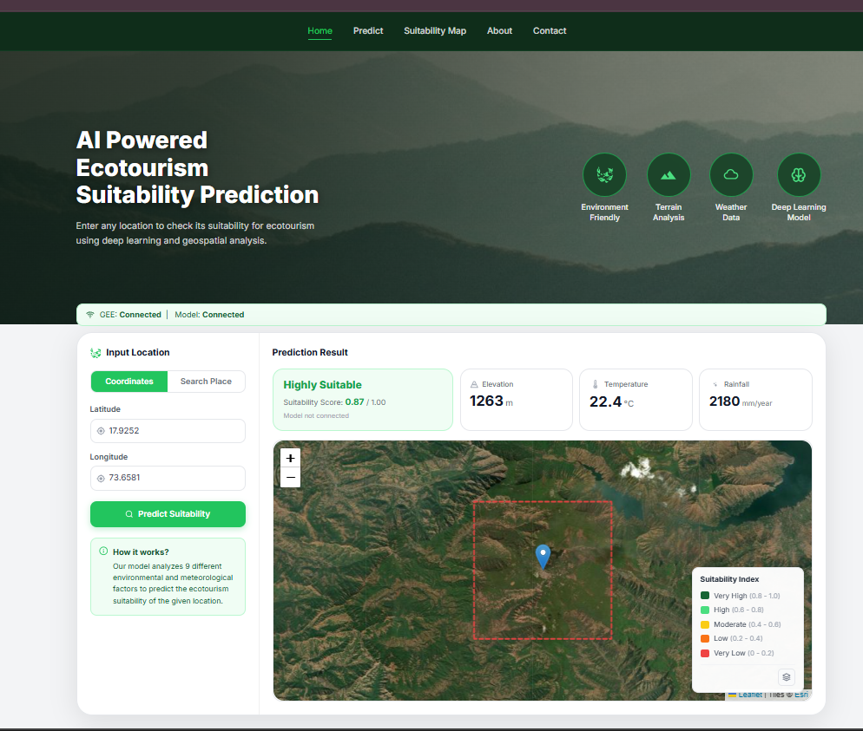
Result And Current Status

Slide 31
Conclusion
This project aims to develop an AI-based approach for terrain suitability mapping using satellite imagery, DEM, and terrain factors. By applying a Convolutional Neural Network (CNN), it is expected to classify land into highly suitable and Not-Suitable areas. The resulting suitability maps will help planners and authorities make informed decisions for sustainable eco-tourism while promoting environmental conservation.

Slide 32
References
[1] J. Wang and Z. Zhang, "Developing an Ecological Zoning Framework for Post-Pandemic Coastal Tourism Recovery: Evidence from 5-Year Remote Sensing and Tourism Data (2019–2024)," 2026.
[2] G. Uday and B. V. Purse, "Radar versus Optical: The Impact of Cloud Cover When Mapping Seasonal Surface Water for Health Applications in Monsoon-Affected India," 2025.
[3] A. Nowakowski and M. P. Del Rosso, "Transfer Learning in Earth Observation Data Analysis: A Review," 2025.
[4] L. Ma and Y. Liu, "A Comprehensive Review of Remote Sensing and Artificial Intelligence Integration: Advances, Applications, and Challenges," 2023.
[5]J.-F. Pekel, A. Cottam, N. Gorelick, and A. S. Belward, "High-Resolution Mapping of Global Surface Water and Its Long-Term Changes," Nature, vol. 540, no. 7633, pp. 418–422, Dec. 2016

Slide 33
References
[1] A. Madani, “Digital Elevation Model Estimation from RGB Satellite Imagery Using Generative Deep Learning,” IEEE Access, 2025
[2] V. Nandam, P. L. Patel, “A Framework to Assess Suitability of Global Digital Elevation Models for Hydrodynamic Modelling in Data-Scarce Regions,” Journal of Hydrology, Elsevier, 2024
[3] S. T. C. Wirawan, H. P. Chernovita, “Analysis of Vegetation Changes Using Satellite Imagery and NDVI,” Journal of Information Systems and Informatics, vol. 5, no. 4, 2023
[4] S. Liang, “Remote Sensing of Vegetation: Principles, Techniques, and Applications,” Remote Sensing of Environment, Elsevier, 2009
[5] D. Poli, F. Remondino, C. Dolci, “Use of Satellite Imagery for DEM Extraction, Landscape Modeling and GIS Applications,” International Archives of Photogrammetry, Remote Sensing and Spatial Information Sciences, vol. 36, 2004

Slide 34
References
1] Zhiqiang Li, Fumin Liu, Wei Yang, Shuo Peng, and Jun Zhou, “A survey of convolutional neural networks: Analysis, applications, and prospects,” IEEE Transactions on Neural Networks and Learning Systems, vol. 33, no. 12, pp. 6999–7019, 2021
[2] Teja Kattenborn, Jens Leitloff, Florian Schiefer, and Stefan Hinz, “Review on convolutional neural networks in vegetation remote sensing,” ISPRS Journal of Photogrammetry and Remote Sensing, vol. 173, pp. 24–49, 2021
[3] Lei Ma, Yu Liu, Xueliang Zhang, Yuanxin Ye, Gaofeng Yin, and Brian Alan Johnson, “Deep learning in remote sensing applications: A meta-analysis and review,” ISPRS Journal of Photogrammetry and Remote Sensing, vol. 152, pp. 166–177, 2019
[4] Yongsheng Zhang, Hong Zhang, and Liangpei Zhang, “Remote sensing image scene classification using CNN-CapsNet,” Remote Sensing, vol. 11, no. 5, p. 494, 2019
[5] Yushi Chen, Zhouhan Lin, Xing Zhao, Gang Wang, and Yanfeng Gu, “Deep learning-based classification of hyperspectral data,” IEEE Journal of Selected Topics in Applied Earth Observations and Remote Sensing, vol. 7, no. 6, pp. 2094–2107, 2014

Slide 35
References
[1] Deepa Rai, “New Horizons for Ecotourism in Sikkim: An Integrated MCDA Approach,” International Journal of Ecology and Environmental Sciences, 2025
[2] Q. Huang, C. Zhou, M. Li, Y. Ma, and S. Hua, “An Approach for Mapping Ecotourism Suitability Using Machine Learning: A Case Study of Zhangjiajie, China,” Land, vol. 13, no. 8, 2024
[3] R. S. Chandel, S. Kanga, S. K. Singh, B. Đurin, O. B. Oršulić, D. Dogančić, and J. D. Hunt, “Assessing Sustainable Ecotourism Opportunities in Western Rajasthan, India, through Advanced Geospatial Technologies,” Sustainability, vol. 15, no. 14, 2023
[4] Aditi Acharya, “Geospatial Analysis of Geo-Ecotourism Site Suitability Using AHP and GIS for Sustainable and Resilient Tourism Planning in West Bengal, India,” Sustainability, vol. 14, no. 4, 2022
[5] N. Li, J. Y. Wang, H. Y. Wang, and X. L. Yang, “Study on Ecological and Environmental Suitability of Tourism Resources Development in Lijiang River Basin of Guilin, China,” International Archives of the Photogrammetry, Remote Sensing and Spatial Information Sciences, vol. XLII-3/W10, pp. 601–606, 2020

Slide 36
THANK YOU !!
Department of Computer Engineering
K.K.Wagh Institute of Engineering Education & Research, Nashik

