Slide 1
The Knowledge Discovery Process; Data Preparation & Preprocessing
Bamshad Mobasher
DePaul University

Slide 2
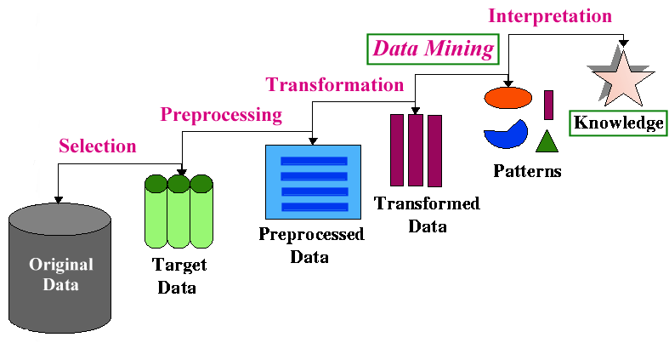
The Knowledge Discovery Process
- The KDD Process

Slide 3
Types of Data Sets
Record
Relational records
Data matrix, e.g., numerical matrix, crosstabs
Document data: text documents: term-frequency vector
Transaction data
Graph and network
World Wide Web
Social or information networks
Molecular Structures
Ordered
Video data: sequence of images
Temporal data: time-series
Sequential Data: transaction sequences
Genetic sequence data
Spatial and multimedia:
Spatial data: maps
Image data
Video data
Notes:
May we categorize data along the following dimensions?
- structured, semi-structured, and unstructured
- numeric and categorical
- static and dynamic (temporal?)
- by application

Slide 4
Data Objects
Data sets are made up of data objects.
A data object represents an entity.
Examples:
sales database: object → customers, store items, sales
medical database: object → patients, treatments
university database: object → students, professors, courses
Also called samples , examples, instances, data points, objects, tuples, vectors.
Data objects are described by attributes.
Database rows → data objects; columns → attributes.

Slide 5
Attributes
Attribute (or dimensions, features, variables): a data field representing a characteristic or property of a data object
E.g., customer _ID, name, address, income, GPA, ….
Types:
Nominal (Categorical)
Ordinal
Numeric: quantitative
Interval-scaled
Ratio-scaled

Slide 6
Attribute Types
Nominal (Categorical): categories, states, or “names of things”
Hair_color = {auburn, black, blond, brown, grey, red, white}
marital status, occupation, ID numbers, zip codes
Often attributes with “yes” and “no” as values
Binary
Nominal attribute with only 2 states (0 and 1)
Ordinal
Values have a meaningful order (ranking) but magnitude between successive values is not known.
Size = {small, medium, large}, grades, army rankings
Month = {jan, feb, mar, … }
Numeric
Quantity (integer or real-valued)
Could also be intervals or ratios

Slide 7
Discrete vs. Continuous Attributes
Discrete Attribute
Has only a finite or countably infinite set of values
E.g., zip codes, profession, or the set of words in a collection of documents
Sometimes, represented as integer variables
Note: Binary attributes are a special case of discrete attributes
Continuous Attribute
Has real numbers as attribute values
E.g., temperature, height, or weight
Practically, real values can only be measured and represented using a finite number of digits
Continuous attributes are typically represented as floating-point variables

Slide 8
The Knowledge Discovery Process
- The KDD Process

Slide 9
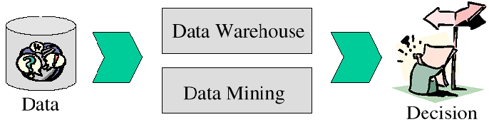
Data Preprocessing
Why do we need to prepare the data?
In real world applications data can be inconsistent, incomplete and/or noisy
Data entry, data transmission, or data collection problems
Discrepancy in naming conventions
Duplicated records
Incomplete or missing data
Contradictions in data
What happens when the data can not be trusted?
Can the decision be trusted? Decision making is jeopardized
Better chance to discover useful knowledge when data is clean

Slide 10
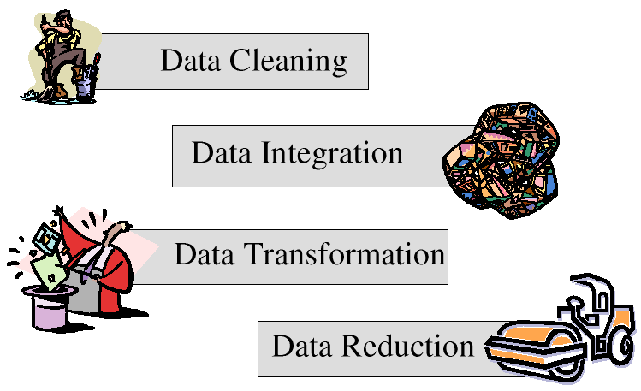
Data Preprocessing

Slide 11
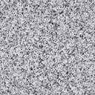

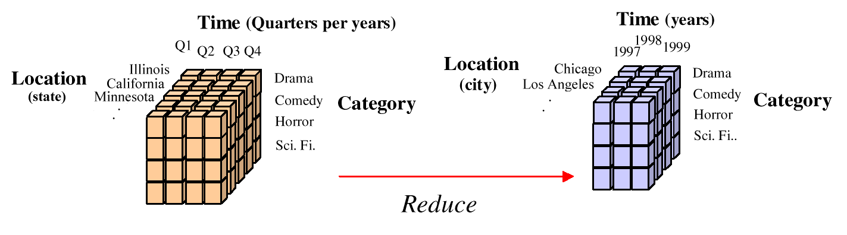
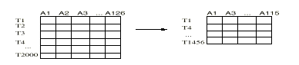
Data Preprocessing
Data Cleaning
Data Integration
-2,32,100,59,48
-0.02,0.32,1.00,0.59,0.48
Data Transformation
Data Reduction

Slide 12

Data Cleaning
Real-world application data can be incomplete, noisy, and inconsistent
No recorded values for some attributes
Not considered at time of entry
Random errors
Irrelevant records or fields
Data cleaning attempts to:
Fill in missing values
Smooth out noisy data
Correct inconsistencies
Remove irrelevant data

Slide 13
Dealing with Missing Values
Data is not always available (missing attribute values in records)
equipment malfunction
deleted due to inconsistency or misunderstanding
not considered important at time of data gathering
Solving Missing Data
Ignore the record with missing values;
Fill in the missing values manually;
Use a global constant to fill in missing values (NULL, unknown, etc.);
Use the attribute value mean to filling missing values of that attribute;
Use the attribute mean for all samples belonging to the same class to fill in the missing values;
Infer the most probable value to fill in the missing value
may need to use methods such as Bayesian classification or decision trees to automatically infer missing attribute values

Slide 14
Smoothing Noisy Data
The purpose of data smoothing is to eliminate noise and “smooth out” the data fluctuations.
Ex: Original Data for “price” (after sorting): 4, 8, 15, 21, 21, 24, 25, 28, 34
Partition into equidepth bins
Bin1: 4, 8, 15
Bin2: 21, 21, 24
Bin3: 25, 28, 34
Binning
Min and Max values in each bin are identified (boundaries). Each value in a bin is replaced with the closest boundary value.
Each value in a bin is replaced by the mean value of the bin.
means
Bin1: 9, 9, 9
Bin2: 22, 22, 22
Bin3: 29, 29, 29
boundaries
Bin1: 4, 4, 15
Bin2: 21, 21, 24
Bin3: 25, 25, 34

Slide 15
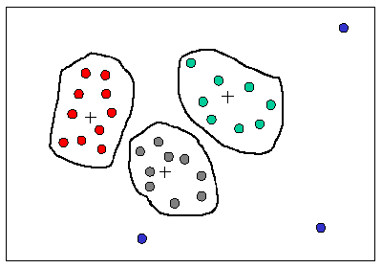
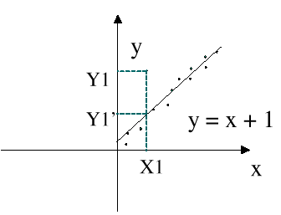
Smoothing Noisy Data
Other Methods
Similar values are organized into groups (clusters). Values falling outside of clusters may be considered “outliers” and may be candidates for elimination.
Clustering
Fit data to a function. Linear regression finds the best line to fit two variables. Multiple regression can handle multiple variables. The values given by the function are used instead of the original values.
Regression

Slide 16
Smoothing Noisy Data - Example
Want to smooth “Temperature” by bin means with bins of size 3:
First sort the values of the attribute (keep track of the ID or key so that the transformed values can be replaced in the original table.
Divide the data into bins of size 3 (or less in case of last bin).
Convert the values in each bin to the mean value for that bin
Put the resulting values into the original table

Slide 17
Smoothing Noisy Data - Example
Value of every record in each bin is changed to the mean value for that bin. If it is necessary to keep the value as an integer, then the mean values are rounded to the nearest integer.

Slide 18
Smoothing Noisy Data - Example
The final table with the new values for the Temperature attribute.

Slide 19
Data Integration
Data analysis may require a combination of data from multiple sources into a coherent data store
Challenges in Data Integration:
Schema integration: CID = C_number = Cust-id = cust#
Semantic heterogeneity
Data value conflicts (different representations or scales, etc.)
Synchronization (especially important in Web usage mining)
Redundant attributes (redundant if it can be derived from other attributes) -- may be able to identify redundancies via correlation analysis:
Meta-data is often necessary for successful data integration
Pr(A,B) / (Pr(A).Pr(B))
= 1: independent,
> 1: positive correlation,
< 1: negative correlation.

Slide 20
Data Transformation: Normalization
Min-max normalization: linear transformation from v to v’
v’ = [(v - min)/(max - min)] x (newmax - newmin) + newmin
Note that if the new range is [0..1], then this simplifies to
v’ = [(v - min)/(max - min)]
Ex: transform $30000 between [10000..45000] into [0..1] ==>
[(30000 – 10000) / 35000] = 0.514
z-score normalization: normalization of v into v’ based on attribute value mean and standard deviation
v’ = (v - Mean) / StandardDeviation
Normalization by decimal scaling
moves the decimal point of v by j positions such that j is the minimum number of positions moved so that absolute maximum value falls in [0..1].
v’ = v / 10^{j}
Ex: if v in [-56 .. 9976] and j=4 ==> v’ in [-0.0056 .. 0.9976]

Slide 21
Normalization: Example
z-score normalization: v’ = (v - Mean) / Stdev
Example: normalizing the “Humidity” attribute:
Mean = 80.3
Stdev = 9.84

Slide 22

Normalization: Example II
Min-Max normalization on an employee database
max distance for salary: 100000-19000 = 81000
max distance for age: 52-27 = 25
New min for age and salary = 0; new max for age and salary = 1

Slide 23
Data Transformation: Discretization
3 Types of attributes
nominal - values from an unordered set (also “categorical” attributes)
ordinal - values from an ordered set
numeric/continuous - real numbers (but sometimes also integer values)
Discretization is used to reduce the number of values for a given continuous attribute
usually done by dividing the range of the attribute into intervals
interval labels are then used to replace actual data values
Some data mining algorithms only accept categorical attributes and cannot handle a range of continuous attribute value
Discretization can also be used to generate concept hierarchies
reduce the data by collecting and replacing low level concepts (e.g., numeric values for “age”) by higher level concepts (e.g., “young”, “middle aged”, “old”)

Slide 24
Discretization - Example
Example: discretizing the “Humidity” attribute using 3 bins.
Low = 60-69
Normal = 70-79
High = 80+

Slide 25
Data Discretization Methods
Binning
Top-down split, unsupervised
Histogram analysis
Top-down split, unsupervised
Clustering analysis
Unsupervised, top-down split or bottom-up merge
Decision-tree analysis
Supervised, top-down split
Correlation (e.g., χ2) analysis
Unsupervised, bottom-up merge
25
Notes:
25

Slide 26
Simple Discretization: Binning
Equal-width (distance) partitioning
Divides the range into N intervals of equal size: uniform grid
if A and B are the lowest and highest values of the attribute, the width of intervals will be: W = (B –A)/N.
The most straightforward, but outliers may dominate presentation
Skewed data is not handled well
Equal-depth (frequency) partitioning
Divides the range into N intervals, each containing approximately same number of samples
Good data scaling
Managing categorical attributes can be tricky

Slide 27
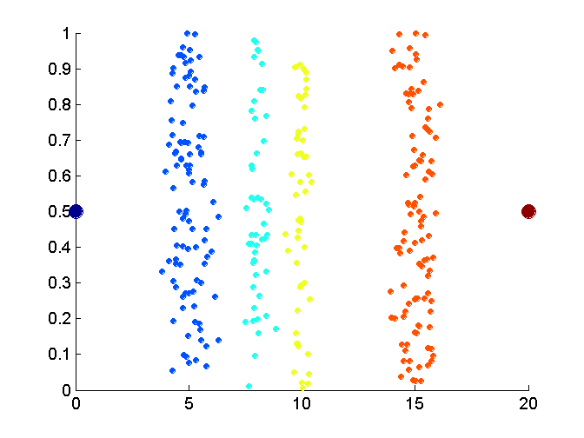
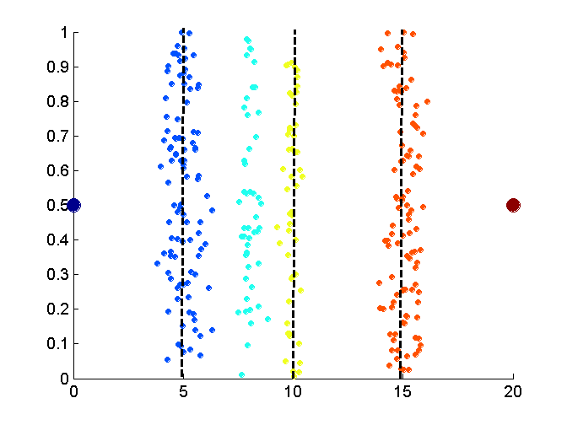
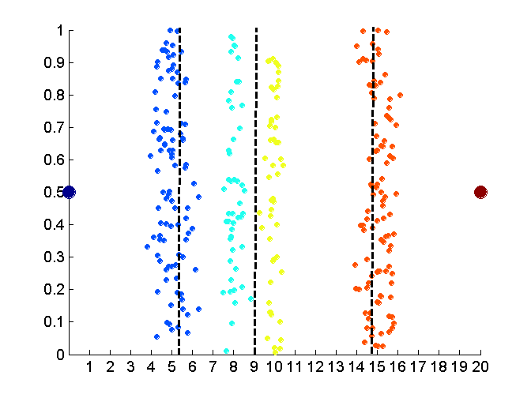
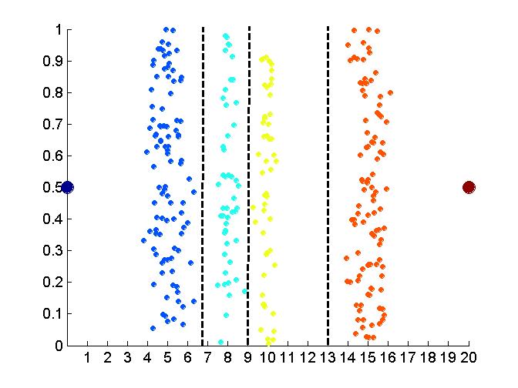
Discretization Without Using Class Labels (Binning vs. Clustering)
Data
Equal interval width (binning)
Equal frequency (binning)
K-means clustering leads to better results
27
Notes:
27

Slide 28
Discretization by Classification & Correlation Analysis
Classification (e.g., decision tree analysis)
Supervised: Given class labels, e.g., cancerous vs. benign
Using entropy to determine split point (discretization point)
Top-down, recursive split
Correlation analysis (e.g., Chi-merge: χ2-based discretization)
Supervised: use class information
Bottom-up merge: merge the best neighboring intervals (those with similar distributions of classes, i.e., low χ2 values)
Merge performed recursively, until a predefined stopping condition
28
Notes:
28

Slide 29
Converting Categorical Attributes to Numerical Attributes
Attributes:
Outlook (overcast, rain, sunny)
Temperature real
Humidity real
Windy (true, false)
Standard Spreadsheet Format
Create separate columns for each value of a categorical attribute (e.g., 3 values for the Outlook attribute and two values of the Windy attribute). There is no change to the numerical attributes.

Slide 30

Data Reduction
Data is often too large; reducing data can improve performance
Data reduction consists of reducing the representation of the data set while producing the same (or almost the same) results
Data reduction includes:
Data cube aggregation
Dimensionality reduction
Discretization
Numerosity reduction
Regression
Histograms
Clustering
Sampling

Slide 31
Data Cube Aggregation
Reduce the data to the concept level needed in the analysis
Use the smallest (most detailed) level necessary to solve the problem
Queries regarding aggregated information should be answered using data cube when possible

Slide 32
Dimensionality Reduction
Curse of dimensionality
When dimensionality increases, data becomes increasingly sparse
Density and distance between points, which is critical to clustering, outlier analysis, becomes less meaningful
The possible combinations of subspaces will grow exponentially
Dimensionality reduction
Avoid the curse of dimensionality
Help eliminate irrelevant features and reduce noise
Reduce time and space required in data mining
Allow easier visualization
Dimensionality reduction techniques
Principal Component Analysis
Attribute subset selection
Attribute or feature generation
Notes:
32
JH: put SVD at clustering high-D reduction.

Slide 33
Principal Component Analysis (PCA)
Find a projection that captures the largest amount of variation in data
The original data are projected onto a much smaller space, resulting in dimensionality reduction
Done by finding the eigenvectors of the covariance matrix, and these eigenvectors define the new space
x₂
e
x₁

Slide 34
Principal Component Analysis (Steps)
Given N data vectors (rows in a table) from n dimensions (attributes), find k ≤ n orthogonal vectors (principal components) that can be best used to represent data
Normalize input data: Each attribute falls within the same range
Compute k orthonormal (unit) vectors, i.e., principal components
Each input data (vector) is a linear combination of the k principal component vectors
The principal components are sorted in order of decreasing “significance” or strength
The size of the data can be reduced by eliminating the weak components, i.e., those with low variance
Using the strongest principal components, it is possible to reconstruct a good approximation of the original data
Works for numeric data only

Slide 35
Attribute Subset Selection
Another way to reduce dimensionality of data
Redundant attributes
Duplicate much or all of the information contained in one or more other attributes
E.g., purchase price of a product and the amount of sales tax paid
Irrelevant attributes
Contain no information that is useful for the data mining task at hand
E.g., students' ID is often irrelevant to the task of predicting students' GPA

Slide 36
Heuristic Search in Attribute Selection
There are 2^{d} possible attribute combinations of d attributes
Typical heuristic attribute selection methods:
Best single attribute under the attribute independence assumption: choose by significance tests
Best step-wise feature selection:
The best single-attribute is picked first. Then next best attribute condition to the first, ...
{}{A1}{A1, A3}{A1, A3, A5}
Step-wise attribute elimination:
Repeatedly eliminate the worst attribute: {A1, A2, A3, A4, A5}{A1, A3, A4, A5} {A1, A3, A5}, ….
Combined attribute selection and elimination
Decision Tree Induction

Slide 37
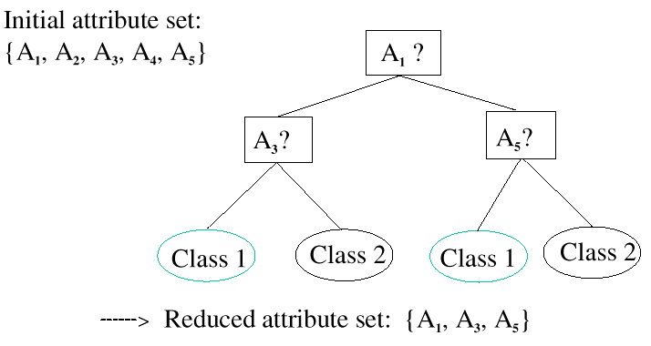
Decision Tree Induction
Use information theoretic techniques to select the most “informative” attributes

Slide 38
Attribute Creation (Feature Generation)
Create new attributes (features) that can capture the important information in a data set more effectively than the original ones
Three general methodologies
Attribute extraction
Domain-specific
Mapping data to new space (see: data reduction)
E.g., Fourier transformation, wavelet transformation, etc.
Attribute construction
Combining features
Data discretization
38
Notes:
38

Slide 39
Data Reduction: Numerosity Reduction
Reduce data volume by choosing alternative, smaller forms of data representation
Parametric methods (e.g., regression)
Assume the data fits some model, estimate model parameters, store only the parameters, and discard the data (except possible outliers)
Ex.: Log-linear models—obtain value at a point in m-D space as the product on appropriate marginal subspaces
Non-parametric methods
Do not assume models
Major families: histograms, clustering, sampling, …

Slide 40
Regression Analysis
y
Collection of techniques for the modeling and analysis of numerical data consisting of values of a dependent variable (also response variable or measurement) and of one or more independent variables (aka. explanatory variables or predictors)
The parameters are estimated to obtains a "best fit" of the data
Typically the best fit is evaluated by using the least squares method, but other criteria have also been used
Y1
Y1’
y = x + 1
X1
x
Used for prediction (including forecasting of time-series data), inference, hypothesis testing, and modeling of causal relationships

Slide 41
Regression Analysis
Linear regression: Y = w X + b
Two regression coefficients, w and b, specify the line and are to be estimated by using the data at hand
Using the least squares criterion on known values of Y₁, Y₂, …, X₁, X₂, ….
Multiple regression: Y = b₀ + b₁ X₁ + b₂ X₂
Many nonlinear functions can be transformed into the above
Log-linear models
Approximate discrete multidimensional probability distributions
Estimate the probability of each point in a multi-dimensional space for a set of discretized attributes, based on a smaller subset of dimensions
Useful for dimensionality reduction and data smoothing

Slide 42
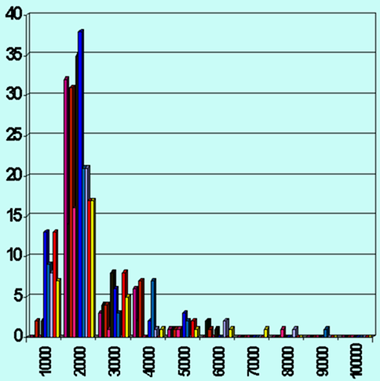
Numerocity Reduction
Reduction via histograms:
Divide data into buckets and store representation of buckets (sum, count, etc.)
Reduction via clustering
Partition data into clusters based on “closeness” in space
Retain representatives of clusters (centroids) and outliers
Reduction via sampling
Will the patterns in the sample represent the patterns in the data?
Random sampling can produce poor results
Stratified sample (stratum = group based on attribute value)

Slide 43
Sampling Techniques
SRSWOR
(simple random
sample without
replacement)
SRSWR
Raw Data
Cluster/Stratified Sample
Raw Data

