Slide 1
Overview of Data Mining and the KDD Process
Bamshad Mobasher
DePaul University

Slide 2
From Data to Wisdom
Data
The raw material of information
Information
Data organized and presented by someone
Knowledge
Information read, heard or seen and understood and integrated
Wisdom
Distilled knowledge and understanding which can lead to decisions
Wisdom
Knowledge
Information
Data
The Information Hierarchy

Slide 3
Why Data Mining?
The Explosive Growth of Data: from terabytes to petabytes
Data collection and data availability
Automated data collection tools, database systems, Web, computerized society
Major sources of abundant data
Business: Web, e-commerce, transactions, stocks, …
Science: Remote sensing, bioinformatics, scientific simulation, …
Society and everyone: news, images, video, documents
Internet …

Slide 4
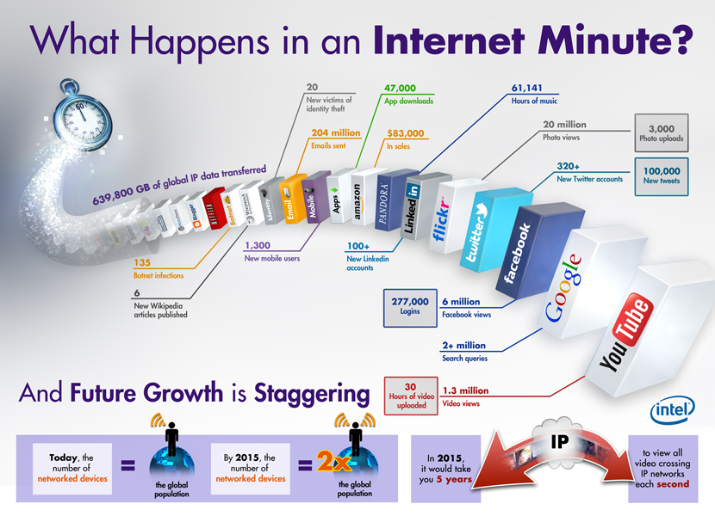
Source: Intel

Slide 5
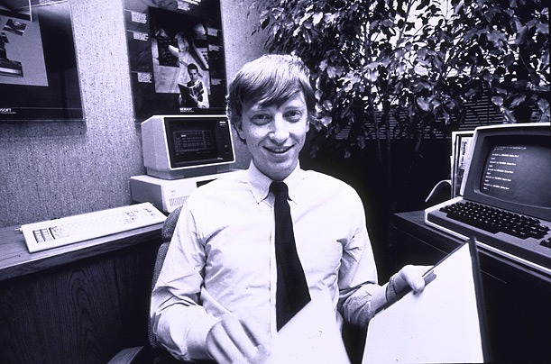
How much data?
Google: ~20-30 PB a day
Wayback Machine has ~4 PB + 100-200 TB/month
Facebook: ~3 PB of user data + 25 TB/day
eBay: ~7 PB of user data + 50 TB/day
CERN’s Large Hydron Collider generates 15 PB a year
In 2010, enterprises stored 7 Exabytes = 7,000,000,000 GB
640K ought to be enough for anybody.

Slide 6
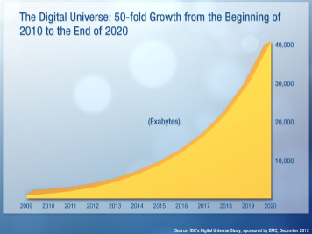
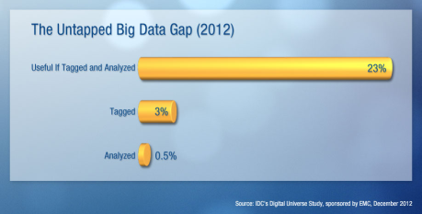
Big Data Growing
IDC predicts: From 2005 to 2020, the digital universe will double every 2 years and grow from 130 exabytes to 40,000 exabytes
or 5,200 GB / person in 2020.
The Untapped Data Gap:
Most of the useful data will not be tagged or analyzed – partly due to skill shortage

Slide 7
What Is Data Mining?
We are drowning in data, but starving for knowledge!
“Necessity is the mother of invention”—Data mining—Automated analysis of massive data sets
Data Mining: A Definition
The non-trivial extraction of implicit, previously unknown and potentially useful knowledge from data in large data repositories
Non-trivial: obvious knowledge is not useful
implicit: hidden difficult to observe knowledge
previously unknown
potentially useful: actionable; easy to understand

Slide 8
Data Mining: Confluence of Multiple Disciplines
Machine
Learning
Pattern
Recognition
Statistics
Applications
Data Mining
Visualization
Algorithm
Database
Technology
High-Performance
Computing

Slide 9
Data Mining’s Virtuous Cycle
Identifying the problem
Mining data to transform it into actionable information
Acting on the information
Measuring the results
9
Notes:
9

Slide 10
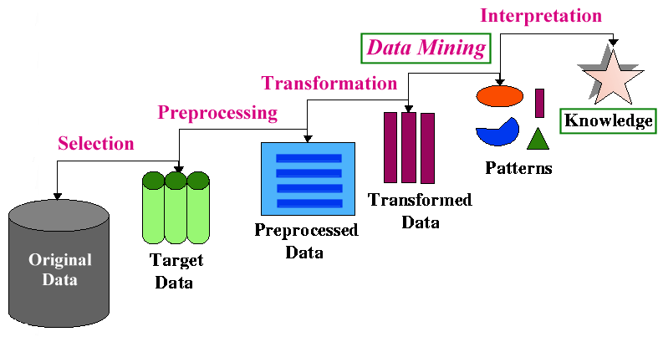
The Knowledge Discovery Process
Data Mining v. Knowledge Discovery in Databases (KDD)
DM and KDD are often used interchangeably
actually, DM is only part of the KDD process
- The KDD Process

Slide 11
Types of Knowledge Discovery
Two kinds of knowledge discovery: directed and undirected
Directed Knowledge Discovery
Purpose: Explain value of some field in terms of all the others (goal-oriented)
Method: select the target field based on some hypothesis about the data; ask the algorithm to tell us how to predict or classify new instances
Examples:
what products show increased sale when cream cheese is discounted
which banner ad to use on a web page for a given user coming to the site
Undirected Knowledge Discovery
Purpose: Find patterns in the data that may be interesting (no target field)
Method: clustering, affinity grouping
Examples:
which products in the catalog often sell together
market segmentation (find groups of customers/users with similar characteristics or behavioral patterns)

Slide 12
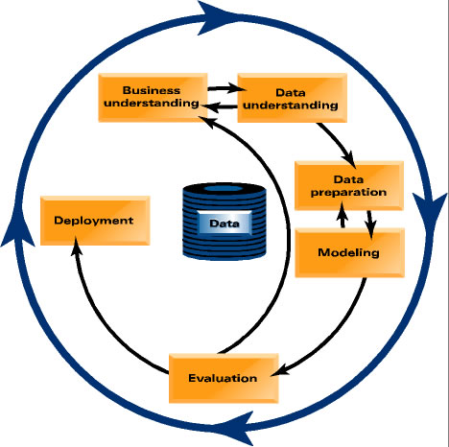
From Data Mining to Data Science
Notes:
Of course, data mining must be understood in the context of problem solving in real world. In recent years, people have started to use the term data science. This term emphasizes that data mining is a set of tools and techniques that are used as part of a scientific approach to solving problems. One must always start with a problem formulation is a specific application or business domain. A data-driven solution to this problem involves understanding the data that provide the observations relevant to the problem. These observations and preliminary analysis lead to a formulation of one or more hypotheses. The knowledge discovery process is guided by the hypotheses, including the data preparation and transformation, and well as the derivation of various models. The models must then be evaluated with appropriate test data. This evaluation, including the accuracy of predictive models, tells us whether we must go back and revise our hypotheses, or to modify our procedures. Eventually, the successful models must be deployed and tested in real-world situations.

Slide 13
Data Mining: On What Kinds of Data?
Database-oriented data sets and applications
Relational database, data warehouse, transactional database
Object-relational databases, Heterogeneous databases and legacy databases
Advanced data sets and advanced applications
Data streams and sensor data
Time-series data, temporal data, sequence data (incl. bio-sequences)
Structure data, graphs, social networks and information networks
Spatial data and spatiotemporal data
Multimedia database
Text databases
The World-Wide Web

Slide 14
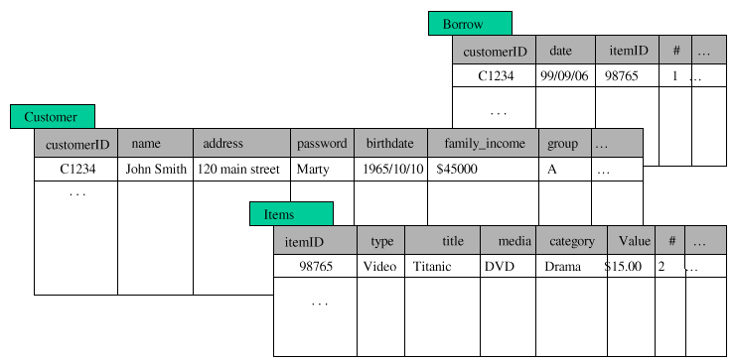
Data Mining: What Kind of Data?
Structured Databases
relational, object-relational, etc.
can use SQL to perform parts of the process
e.g., SELECT count(*) FROM Items WHERE
type=video GROUP BY category

Slide 15
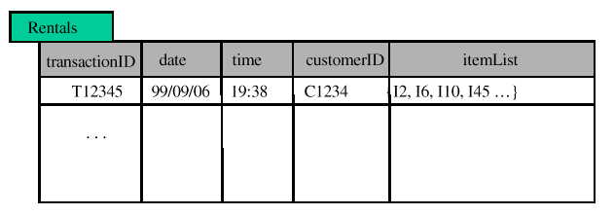
Data Mining: What Kind of Data?
Flat Files
most common data source
can be text (or HTML) or binary
may contain transactions, statistical data, measurements, etc.
Transactional databases
set of records each with a transaction id, time stamp, and a set of items
may have an associated “description” file for the items
typical source of data used in market basket analysis

Slide 16
Data Mining: What Kind of Data?
Other Types of Databases
legacy databases
multimedia databases (usually very high-dimensional)
spatial databases (containing geographical information, such as maps, or satellite imaging data, etc.)
Time Series Temporal Data (time dependent information such as stock market data; usually very dynamic)
World Wide Web
basically a large, heterogeneous, distributed database
need for new or additional tools and techniques
information retrieval, filtering and extraction
agents to assist in browsing and filtering
Web content, usage, and structure (linkage) mining tools
The “social Web”
User generated meta-data, social networks, shared resources, etc.

Slide 17
What Can Data Mining Do
Many Data Mining Tasks
often inter-related
often need to try different techniques/algorithms for each task
each tasks may require different types of knowledge discovery
What are some of data mining tasks
Classification
Prediction
Clustering
Affinity Grouping / Association discovery
Sequence Analysis
Characterization
Discrimination

Slide 18
Some Applications of Data mining
Business data analysis and decision support
Marketing focalization
Recognizing specific market segments that respond to particular characteristics
Return on mailing campaign (target marketing)
Customer Profiling
Segmentation of customer for marketing strategies and/or product offerings
Customer behavior understanding
Customer retention and loyalty
Mass customization / personalization

Slide 19
Some Applications of Data mining
Business data analysis and decision support (cont.)
Market analysis and management
Provide summary information for decision-making
Market basket analysis, cross selling, market segmentation.
Resource planning
Risk analysis and management
"What if" analysis
Forecasting
Pricing analysis, competitive analysis
Time-series analysis (Ex. stock market)

Slide 20
Some Applications of Data mining
Fraud detection
Detecting telephone fraud:
Telephone call model: destination of the call, duration, time of day or week
Analyze patterns that deviate from an expected norm
British Telecom identified discrete groups of callers with frequent intra-group calls, especially mobile phones, and broke a multimillion dollar fraud scheme
Detection of credit-card fraud
Detecting suspicious money transactions (money laundering)
Text mining:
Message filtering (e-mail, newsgroups, etc.)
Newspaper articles analysis
Text and document categorization
Web Mining
Mining patterns from the content, usage, and structure of Web resources

Slide 21
Types of Web Mining
Web Mining
Web Content
Mining
Web Usage
Mining
Web Structure
Mining

Slide 22
Types of Web Mining
Web Mining
Web Content
Mining
Web Usage
Mining
Web Structure
Mining
Applications:
document clustering or categorization
topic identification / tracking
concept discovery
focused crawling
content-based personalization
intelligent search tools

Slide 23
Types of Web Mining
Web Mining
Web Content
Mining
Web Usage
Mining
Web Structure
Mining
Applications:
user and customer behavior modeling
Web site optimization
e-customer relationship management
Web marketing
targeted advertising
recommender systems

Slide 24
Types of Web Mining
Web Mining
Web Content
Mining
Web Usage
Mining
Web Structure
Mining
Applications:
document retrieval and ranking (e.g., Google)
discovery of “hubs” and “authorities”
discovery of Web communities
social network analysis

Slide 25
The Knowledge Discovery Process
Next: We first focus on understanding the data and data preparation/transformation
- The KDD Process

