Slide 1
Employee Data Analysis using Excel
STUDENT NAME: KOKILA N
REGISTER NO: 312204092 ( DDAB6084CB1AE218EDF45A75D4A28BA6 )
DEPARTMENT: B.COM ( COMMERCE )
COLLEGE : SRIRAM COLLEGE OF ARTS AND SCIENCE

Slide 2
PROJECT TITLE
Employee Salary Analysis Using Excel

Slide 3


AGENDA
Problem Statement
Project Overview
End Users
Our Solution and Proposition
Dataset Description
Modelling Approach
Results and Discussion
Conclusion
3/21/2024 Annual Review

Slide 4

PROBLEM STATEMENT
Objective: To create an efficient and comprehensive Excel spreadsheet that manages and analyzes employee salary information for a company. The goal is to enable accurate tracking of salary details, generate useful reports, and ensure compliance with payroll regulations.
Data Entry:
Employee Details: Name, Employee ID, Department, Position, and Hire Date.
Calculations:
Gross Salary Calculation: Sum of Base Salary and Bonuses.
Data Analysis:
Departmental Salary Summary: Total and average salary per department.
Reporting:
Salary Report: Detailed report of salaries paid, including breakdowns and totals.
User Interface:
Data Validation: Prevent entry errors with dropdowns and validation rules.

Slide 5

PROJECT OVERVIEW
Objective: Develop an Excel-based system to efficiently manage, calculate, and report employee salary data. This system aims to streamline payroll processes, ensure accurate salary tracking, and facilitate comprehensive reporting for decision-making and compliance purposes.
Scope: The project will encompass the following components:
Data Management: Collection and organization of employee salary details.
Data Entry Sheet:
Employee Information: Captures essential details such as Name, Employee ID, Department, Position, and Hire Date.
Calculation Sheets:
Gross Salary Calculation: Uses formulas to add Base Salary and Bonuses.
Analysis Sheets:
Departmental Summaries: Provides total and average salary data by department.
Reporting Sheets:
Salary Report: Detailed breakdown of salaries including individual and departmental summaries.

Slide 6

WHO ARE THE END USERS?
Payroll Administrators
HR Managers
Finance Department
Department Heads
Accountants Validate Payroll records
Executives/Seniors Management

Slide 7

OUR SOLUTION AND ITS VALUE PROPOSITION
Centralized Data Management:
Consolidates all employee salary information in one place, including base salaries, bonuses, deductions, and payment details.
Automated Calculations:
Automatically computes gross and net salaries, annual projections, and overtime pay using built-in formulas.
Comprehensive Reporting:
Generates detailed salary reports, departmental summaries, and payroll overviews.
Advanced Data Analysis:
Analyzes salary trends and departmental expenses to support strategic decision-making.
User-Friendly Interface:
Features intuitive data entry forms, validation rules, and navigational aids to simplify use.

Slide 8
Dataset Description
Employee Information Sheet:
Employee ID: Unique identifier for each employee.
Name: Full name of the employee.
Department: Department where the employee works.
Position: Job title or role of the employee.
Hire Date: The date when the employee joined the company.
Departmental Salary Summary Sheet:
Department: Name of the department.
Total Salary: Sum of all salaries paid within the department.
Average Salary: Average salary within the department.
Number of Employees: Total number of employees in the department.
Total Bonuses: Total bonuses paid within the department.
Total Deductions: Total deductions made within the department.

Slide 9

THE "WOW" IN OUR SOLUTION
Seamless Automation:
Automated Calculations: Our solution automates complex salary calculations, including gross and net salaries, annual projections, and overtime pay, reducing manual errors and saving time.
Dynamic Updates: Formulas and linked cells ensure that any update in one part of the dataset reflects throughout the system, maintaining consistency and accuracy.
3/21/2024 Annual Review
9

Slide 10
MODELLING
Define the Structure:
a. Sheets to Include:
Employee Information
Salary Details
Overtime and Additional Compensation (if applicable)
Payroll Summary
Departmental Summary
Compliance and Exception Reports
Design the Data Entry Sheets:
a. Employee Information Sheet:
Columns:
Employee ID
Name
Department
Position
Hire Date
Purpose: Store basic employee details.
10

Slide 11
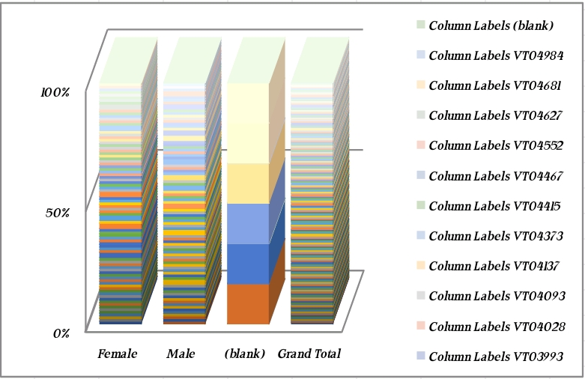
RESULTS
11

Slide 12
conclusion
Employee Salary Management Using Excel
Effectiveness: Using Excel for employee salary management offers a versatile and cost-effective solution for tracking and processing payroll. By leveraging Excel’s capabilities, organizations can streamline salary calculations, maintain comprehensive records, and generate insightful reports. This approach is especially advantageous for small to medium-sized businesses or those seeking an affordable alternative to specialized payroll software.

