Slide 1
Data analytics
Tomato Price Forecast

Slide 2
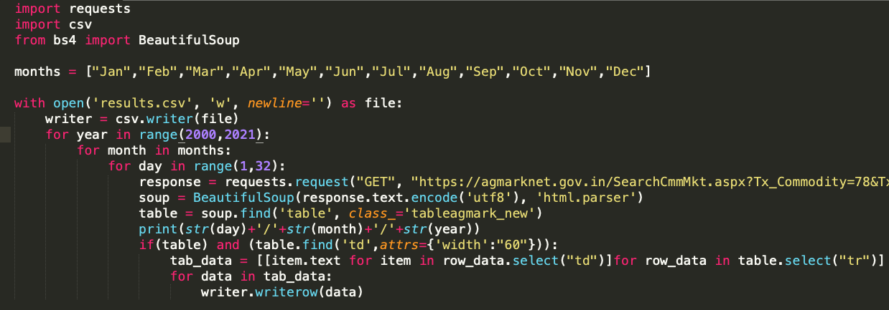
Tomato Price Forecast
Problem : Forecasting price with time series data of past years
Dataset : Web scrapping the data from http://agmarknet.gov.in/

Slide 3

Tomato Price Forecast
Dataset Discription:
Number of Samples : 1736552
Categorical Columns : 5
State
District
Market
Variety
Commadity
Numerical Columns : 8
Tons
Min Price
Max Price
Modal Price
Arrival Date
Month
Date
Year

Slide 4
Tomato Price Forecast
Why is what you have done important/ useful?
A substantial percentage of the inhabitants of the country depend on the agriculture.
but it’s the field where technology is less updated.
Predicting the vegetable price is essential in agriculture sector for effective decision making.
An accurate forecasting method for prices and an early-warning system in the vegetable market
are an urgent need in people’s daily lives.

Slide 5
Tomato Price Forecast
Approach:
Collect all the related information to tomato costs
Preprocess the data
Build the model
Use the model to forecast price for upcoming days

Slide 6
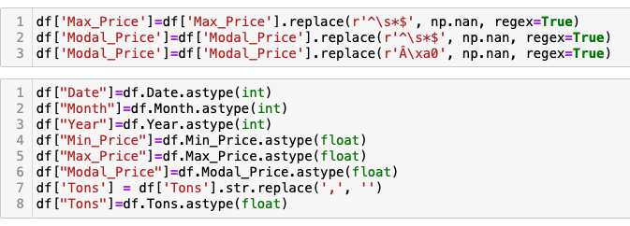
Tomato Price Forecast
Preprocessing Data
Cleaning the dataset as it is web scrapped

Slide 7
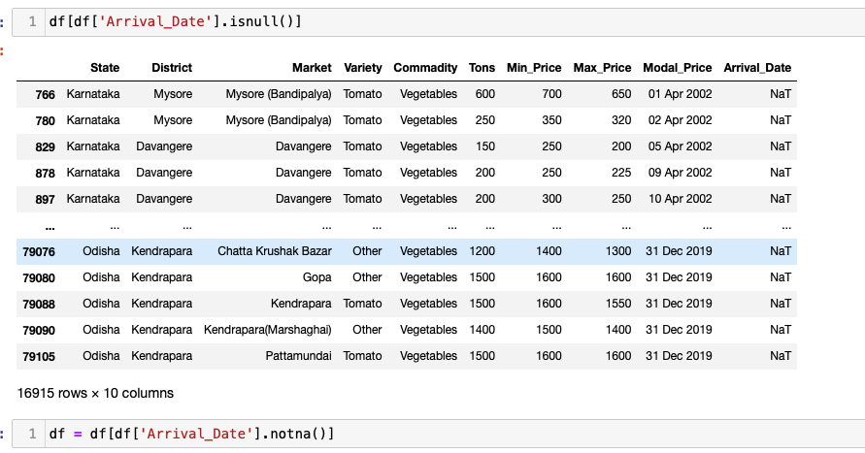
Tomato Price Forecast
Preprocessing Data
Removing the NaTs

Slide 8
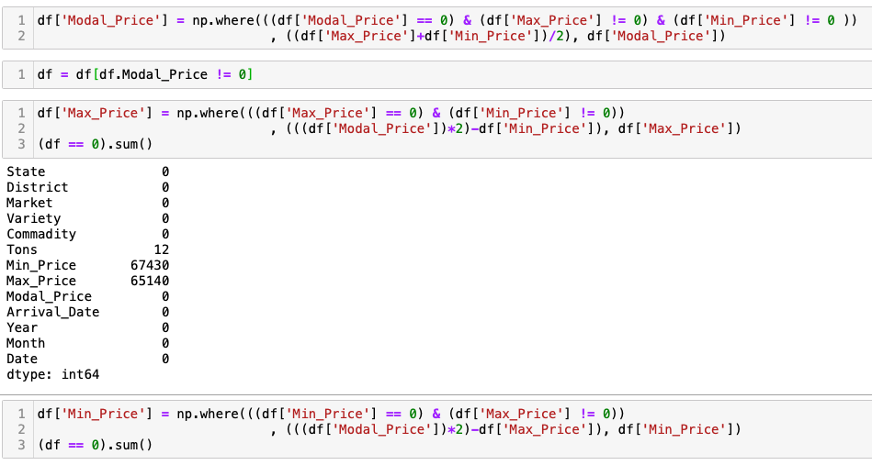
Tomato Price Forecast
Preprocessing Data
Replacing Null values with accurate values

Slide 9
Tomato Price Forecast
Data Analysis:

Slide 10
Tomato Price Forecast
Data Analysis:

Slide 11
Tomato Price Forecast
Data Analysis:

Slide 12
Tomato Price Forecast
Data Analysis:

Slide 13
Tomato Price Forecast
Data Analysis:

Slide 14
Tomato Price Forecast
Data Analysis:(correlation)

Slide 15
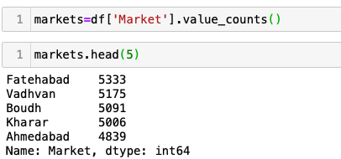
Tomato Price Forecast
Data Selection for Model:
As the data is for 1378 markets, we have decided to forecast for 1 market, and the same ideology can be used for other markets.
Selection of one market is done by considering the market which have many samples in the data.
Fatehabad has highest values - so it is considered

Slide 16
Tomato Price Forecast
Fatehabad Modal price vs Year vs Month
From the chart it is clear that most of the values in 2017 are missing and as it won’t be appropriate to use it we have moved to next market with highest values Vadhvan

Slide 17
Tomato Price Forecast
Vadhvan Modal price vs Year vs Month

Slide 18
Tomato Price Forecast
Vadhvan Modal price vs Month

Slide 19
Tomato Price Forecast
Vadhvan Tons vs Year vs Month

Slide 20
Tomato Price Forecast
Vadhvan: Tons vs Month

Slide 21
Tomato Price Forecast
Solution (Model)
As Tomato is a seasonal vegetable and also from the above charts we can see the data is seasonal , this data is time series so the best model to fit the data is SARIMA
SARIMA-Seasonal Autoregressive Integrated Moving Average
Testing the model by splitting the data to test and train data
Fitting the train data set to the model with seasonality 365

Slide 22
Tomato Price Forecast
Sarima: autocorrelation_plot

Slide 23
Tomato Price Forecast
Sarima:
grid plot
Dot plot

Slide 24
Tomato Price Forecast
Sarima distplot(histogram)

Slide 25
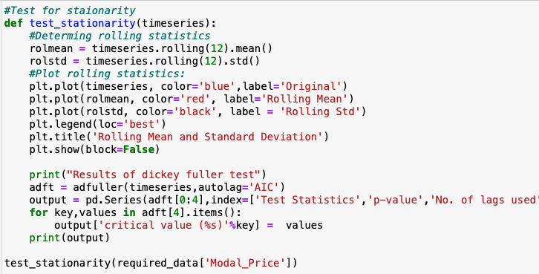
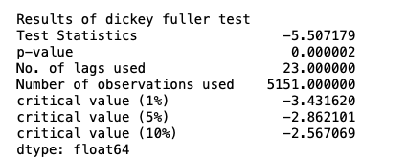
Tomato Price Forecast
Sarima
Checking if data is stationary to find d (difference) using dickey fuller test

Slide 26
Tomato Price Forecast
Sarima
Zero difference chart
Data is not stationary

Slide 27
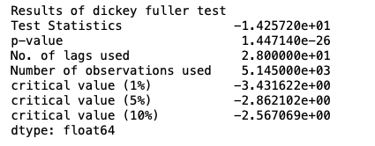
Tomato Price Forecast
Sarima
First differencing
Data is stationary hence d=1

Slide 28
Tomato Price Forecast
Sarima Seasonal Decomposition

Slide 29
Tomato Price Forecast
Sarima data Splitting

Slide 30
Tomato Price Forecast
Acf autocorrelation and Pacf Partial autocorrelation for stationary data
p=1
q=1

Slide 31
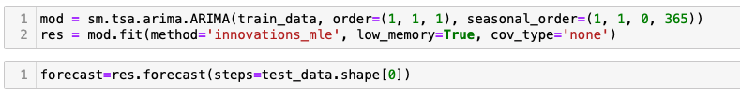
Tomato Price Forecast
Sarima
We have done 2 modals
Without exogenous values only endogenous values.
Considering exogenous values
Without exogenous values only endogenous values.
Training Modal Price and forecasting Modal Price for upcoming days

Slide 32
Tomato Price Forecast
Without exogenous values only endogenous values.

Slide 33
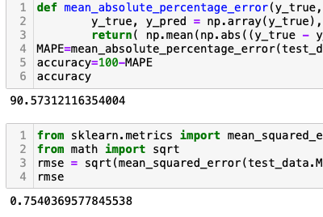
Tomato Price Forecast
Without exogenous values only endogenous values.
MAPE = 9.42
RMSE = 0.75
Accuracy = 100-MAPE =90.57

Slide 34
Tomato Price Forecast
Without exogenous values only endogenous values.
For Upcoming 30 days

Slide 35
Tomato Price Forecast
Considering exogenous values
Considering Modal Price as endogenous variable and Tons as an exog value as we have seen from correlation graph that both are correlated.
Training Modal Price and Tons for Modal and passing Tons of test data set for forecasting test Modal Price
For Forecasting future Modal Price ,as there is no data about Tons for future tons for future is forecasted using sarima and used to forecast modal Price

Slide 36
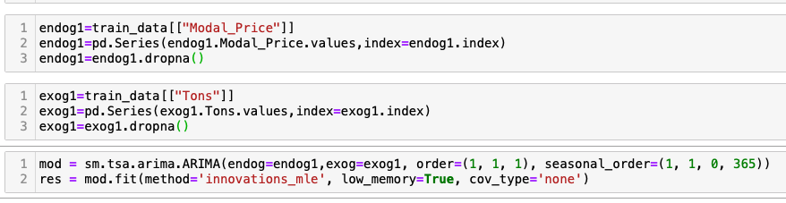
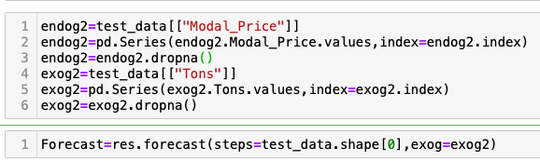
Tomato Price Forecast
Considering exogenous values

Slide 37
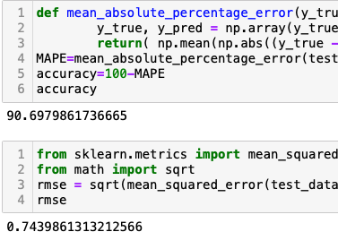
Tomato Price Forecast
Considering exogenous values
MAPE = 9.30
RMSE = 0.74
Accuracy = 100-MAPE =90.69

Slide 38
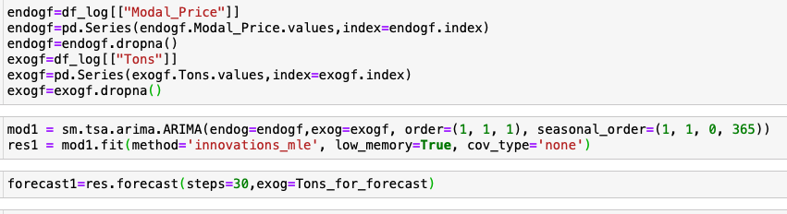
Tomato Price Forecast
Considering exogenous values

Slide 39
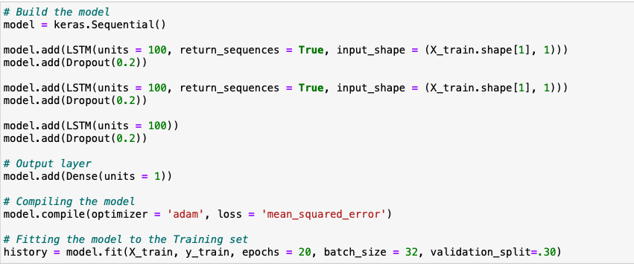
Tomato Price Forecast
Other Models that we tried LSTM
To predict the price from past 15 days

Slide 40
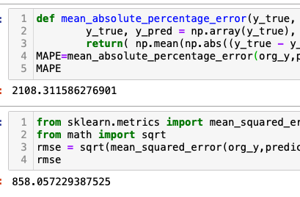
Tomato Price Forecast
LSTM

Slide 41
Tomato Price Forecast
LSTM
For Upcoming 30 days

Slide 42
Tomato Price Forecast
Further Works:
The SARIMA modal can be updated better by considering the other factors such as temp, rain , number of saplings planted which can lead to a better and a much more appropriate model.

