Slide 1
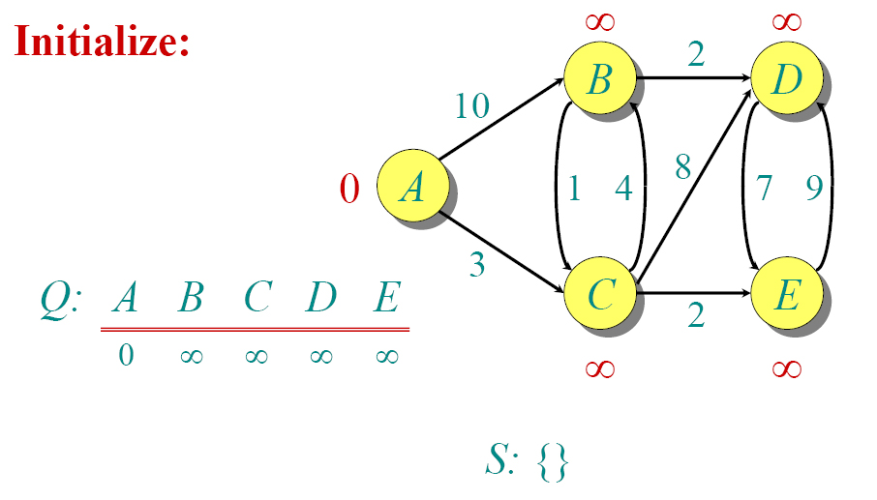
Dijkstra Animated Example

Slide 2

Dijkstra Animated Example

Slide 3

Dijkstra Animated Example

Slide 4

Dijkstra Animated Example

Slide 5

Dijkstra Animated Example

Slide 6

Dijkstra Animated Example

Slide 7

Dijkstra Animated Example

Slide 8

Dijkstra Animated Example

Slide 9

Dijkstra Animated Example

Slide 10

Dijkstra Animated Example

