Slide 1

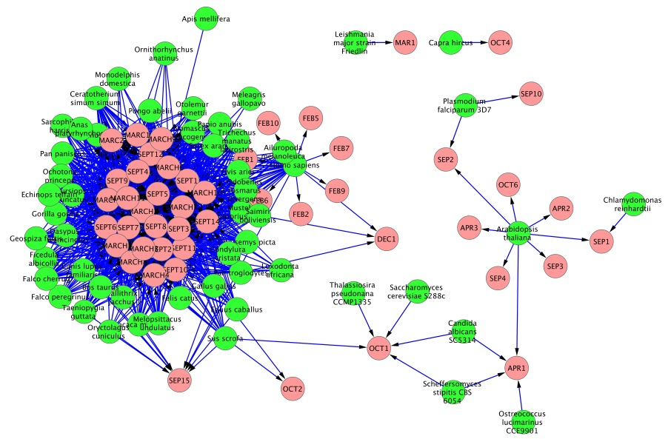
NCBI Gene
ftp://ftp.ncbi.nih.gov/gene//DATA/gene_info.gz
extract_TAXID_GENESYMBOL.sh
TAXID_GENESYMBOL.txt
7 | NEWENTRY
9 | repA1
1394141 | P384_gp1
tagcloud.R
TABLE.txt
3055 | Chlamydomonas reinhardtii | SEP1
3702 | Arabidopsis thaliana | SEP3
559292 | Saccharomyces cerevisiae S288c | OCT1
extract_TAXID.R
TAXID.txt
TAXID_GENESYMBOL.txt
9
33
1394141
9 | repA1
9 | repA2
1394141 | P384_gp1
make_TABLE.R
CytoScape
download.pl
TAXID_TAXNAME.txt
9 | Buchnera aphidicola
33 | Myxococcus fulvus
1353016 | Sclerotinia sclerotiorum endornavirus-1
Ensembl

