Slide 1
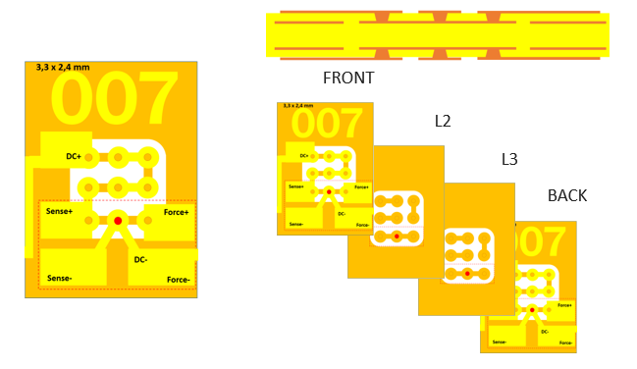
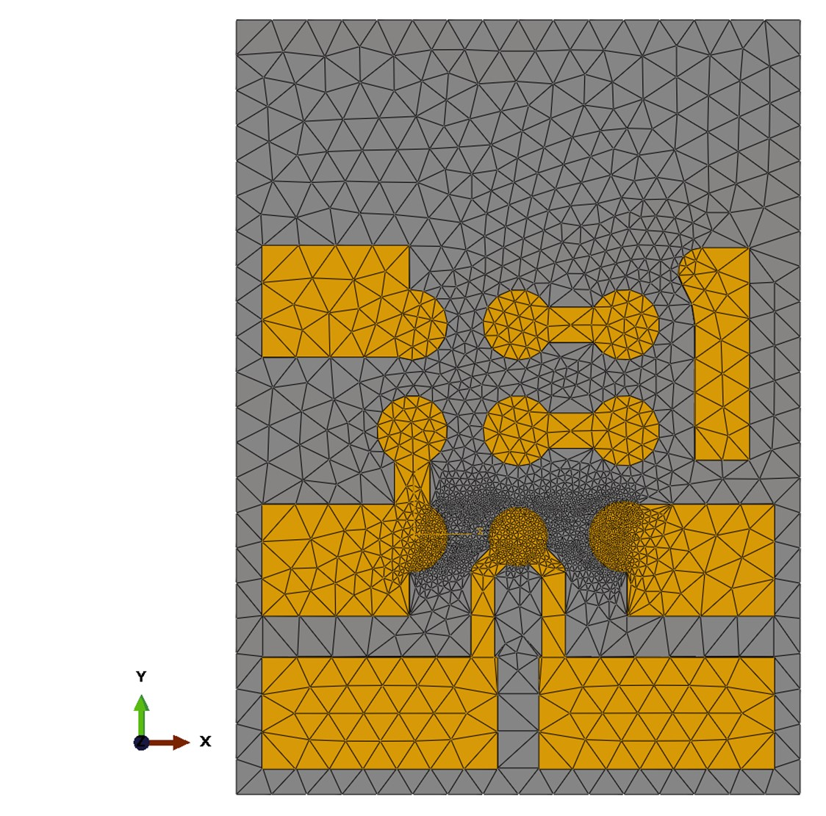
Simulation model of single-via coupon

Slide 2
Simulation model
Single-via coupon FWT1020
Simple 2 layer Single-Via coupon featuring 9 vias
Stochastic simulation approach considering process and product variations
Variation of parameters
Copper thickness
Dielectric thickness
Via diameters
Via positions in x/y
Via draft angle (difference top/bottom)
In total, variation of 30 different parameters per model
Via for resistance measurement

Slide 3
Simulation model
Modelling approach
3D solid; 114.147 lin. tet. elements of type DC3D4E
Coupled thermal-electric step (Nlgeom off)
Predefined temperature field: 20DegC
BC1 - Concentrated current: 1A
BC2 - Electric potential: 0V
Surface film condition:
Film coeff / W/(m²K) | Temp / DegC
0,005 | 20
0,01 | 50
0,02 | 100
0,045 | 200
0,08 | 300
BC2
BC1

Slide 4
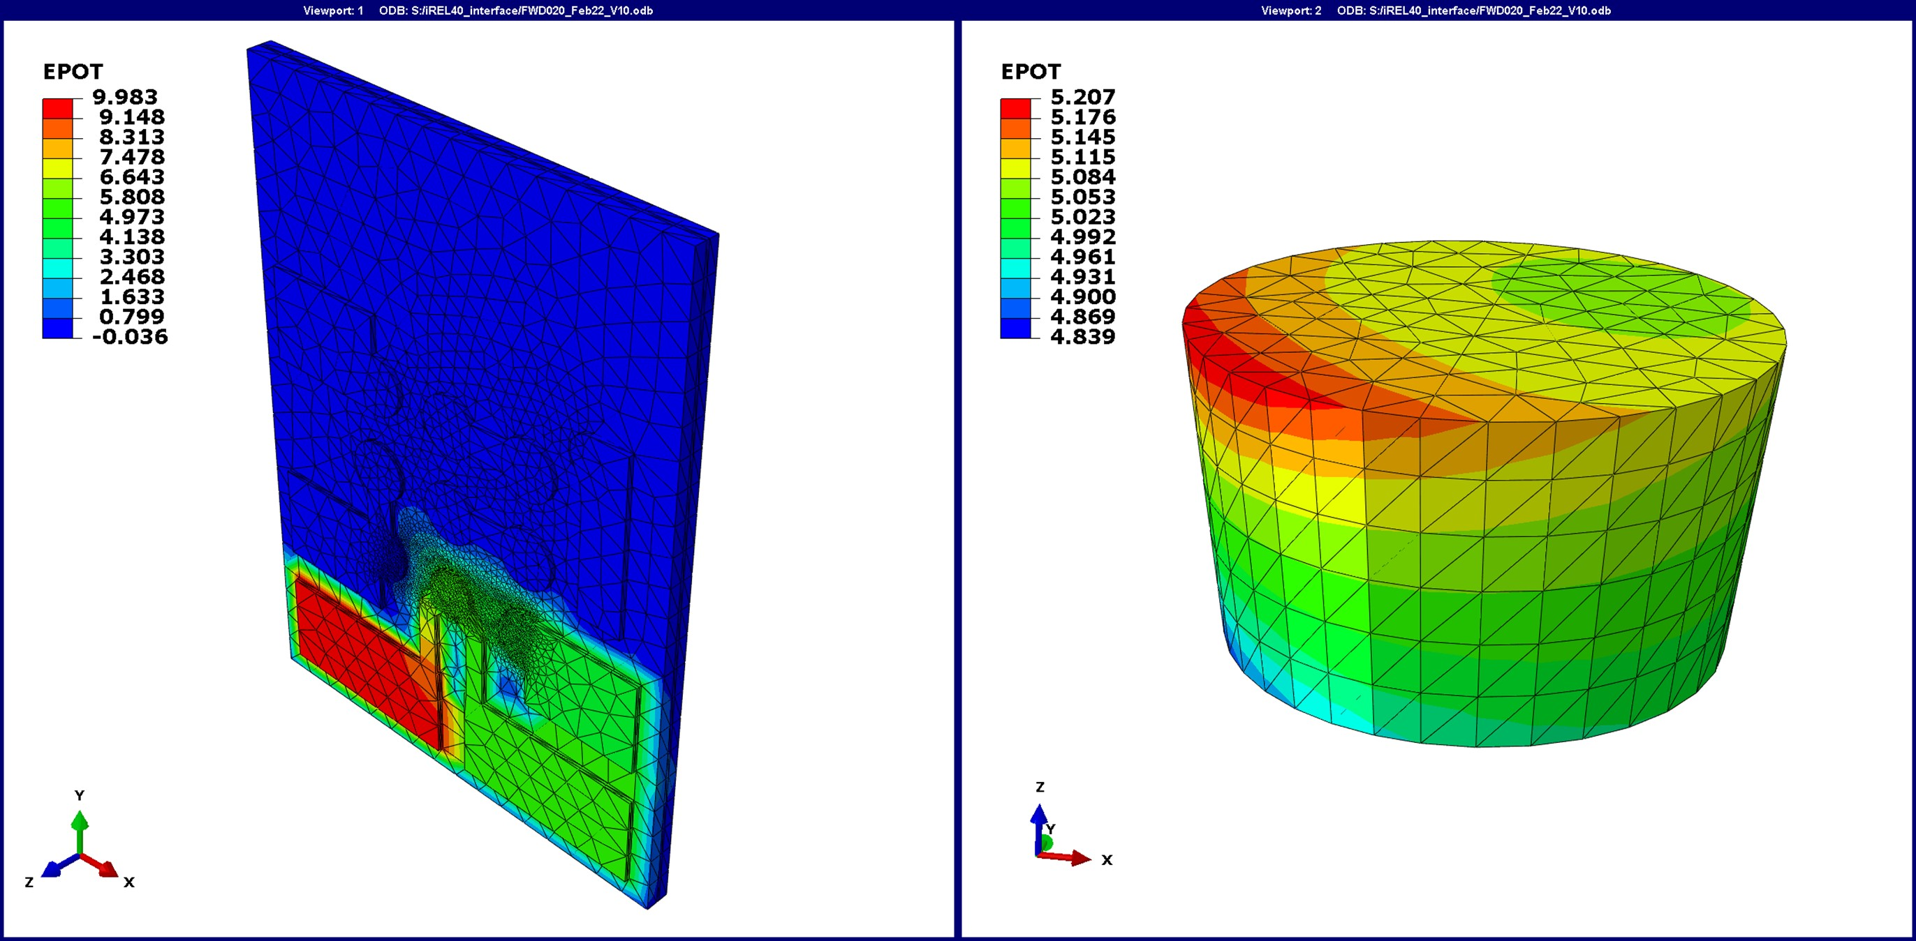
Simulation model
Modelling approach
Evaluation of voltage drop over whole via
Comparison to results of 4-wire measurements

