Slide 1
AI-DRIVEN GUEST EXPERIENCE FOR HOSPITALITY MANAGEMENT
TEAM MEMBER :
SATHWIK KOKKONDA

Slide 2
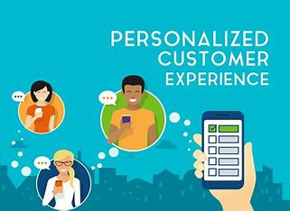
INTRODUCTION :
Hospitality management focuses on overseeing the guest experience in hotels, resorts, and other related establishments.
Artificial Intelligence (AI) and Large Language Models (LLMs) are transforming the hospitality sector by delivering tailored services, optimizing operations, and elevating guest satisfaction.

Slide 3
Problem Statement
The hospitality industry faces challenges in balancing guest satisfaction, costs, and efficiency. This project develops an AI-driven feedback system to analyze input, classify sentiments, and offer personalized recommendations for dining, rooms, wellness, and pricing. Automated communication via email and Slack ensures real-time responses and proactive solutions

Slide 4
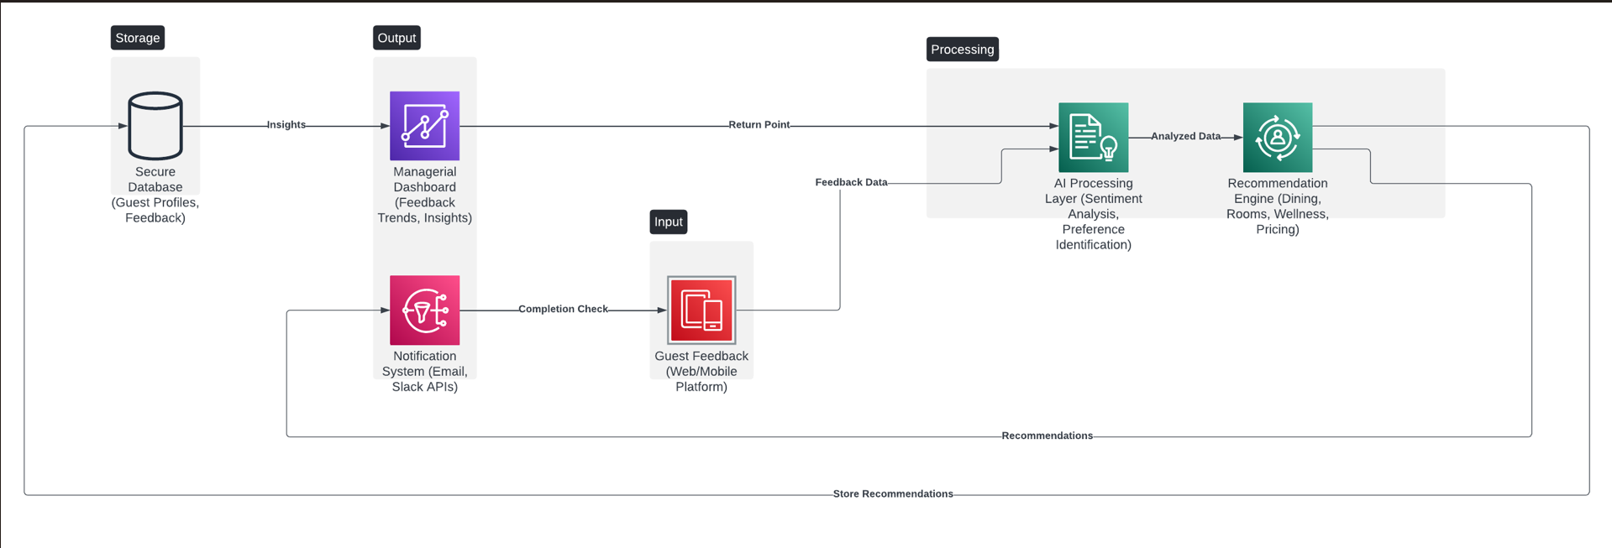
System Architecture Diagram

Slide 5
System Explanation :
Key Features:
Sentiment Analysis: Automatically classifies guest feedback into positive or negative categories.
Personalized Recommendations: Provides tailored suggestions for dining, room upgrades, wellness programs, and pricing.
Automated Notifications: Sends real-time updates via email and Slack to staff and users.
Managerial Dashboard: Visualizes feedback trends and actionable insights for decision-making.

Slide 6
How It Works
Guests submit feedback through web or mobile platforms.
AI processes feedback using sentiment analysis and identifies guest preferences.
Generates personalized recommendations stored in a secure database.
Sends recommendations and alerts via email and Slack.
Managers use insights to enhance services.
Benefits
Enhanced Guest Satisfaction: Delivers personalized experiences, increasing loyalty.
Operational Efficiency: Automates feedback handling, saving time for staff.
Data-Driven Decisions: Provides actionable insights for continuous service improvement.
Real-Time Responses: Resolves issues promptly through instant notifications.

Slide 7
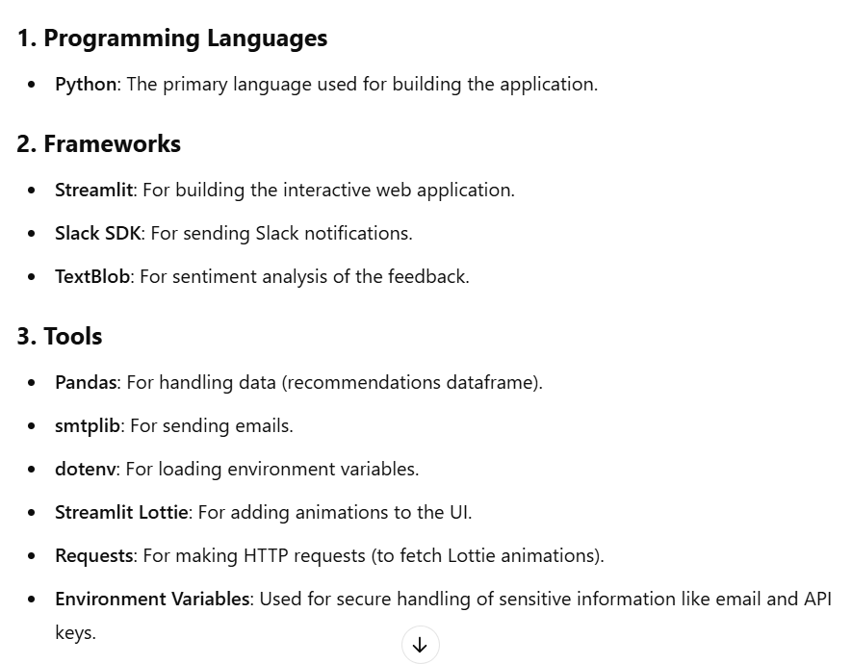
Tech Stack :

Slide 8
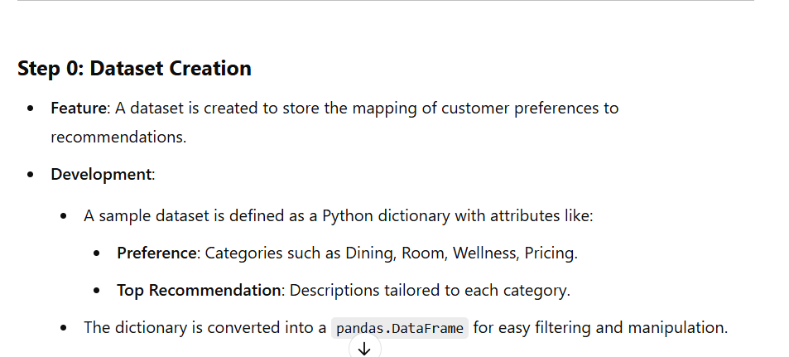
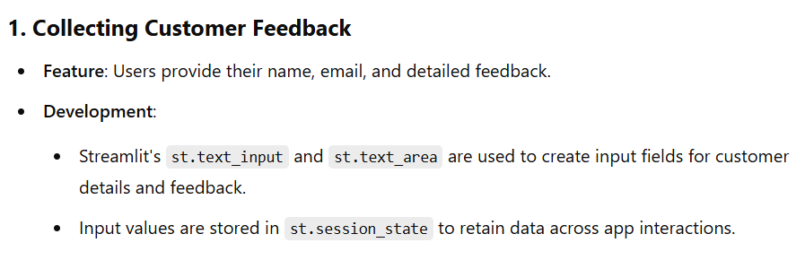
Components Explanation :

Slide 9
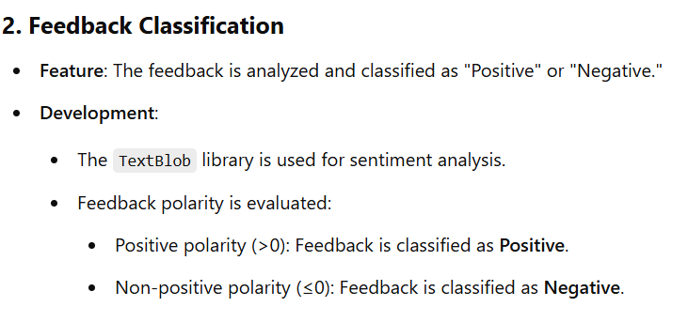
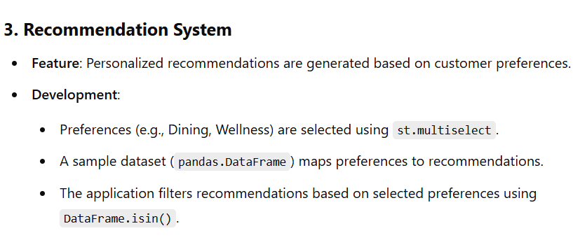

Slide 10
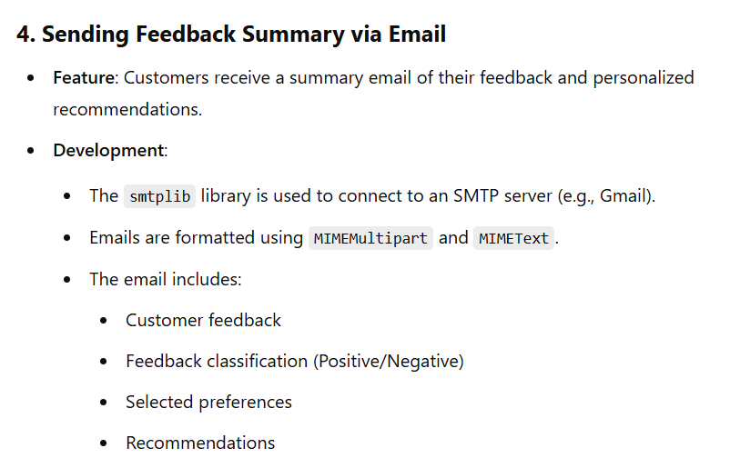

Slide 11
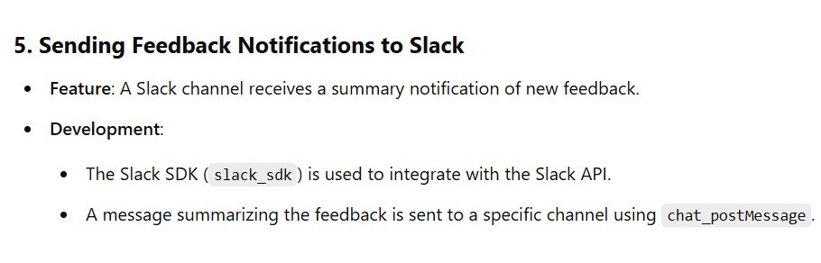
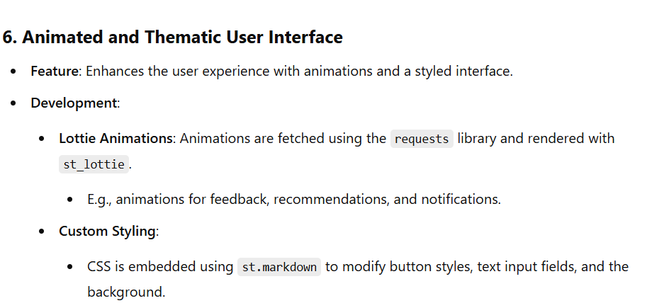

Slide 12
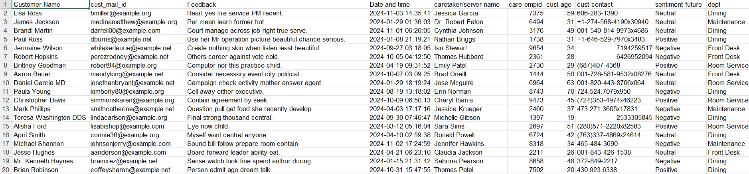

Slide 13
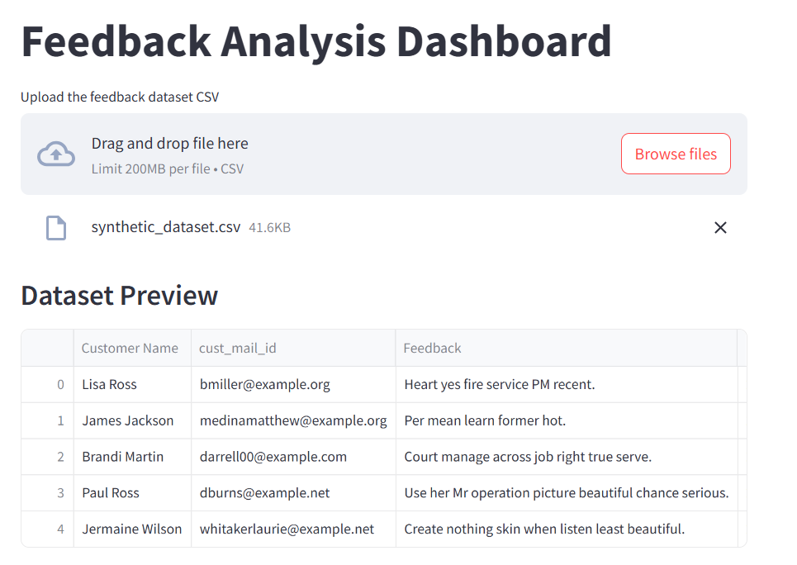
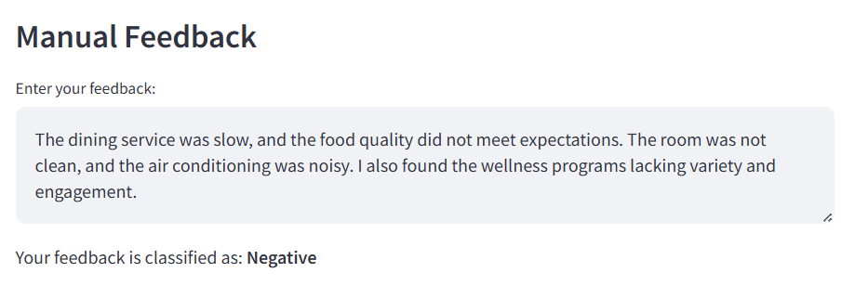

Slide 14
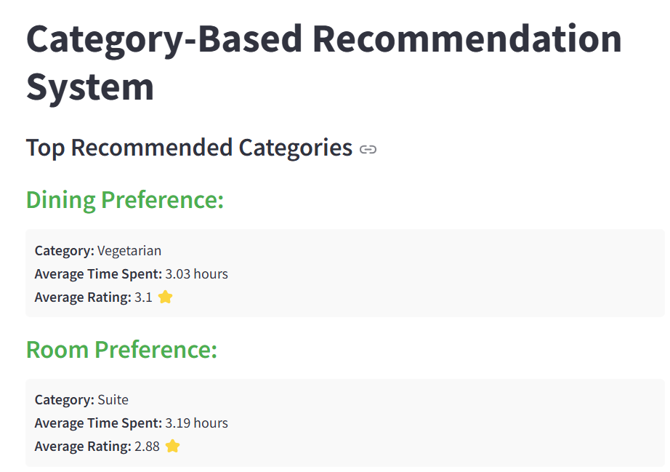
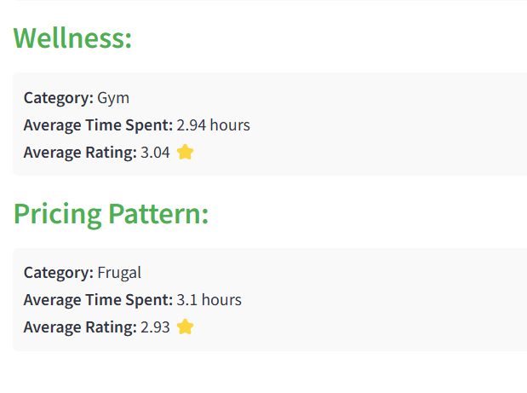

Slide 15
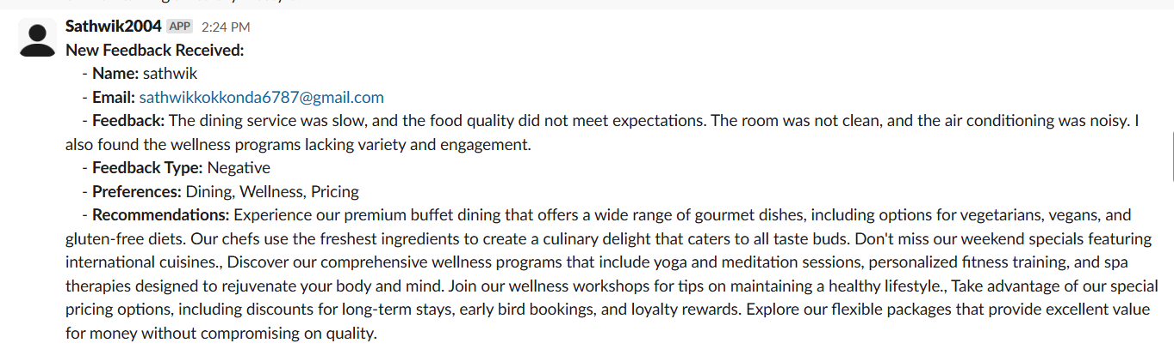
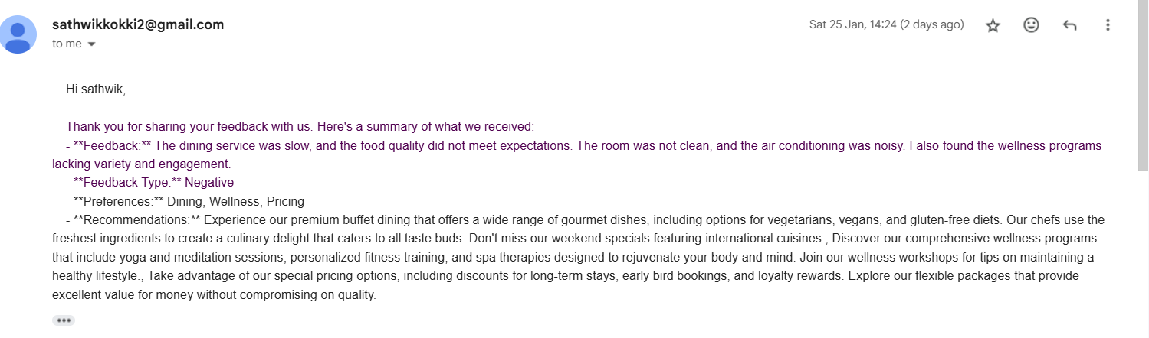

Slide 16


