Slide 1
EECS 4422 Garbage Classifier
Koko Nanahji

Slide 2
Overview:
1) Motivation
2) Context
3) Summary Of The Methods Used
4) Dataset Description
5) Evaluation Method
6) Demonstration
7) Restrictions

Slide 3
Main Motivation
Why garbage classification ?
Environmental Pollution.
Effective waste management infrastructure can help clean up the environment.
Effective waste management starts from the time that the object makes it to disposal.
There are tons of articles that stress the importance of garbage segregation. For example: Article, article.
However, separating waste into proper categories can be challenging.

Slide 4
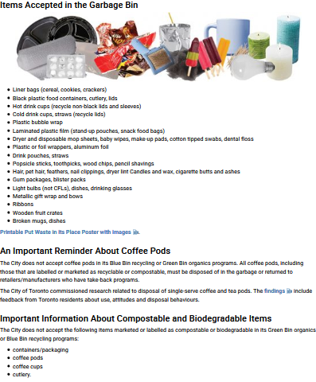

Slide 5
Context
The aim of this project is to develop an application that classifies garbage in a three-bin system for the garbage bins on the street.
Develop an object classification tool that is focused on objects that typically go in the garbage.
Such as apples and soda cans but does not need to classify other things such as rockets.
Additional requirements:
New hardware for garbage bins.
Capture an image of the object and feed the image to this application.
Drop the object into the correct bin based on the output from this application.
Note: There is a start-up company in Toronto that is basically trying to do this.
Link

Slide 6
Summary Of The Methods Used
Two main methods in development
Histogram of Oriented Gradients (HOG)
Support Vector Machines (SVM)

Slide 7
Histogram of Oriented Gradients (HOG)
1) Why use HOG ?
HOG gives us a feature vector for each image that can be used for image comparison.
2) How does HOG work ?
compute the gradient of the image in both x and y directions.
compute a histogram of oriented gradients for small patches of the image (using magnitude and orientation).
normalise the histograms (decrease sensitivity to overall lighting).
create the feature vector by combining all of the normalized histograms.

Slide 8
Support Vector Machines (SVM)
1) What is SVM?
Supervised classification method.
2) Why use SVM ?
Performed better than the other methods that I tired (KNN and Logistic Regression).
3) How does SVM work ?
Finds the hyperplane that has the largest distance to the nearest training data point of any class.
Since, in general the larger the margin (the distance from the hyperplane to the nearest training data point of any class), the lower the error of the classifier

Slide 9
The Dataset
This application is developed for three bin system
One bin for recyclables,
One bin for organics
One bin for non-recyclables.
I focused on classifying a few items only (due to time restriction).
Apple and banana in the organic category.
Cans and juice boxes in the recyclable category.
Light bulbs in the non-recyclable category.
Most of the dataset consists of real images and a few synthetic ones.

Slide 10
Evaluation Method
Cross Correlation on the available data.

Slide 11
Demo (hopefully goes well)

Slide 12
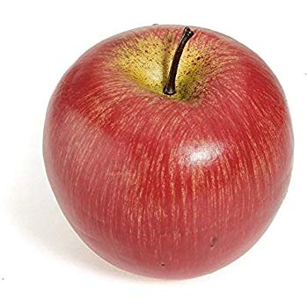
Restrictions
Scalability of the items.
Data shortage.
Although, It requires much less data compared to a CNN approach.
Difficulty of distinguishing similar objects without adding other features into the feature vector.
Difficulty of distinguishing between real and fake objects which could lead to classification errors.
For example, apple vs plastic apple
Possible solution could be to add other measurements such as weight

Slide 13
Future Work (Until The Deadline)
Add more images
Specifically images of deformed objects.

Slide 14
Any Questions ?

