Slide 1
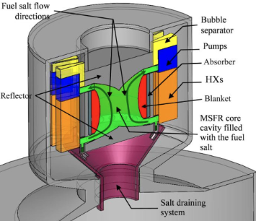
Coupling of Monte Carlo Neutronics with Two-Phase CFD for Molten Salt Fast Reactor Analysis in Realistic Geometry: Modeling Delayed Neutron and Decay Heat Precursor Drift
Research Proposal by Samuel Kokomoor

Slide 2
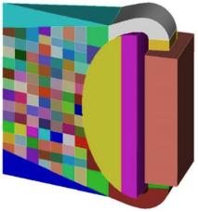
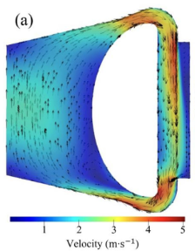
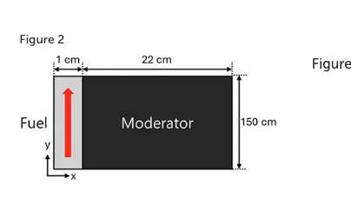
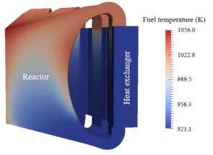
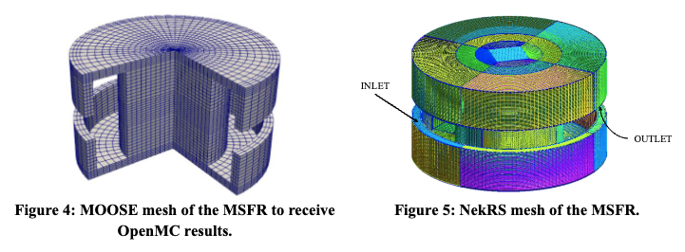
Background and Motivation
Current state-of-the-art MSFR simulations fail to capture closely-coupled neutronics and thermal-hydraulics interactions and their effects on core efficiency and safety
Deng et al. Couple OpenMC and OpenFOAM, but do no DNP, DHP, or Helium Bubbling Analysis.
Kim et al. Couple iMC and OpenFOAM and analyze spatiotemporal DNP & DHP drift, but only in two dimensions, simplified geometry, and incompressible flow.
Source: Deng et al., “Coupled simulation of the Molten Salt Fast Reactor using OpenFOAM and OpenMC,” Nucl. Sci. Tech., 2020.
Source: Kim et al., “Monte Carlo–CFD coupling for delayed neutron transport in MSRs,” Ann. Nucl. Energy, in press, 2025.
Cervi et al. demonstrated a one-way neutronics-CFD coupling approach using OpenFOAM and Serpent 2, but did not model DNP & DHP drift in a Monte Carlo solver, nor use continuous 2-way coupling to accurately capture neutronics-CFD interplay
Dalinger et al. demonstrated a high-fidelity MSFR simulation using Cardinal (OpenMC + NekRs), capturing convective transport of DHPs and DNPs, but did not model two-phase compressible flow or realistic geometry.
Source: Cervi et al., “Multiphysics analysis of the MSFR helium bubbling system,” Ann. Nucl. Energy, vol. 126, pp. 227–239, 2019.
Source: Dalinger et al., “High-fidelity transient simulation of the MSFR with OpenMC and NekRS coupling,” Proc. NURETH-21, 2025.

Slide 3
Proposed Research
The development of a closely-coupled, high-fidelity neutronics-CFD solver capable of:
Solving two-phase, bubbly, compressible flow
Simulating DNP & DHP drift in liquid fuel
Simulating realistic mesh-based geometries
Power Distribution Precursor Concentrations
OpenMC
CFD-Solver
K-eigenvalue Neutron Transport
Compressible Two-Phase Navier-Stokes + Heat Transport
Density Temperature Void Fraction
Update DHPs & DNPs
DHP, DNP Fields

Slide 4
Work Plan & Timeline*
Year 1- Coupling Infrastructure
Implement OpenMC-CFD Coupling Interface
Year 2 – Precursor Drift & 2-Phase Modeling
Add DHP & DNP dynamic location functionality to OpenMC, implement drift data passing from MFC
Year 3 – Validation & Transients
Perform validation and benchmarking against literature
Demonstrate steady-state single-phase calculations in complex geometry
Implement two-phase helium-salt modeling
Run realistic MSFR transient simulations
Conduct sensitivity analyses (e.g., flow, void fraction, material properties)
*Work plan modularized and adjustable to 2-4-year timeline depending on program/researcher scope. See proposal document for details

Slide 5
Deliverables
Coupled OpenMC–CFD Simulation Framework
Full integration of Monte Carlo neutronics with compressible, two-phase thermal-hydraulics in arbitrary mesh geometries, supporting exascale compute.
DNP & DHP Transport and Deposition Capability
Groupwise precursor advection–decay modeling with spatially resolved delayed neutron emission and decay-heat deposition.
End-to-End MSFR Simulation Functionality
Steady-state and transient operation with full neutronic–thermal–hydraulic feedback.
Sensitivity and Parametric Analysis Toolkit
Systematic evaluation of flow rate, void fraction, geometry, and thermal feedback effects on reactor performance and safety.

Slide 6
Sources
D. Zhao, L. Yan, T. Jiang, S. Peng, and B. Yue (2022). "Multiphysics Simulation Study of the Electrorefining Process of Spent Nuclear Fuel from LiCl-KCl Eutectic Molten Salt." Journal of The Electrochemical Society, 169(7), 046520.
B. Deng, Z. Zhang, Y. Liu, et al. (2020). "Core and blanket thermal–hydraulic analysis of a molten salt fast reactor based on coupling of OpenMC and OpenFOAM." Nuclear Science and Techniques, 31:85.
D. Gérardin, M. Allibert, D. Heuer, A. Laureau, E. Merle-Lucotte, and C. Seuvre (2017). "Design Evolutions of the Molten Salt Fast Reactor." Proceedings of the International Conference on Fast Reactors and Related Fuel Cycles (FR17), Yekaterinburg, Russia.
E. Cervi, S. Lorenzi, A. Cammi, and L. Luzzi (2019). "Development of a multiphysics model for the study of fuel compressibility effects in the Molten Salt Fast Reactor." Chemical Engineering Science, 193, 379–393.
M. Dalinger, E. Merzari, S. Lee, and C. Emler (2025). "High-Fidelity Modelling of the Molten Salt Fast Reactor." Proceedings of NURETH-21 (21st Int. Topical Meeting on Nuclear Reactor Thermal Hydraulics), Paper 2507.
H. Kim, J. Smith, L. Chen, and R. Alvarez (2025). “Monte Carlo–CFD Coupling for Delayed Neutron Transport in MSRs.” Annals of Nuclear Energy, in press.

