Slide 1

Un-manned Vehicle : Following System
Vincent Mary School of Engineering
ThanHtutAung 5618361
KoKoMyoHeinHtet 5558323

Slide 2
Introduction
Vehicle based on Arduino platform and Raspberry Pi
Object detection system.
The object is detected and followed by the vehicle
It is named as “Un-manned Vehicle: Following System”.
Camera module and ultrasonic sensor are installed in this system.

Slide 3
Objective
The object is detected by Camera Module from received image .
The distance is fixed by installation of ultrasonic sensor.
The system will be calculated when camera module detect the object.
The vehicle will move forward and backward in straight line.

Slide 4
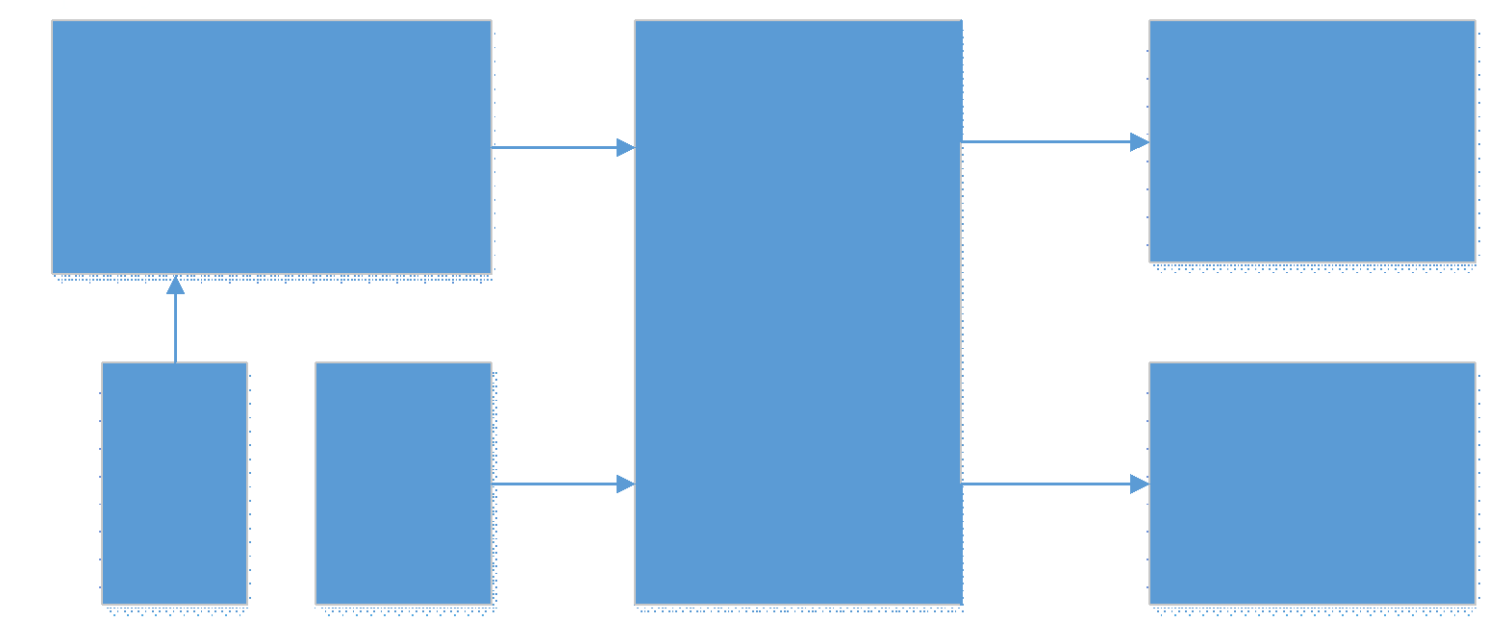
Overview of our project
Block Diagram

Slide 5
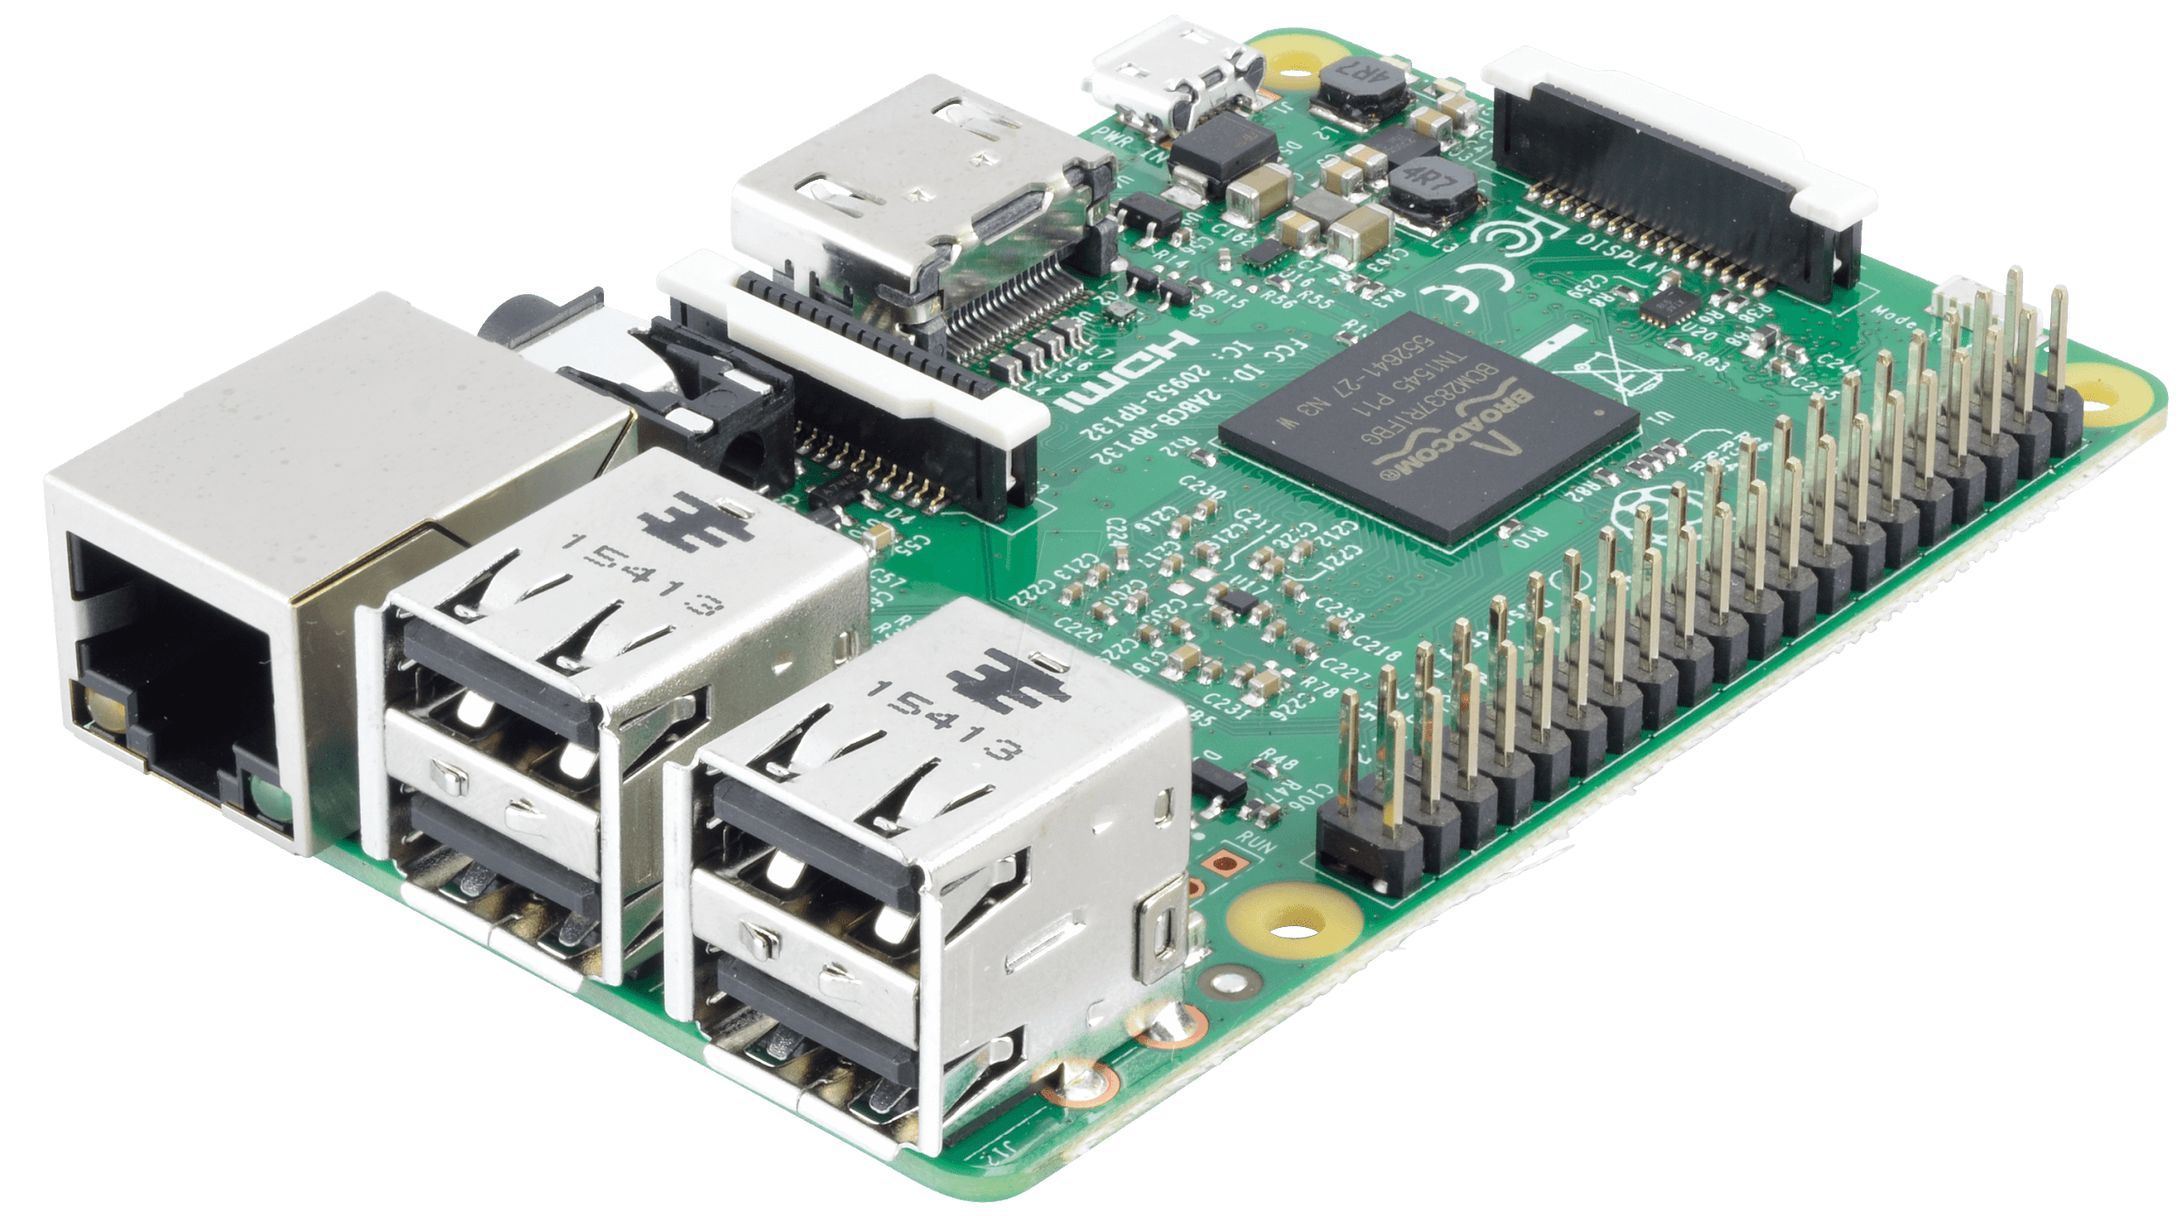
Controller Master Controller (Raspberry Pi)
SOC: Broadcom BCM2837 (roughly 50% faster than PI2)
CPU: 1.2 GHZ quad-core ARM Cortex A53 (ARMv8 Instruction Set)
GPU: Broadcom VideoCore IV @ 400 MHz
Memory: 1GB LPDDR2-900 SDRAM
USB ports: 4
Network: 10/100 MBPS Ethernet,802.11n Wireless LAN,
Bluetooth 4.0
Detect object
Transmit UART Signal
https://downloads.flytbase.com/flytwebsite/2017/04/RASP_03_01.png

Slide 6
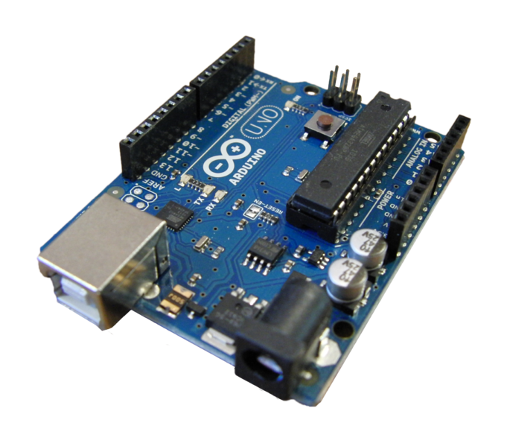
Controller Slave Controller (Arduino UNO R3)
Microcontroller:Atmega328p
Input Voltage (recommended);7-12V
Slave controller to control motors.
Also maintain a space between object.
Used PWM to control motor speed.
PWM Digital I/O Pins.
https://commons.wikimedia.org

Slide 7
Power Supply Signal Power Supply
9V DC Power Supply to Arduino Uno R3 is enough
7 to 12 V DC Power Supply to Raspberry Pi
Both controllers have common ground
To TX and RX UART Signal

Slide 8
Power Supply Actuator Power Supply
DC Motor Driver need different Power Supply
Interfere signals occurs to Controllers
5V for Driver Chip from Arduino UNO R3
5 to 35V Supply for Motors

Slide 9
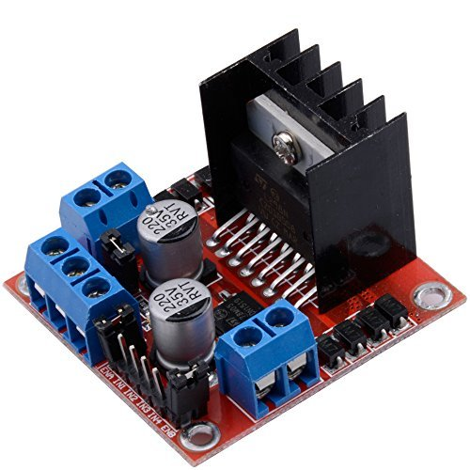
Actuator (Driver & Motor) DC Motor Driver
L298N Dual H bridge Motor Driver
Control 2 motors of the wheel
Support PWM
PWM control the duration of an electronic pulse.
http://artofcircuits.com/product/l298n-motor-driver-board

Slide 10
Actuator (Driver & Motor) DC Motor
Two DC Motors are attached beside the wheels.
DC Motors are driven by the dual H Bridge DC driver (L298N).
Vehicle’s wheels are driven by the DC motor.
5-35V power supply to DC motor.

Slide 11
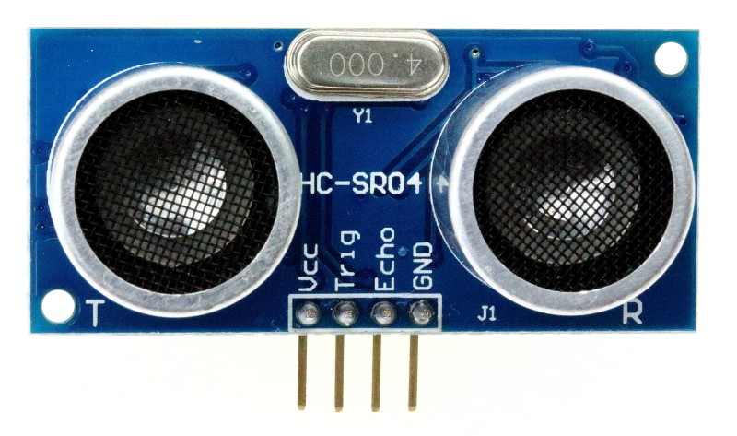
Sensors (Ultrasonic Sensor)
Ultrasonic Sensor HC-SR04.
The distance is measured by Ultrasonic Sensor.
Connected with Arduino Uno R3.
https://www.aimagin.com/hc-sr04-ultrasonic-sensor.html

Slide 12
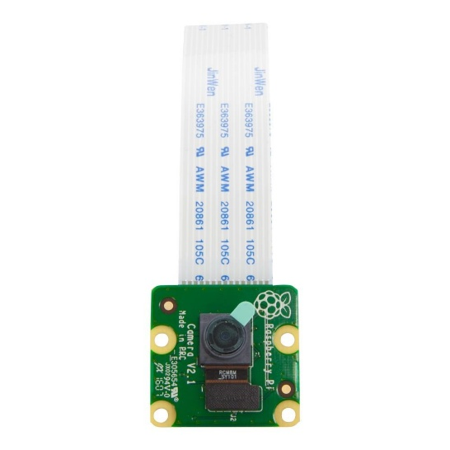
Camera Module
Raspberry Pi Camera Version 2.1.
Is used to catch the object.
Is connected to Raspberry Pi camera’s slot (CSI port).
Supports 1080p30, 720p60 and 640 x 480p90 video.
http://innovo-lb.com/openkits/product/raspberry-pi-camera-module/

Slide 13
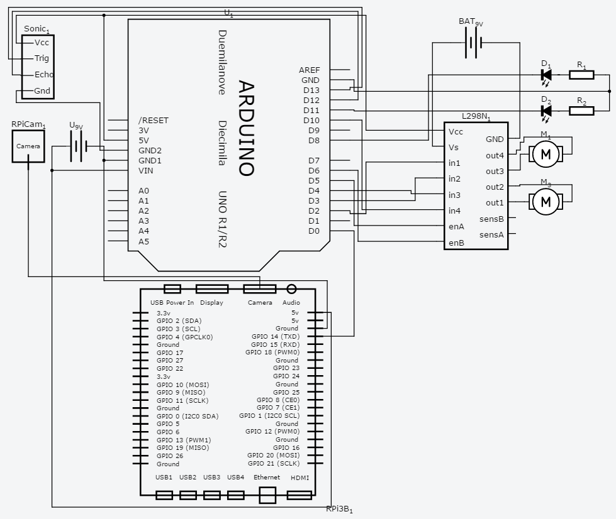
Circuit Connection

Slide 14
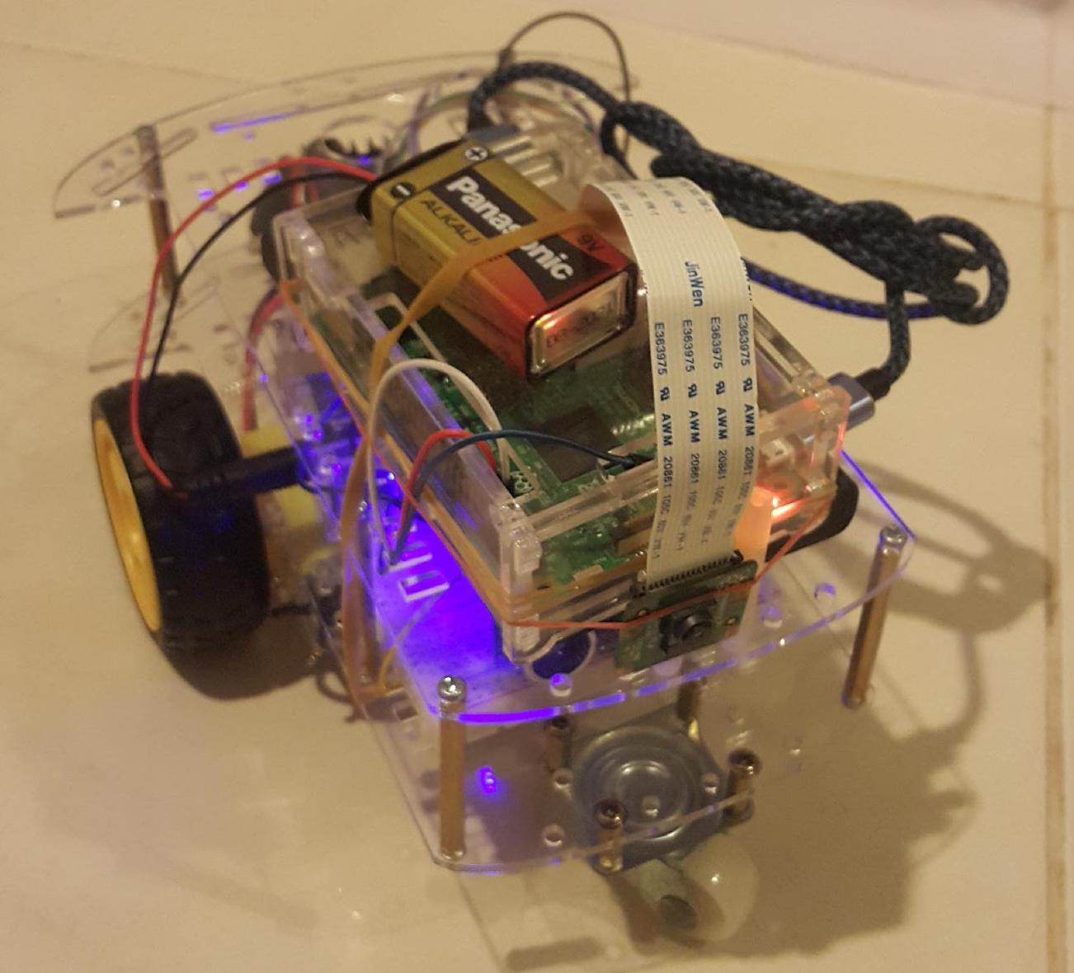
Project’s Hardware

Slide 15
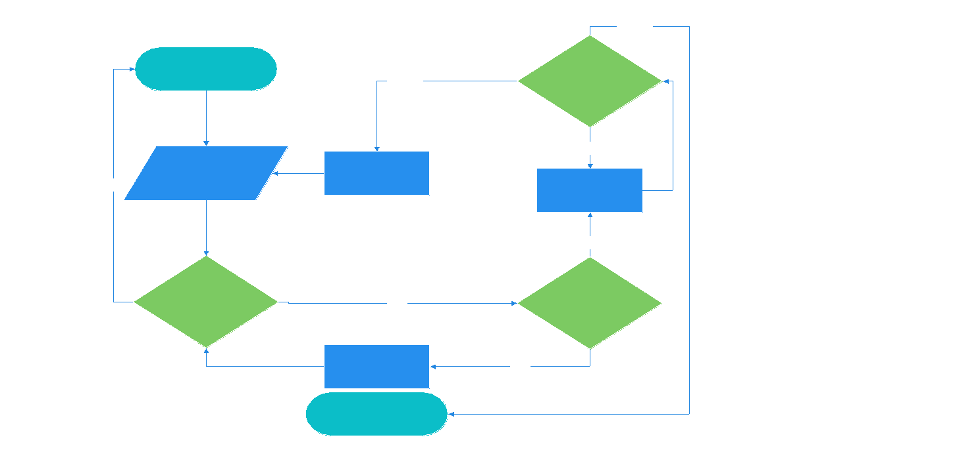
Flow Chart

Slide 16
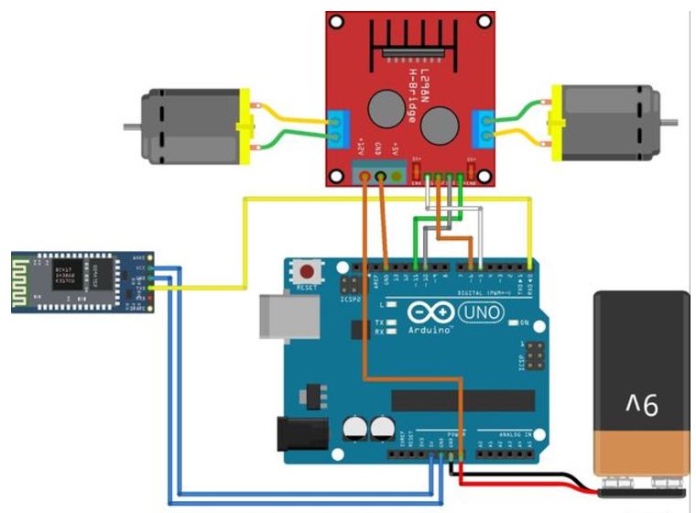
Experiments and Results Experiment 1
Built mini project
Was Arduino Bluetooth RC Car.
Arduino Uno
Robot platform
L298N Motor Driver
HC-06 Bluetooth module
9V battery
Android device

Slide 17
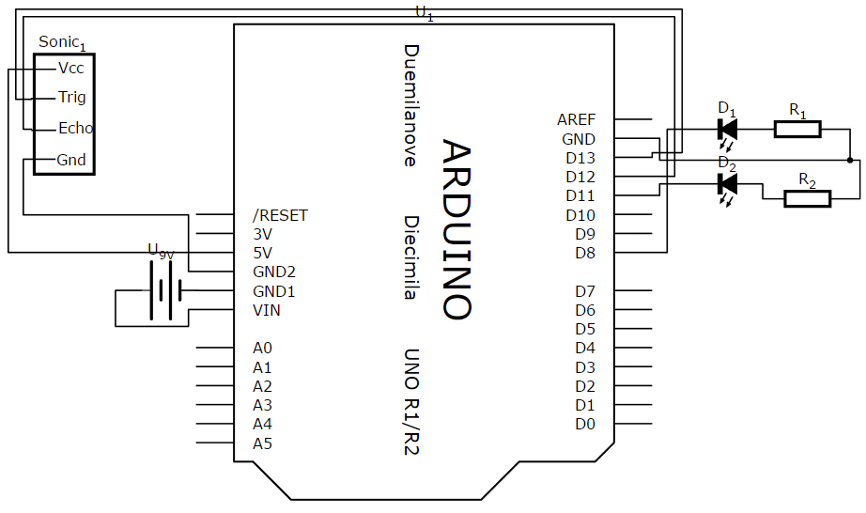
Experiment 2
Tested Ultra sonic sensor with Arduino
Arduino Uno
Ultrasonic Sensor HC-SR04
9V Battery
2LEDs
2x 1kΩ Resistors

Slide 18
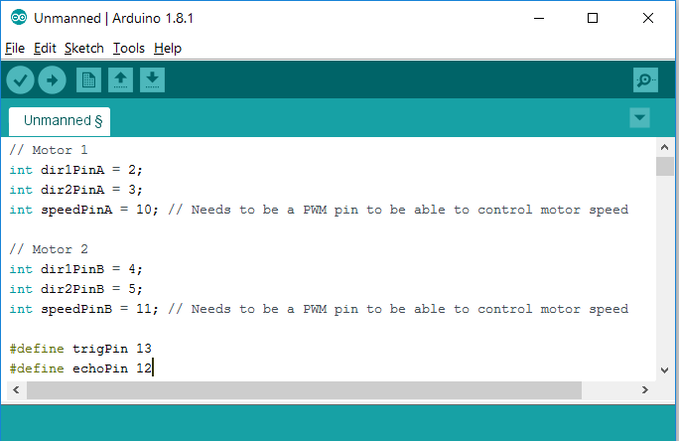
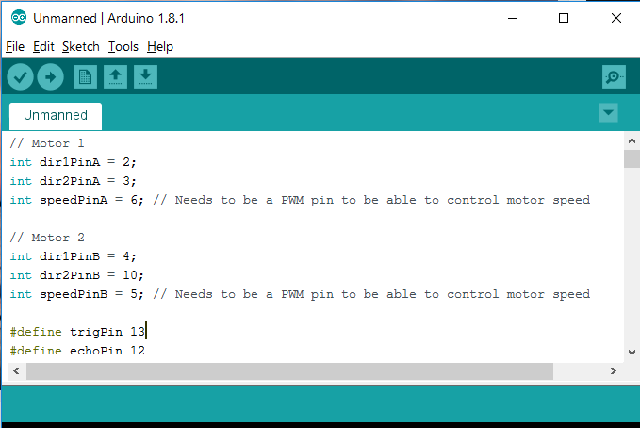
Experiment 3
Wrong PWM frequency (f=100Hz)
Changed it to be f=1kHz PWM

Slide 19
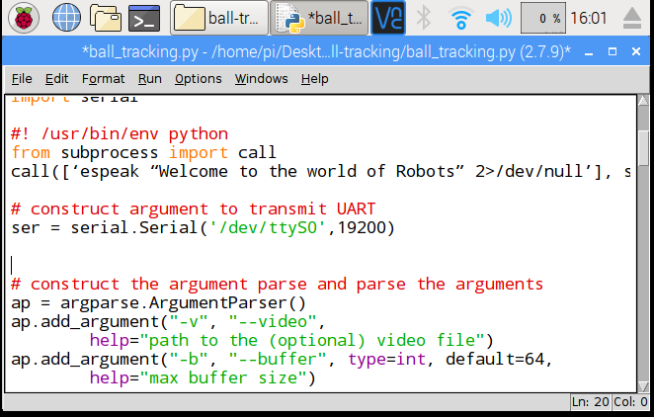
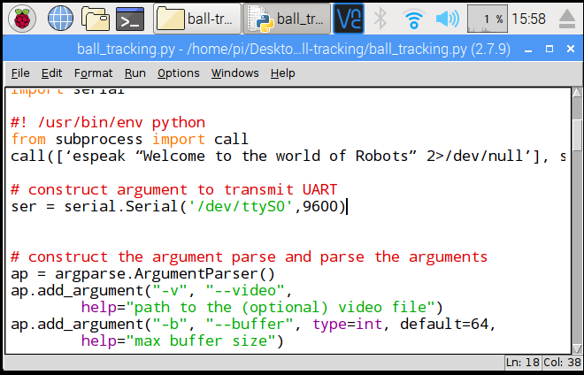
Experiment 4
Tried to detect the wanted object on Raspberry Pi.
Sent signal to Arduino by UART communication.
It was wrong signals from Raspberry Pi.
Wrong baud rate.

Slide 20
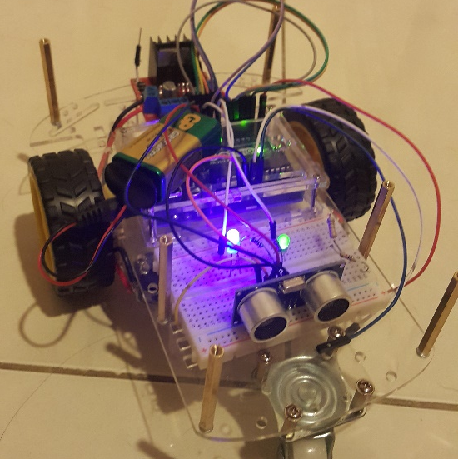
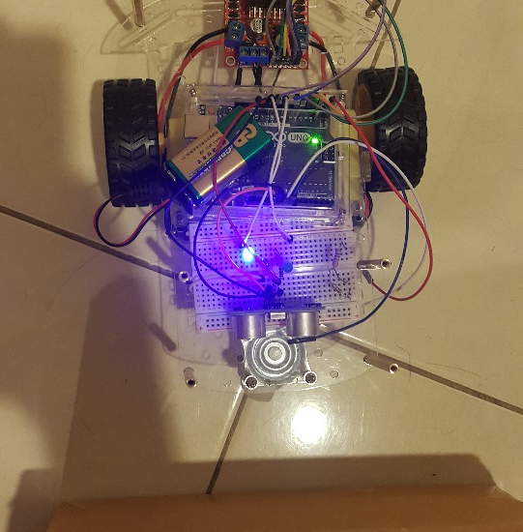
Experiment 5
Distance more than 30 cm, one LED is on.
Distance less than 30 cm, another LED is on.
When vehicle stop, both LEDs will on.

Slide 21
Application -Tracker for police
Can be used in Police station
Detect and track suspected vehicle’s register number
Follow that vehicle
Report location
Stream Live Videos

Slide 22
Conclusion
Mainly focus on the detecting object and following the object.
Yellow ball to be detected and followed.
Using Raspberry Pi3, Camera module, Arduino UNO R3, Sensor HC-SR04, Driver L298N and Gear motors 48:1.
Learnt a lot of experiences concerns with Arduino and Pi and how to use components on Arduino..
Learnt how to troubleshoot the problems
Learnt to use Raspbian OS based on OS designed for Pi.

Slide 23
THANK YOU

