Slide 1
Introduction to Ansible

Slide 2

What is Ansible?

Slide 3
What is Ansible?
How to install something on a remote machine?
You
SSH
Remote
Machine

Slide 4
What is Ansible?
How to install something on 20 remote machines?
Machine
Machine
Machine
Machine
You
Machine
Machine
Machine
Machine
SSH
Machine
Machine
Machine
Machine
Machine
Machine
Machine
Machine
Machine
Machine
Machine
Machine

Slide 5
What is Ansible?
How to install something on 20 remote machines running different OS?
Win
Mac
Ubuntu
CentOS
You
Win
Mac
CentOS
CentOS
SSH
CentOS
Win
Mac
Win
CentOS
Mac
Win
Ubuntu
CentOS
CentOS
Ubuntu
Ubuntu

Slide 6
What is Ansible?
IT automation tool
Uses OpenSSH (and more) for transport
YAML configurations
Human readable
Easy to understand
Idempotent, which means it produces the same result every time it runs.

Slide 7
Ansible basics - Setup
Ansible + Docker to deploy a full Elastic stack using Docker playground
https://labs.play-with-docker.com/
Throughout this lab, if something does not work, retry. It always works.
Cannot create instances? Close session and retry.
Download/Extract takes too long? Ctrl+C and retry.
Create 5 instances (click the wrench, create 5 managers)
Clone https://tinyurl.com/ansible-sample
git clone https://tinyurl.com/ansible-sample
Cd inside and run run.sh
cd ansible-sample && bash run.sh

Slide 8
Ansible basics - Setup
Docker playground machines don’t have apt-get, so we will run Ansible and the stack on Docker containers.

Slide 9
Ansible basics – Installation
Ansible is supported almost on any systems with Python and sshpass, except for Windows.
To install Ansible on Ubuntu, use apt-get
apt-get install ansible

Slide 10
Ansible basics – Inventory
Ansible takes a list of hosts, SSH to each host (or WinRM if host is Windows), executes a list of tasks on the host.
The list of hosts is called an inventory, usually defined in /etc/ansible/hosts
To make Ansible reusable, we will define the hosts in our own folder.
Cd to ansible
cd ansible

Slide 11
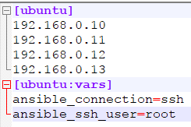
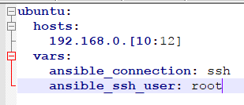
Ansible basics – Inventory
Add hosts (can be seen from the instances) to ./hosts
vim hosts
Indentation matters in YAML!
Some more important variables:
ansible_ssh_pass: ssh password to access host
ansible_become_pass: super user password
in case some commands need elevated access
ansible_port: ssh port in case it's not the standard port 22
INI
YAML

Slide 12
Ansible basics – Inventory
Add the inventory path to Ansible config file ./ansible.cfg
echo [defaults] >> ansible.cfg
echo inventory = ./hosts >> ansible.cfg
echo host_key_checking = False >> ansible.cfg
Test that your hosts can be reached by pinging them
ansible all –m ping
You can also execute shell commands with –m shell –a COMMAND
ansible all –m shell –a “echo Hello”

Slide 13
Ansible basics – Organization
Running dozens of non-reusable Ansible commands is not the recommended way to do automation.
Ansible can be used to run:
Individual commands
Tasks, which consist of commands
Roles, which consist of tasks, the variables a task can use, extra files, templates, handlers
Playbooks, which generally consist of only roles but can have commands, variables, or anything
The recommended structure/workflow is to write reusable roles which have many small and manageable tasks, then use the roles in a playbook.

Slide 14
Ansible basics – Roles
A role usually takes care of a small function, e.g. install Elasticsearch on Ubuntu, install nginx on Mac, factory restore a Windows machine, etc.
Role structure:
tasks - contains the main list of tasks to be executed by the role
defaults - default variables for the role (always imported in a role)
handlers - contains handlers, which may be used by this role or even anywhere outside this role
vars - other variables for the role (can be imported by users)
files - contains files which can be deployed via this role
templates - contains templates which can be deployed via this role
meta - defines some meta data for this role
Usually, only the first two directories are important. So we will continue this lab with only those two components.

Slide 15
Ansible basics – Role variables
Cd to the role
cd roles/ansible-role-metricbeat
First, let’s take a look at how Docker will start a Metricbeat container
vim tasks/metricbeat-docker/Dockerfile.j2
Now we need to declare the variables in ./defaults/main.yml
vim defaults/main.yml
Solution:

Slide 16
Ansible basics – Role tasks
To install Metricbeat to a host, we need to copy the necessary files for Docker to the host, then use Docker to start a Metricbeat container.
So we will create two tasks: setup.yml and deploy.yml
Let’s start with setup.yml
vim tasks/setup.yml

Slide 17
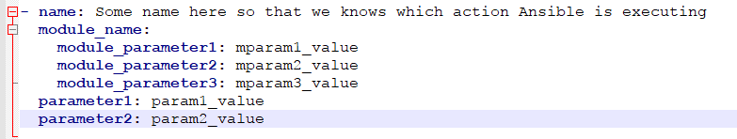
Ansible basics – Role tasks
A task consists of multiple actions, each action roughly has this format:
Now we need 4 actions to setup the necessary files.

Slide 18
Ansible basics – Role tasks
Important modules and parameters (required params are underlined):
file: Set file/directory attribute
path, owner, group, mode, state
copy: Copy file/directory from Ansible machine to remote host
src, dest, owner, group, mode
template: Like copy but processed by the Jinja2 templating language. In other words, it inserts variables into a template before copying it to the remote machine.
src, dest, owner, group, mode
raw: Quick and dirty way to directly execute a shell script
service: Manage a service
name, enabled (yes/no), state (started/stopped/…)
yum/apt: Manage a package with yum/apt depending on system.
name, state (absent/installed/latest/…)
More modules can be found in Ansible documentation.

Slide 19
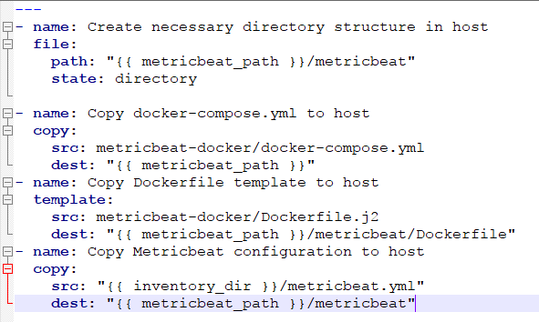
Ansible basics – Role tasks
Hint:
You will need file, copy and template.
You have to create the necessary directory structure first.
Modules and important parameters:
file: Set file/directory attribute
path, state: directory
copy: Copy file/directory from Ansible machine to remote host
src, dest
template: Insert variables into a template before copying it to the remote machine.
src, dest
Solutions

Slide 20
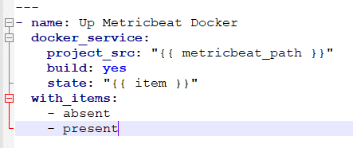
Ansible basics – Role tasks
Now that we have all the files needed to set up a Docker container, let’s continue to deploy.yml
vim tasks/deploy.yml
We will need the module docker_service for this. We also need to take down the containers before setting them up again
docker_service:
project_src: Directory that contains docker-compose.yml
build (yes/no): Build image before starting the application?
state (absent/present):
absent is like docker-compose down
present is like docker-compose up
Solutions
Loops can be used for shorter tasks.

Slide 21
Ansible basics – Role tasks
Now that we have the two tasks, we need to include them in main.yml

Slide 22
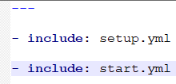
Ansible basics – Role tasks
Now we need to include the two defined tasks in main.yml
vim tasks/main.yml
We will need the module include for this
include: TASK_PATH
There is no parameter for include, just plain “include: path/to/task.yml”
Solutions

Slide 23
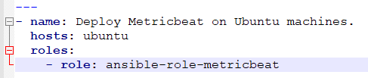
Ansible basics – Playbooks
You are done! Now, cd back to /ansible, import the role into a playbook and run it.
cd ../..
vim playbook.yml

Slide 24
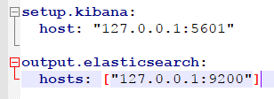
Ansible basics – Playbooks
Before we can run our playbook, let’s change the Elasticsearch and Kibana host to the correct one.
vim metricbeat.yml
Run the playbook
ansible-playbook playbook.yml

