Slide 1

Netflix Stock Profile
Paulina Kossowska

Slide 2
The presentation contains 4 visualizations
A visualization of the distribution of the stock prices for Netflix in 2017
A visualization and a brief summary of their earned versus actual earnings per share
A visualization and a summary of Netflix stock and revenue for the past four quarters and a summary
A visualization of Netflix stock against the Dow Jones stock in 2017

Slide 3
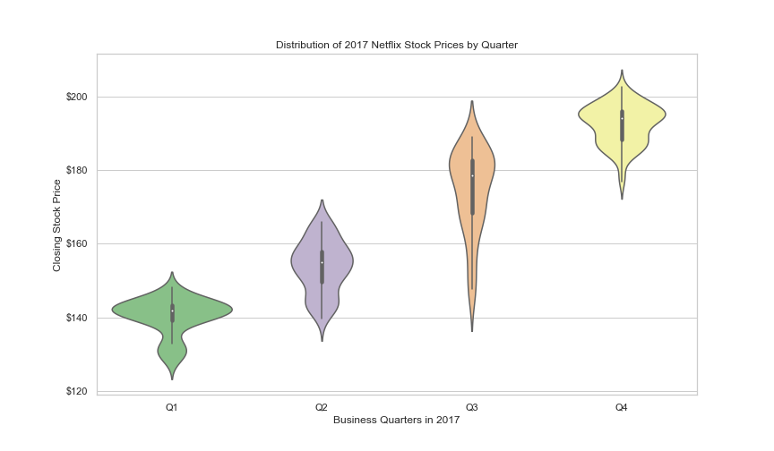
A visualization of the distribution of the stock prices for Netflix in 2017
Netflix price at stock market was growing quarter by quarter in 2017
The largest price fluctuations took place in the third quarter of 2017

Slide 4
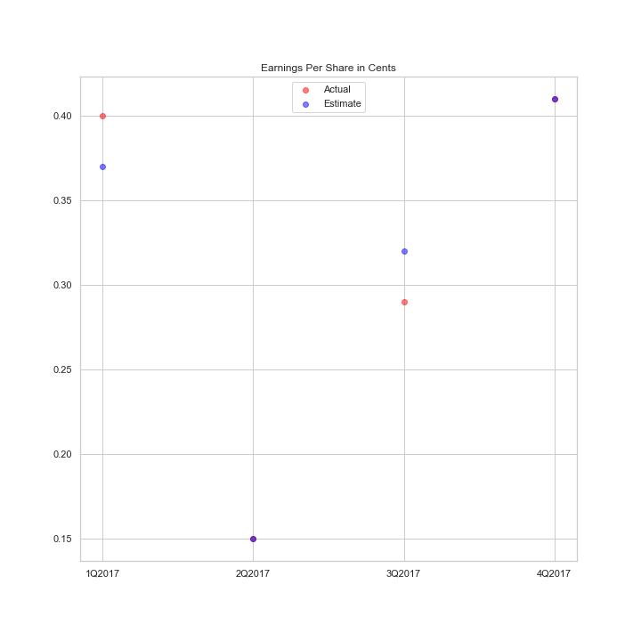
A visualization and a brief summary of Netflix earned versus actual earnings per share
The purple dots means that actual and estimated earnings are the same for quarter 2 and 4 in 2017 year

Slide 5
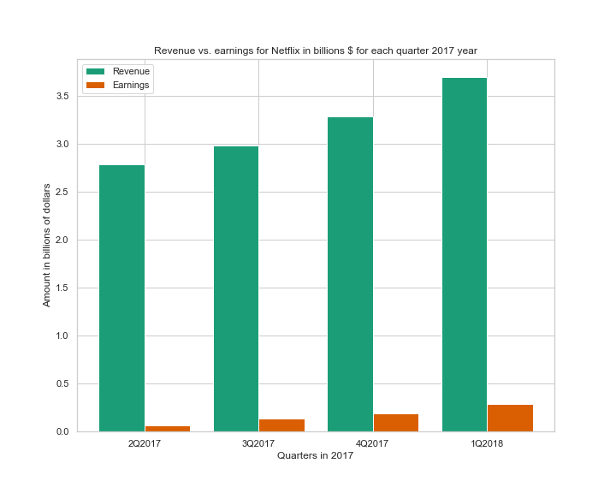
A visualization and a summary of Netflix stock and revenue and earnings for the past four quarters
Both revenue and earnings follow growing trend in 2017 year
Roughly its seems that earnings are about 20% of revenue in 2Q2017
since 3Q2017 the percentage of earnings has decreased to around 4% of revenue but it shows an upward trend in the following quarters

Slide 6
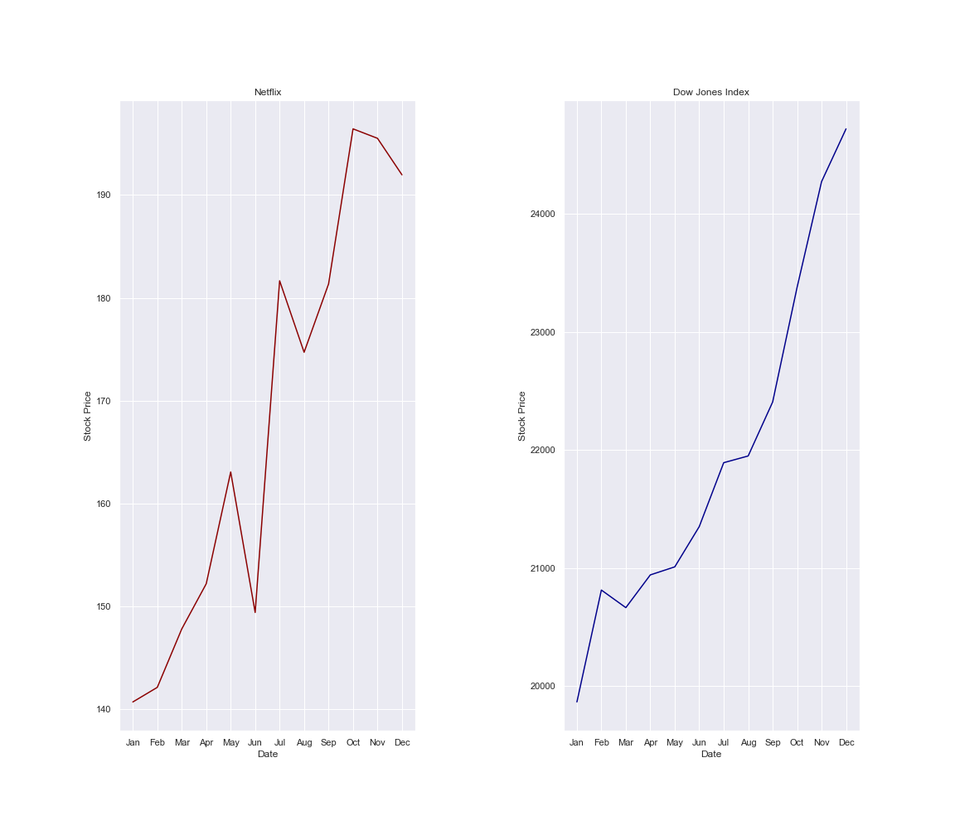
A visualization of Netflix stock against the Dow Jones stock in 2017
Netflix in compared to Dow Jones Index perform relatively similar results
In June and August Netflix price at stock market collapsed but after that very quickly return to growing trend
The graph shows also that Netflix price collapsed in October and downward trend continue till end of year

