Slide 1
The final evaluation answers six questions on how REALISE was delivered and what it contributed
REALISE Liberia | Process and ex-post evaluation
Volume 1 summary for the Project Management Team, the Government of Liberia and the World Bank
Presentation to the Project Management Team | 4 November 2026
Strategic Initiative for Transformation and Empowerment (SITE)
Notes:
Welcome. This is the final evaluation of REALISE components 1, 2, 5 and 6. We will cover how the PMT's comments were addressed, what we found for each component and the six evaluation questions, and the actions we recommend before closure and for a follow-on programme.

Slide 2
Four messages for the PMT
1
Support reached almost every beneficiary; completing the full package (33 to 61% today) is the next step.
2
Mobile-money payments worked and were usually on time (63 to 92%); SCT timing, ID and cash-out are the areas to improve.
3
Households report better ability to meet basic needs, most in SCT (90% better off); CLAS needs attention in Bomi and Grand Cape Mount.
4
Evidence of contribution is Moderate for 3 claims, Limited for 27 and Insufficient for 1; linked payment and delivery records would strengthen it.
Notes:
If you remember four things: support reached almost everyone, but the full package often did not; payments were mostly on time except in SCT; households report relief, with CLAS split and concentrated problems in Bomi and Grand Cape Mount; and the evidence of contribution is Moderate for three claims, Limited for most and Insufficient for one, because records could not be linked to beneficiaries.

Slide 3
Overview
PART 1
How the evaluation was done and how the PMT's feedback was addressed

Slide 4
REALISE was evaluated across four components using 1,477 survey interviews and 61 transcripts
SSB
LIPW
CLAS
SCT
Small businesses
Public works
Agriculture support
Cash transfer
268
254
598
357
interviews
interviews
interviews
interviews
1,477
61
Contribution analysis
analysed interviews in 43 sites
transcripts: 34 interviews and 27 focus groups
Theory-based, mixed methods; no net impact is estimated
Source: Executive summary and Table ES.1; Chapter 5.
Notes:
The evidence base: 1,477 beneficiary interviews in 43 sites and 10 counties, plus 61 interview and focus group transcripts. The design is contribution analysis: we test whether the outcome pattern fits the delivery chain better than other explanations. We do not estimate a net impact.

Slide 5
The discussion today
A. The evaluation in brief
How we worked
What we found
What comes next
Instruments, sampling, training and fieldwork
Results and evidence across four components
Key messages, recommendations and decisions
Discussion throughout: methods, results and priorities for action.
Source: Volume 1, Chapters 4 to 14.
Notes:
Four parts: an overview of the evaluation, who we reached, the results, and the recommendations. Please interrupt at any point.

Slide 6
The revised report answers the PMT's seven points; three inputs are needed from the PMT
1. Efficiency and records (points 1, 2, 6)
2. Results Matrix (point 5)
Indicative efficiency added: budgets, transfers and budget execution (Table 11.1c).
Table 11.5.1 shows what each finding rests on.
Cost-effectiveness was not possible: 2022 to 2024 expenditure records were not received.
10 of 74 indicators differ between two project sources; 4 change status.
Both values are shown (Table 11.3.1).
To close: PMT reconciliation before final acceptance (R15).
3. Qualitative evidence (point 3)
4. CLAS worse off and SWOT (points 4, 7)
Planned against completed sources in Table L.11.
33 of 55 core KIIs, 26 of 29 FGDs analysed, 15 of 16 sites, 2 case grids and 1 narrative of 6.
Other case questions are covered by FGDs, KIIs and 17 site records.
Section 8.9 tests seven explanations; worse-off answers cluster in Bomi and Grand Cape Mount.
Consolidated SWOT added (Table 12.5).
To close: CLAS payroll by county from the PMT.
Point-by-point response in the accompanying note (Annex L, Table L.12).
Source: PMT overall assessment of the draft report; Volume 1, v5; Annex L, Tables L.11 and L.12.
Notes:
We start with your feedback. All seven points are answered in the revised report. Five are addressed in the text; the Results Matrix reconciliation and the dated records need PMT input, and the CLAS payroll would further test the county pattern. The full response is in the accompanying note.

Slide 7
REALISE's theory of change
A. The evaluation in brief
Household livelihoods
Agriculture and communities
Protection and systems
SSB grants and LIPW work support income and immediate needs.
CLAS inputs, practices, infrastructure and cooperatives.
SCT transfers, financial planning, social registry and information systems.
Capacity and coordination support all pathways. Expected long-term outcomes include resilience and poverty reduction.
Source: Project Operations Manual, updated November 2024, Figure 1.
Notes:
REALISE works through three pathways: household livelihoods through SSB grants and LIPW work, agriculture and communities through CLAS, and protection and systems through SCT and the social registry. The full POM figure is in backup if needed.

Slide 8
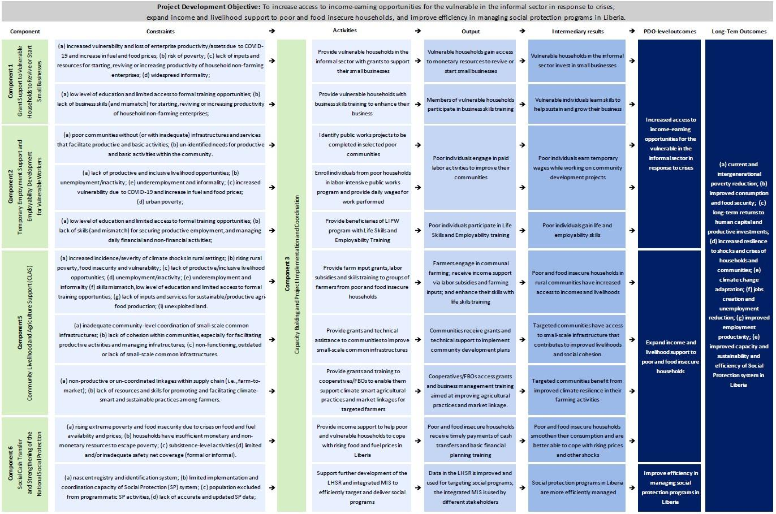
Backup: REALISE theory of change (POM, Figure 1)
A. The evaluation in brief
Source: REALISE Project Operations Manual, updated November 2024, Figure 1: Theory of Change.

Slide 9
The design rests on the three pillars of the technical proposal
A. The evaluation in brief
Contribution analysis
Qualitative research
Beneficiary survey
The framework (Mayne, 2012): Does the outcome pattern fit the delivery chain better than the rival explanations?
Interviews, focus groups, site records and documents describe mechanisms, experiences and rival explanations.
The survey estimates reach and reported outcomes; qualitative accounts explain context, while available records provide a separate check.
Each strand is analysed separately and then integrated. The protocol allows one logged explanatory follow-up; this update re-analyses existing sources. No net impact or average treatment effect is estimated.
Source: technical proposal, Sections 3.1 to 3.4; Volume 1, Section 4.1 and Table 4.1.
Notes:
Three strands, analysed separately and then brought together: the survey for reach and reported outcomes, the qualitative work for mechanisms and experiences, and records as a separate check where they were available.

Slide 10
Key Evaluation Questions
A. The evaluation in brief
KEQ1 Relevance: Did support and selection match intended beneficiaries' needs and profiles?
KEQ2 Effectiveness: Were intended benefits delivered and were expected changes reported?
KEQ3 Efficiency: How efficiently were resources used, how timely were delivery and internal operations, and what transaction costs fell on beneficiaries?
KEQ4 Impact and outcome contribution: What changes in income, employment, food security, consumption, resilience and agency are observed, and how plausible is REALISE’s contribution?
KEQ5 Coherence: How do the four components complement one another and align with other government and partner programmes, and where are synergies, duplication or coordination gaps?
KEQ6 Sustainability: Which businesses, assets, groups, practices and household changes are likely to continue?
The evaluation answers six key evaluation questions (KEQs), one for each OECD-DAC (Organisation for Economic Co-operation and Development-Development Assistance Committee) criterion: relevance, effectiveness, efficiency, impact, coherence and sustainability.
Source: Volume 1, Section 3.2; pre-analysis plan.
Notes:
The six questions follow the OECD-DAC criteria. Every result in this presentation feeds one of them, and each question gets a status: answered or partly answered.

Slide 11
Six primary outcomes, fixed in the pre-analysis plan, are reported for every component
A. The evaluation in brief
Outcome | What it measures | Scale
P1 Receipt | Received every benefit the respondent expected | Share, higher is better
P2 Timeliness | Payments always on the communicated schedule | Share, higher is better
P3 Coping | Days of 12 coping strategies in the past 7 days | 0 to 84, lower is better
P4 Basic needs | Recalled change in ability to meet basic needs | -2 to +2, higher is better
P5a Mobile money | Mobile-money account in the respondent's own name | Share, higher is better
P5b Women's self-efficacy | Eight self-efficacy items, women answering in private | 8 to 40, higher is better
Source: Volume 1, Table 3.1 (pre-analysis plan, Table 5).
Notes:
Six outcomes were fixed in the pre-analysis plan and are reported the same way for every component, so the components can be read side by side. They describe these components; differences between components are not effects.

Slide 12
Sites were chosen on purpose, and households were then drawn at random inside exact cells
Stage 1: Purposeful Sites
Stage 2: Exact Cell Stratification
Total Release & Allocation
43 Sites / 10 Counties
42 physical communities covered
134 Sampling Cells
Zero unmapped sampling cells
2,100 Identities
1,600 main draw + 500 reserves
Site selection: 35 sites confirmed by PMT on 26 July 2026 + 8 chosen by SITE to apply criteria.
Geographic balance: Covers urban (Greater Monrovia), rural agriculture, and remote cash transfer counties.
Shared site: Stephen Tolbert Estate hosts both SSB and LIPW operations.
De-duplication: 5,081 registrations resolved into 4,523 unique identity groups.
Strata definition: Cells defined by component, community, round, group, sex, and status.
Replication: One draw per identity group; fixed seed in Stata 17.
Main draw (+ reserves):
SSB 300 (+111 reserves)
LIPW 300 (+174 reserves)
CLAS 600 (+104 reserves)
SCT 400 (+111 reserves).
Reserves were used only after documented failed contact attempts.
Qualitative sample: 55 core KIIs and 29 FGDs purposively sampled by role.
Estimates describe eligible beneficiaries in covered sites and rounds, not all REALISE beneficiaries nationwide.
Source: Report Sections 4.1, 4.2 and 4.4; Annex F Table 4.2.
Notes:
Sites were chosen with the PMT, then beneficiaries were drawn at random within exact cells. So results describe beneficiaries in the covered sites and rounds, not all REALISE beneficiaries nationwide.

Slide 13
Results describe beneficiaries in the sites and rounds we covered, not all REALISE beneficiaries
B. Quantitative survey
Weight by cell
Intervals
Each interview counts for the number of beneficiaries it represents in its site, round and group
Ranges around each result show the uncertainty that comes from interviewing a sample
Comparisons
Small groups
Differences between groups are adjusted for county, round, sex and age; they are associations, not effects
Results based on 10 to 24 people are indicative; fewer than 10 are not shown
Source: Volume 1, Sections 4.2, 4.7 and 4.11; Annex F supplement for every estimate with its n, interval, design effect and effective sample size.
Notes:
Weights make each interview count for the beneficiaries it represents. The ranges show sampling uncertainty. Comparisons between groups are associations.

Slide 14
Fieldwork preparation and PAP approval followed distinct timelines
1. Design and PAP chronology
2. Ethics & UL IRB (7 August 2026)
PAP v14 approved 1 October; interviews began 24 September.
UL ethics approval; consent, safeguarding and privacy procedures.
3. Frame & Sites (July to September 2026)
4. CAPI Setup & Training (September 2026)
4,523 unique IDs; random draw within 134 cells.
Preloads, quizzes, role plays and a field pilot.
All cleaning and analysis run in ordered Stata do-files from unaltered raw exports. Decisions logged in Annex L.
Source: Report Chapter 4 (Sections 4.1 to 4.4, 4.9); Annexes C, D, E, L and N.
Notes:
Ethics approval came in August, the sampling frame was built from 5,081 registrations, and teams were trained and piloted before interviews began on 24 September.

Slide 15
B. Who we reached
PART 2
Survey and qualitative coverage, and how data quality was checked

Slide 16
Five survey sub-teams (16 enumerators, 2 supervisors) and two qualitative teams covered 43 sites in 10 counties
SSB
SCT
LIPW
CLAS
268
SSB | 89.3% of target
357
SCT | 89.3% of target
254
LIPW | 84.7% of target
598
CLAS | 99.7% of target
Survey interviews completed across sampled sites.
Survey interviews completed across sampled sites.
Survey interviews completed across sampled sites.
Survey interviews completed across sampled sites.
Stephen Tolbert Estate serves both SSB and LIPW (43 component sites in 42 physical communities). All 134 cells covered.
Source: Report Sections 4.2 to 4.4, 5.1 and 5.4; Tables 4.2, 4.4 and 5.1.2; Annexes D and E.
Notes:
The survey covered 43 component-sites in ten counties. The achieved sample contains 268 SSB, 254 LIPW, 598 CLAS and 357 SCT interviews. Sampling was random within the selected site cells; coverage does not imply national representativeness. Sources: Report Sections 4 and 5; Annex F.

Slide 17
Case management tracked every sampled identity and set the rules for replacing a case
1. Preload & Live Tracking
2. Contact outcomes and gaps
2,100 Sampled IDs | 1,890 identities released to field
SurveyCTO tracking: Preloaded case lists with unique identity codes, phone numbers, and location.
Daily oversight: Real-time tracking through Case Operations and Contact Outcomes forms.
273 recorded non-contacts; 140 unresolved outcomes
No confirmed refusals recorded: this does not establish that none occurred.
Protocol: three dated attempts at different times were required.
3. Reserve Replacement (290 reserves)
4. Supervisor Undo Protocol
290 reserves activated; 220 interviewed; 210 never needed
Documentation: 88 reserves linked to 86 main cases failed the attempts/reason check.
Interpretation: this does not prove a breach of same-cell matching.
Supervisors could undo a replacement before a reserve interview.
Annex L records decisions; missing attempts/reason evidence remains an explicit limitation.
140 final outcomes remain unresolved; reserve documentation gaps limit claims about complete protocol compliance.
Source: Report Sections 4.2, 4.3, 4.11 and 5.1; Table 4.3.
Notes:
Case management tracked every sampled identity and set the rules for replacing a case: 290 reserves were activated, 220 were interviewed and 210 were never needed. 140 final outcomes remain unresolved, and reserve documentation gaps limit claims about complete protocol compliance.

Slide 18
Survey completion reached 92.3% of plan: 1,477 of the 1,600 planned interviews
CLAS (Rural Agriculture)
SCT (Cash Transfer)
SSB (Small Businesses)
LIPW (Public Works)
598 / 600
99.7% Achieved | -0.3% Shortfall
357 / 400
89.3% Achieved | -10.8% Shortfall
268 / 300
89.3% Achieved | -10.7% Shortfall
254 / 300
84.7% Achieved | -15.3% Shortfall
561 main-draw and 37 reserve interviews.
299 main-draw and 58 reserve interviews.
205 main-draw and 63 reserve interviews.
192 main-draw and 62 reserve interviews.
Interviewing ran from 24 September to 28 October 2026 across 43 sites; all 134 cells have an interview. 140 released cases unresolved.
Source: Report Tables 4.2 and 5.1.2; Sections 4.2 and 4.11.
Notes:
We completed 1,477 of the 1,600 planned interviews, 92.3 percent. CLAS was almost complete; LIPW was hardest because workers in Monrovia were very mobile. Every one of the 134 sampling cells has interviews.

Slide 19
Data quality checks combine daily reviews, recalls and back-checks
Pillar 1: Daily Stata HFCs
Pillar 2: 201 Telephone Recalls
Pillar 3: Back-checks
1,477 Checked Daily
Duration, consistency and records checked every day
201 Recalls Completed
Item recovery from early form versions
Identity confirmed
Daily automated checks reviewed duration, consistency and records.
Telephone recalls recovered indicators missed by early form routing.
Back-checks confirmed the identity of those interviewed. Together with the HFCs, they supported the operational review of data quality.
Sensitivity analyses examine non-response and reserve rules; they do not eliminate all measurement or implementation uncertainty.
Source: Report Sections 4.3, 4.6, 4.10, 4.11; Table 4.10.2; Annex F, Table 4.10.1; Annex E (Tables E.2a to E.7); Annex G.
Notes:
Data quality was checked every day, missing items from early form versions were recovered by phone, and back-checks confirmed the identity of the people interviewed.

Slide 20
Qualitative coverage: 33 of 55 core interviews and 27 of 29 group discussions transcribed, and 15 of 16 sites visited
Core Key Informant Interviews
Focus Group Discussions
Site Locations & Case Studies
33 of 55 Matched
60.0% Transcript Coverage
27 of 29 Files
93.1% Discussion Coverage
15 of 16 Sites
93.8% Location Coverage
22 planned roles not represented.
26 files analysed; one continues an earlier discussion.
Site records and case materials are illustrative.
Missing transcripts are qualitative attrition: unobserved roles are not imputed and findings say so. Table L.11.
Source: Report Tables ES.1, 4.4 and 5.4; Section 4.5; Annex L Table L.11.
Notes:
On the qualitative side, 33 of 55 core interviews and 27 of 29 group discussions were transcribed, and 15 of 16 sites were visited. The gaps are mainly CLAS local leaders and some national roles; findings that would rely on them say so.

Slide 21
Two qualitative teams collected the interviews and discussions, which were coded against a 147-code framework
1. Field Teams & Deployment
2. Coding framework
2 Teams of 3 Researchers | Simultaneous qualitative field mission
Deployment structure: Team One for SSB and SCT and Team Two for LIPW and CLAS, each with a facilitator, a note taker and a team leader.
Language adaptation: Conducted in Liberian English and local languages with audio recording consent.
147 codes; 3,771 segments (3,544 substantive)
Coverage: 60 analysed files.
3. Evidence Triangulation
4. Validation
60 analytical units
Comparison: respondent roles and evidence strands; administrative verification remains incomplete.
Traceability: corpus IDs identify sources; quote counts are not independent observations.
10% recoded independently
A 10 percent sample of coded segments was recoded independently by members of the evaluation team, and differences were discussed and resolved before the codes were finalised.
Analytic unit is the discussion or interview, not the quote count. Claims cite corpus IDs and report sections.
Source: Report Sections 4.4 and 4.8; Annex C.
Notes:
Two teams of three researchers collected the qualitative material in English and local languages. Transcripts were coded against a 147-code framework, and a 10 percent sample was recoded independently to check consistency.

Slide 22
Results
PART 3
What works, how to read the grades, the six evaluation questions, then each component
Notes:
We now move to results. First, how to read the contribution grades, because they come up on every slide.

Slide 23
What is working well across REALISE
Reach and targeting
Payments
98% or more received support
95.4 to 99.5% rate selection fair or very fair.
97 to 99% hold an own-name account
Mobile money worked in all four components; 91.5% of SSB grants always arrived on schedule.
Household gains
Agriculture and groups
90.4% of SCT households better off
71.6% in SSB and 59.1% in LIPW report better ability to meet basic needs.
91.3% use a climate-smart practice
Core inputs reached 94.9 to 98.4%; 86.8% expect their group to keep farming; 14,151 trained (141% of target).
Results reported by beneficiaries in the covered sites, weighted.
Source: Volume 1, Executive summary and Chapters 6 to 10.
Notes:
Before the detail, what works: support reached almost everyone and selection is seen as fair; mobile-money payments work and almost all beneficiaries hold an account in their own name; households report better ability to meet basic needs, most in SCT; CLAS inputs reached farmers and nine in ten use climate-smart practices.

Slide 24
Of 31 claims, 3 are Moderate, 27 Limited and 1 Insufficient: grades are held back mainly by missing records
3
27
1
Moderate: plausible contribution. Limited: consistent with a contribution, not yet firm. Most claims are Limited because records could not be matched to beneficiaries.
Moderate
Limited
Insufficient
Claims by grade and component
Source: Executive summary, Table ES.3; Table 11.2 and Section 11.2.
Notes:
A grade rates the strength of the evidence, not the performance of the programme. Moderate means the evidence supports a plausible contribution. Limited means the evidence is consistent with a contribution but not yet firm. Most claims are Limited because we could not link payment, delivery and grievance records to the beneficiaries we interviewed. With those records, several grades could be reviewed.

Slide 25
95.4 to 99.5% of beneficiaries rate selection as fair; checking who was left out is the next step
Answered
Key evaluation question 1 of 6
KEQ1 Relevance: Did support and selection match intended beneficiaries' needs and profiles?
Almost everyone on the beneficiary lists saw selection as fair. The survey cannot show who was left out.
95.4 to 99.5%
13.7%
of beneficiaries in each component rated selection fair or very fair
of SCT respondents rated it very fair, against 40.0 to 53.7% elsewhere
Descriptive finding, not graded
Source: Executive summary, KEQ1 and Table ES.2; Section 11.1.
Notes:
Selection is seen as fair by 95.4 to 99.5 percent in every component. The survey only covers people on the lists, so it cannot tell us who was left out; interviews describe skipped settlements and the household cap, which are worth checking.

Slide 26
Support reached almost everyone; completing the full package (33 to 61% today) is the next step
Partly answered
Key evaluation question 2 of 6
KEQ2 Effectiveness: Were intended benefits delivered and were expected changes reported?
National ID support was a gap in every component where it was expected (SSB 70.7%, LIPW 50.0%, CLAS 28.6% of those expecting it received it).
98%+
Basic reach (at least one benefit)
33% to 61%
Full package (central bottleneck)
61.1% SCT Cash Transfer
Up-to-six-transfer item: 32.1% of 166 expecting it; due transfers not reconciled.
56.9% SSB Business Grants
National ID / NIN: 70.7% of those expecting it.
Contribution grade
SSB: Limited
LIPW: Limited
50.6% LIPW Public Works
Gap: National ID (50.0%) and accommodation or childcare (82.9%).
32.7% CLAS Livelihoods
Gap: labour subsidies & buyer links (28.1%).
CLAS: Limited
SCT: Limited
Source: Executive summary, KEQ2 and Table ES.2; Section 11.1 and Table 11.2.
Notes:
Almost everyone received at least one benefit, but only a third to three fifths received everything they expected. National ID support was a gap wherever it was part of the package.

Slide 27
Payments arrived on schedule for most beneficiaries, best in SSB (91.5%); SCT timing (62.8%) is the priority
Partly answered
Key evaluation question 3 of 6
KEQ3 Efficiency: How efficiently were resources used, how timely were delivery and internal operations, and what transaction costs fell on beneficiaries?
Mobile money simplified delivery. Cost-effectiveness needs 2022 to 2024 expenditure records (Table 11.1c).
91.5%
SSB on-time (highest)
62.8%
SCT on-time (lowest)
91.5% SSB Business Grants
Two tranches by mobile money; the second came late for some groups.
72.8% LIPW Public Works
Late or reduced wages reported in some groups.
Contribution grade, timeliness
SSB: Moderate
LIPW: Limited
68.9% CLAS Livelihoods
12.0% never paid on time; median subsidy received LRD 17,000 against 59,500 expected.
62.8% SCT Cash Transfer
Approvals, agent cash and travel delayed cash-out.
CLAS: Limited
SCT: Limited
Source: Executive summary, KEQ3 and Table ES.2; Section 11.1.
Notes:
SSB payments were the most punctual, SCT the least. In SCT, approvals, agent cash and travel delayed cash-out. Cost-effectiveness could not be assessed because the 2022 to 2024 expenditure records were not received.

Slide 28
Households report better ability to meet basic needs, most in SCT (+1.06); CLAS needs a closer look in two counties
Partly answered
Key evaluation question 4 of 6
KEQ4 Impact and outcome contribution: What changes in income, employment, food security, consumption, resilience and agency are observed, and how plausible is REALISE’s contribution?
CLAS split: 49.4% better, 44.7% worse, mostly in Bomi and Grand Cape Mount.
+1.06
+0.06
SCT, largest gain on a −2 to +2 scale
CLAS mean; community CI −0.18 to +0.30
Contribution grade, basic needs
SSB: Limited
LIPW: Limited
90.4%
18.4%
CLAS: Limited
SCT: Moderate
of SCT households say they are better off
of SCT households have poor food consumption
Coping days: Limited in all four
Source: Executive summary, KEQ4 and Table ES.2; Section 11.1 and Chapter 10. Scale: recalled change in basic needs, -2 to +2.
Notes:
SCT shows the largest reported improvement in basic needs. CLAS is split almost evenly between better and worse off, with the worse-off answers concentrated in two counties. These are recalled changes, not measured impacts.

Slide 29
CLAS training aligns with national climate priorities; target definitions differ
Partly answered
Key evaluation question 5 of 6
KEQ5 Coherence: How do the four components complement one another and align with other government and partner programmes, and where are synergies, duplication or coordination gaps?
Project records report 14,151 people trained, 141% of the project target of 10,063. The national farmer-field-school definition differs, so national-target attainment is not established.
14,151
people trained in life skills and climate-smart farming
141%
of the project target of 10,063; national definition differs
Descriptive finding, not graded
67.6%
of CLAS respondents had no other support; government or NGO help was rare
Source: Sections 8.5 and 10.7. National targets require aligned definitions.
Notes:
CLAS trained 14,151 people, above the project target. The national target uses a different definition, so we cannot say it was met. Overlap with other assistance is small.

Slide 30
Beneficiaries plan to continue; follow-up support will help the gains last
Partly answered
Key evaluation question 6 of 6
KEQ6 Sustainability: Which businesses, assets, groups, practices and household changes are likely to continue?
SSB: visited businesses were operating. LIPW: upkeep of works depends on local arrangements. SCT: some recipients save through susu. Continuation after support ends is a prospect, not yet observed; shocks and budgets put gains at risk.
86.8%
of CLAS respondents expect their group to keep farming
Contribution grade
SSB
Limited
LIPW
Limited
CLAS
Limited
SCT
Limited
Source: Executive summary, KEQ6 and Table ES.2; Section 11.1.
Notes:
People plan to continue: 87 percent of CLAS members expect their group to keep farming. A one-round evaluation cannot observe what happens after support ends, so these are prospects.

Slide 31
SSB grants and training reached most beneficiaries; ID and business registration are the items to complete
E. SSB | Delivery
P1: 56.9% received every expected benefit
Gaps: NIN support and business registration
County receipt comparison withheld to protect small cells
Source: Annex F supplement, Table 6.3.2 (Volume 1, Section 6.3). Share receiving each benefit among those who expected it, n expecting in brackets. Final survey data, weighted.
Notes:
SSB grants and training reached most beneficiaries; ID and business registration were the weakest items.

Slide 32
SSB: timely payments and spending on business-plan items
E. SSB | Delivery
P2: 91.5% always on schedule
Business use: 87.3% spent on the plan
Use, not amounts: sales and profit were not surveyed
Source: Annex F supplement, Table 6.3.3 and Volume 1, Table 6.3.1 (P2); several answers allowed. Final survey data, weighted.
Notes:
Nine in ten SSB beneficiaries were always paid on schedule, and most spent the grant on their business plan.

Slide 33
Seven in ten SSB households are better able to meet basic needs (+0.65)
E. SSB | Outcomes
+0.65
4.0
14.3%
P4: change in basic needs (-2 to +2)
P3: coping score (0 to 84, lower is better)
households with poor food consumption
24.3% say they are worse off, about 1 in 4
No clear difference between women and men on coping, basic needs, timeliness or accounts
Not surveyed: business survival, sales, profit
Source: final survey data, weighted (Volume 1, Table 6.4.1 and Section 6.4; food consumption, 223 households with a score).
Notes:
Seven in ten SSB households report better ability to meet basic needs, while about one in four say they are worse off.

Slide 34
LIPW: 50.6% received every expected benefit and 72.8% were always paid on schedule
E. LIPW | Delivery
50.6%
72.8%
47.8%
P1: received every expected benefit
P2: always paid on schedule
P1 when the interview with the largest weight is omitted
Largest gap: National ID or NIN support, received by 50.0% of those expecting it
Workdays: 9.7% did not report receiving the 60 paid workdays
Women and men: on-time payment 79.2% against 65.3%, a clear difference
Source: Volume 1, Section 7.3 and Table 7.3.1; final survey data, weighted.
Notes:
Half of LIPW workers received everything they expected; ID support was again the main gap. Women were more often paid on time.

Slide 35
LIPW wages and tools reached nearly all who expected them; National ID support reached half
E. LIPW | Delivery
National ID: received by 50.0% of those who expected it
Wages, tools and mobile money: 95.5 to 98.0%
Accounts differ on whether the ID card was provided free
Source: Annex F supplement, Table 7.3.2 (Volume 1, Section 7.3). Share receiving each benefit among those who expected it, n expecting in brackets. Final survey data, weighted.
Notes:
Wages, tools and mobile money reached nearly all who expected them.

Slide 36
LIPW households report a gain in basic needs (+0.47); six in ten are better off
E. LIPW | Outcomes
+0.47
5.9
59.1%
P4: change in basic needs (-2 to +2)
P3: coping score (0 to 84, lower is better)
better or much better off (31.9% worse off)
“Through the work and the small amount of money we received, I was able to move forward with my life and rent a place of my own.”
LIPW-FGD-004, P0184
Source: final survey data, weighted (Volume 1, Table 7.4.1 and Section 7.4).
Notes:
LIPW households report a modest gain, and some describe gains fading after the work ended.

Slide 37
CLAS core inputs reached 95 to 98% of farmers; market links and ID support are the gaps to close
E. CLAS | Delivery
P1: 32.7%, the lowest of the four
Core inputs: 94.9 to 98.4%
Market linkage: 28.1% of those expecting it
Source: Annex F supplement, Table 8.3.2 (Volume 1, Section 8.3). Share receiving each benefit among those who expected it, n expecting in brackets. Final survey data, weighted.
Notes:
CLAS inputs reached almost everyone, but market linkage and ID support reached fewer than a third of those who expected them.

Slide 38
Labour subsidies received were below expectations; payroll records by county will show why
E. CLAS | Delivery
LRD 59,500
LRD 17,000
12.0%
median labour subsidy expected
median labour subsidy received
never paid on time, the highest of the four
P2: 68.9% always on schedule among those given a schedule
No schedule communicated: 13.5% of those expecting a timed payment, all in Bomi and Grand Cape Mount
Needed: payroll, entitlements and payment-cycle records by county to reconcile recalled amounts
Source: Volume 1, Section 8.3 (medians); Annex F supplement, Table 8.3.3 (n = 597); Volume 1, Table 8.3.1 (P2). Final survey data, weighted.
Notes:
Recalled labour subsidies were much lower than expected, and all reports of no payment schedule come from Bomi and Grand Cape Mount. Payroll records by county would confirm whether this is a delivery gap.

Slide 39
CLAS households are split between better and worse off; difficulties concentrate in Bomi and Grand Cape Mount
E. CLAS | Outcomes
P4: +0.06, recipients split between better and worse off
Bomi 65.9% and Grand Cape Mount 74.5% worse off, against 22 to 37% elsewhere
Same share in all three rounds (42 to 46%): not only an unfinished harvest
No payment schedule communicated: 73.9% worse off; price shocks also linked
Interviewer assignment overlaps these two counties, so the cause is not yet separated
Source: Annex F supplement, Table 8.4.2 (n = 553, proxies excluded); Volume 1, Section 8.4. Final survey data, weighted. Scale -2 to +2.
Notes:
This answers the PMT's question on the CLAS worse-off group. Worse-off reports are concentrated in Bomi and Grand Cape Mount and are the same in all three rounds, so an unfinished harvest is not the only reason. They are linked to missing payment schedules and to price shocks. Interviewer assignment overlaps with these two counties, so we do not attribute the pattern to a single cause.

Slide 40
91% of CLAS farmers report using at least one climate-smart practice, and 87% expect their group to keep farming
E. CLAS | Practices
“We learned how to arrange the planting beds and channels so that water flows to the side rather than damaging what we have planted.”
CLAS-FGD-001, P0249, P7 [29:42-30:32]
91.3%
report applying at least one climate-smart practice
“We are beginning to save money. If we continue saving together, we will have a reason to remain organized and work towards a common goal.”
CLAS-FGD-007, P0306, P3 [47:43-48:21]
86.8%
expect the group to keep farming (likely or very likely)
Source: Volume 1, Sections 8.5 and 8.7; CLAS focus groups. Practices are self-reported; yields were not measured.
Notes:
Nine in ten CLAS farmers report using at least one climate-smart practice; this is the CLAS claim with Moderate evidence. Yields were not measured.

Slide 41
SCT transfers reached nearly everyone; receipt of the expected number of transfers was less complete
E. SCT | Delivery
P1: 61.1%
Expected transfers (up to six): 32.1% among those expecting this benefit
Needed: registry data on transfers due and paid
Source: Annex F supplement, Table 9.3.2 (Volume 1, Section 9.3). Share receiving each benefit among those who expected it, n expecting in brackets. Final survey data, weighted.
Notes:
SCT transfers reached nearly everyone, but only a third of those expecting up to six transfers had received them; registry data on transfers due would settle this.

Slide 42
SCT payments were on schedule for 62.8%; dated calendars and closer agents can lift this
E. SCT | Delivery
P2: 62.8% among respondents with a communicated schedule (n=350)
Not always on time: 37.2%
Mobile money was the reported channel; sparse non-receipt withheld
Source: Annex F supplement, Table 9.3.3 and Volume 1, Table 9.3.1. Communicated-schedule domain n=350; weighted. Fine timing and exclusion categories are withheld.
Notes:
SCT has the least punctual payments of the four components.

Slide 43
SCT shows the largest reported improvement (90% better off); food adequacy is the next challenge
E. SCT | Outcomes
“the programme benefited me because I was able to provide for my child health when he was very sick. I also bought some materials that could help me.”
SCT-FGD-006, P0221, P6 [13:31-14:09]
+1.06
18.4%
P4, the largest of the four
poor food consumption
“Because the food is not available every day the money will be there and what I wanted to buy for the food to be there throughout the money will not be plenty like that (enough) just to buy food.”
SCT-FGD-008, P0458, P7 [47:37]
90.4% better or much better off
Mean food score: 40.9, the lowest
Why both: SCT serves the poorest; the food score covers 7 days, transfers are quarterly
Source: final survey data, weighted (Volume 1, Table 9.4.1; Annex F supplement, Table 9.4.2; food consumption, n = 321).
Notes:
SCT households report the largest improvement and still the poorest diet. Both can be true: SCT serves the poorest households, and the food score covers only the last seven days while transfers are quarterly.

Slide 44
Recommendations
PART 4
SWOT, priority actions and the decisions needed today
Notes:
We now turn to what the findings mean for action.

Slide 45
REALISE SWOT: strong reach and a working payment channel, with clear areas to strengthen
Strengths
Weaknesses
• Broad receipt of support
• Business and basic-needs uses
• Reported climate-smart practices
• Some expected support not received
• Payment timing varies
• CLAS market links remain limited
Opportunities
Threats
• Strengthen market links
• Clarify complaints channels
• Improve payment and delivery records
• Shocks affect household outcomes
• Market access constrains livelihoods
• Financing affects continuation
On-time payments: 62.8% SCT and 68.9% CLAS among respondents given a schedule. Receipt gaps do not distinguish late delivery from non-delivery.
Source: Volume 1, Sections 4.5, 8.3 to 8.9, 9.3 to 9.4, 10.3 to 10.5 and 11.3; Table 12.5.
Notes:
The consolidated SWOT brings the component findings together: broad reach and a working payment channel, but incomplete packages, uneven timing and weak market links.

Slide 46
Eight priority actions: start before project closure in December 2026 and carry into a follow-on programme
No. | Priority action | Lead actor | When
R2 | Enrol people without a national ID card | PMT | Short term
R5 | Publish dated payment calendars | MGCSP, MYS and LACE | Short term
R6 | Collect cash-out fee data; bring agents closer | MGCSP | Short term
R10 | Review CLAS market linkage and training | LACE | Short term (review); medium (follow-up)
R12 | Give SCT recipients one end date | MGCSP | Short term; linkages medium
R13, R14 | Raise complaint awareness; record safeguards data | PMT | Short term
R15 | Agree one verified set of indicator values | World Bank with PMT M&E | Before final acceptance
R16 | Join payment, payroll and grievance records | PMT | Short term (access); medium (fields)
Short term: before project closure in December 2026 and during the completion report. Medium term: 2027 and the design of a follow-on programme.
Source: Executive summary, Tables ES.4a and ES.4b; Chapter 14 gives all twenty recommendations.
Notes:
Eight priority actions. Most can start before closure in December; others belong to 2027 and a follow-on programme. The indicator reconciliation is needed before final acceptance of the report.

Slide 47
For this presentation, the twenty recommendations are grouped in three themes
1. Delivery, payments and markets
2. Inclusion, safety and grievances
3. Data systems, costs and design
7 recommendations
5 recommendations
8 recommendations
Explain the full package at enrolment and track each benefit.
Publish dated payment calendars and keep the actual dates.
Link CLAS groups to buyers.
Add a late-registration route and publish the household cap.
Track disability with one definition.
Raise complaint awareness and record safeguards data.
Agree one verified set of indicator values.
Join payment, payroll and grievance records.
Fund a cost study and a follow-up after harvest.
Fifteen are for the Government (PMT, LACE, MYS, MGCSP); five are for the financing agencies (World Bank, AFD, Sida) and the PSC.
Source: Report Chapter 14, Tables 14.1, 14.2 and 14.3; Section 14.4.
Notes:
All twenty recommendations fall under three themes: delivery and payments, inclusion and grievances, and data systems and design. Each is linked to a conclusion in Table 14.3.

Slide 48
REALISE reached its beneficiaries; completeness, payment timing and records are where to act
1
The package reached almost everyone, often incomplete.
2
Payment timing and cash-out shaped how usable payments were.
3
Households report relief, but need remains.
4
Contribution is plausible for SSB payment timing, SCT basic needs and CLAS practices; elsewhere the evidence is consistent with it but not yet firm.
Notes:
To close: REALISE reached its beneficiaries; completeness, payment timing and records are where to act.

Slide 49
Decisions needed today: three PMT inputs and a date for the final version
No. | Decision or input needed | Responsible | When
A1 | Reconcile the 10 Results Matrix indicators that differ and confirm the target set | PMT M&E Officer with the World Bank | Before final acceptance
A2 | Share dated payment, delivery and grievance records with beneficiary IDs | PMT with MGCSP, MYS and LACE | To agree today
A3 | Share the CLAS labour-subsidy payroll by group for Bomi and Grand Cape Mount | PMT with LACE | To agree today
A4 | Agree the date for submitting the final version | PMT and SITE | Today
These inputs close the open points in the response to the PMT (Annex L, Table L.12).
Source: Response to the PMT overall assessment, Section 3.
Notes:
We ask the PMT for three inputs and one date: the indicator reconciliation, the dated records, the CLAS payroll for Bomi and Grand Cape Mount, and a date for the final version.

Slide 50
Backup slides for questions
BACKUP
Detail for questions from the PMT
Notes:
Backup slides follow, for questions.

Slide 51
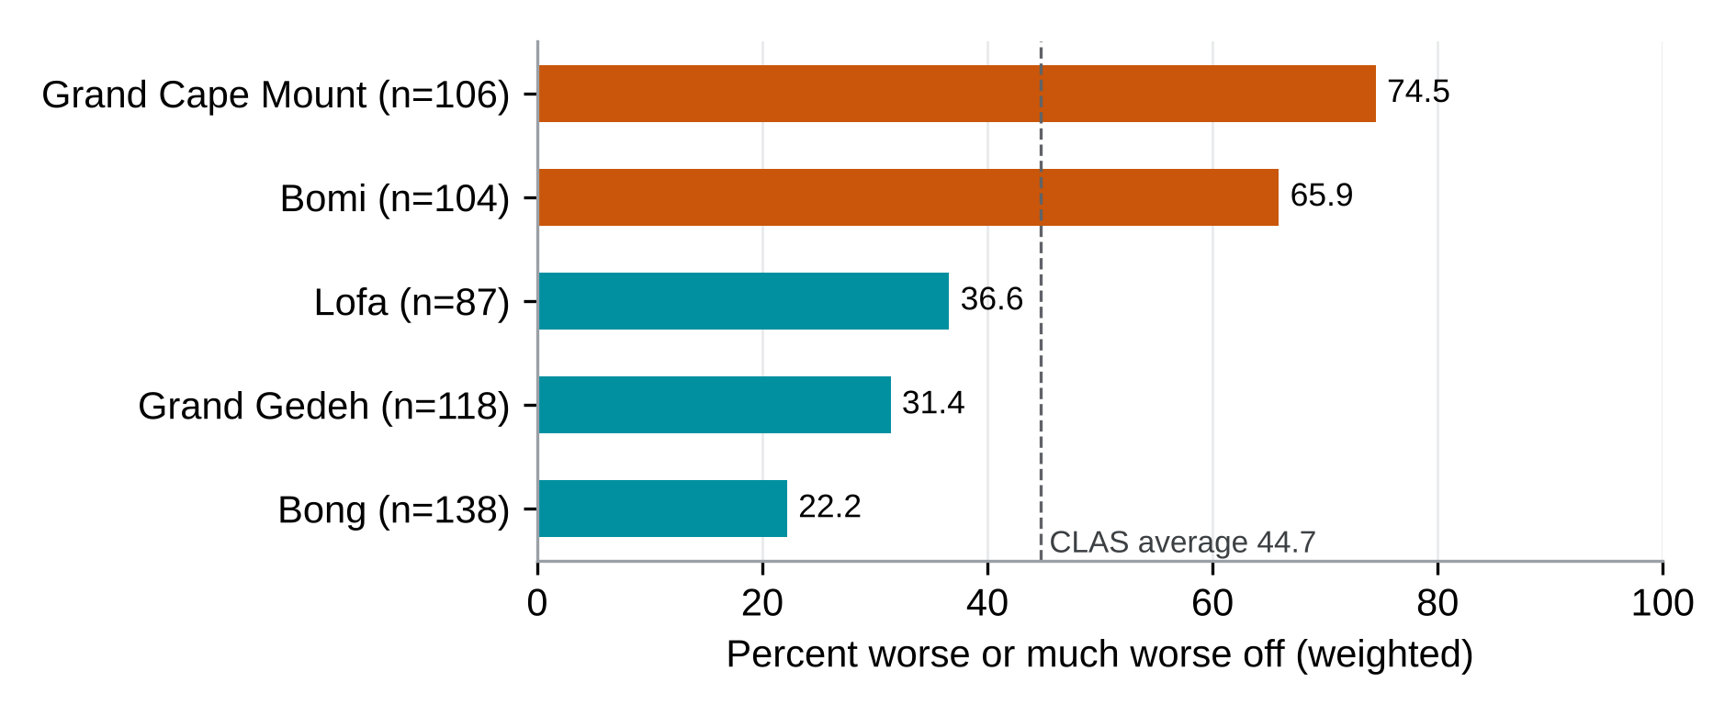
Worse-off reports in CLAS are concentrated in Bomi and Grand Cape Mount, in all three rounds
Backup | CLAS
Source: beneficiary survey, weighted; exploratory, decided after outcome access (Annex G, Table G.13.D15). Worse off by round: 41.8%, 41.7% and 46.1%.

Slide 52
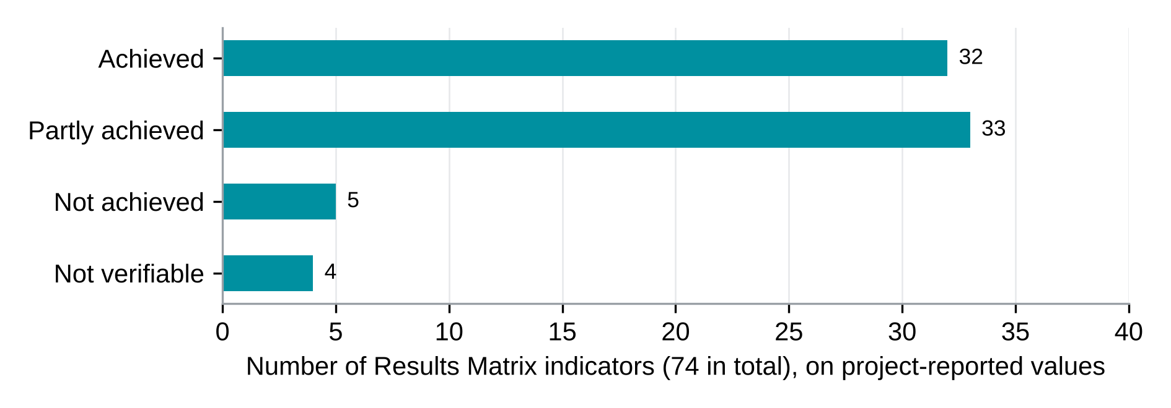
On project-reported values, 32 of 74 indicators are achieved and 33 partly achieved
Backup | Results Matrix
Source: Results Matrix (February 2026 mission) and first quarter 2026 report; Volume 1, Section 11.3. Values not independently verified.

Slide 53
Ten indicators differ between the Results Matrix and the Q1 2026 report; four change status
Indicator | Target | Matrix (Apr 2026) | Q1 2026 report | Status with each value
CLAS community development plans funded | 500 | 735 | 432 | Achieved / partly achieved
Village development plans funded for youth | 705 | 735 | 432 | Achieved / partly achieved
Farmers reached by marketing services | 1,420 | 3,226 | 600 | Achieved / not achieved
Cooperative staff trained | 75 | 38 | 36 | Partly achieved / not achieved
Female share of LIPW beneficiaries | 50% | 51.7% | 54.7% | Achieved on both
LIPW work-days created | 1,074,000 | 843,420 | 547,020 | Partly achieved on both
LIPW final wage paid within two weeks | 90% | 88.8% | 84.2% | Partly achieved on both
Female CLAS beneficiaries satisfied | 80% | 98% | 91% | Achieved on both
SCT programme beneficiaries | 16,711 | 16,586 | 16,525 | Partly achieved on both
SCT safety-net beneficiaries | 83,555 | 82,930 | 64,625 | Partly achieved on both
Source: Volume 1, Table 11.3.1. Both values are shown; the PMT reconciliation (R15) decides which one is retained.

Slide 54
How to read the contribution grades
Strong (no claim)
Moderate (3 claims)
Supports a strong contribution claim.
Independent, high-quality sources with different biases converge; major rivals are less convincing than the REALISE pathway.
Supports a plausible contribution, with qualifications.
The chain is mostly observed; a rival remains but does not explain the whole pattern.
Limited (27 claims)
Insufficient (1 claim)
Consistent with a possible contribution, too limited for a firm claim.
Important links rest on self-report, or material rivals remain unresolved.
Too little evidence for a contribution claim.
A critical link is missing, or a rival explains the pattern as well.
The overall grade cannot be higher than the weakest of four dimensions: causal chain, rival explanations, triangulation and data quality.
Source: Pre-analysis plan v14, grading rubric; Volume 1, Section 4.8.

Slide 55
The analysis plan was approved on 1 October; primary outcomes did not change from version 13
24 September 2026
25 September 2026
Interviews begin.
PAP amendment 4 adds respondent profile items.
26 September 2026
1 October 2026
Interview-level outcomes visible in the daily quality checks.
PAP v14 approved; outcomes, comparison families, sampling and weights unchanged.
Decisions taken after 26 September are flagged in Annex L and are not presented as prespecified.
Source: Volume 1, preliminary section; Annex L, Table L.2.

