Slide 1


Forecasting Regional Healthcare Workforce Demand in Turkey Using Machine Learning Algorithms
Bedirhan KOKSOY, Yeditepe University, Türkiye
Ali PASAOGLU, Istanbul Rumeli University, Türkiye
Aysel AKBEL, Istanbul Rumeli University, Türkiye

Slide 2

Background and Motivation
This study focuses on healthcare workforce assignments in Türkiye.
Türkiye is a large country with approximately 85 million people and 81 provinces.
Due to its population size and geographic scale, healthcare planning is a critical public policy issue.
Türkiye adopts a social welfare–oriented healthcare system.

Slide 3

Understanding the Healthcare System in Türkiye
To better understand the healthcare context in Türkiye, public healthcare services are largely funded by the state.
In addition, a substantial share of medication costs is covered by government reimbursement schemes.

Slide 4

Problem Statement
Healthcare workforce planning is critical due to the essential role of healthcare systems.
In Türkiye, personnel assignments are based on hospitals’ self-reported staffing requests.
This approach may lead to over-allocation in low-need hospitals and under-allocation in high-urgency regions.

Slide 5
Proposed Solution
To address this issue, we propose a population-driven forecasting model for healthcare workforce planning.
Instead of relying on hospital requests, the model predicts future personnel needs at the city level based on population trends.
This approach enables pre-assignment identification of required personnel types and quantities for each city.

Slide 6
Methodological Overview
The proposed solution is implemented through a data-driven and machine learning–based framework.
The study integrates demographic and healthcare indicators to forecast future workforce demand.

Slide 7
Data Collection
Data were collected from TURKSTAT (Turkish Statistical Institute) covering the period 2002–2023.
The dataset includes:
Eight healthcare personnel types
Number of hospitals
Number of hospital beds
City-level population data
In addition, population data for 2024 were included to estimate city-level workforce demand for 2024.

Slide 8
Data Collection (Personnel Categories)
The dataset covers eight healthcare personnel categories:
Consultant
Resident Doctor
General Practitioners
Pharmacists
Dentists
Midwives
Nurses
Other Healthcare Personnel
For each category, data were collected for 81 cities over 22 years, resulting in 1,782 records per personnel type.

Slide 9
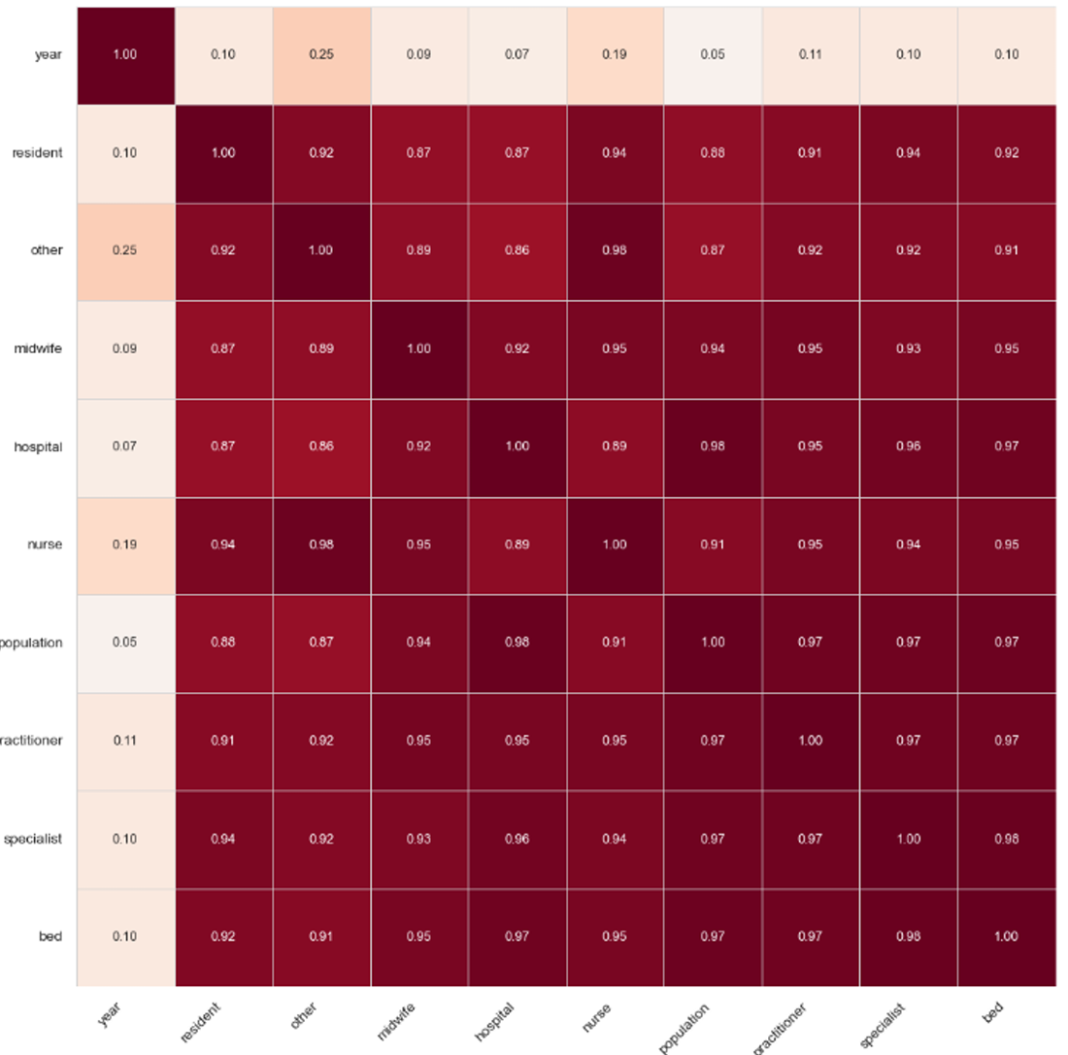
Data Preprocessing
Irrelevant features were removed from the dataset.
Dentists and pharmacists were excluded from hospital-based analysis.
The final dataset consists of 16,119 records.
Correlation analysis indicated strong relationships among variables.

Slide 10
Machine Learning Models
Classical Regression Models
Tree-Based Ensemble Models
Deep Learning Models
Time Series Forecasting Models
Support Vector Regression
K-Nearest Neighbors Regression

Slide 11
Results Overview
City Based Approach
Region Based Approach

Slide 12
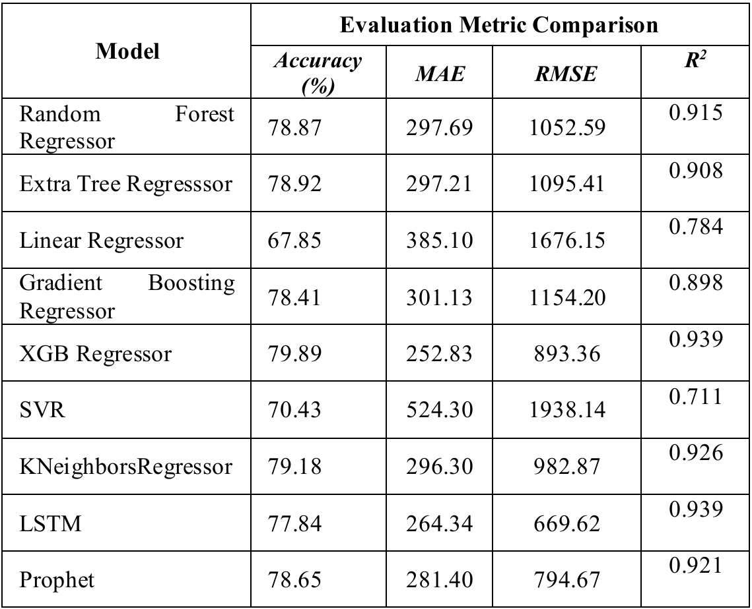
City Based Approach
City-level forecasts were generated for 2024 using nine machine learning models.
Hyperparameter optimization and cross-validation were applied to ensure robust and generalizable results.
Model performance was evaluated using Accuracy, MAE, RMSE, and R² metrics.

Slide 13
Why City-Based Results Are Limited
The city-based approach did not yield the desired prediction performance.
01
In less developed cities, healthcare personnel data contained zero values, especially during 2002–2010.
02
Between 2010–2020, these cities still had very small personnel counts (e.g., 1–10), limiting the reliability of city-level forecasting.
03

Slide 14
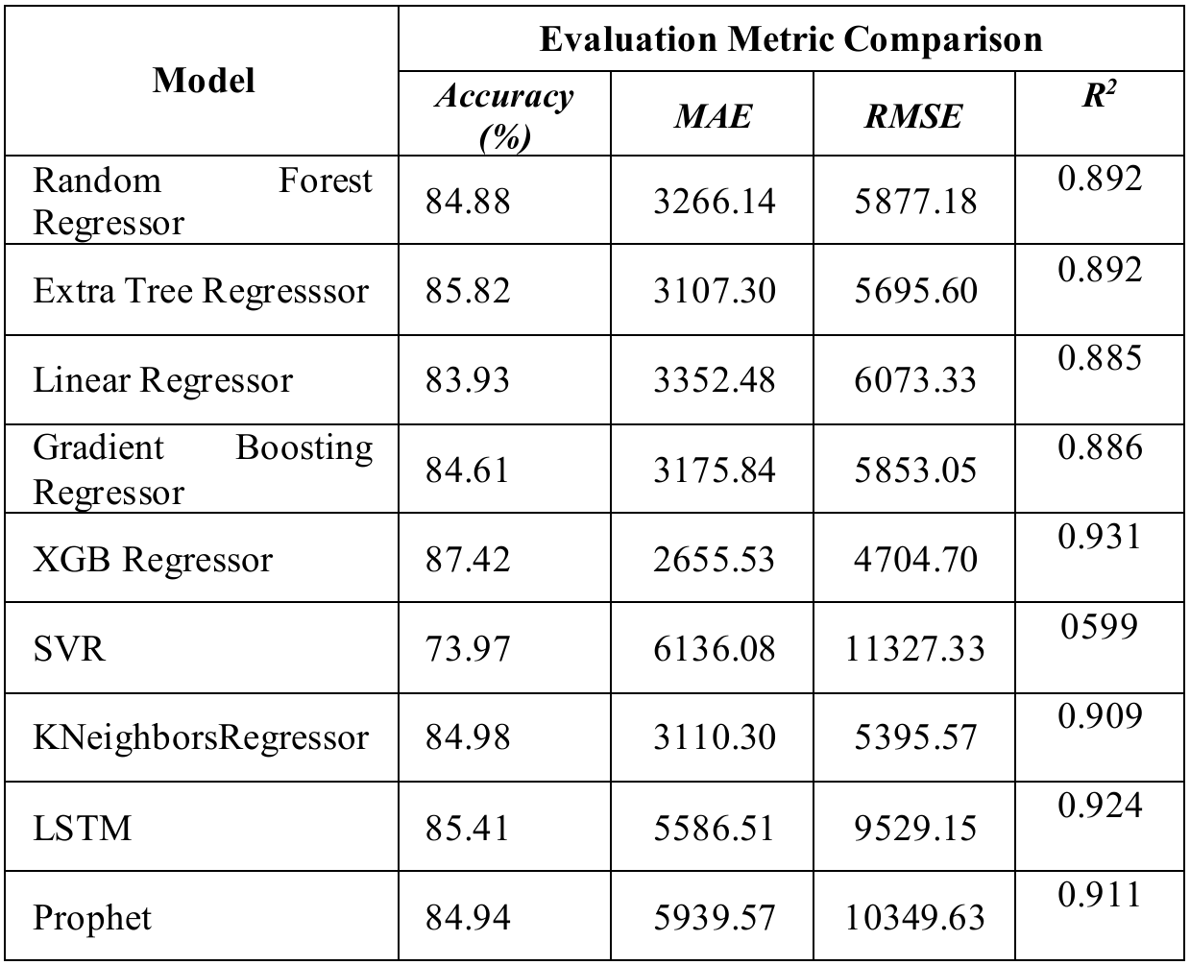
Region-Based Approach
In the second phase, forecasts were conducted using a region-based perspective.
Aggregating cities into regions reduced data sparsity and local variability observed in city-level analysis.
As a result, the region-based approach produced more stable and reliable workforce demand predictions.

Slide 15

Best Performing Model and Limitations
XGBoost achieved the best overall performance by effectively modeling non-linear relationships in the data.
Its robust handling of complex and multivariate features contributed to higher predictive accuracy.
The model accuracy did not exceed 90% due to external factors such as earthquakes, major healthcare assignment regulations, and the 2014 TUEY reform.

Slide 16
Conclusion
This study demonstrates that a data-driven, region-based approach provides more reliable forecasts for healthcare workforce planning.
Machine learning models can support more informed and proactive assignment decisions in national healthcare systems.

Slide 17
Thank You For Your Attention

