Slide 1


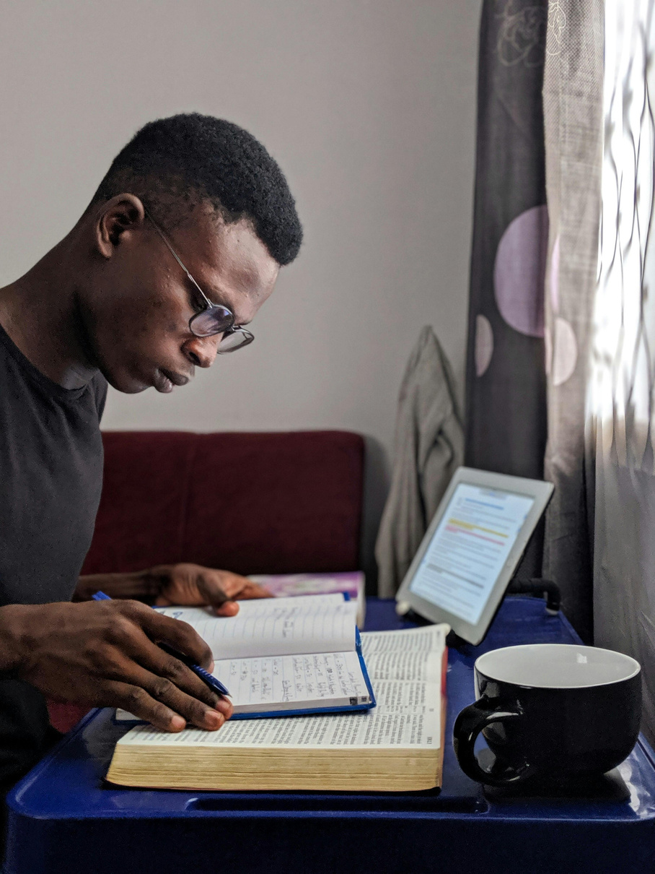

QUIET TIME,
MY HABIT
A Pattern of Daily Devotion & Prayer
By Pastor Emmanuel Ofoe

Slide 2
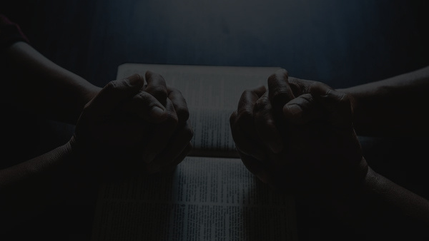
It is the Spirit who gives life; the flesh profits nothing. The words that I speak to you are spirit, and they are life.
John 6:63(NKJV)

Slide 3
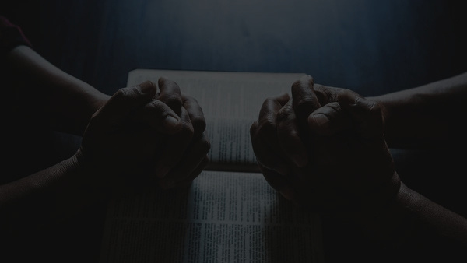
But Jesus often withdrew to lonely places and prayed.
Luke 5:16(NIV)

Slide 4
Very early in the morning, while it was still dark, Jesus got up, left the house and went off to a solitary place, where he prayed.
Mark 1:35(NIV)

Slide 5
WHAT IS QUIET TIME?
1
It’s a consistent, quality, personal time with your LORD.

Slide 6
WHAT IS QUIET TIME?
2
It is a daily appointment that you keep with God.

Slide 7
WHAT IS QUIET TIME?
3
It is a one-on-one, heart-to-heart time with your LORD.

Slide 8
WHAT IS QUIET TIME?
4
It is your private time of prayer, meditation, contemplation, worship of God & a study of the Bible.

Slide 9
WHAT IS QUIET TIME?
5
It is a time of conversation (fellowship) with your LORD, for the strengthening of your relationship with Him.

Slide 10
WHY SHOULD I HAVE QUIET TIME?
1
My source of livelihood is “in Him”.
You thrive only in His Presence. Why miss His feed which He prepared just for you
For in Him we live, and move, and have our being; as certain also of your own poets have said, For we are also His offsprings. (Acts 17:28)

Slide 11
WHY SHOULD I HAVE QUIET TIME?
2
The LORD reveals Himself to those who are attentive to Him.

Slide 12
WHAT ARE THE COMPONENTS OF EFFECTIVE QUIET TIME?
Worship
- Psalm 100:2,4
Prayer
(including confessions & intercessions)
- Ephesians 6:18
Bible Studies
- 1 Peter 2:2, 2 Timothy 2:15

Slide 13
WHAT ARE THE COMPONENTS OF EFFECTIVE QUIET TIME?
Meditation
- Joshua 1:8, Psalm 1:2
Fasting
(Occassionally)
- Matthew 17:21

Slide 14




WHAT ARE THE TOOLS I NEED FOR EFFECTIVE QUIET TIME?
Holy Bible
A journal/jotter
A pen

Slide 15



WHAT ARE THE TOOLS I NEED FOR EFFECTIVE QUIET TIME?
Daily devotional aid
Highlighters
A quiet place
(Optional)

Slide 16

HOW DO I APPROACH GOD?
1
Invitation:
Inviting the all the Great God into your small space. We are the other place, He is the great one. If you can pray prayers in the Bible, you will have your faith lifted up - pray one these scripture back to GOD:

Slide 17
Ask for His presence and help as you read and pray:
Psalm 16:8
Psalms 27:4,9-10
Psalm 40:16-17
Psalm 63:1-3 Psalm 84:5-7 Psalm 103:1-2
Psalm 139:7-10
Isaiah 57:15
Matthew 11:28-30
John 4:23
Ephesians 1:17-19
Ephesians 3:16-21
Ephesians 3:19-21
Psalm 119:17-20

Slide 18
HOW DO I APPROACH GOD?
2
Bible Plus Meditation
Choose a Scripture. Study the passage: Read 3-4 times

Slide 19
HOW DO I APPROACH GOD?
3
Choose a verse and paraphrase in your own words. Also, do well to memorize the verse and/or choose an appropriate memory verse

Slide 20
HOW DO I APPROACH GOD?
4
Meditate and write answers to the following questions:
a) What should I praise God for? list what it says about; God (the Father, Son and Holy Spirit), Yourself, Examples to follow, Promises to claim

Slide 21
b) What should I confess?
c) What need do I have? How should I ask God?

Slide 22
d) How is Jesus Christ and His grace crucial to helping me overcome the sin I have confessed or the need I have identified?

Slide 23
e) How would this change my life if I took it seriously– if this truth was fully alive and effective in my inner being?

Slide 24
Why might God be showing me this now?
What is going on in my life right now that God is speaking to me about?

Slide 25
NOTE: If you can't do that, then you have nothing to share with people. Do this for yourself and do it for others. This is the apostolic questioning that will change the world.

Slide 26
Matt. 11:12 – the Kingdom of heaven is forcefully advancing from the birth of Christ; the kingdom of heaven is advancing when early in the morning, people are asking that question (e).

Slide 27
Any other ministry is dependent on that. This is where you can prophecy – declare what your your life will look like

Slide 28
PRAYER
Pray through each of the meditations that God will give you grace that the fruit will flow out of your life

Slide 29
CONCLUSION
For each episode of your Quiet Time;
Enjoy the uncommon fellowship with your LORD.
Take note of the life's principles from the Word of God.
Receive those necessary instructions for walk with the LORD

Slide 30
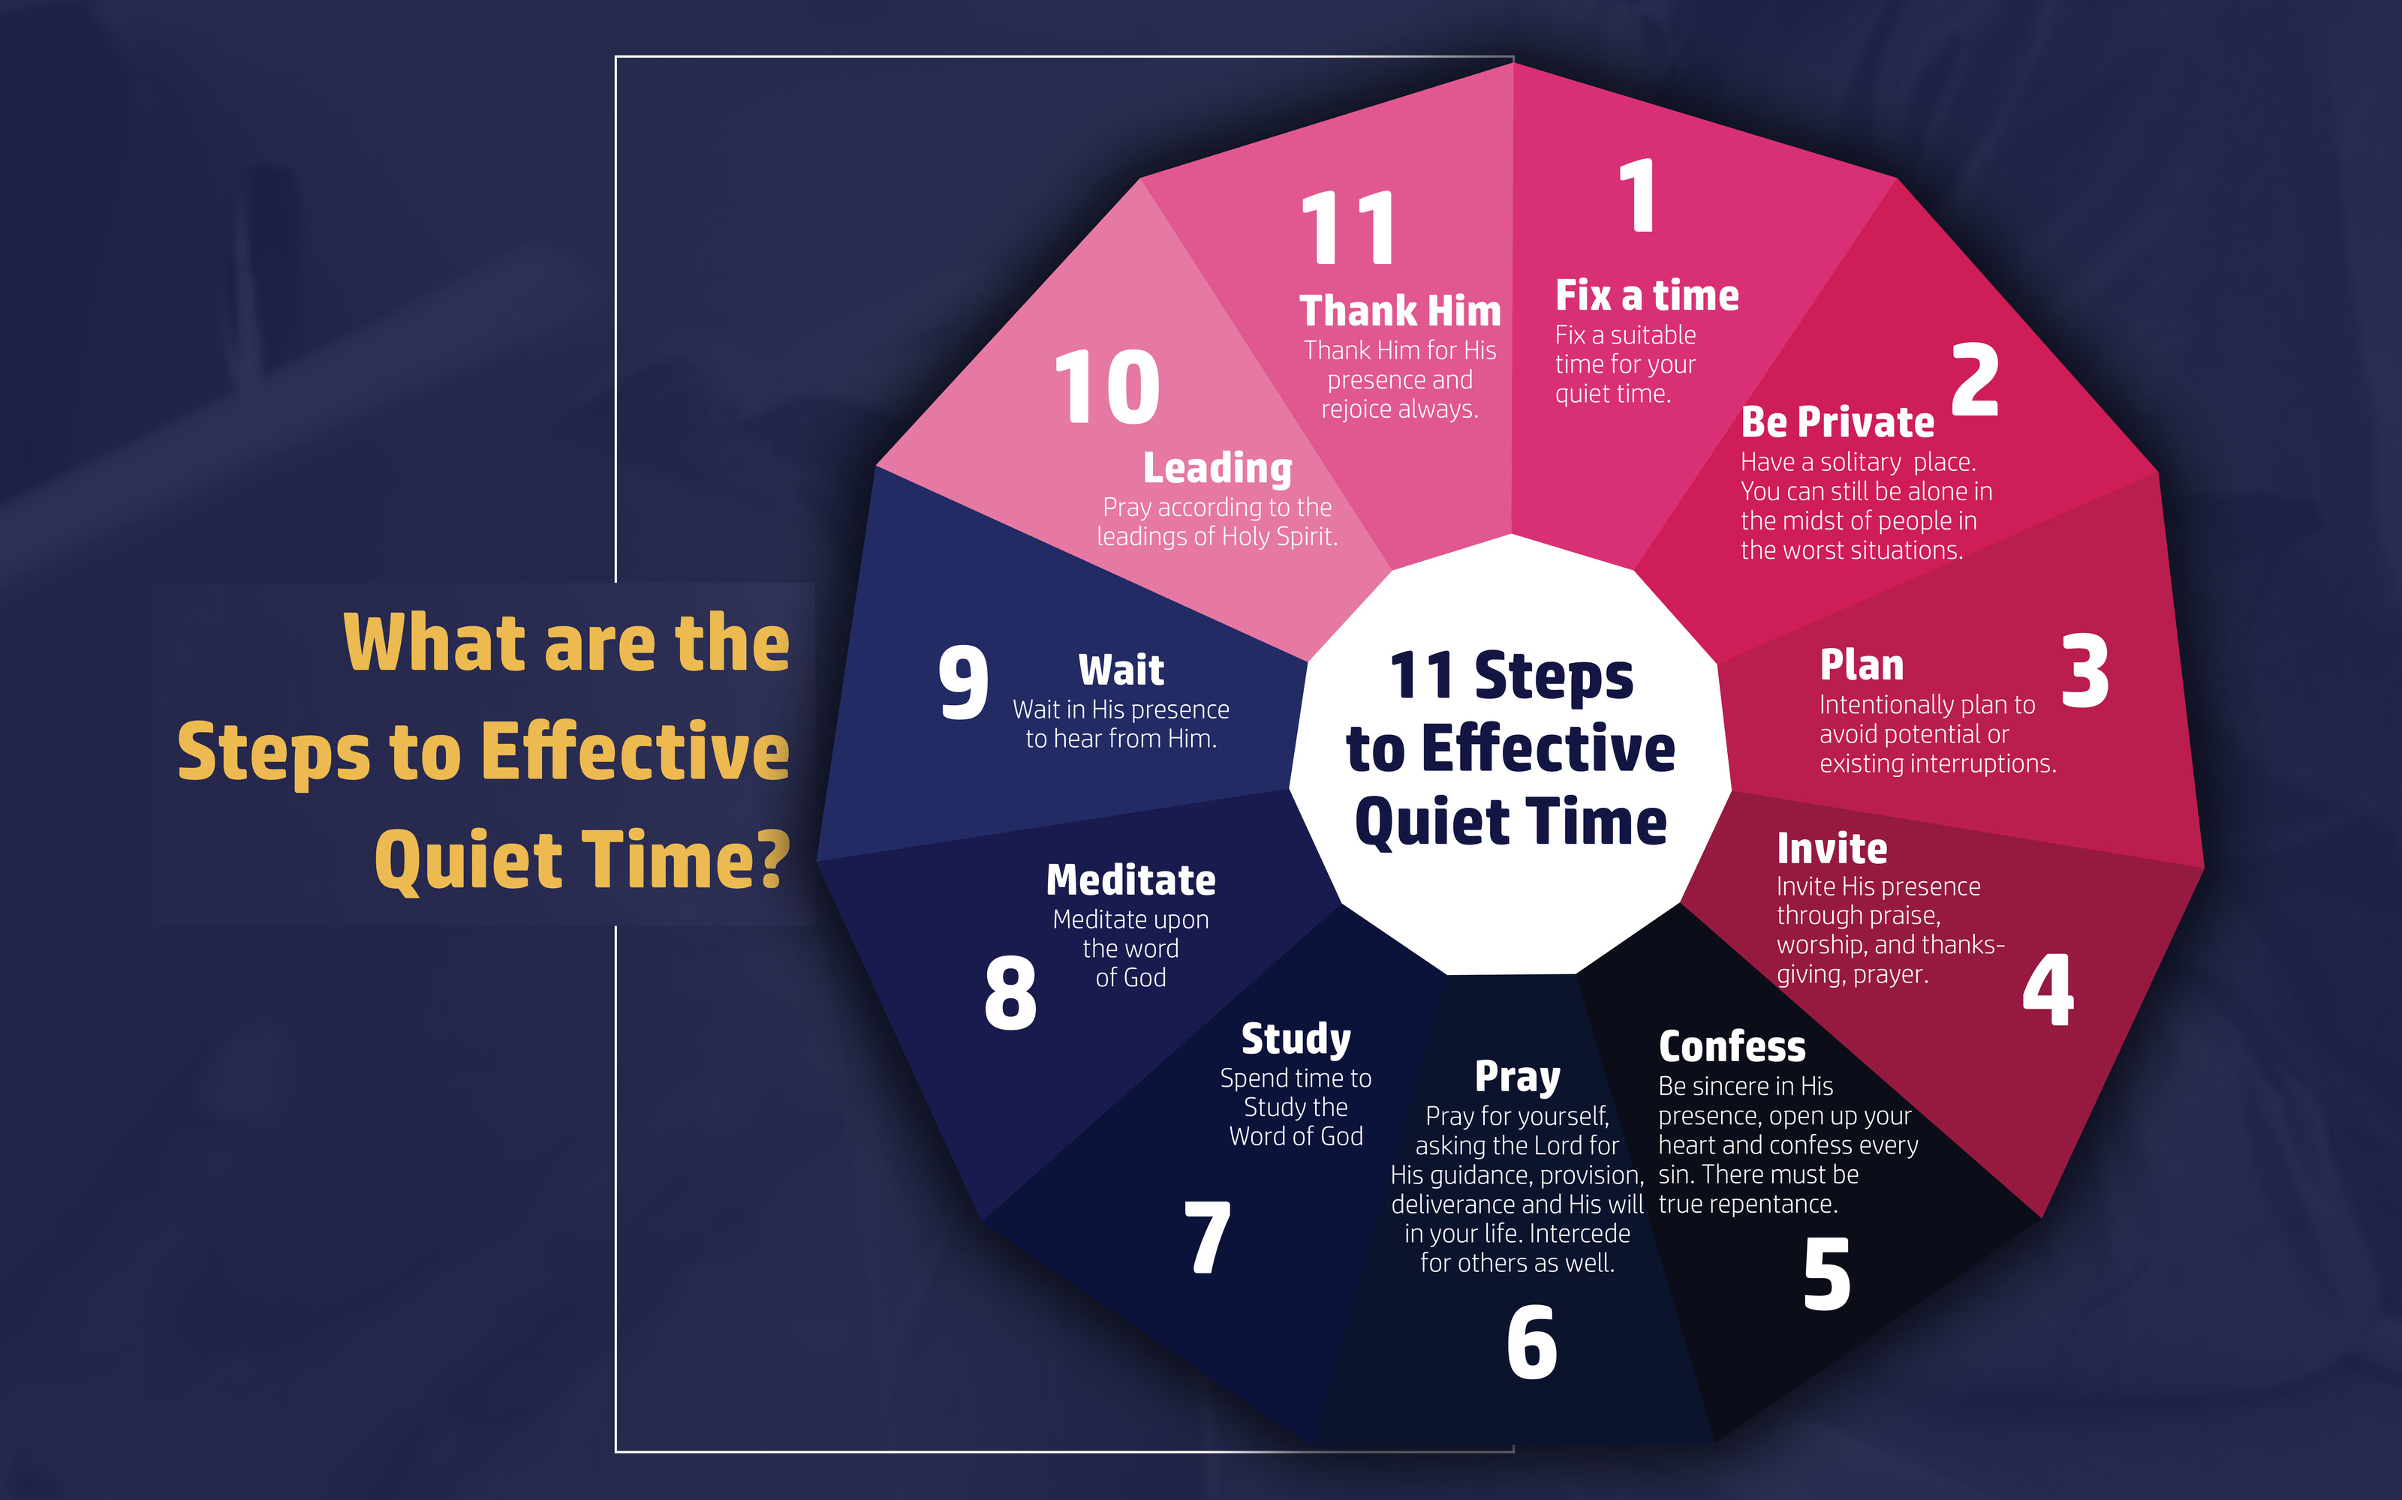

Slide 31


