Slide 1


Weekly Performance
Review
Revenue and Debt Overview
Presented by:
Date: 29. 07. 2025

Slide 2


Executive Summary
Total outstanding debt : US$ 7.84 Million (78% aged, 22% not aged)
Top 3 aged debt contributors: DELL ENTP (43%), DELL (20%), IBM (9%) and NMP (9%)
Business units with 100% aged debt: BCS, DELL, NMP

Slide 3
DEBT BY BUSINESS UNITS
Business Unit
Aged
Not Aged
GRAND TOTAL
% Aged
% Contribution to Aged
% Contribution to Total
APC
438.84
335.80
774.64
57
0
0
BCS
84, 511.93
84, 511.93
100
1
1
CISCO
5111, 3711.51
286, 295.72
797,667.23
64
8
10
DEL ENTP
2,629,578.02
1,081,500.05
3,711,078.07
74
43
47
DELL
1,207,335.10
1,207,335.10
100
20
15
HUAWEI
77,187.21
48,818.88
126, 006.09
61
1
2
IBM
559, 516.03
110, 368.43
669, 884.46
84
9
9

Slide 4

Cont’d
DEBT BY BUSINESS UNIT
Business Unit
Aged
Not aged
GRAND TOTAL
% Aged
% Contribution to Aged
% Contribution to Total
IPG
127,467.81
151,648.65
279,116.46
46
2
4
LENOVO
24,998.20
24,998.20
0
0
0
MICROSOFT
50, 010.66
10,803.56
60, 814.22
82
1
1
NMP
45,738.77
45,738.77
100
1
1
PSG
574,283.53
60,185.86
634, 469.39
91
9
8
STARLINK
4,629.11
4,629.11
100
0
0
SUPPLIES
188, 441.00
377.34
188,818.34
100
3
2
GRAND TOTAL
6,085,507.72
1,750,334.29
7,835,842.01
78
100
100

Slide 5
DEBT BY BUSINESS GROUP
Business Group
Aged
Not aged
GRAND TOTAL
% Aged
% Contribution to Aged
% Contribution to Total
COMPUTING
599, 281.73
60, 185.86
659, 467.59
91
10
8
ENTERPRISE SOLUTION ALPHA
4,907,800.66
1,478,164.20
6,385,964.86
77
81
81
ENTERPRISE SOLUTION BETA
161,699.14
48,818.88
210,518.02
77
3
3
MOBILE
45,738.77
45,738.77
100
1
1
MODERN LIFESTYLE SOLUTION
574,283.53
60,185.86
634, 469.39
100
0
0
POWER
438.84
335.80
774.64
57
0
0
PRINT
4,629.11
4,629.11
46
2
4
SOFTWARE
127,467.81
151,648.65
279,116.46
82
1
1
SUPPLIES
188, 441.00
377.34
188,818.34
100
3
2
GRAND TOTAL
6,085,507.72
1,750,334.29
7,835,842.01
78
100
100

Slide 6
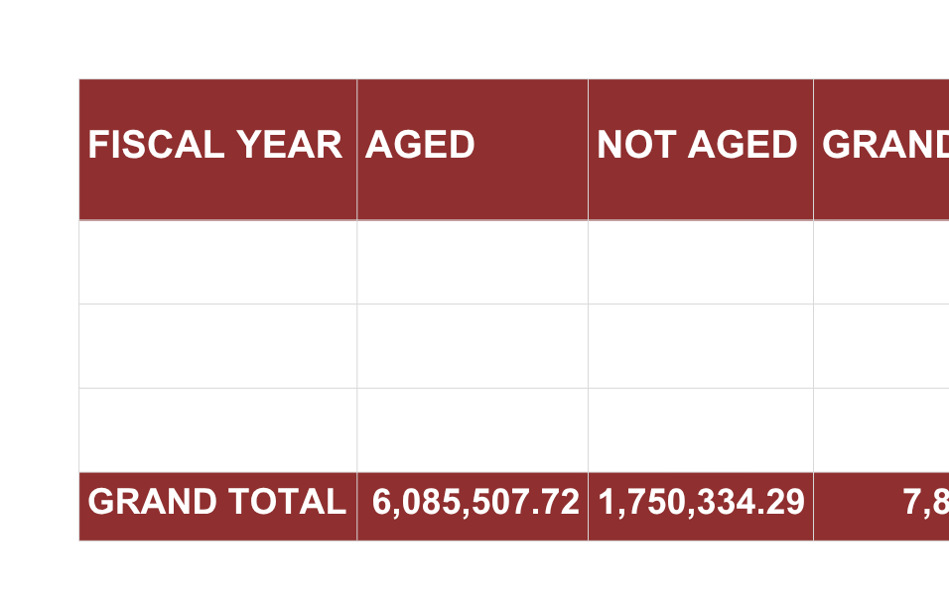
DEBT BY FISCAL YEAR (FY)

Slide 7
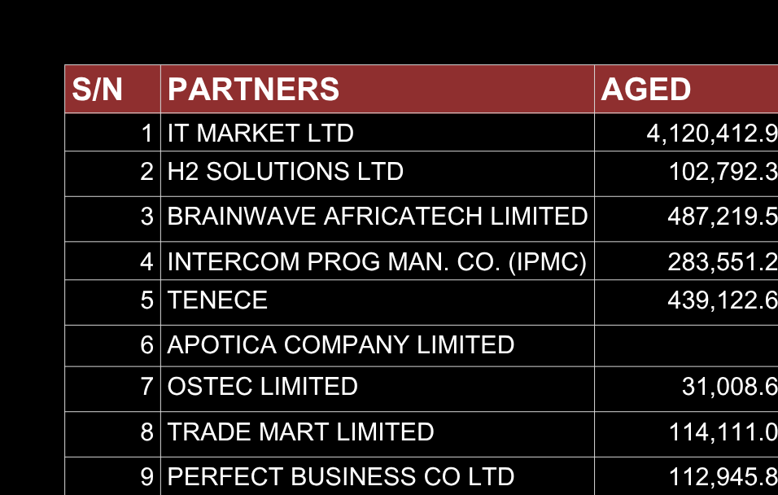
TOP 15 AGED DEBTORS

Slide 8
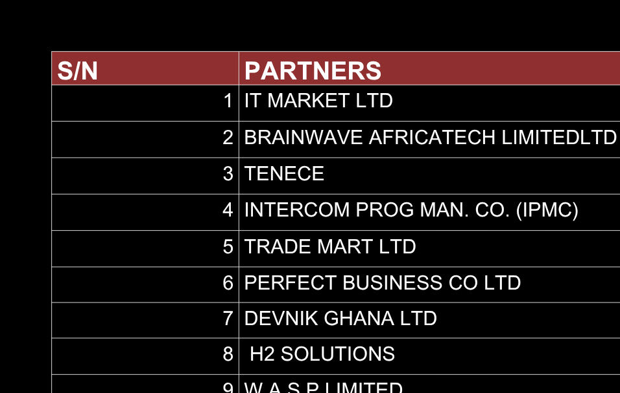
TOP 15 AGED DEBTORS

Slide 9
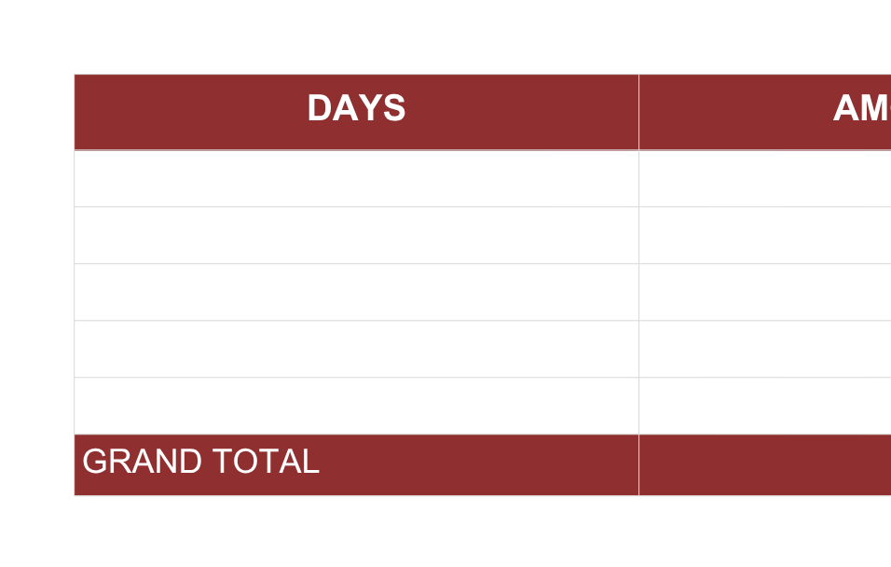
AGING ANALYSIS

Slide 10
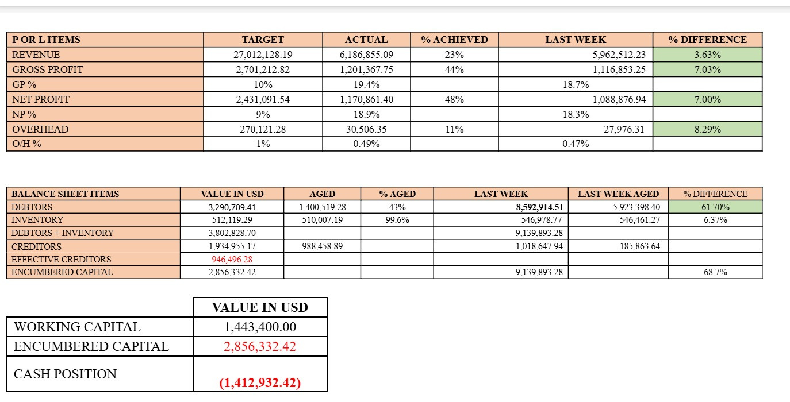
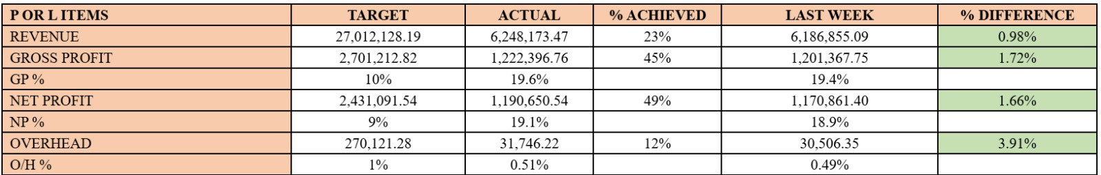
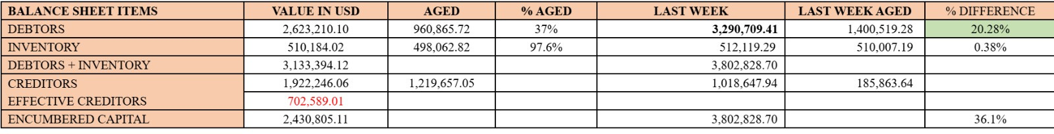
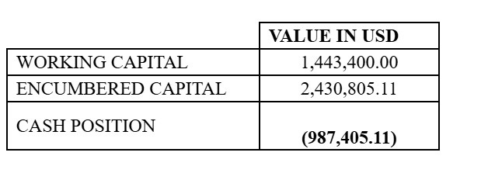
BRANCH PERFORMANCE

Slide 11
Conclusion
While our Ghana operations remain profitable, we face a critical challenge: 78% of total debt is aged, with GHS 4.9M overdue beyond 121 days. This aging has placed significant strain on cash flow.
To address this, we will launch a targeted collections drive, prioritizing major debtors such as DEL ENTP and IT MARKET LTD, and review existing credit terms to reduce future exposure.
With swift execution and full team commitment, we are confident in restoring financial balance and protecting our growth trajectory.

Slide 12
Thank you

