Slide 1
Entity Sets
Example

Slide 2
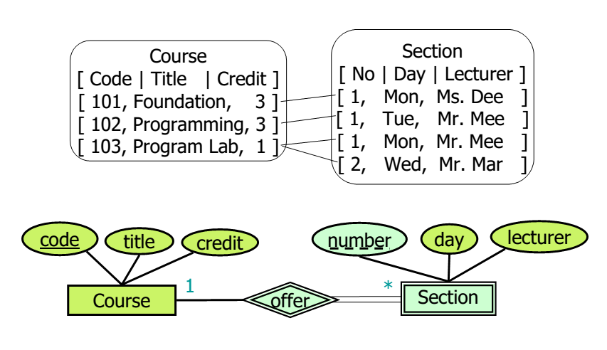
Weak Entity Set: Example

Slide 3
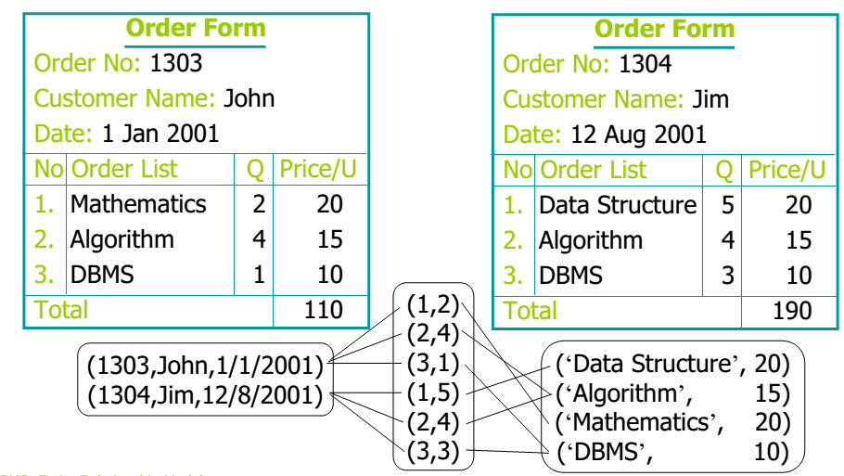
Weak Entity Set: Example

Slide 4
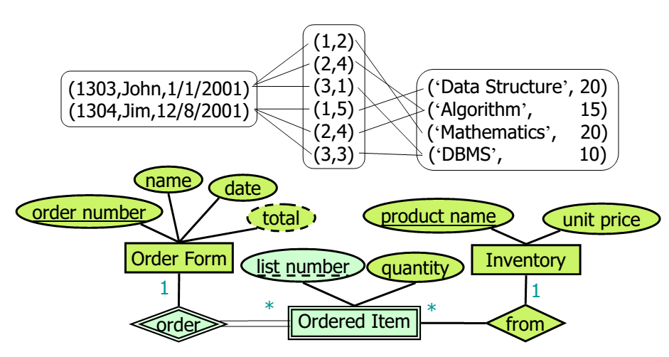
Weak Entity Set: Example

