Slide 1
Spring MVC

Slide 2
Topics in this session
What Problem Does MVC Solve?
MVC Concepts
Web Applications: REST

Slide 3
What Problem Does MVC Solve?
MVC is a software architectural pattern.
It allows to segregate presentation part from business logic part in application.
Initially was invented for desktop applications.

Slide 4
MVC Concept.
Controller
View
Model

Slide 5
Spring MVC
View
Controller
Model: Business Logic & Data Access

Slide 6
MVC: Request Processing Lifecycle
View could be implemented on server side.
Form/Command
Dispatcher Servlet
Controller
View Template (JSP/Velocity)

Slide 7
MVC: Request Processing Lifecycle
But not necessary.
Browser
REST
Controller
Dispatcher Servlet

Slide 8
MVC: Request Processing Lifecycle
Main players
dispatch request
request (URL)
Dispatcher Servlet
Handler
result view
request (URL)
render
Key Artifacts:
DispatcherServlet
Handlers
Views
View

Slide 9
MVC: DispatcherServlet
Heart of Spring Web MVC.
Doing the following:
A “front controller”
- coordinates all request handling activities
- analogous to Struts ActionServlet / JSF FacesServlet
Delegates to Web infrastructure beans
Invokes user Web components
Fully customizable
- interfaces for all infrastructure beans
- many extension points

Slide 10
MVC: DispatcherServlet configuration
Defined in web.xml
Uses Spring for its configuration
- programming to interfaces + dependency injection
- easy to swap parts in and out
Creates separate “servlet” application context
- configuration is private to DispatcherServlet
Full access to the parent “root” context
- instantiated via ContextLoaderListener
- shared across servlets

Slide 11
MVC: Request Handlers
Incoming requests are dispatched to handlers
There are potentially many handlers per DispatcherServlet
Dispatcher Servlet
Handler
handleRequest (request/response)

Slide 12
MVC: Request Handlers (controllers)
Mediator between View and Model
Should be as simple as possible.
No extra logic here.
Handler: @Controller
@Controller
public class ExampleController {
@RequestMapping("/listAccounts.htm")
public ModelAndView list() {
...
}
}
Literally, “execute this method to
process requests for /listAccounts.htm”

Slide 13
MVC: Request Handlers (mapping rules)
Mapping rules you define are typically URL-based, optionally using wild cards:
- /login.htm
- /editAccount.htm
- /reward/*/**
Mapping rules in Spring 2.5: defined using annotations or XML:
- @RequestMapping(“/login.htm”)
Mapping rules in Spring < 2.5: defined in XML
- Using the normal <beans/> config language

Slide 14
MVC: Handlers (controllers) result
After request handling, Controllers return a result object called a ModelAndView
- Selects the view to render the response
- Contains the data needed for rendering
The Model is the contract between the Controller and the View
The same Controller often returns different ModelAndView objects
- To render different types of responses

Slide 15
ModelAndView Result Object
Controller
returns
ModelAndView
Model
View

Slide 16
MVC: Views
A Controller returns a view to render the model.
The View generates the HTTP response
A Controller may return a concrete View implementation like
new JstlView(“/WEB-INF/reward/list.jsp”)
new RewardListingPdf()
Or a view name like “list”
The DispatcherServlet will resolve the name to a View implementation
Or null
The DispatcherServlet will select the view for the request

Slide 17
MVC: View Resolvers
The DispatcherServlet delegates to a ViewResolver to map returned view names to View implementations
The default ViewResolver treats the view name as a Web Application-relative file path
Override this default by registering a ViewResolver bean with the DispatcherServlet
Common view resolver strategies
Internal resource
Bean name

Slide 18
Custom Internal Resource View Resolver Example
1
handle GET /reward/list
DispatcherServlet
RewardController
rewardList
model={rewards}
2
rewardList
/WEB-INF/views/rewardList.jsp
Logical view name
Custom
InternalResource
ViewResolver
Resolved physical path
<bean class=“org.springframework.web.servlet.view.
InternalResourceViewResolver”>
<property name=“prefix” value=“/WEB-INF/views/” />
<property name=“suffix” value=“.jsp” />
</bean>

Slide 19
Quick start
Steps to developing web application functionality with Spring MVC
Deploy a Dispatcher Servlet (one-time only)
Implement a request handler (controller)
Implement the View(s)
Register the Controller with the DispatcherServlet
Deploy and test
Repeat steps 2-5 to develop new functionality

Slide 20
Quick start: Deploy a DispatcherServlet
Define inside <webapp> within web.xml
<servlet>
<servlet-name>rewardsadmin</servlet-name>
<servlet-class>
org.springframework.web.servlet.DispatcherServlet
</servlet-class>
<init-param>
<param-name>contextConfigLocation</param-name>
<param-value>
/WEB-INF/rewardsadmin-servlet-config.xml
</param-value>
</init-param>
</servlet>
Contains the Servlet’s configuration

Slide 21
Quick start: Deploy a Dispatcher Servlet (2)
Map the Servlet to a URL pattern
<servlet-mapping>
<servlet-name>rewardsadmin</servlet-name>
<url-pattern>/rewardsadmin/*</url-pattern>
</servlet-mapping>
http://localhost:8080/rewardsadmin/reward/list http://localhost:8080/rewardsadmin/reward/new
http://localhost:8080/rewardsadmin/reward/show?id=1

Slide 22
Quick start: Initial Dispatcher Servlet Config
/WEB-INF/rewardsadmin-servlet-config.xml
<beans>
<!--
Define your “web beans” here such as your Controllers and
their URL mapping configurations
Web beans here may reference “application beans” in the “root”
web application context
-->
</beans>

Slide 23
Quick start: After DispatcherServlet Deployment
Java EE™ Web Application
Root WebApplicationContext
All web beans will have access to application beans
DispatcherServlet ApplicationContext

Slide 24
Quick start: Implement a Controller
@Controller
public class RewardController {
private RewardLookupService lookupService;
public RewardController(RewardLookupService svc) {
this.lookupService = svc;
}
@RequestMapping("/reward/show")
public ModelAndView show(HttpServletRequest request) {
String id = request.getParameter(“id”);
Reward reward = lookupService.lookupReward(id);
ModelAndView result = new ModelAndView();
result.addObject(“reward”, reward);
result.setViewName(“rewardView”);
return result;
}
}
Depends on application service
Automatically filled in by Spring
Selects the “rewardView” to render the “reward” model

Slide 25
Quick start: Implement the Views
/WEB-INF/views/rewardView.jsp
<html>
<head><title>Your Reward</title></head>
<body>
Amount=${reward.amount}
Date=${reward.date}
Account Number=${reward.account}
Merchant Number=${reward.merchant}
</body>
</html>
References result model object by name

Slide 26
Quick start: Register the Controller with the DispatcherServlet
/WEB-INF/rewardsadmin-servlet-config.xml
<bean id=“rewardController” class=“rewardsadmin.RewardController”>
<constructor-arg ref=“rewardLookupService” />
</bean>

Slide 27
Quick start: Deploy and Test
http://localhost:8080/rewardsadmin/reward/show?id=1
Your Reward
Amount = $100.00
Date = 2006/12/29
Account Number = 123456789
Merchant Number = 1234567890

Slide 28
Quick start: @Controllers are @Components!
This means you can auto-detect Spring MVC Controllers
<context:component-scan base-package=“rewardsadmin”/>
@Controller
public class RewardController {
private RewardLookupService lookupService;
@Autowired public RewardController(RewardLookupService svc) {
this.lookupService = svc;
}
@RequestMapping("/reward/show")
public ModelAndView show(HttpServletRequest request) { ... }
}

Slide 29
Quick start: Some additional possibilities
Model: Contains all domain model and logic.
Model: @Service @Repository @Entiry
Handler: @Controller

Slide 30
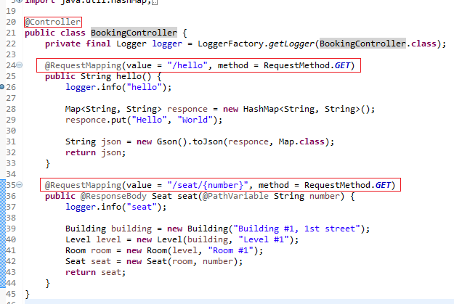
Controller example #1: REST request parameters

Slide 31

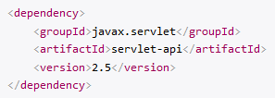
Controller example #2: HttpServletRequest
Or you can see the following mapping:
If cant find HttpServletRequest then add the following dependency:

Slide 32
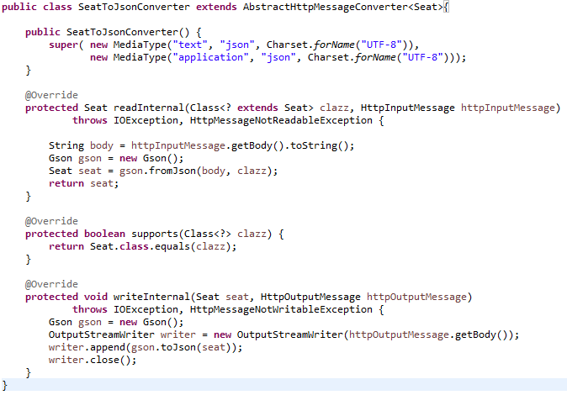
Controller example #3: Message Converter
AbstractHttpMessageConverter

Slide 33
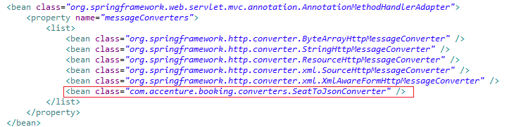
Controller example #3: Message Converter
Spring configuration file

Slide 34
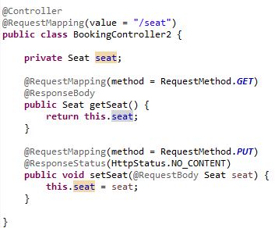
Controller example #3: Message Converter
Controller

Slide 35
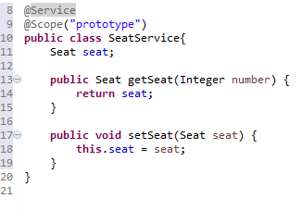
Model example: Service

Slide 36

Questions?

