Slide 1


I Am Your Father
AI · IDENTITY · CRAFT
The joy of engineering in the age of AI
Sunny Kolattukudy
Notes:
Open with the scene everyone knows: Luke on the gantry, Vader's revelation.
Core thesis: We confuse what we do with who we are. AI is changing HOW we engineer software, but not necessarily WHY we became engineers.
Arc for tonight: identity disruption → reflection → historical perspective → expanded possibility → agency and adaptation.

Slide 2
We confuse what we do with who we are.
AI changes how we engineer. Not necessarily why.
Notes:
This is the whole talk in one sentence. Our job titles, our tools, our languages — they become part of how we see ourselves.
When the tools shift underneath us, it can feel like WE are being shifted. Tonight is about separating the two.

Slide 3

The Revelation
PART I
“No. That’s not true. That’s impossible!”
Notes:
Luke discovers something that fundamentally challenges his identity: the villain is his father.
His first response is disbelief, rejection, fear — he'd rather fall than accept it.
AI presents engineers with a similar challenge to professional identity. If a model can write the code, what does that make me?
Pause here. Let people recognize their own first reaction.

Slide 4

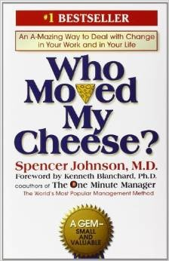




Every reaction is understandable
PART I · THE REVELATION
Who Moved My Cheese?
Spencer Johnson
Sniff
sees it coming
Scurry
acts fast
Hem
resists
Haw
adapts
Notes:
Who Moved My Cheese: two mice (Sniff and Scurry) and two little people (Hem and Haw) respond to the cheese disappearing.
Sniff sniffs out change early. Scurry hustles into action. Hem denies and digs in. Haw is scared, then eventually adapts.
Different people react to fundamental change differently — and every one of those reactions is understandable. Most of us have been Hem at some point this year.
Don't shame anyone in the room for where they are on this.

Slide 5

Why did you become an engineer?
PART II
Remember the first time it worked.
Notes:
Ask the audience: close your eyes for five seconds. What first excited you about this? The first program that ran? The first thing someone else used?
Maybe ask two or three people to shout out answers. You'll hear building, figuring things out, and helping people — which sets up the next slide.

Slide 6


Liberation or loss?
PART II · IDENTITY
Liberation
Loss
It depends which joy of engineering you lean on most.
Addy Osmani · Member of Technical Staff, Anthropic
Notes:
This is where identity comes in. Addy Osmani, who works on Claude Code at Anthropic, posted this on Oct 9, 2026: whether agents feel like liberation or loss depends on which joy of engineering you lean on most.
Some engineers say they've never had more fun: they feel like they're in an all-star lineup. Others mourn the death of their craft and feel hollow. Both are telling the truth.
His point: the 'love coding vs. love shipping' split is too simple. We're mourning different losses and arguing from different places.
And the sadness isn't a failure to adapt. In his words, grief means you're attached to something. That attachment is your identity talking — so let's look at what it's attached to.

Slide 7



The three joys of engineering
PART II · IDENTITY
Making
Knowing
Mattering
flow — the moment it clicks into place
a mental model so sharp you sense the bug
being the expert it all relies on
Addy Osmani (Anthropic), “making, knowing, or mattering” · X, Oct 9 2026
Notes:
Addy Osmani's three sources of joy, which most of us interweave:
• Making (flow): molding something in your hands and feeling it click into place.
• Knowing: a mental model of your system so strong you can sense where the bug is just by glancing at the files.
• Mattering: knowing you're the expert it all relied on.
Ask: which one is yours? Hands up for making… knowing… mattering. Most of us lean on one — and that predicts how AI feels to you.
Agents touch each joy differently. We'll come back to each one in Parts IV and V.
Source: x.com/addyosmani/status/2108444852820066711

Slide 8
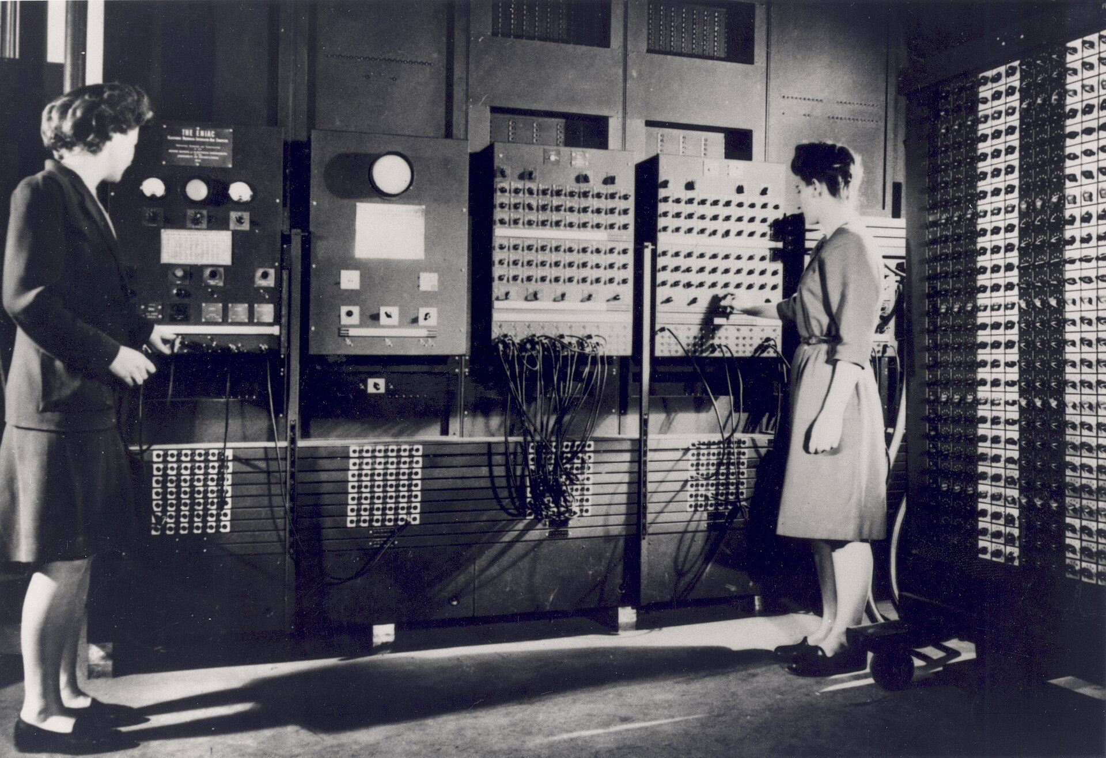
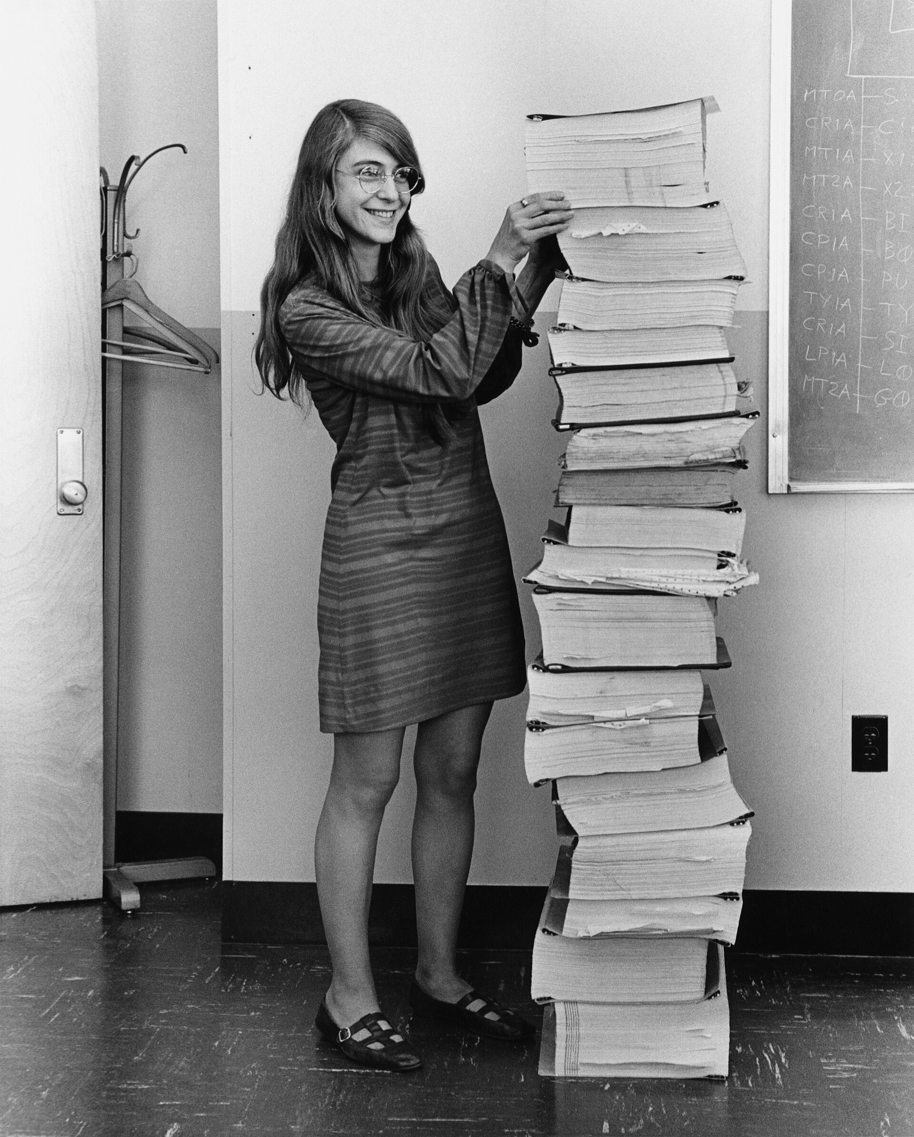
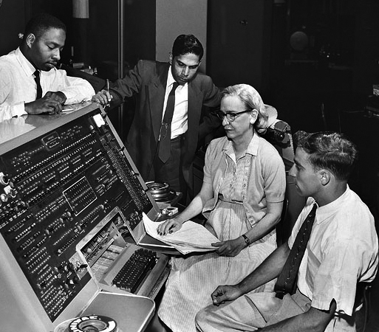
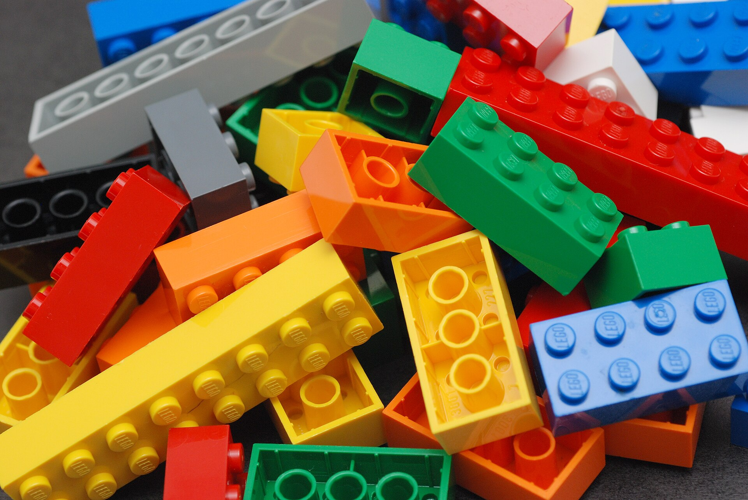



We’ve been here before
PART III
Machine code
Assembly
High-level languages
Frameworks
Cloud
AI agents
Less to execute by hand. More we could build.
Notes:
Machine code → assembly → high-level languages → frameworks → cloud → AI agents.
ENIAC's programmers wired programs by hand. Margaret Hamilton's team wrote Apollo's guidance software in assembly. Grace Hopper was told computers could only do arithmetic — then built the compiler.
Each abstraction changed what engineers needed to understand and personally execute. Each one expanded what an engineer could accomplish.
And at every step, someone felt their mastery had just been made obsolete.

Slide 9
Every abstraction
changes what
mastery means
PART III
Not whether mastery matters.
Margaret Hamilton with the Apollo guidance code · NASA, public domain
Notes:
Margaret Hamilton standing next to the printed Apollo guidance code. That stack WAS mastery in 1969.
Nobody today hand-writes that much assembly — but we didn't stop being masters. Mastery moved: to architecture, systems thinking, reliability, judgment.
Every abstraction changes what mastery means. Not whether it matters.

Slide 10
What’s actually different
PART III · BUT THIS TIME
BEFORE
We delegated instructions
NOW
We delegate decisions
…and some of the reasoning.
Notes:
Be honest that this one IS different. A compiler does exactly what you told it, deterministically.
With AI agents we're increasingly delegating implementation decisions — and some reasoning — not merely instructions.
That's why it feels more personal. It's not just the typing being automated; it's part of the thinking. Which is exactly why our judgment matters more, not less.

Slide 11

You must unlearn what you have learned
PART IV
Notes:
Dagobah. Luke's X-wing is sunk in the swamp. He thinks lifting a starship is fundamentally different from lifting a stone.
Yoda lifts it anyway. Luke: 'I don't believe it.' Yoda: 'That is why you fail.'
Luke's assumptions limited what he believed was possible.

Slide 12
How much can one engineer build?
PART IV · THE POSSIBILITY
Making
Knowing
moves up an abstraction level
don’t just pick — keep conjuring
Notes:
AI challenges our assumptions about how much software one engineer can create. The X-wing isn't heavier than the stone — only in our minds.
Making (Addy Osmani): the easiest joy to keep — it moves up a level. You're shaping the system or the factory, not every line, in a loop fast enough that flow still happens. And when you miss the old flow, nothing stops you writing the code yourself.
Knowing: the joy most at risk of erosion. Picking from an agent's options is a different skill than conjuring an idea yourself. His warning: 'If you always pick and never conjure, the ability to conjure will erode.'
You can't direct what you don't understand. If you don't understand your own codebase, the agent is directing you. Knowing has to evolve deliberately — not disappear.

Slide 13

The Choice
PART V
A revelation about your past doesn’t dictate your future.
Notes:
Luke ultimately refuses to let Vader define who he must become. 'I'll never turn to the dark side.'
Learning where you came from doesn't decide where you go.
Engineers can keep their underlying motivations while reinventing how they practice the craft.

Slide 14
Mattering
comes from us
PART V · THE CHOICE
Choices · Judgment · Impact
Not our tools.
Notes:
The joy of mattering never came from the editor, the language, or the framework.
It comes from what we choose to build, the judgment we bring, and the impact on the people who use it.
Addy Osmani again: obsolescence touches us, but our judgment — and the need for it — has never mattered more. We decide which problems to solve, bring our taste, and own whatever ships.
An AI model can't be accountable. You can.

Slide 15

The tools changed.
The joys don’t have to.
PART VI
Adaptation isn’t abandoning the craft. It’s a new expression of it.
Notes:
Bring it home. Recap the arc: the revelation, why we started, we've been here before, unlearning, choosing.
Adaptation isn't abandoning the craft; it's discovering a new expression of it.

Slide 16

We didn’t become engineers to write syntax.
We became engineers to make, to know, and to matter.
Thank you
Notes:
Let the line land. Pause. Thank you.

Slide 17
Image credits
CREDITS
Two women operating ENIAC — U.S. Army, public domain (Wikimedia Commons)
Margaret Hamilton with Apollo guidance code — NASA, public domain (Wikimedia Commons)
Grace Hopper and UNIVAC — CC BY 2.0 (Wikimedia Commons)
Lego Color Bricks — CC BY-SA 2.0 (Wikimedia Commons)
CERN Computer Center — CC BY-SA 4.0 (Wikimedia Commons)
Who Moved My Cheese? cover — Spencer Johnson / Putnam (via Open Library)
Three joys of engineering (making, knowing, mattering) — Addy Osmani, Anthropic, on X, Oct 9 2026
All other illustrations generated with OpenAI gpt-image-2

