Slide 1
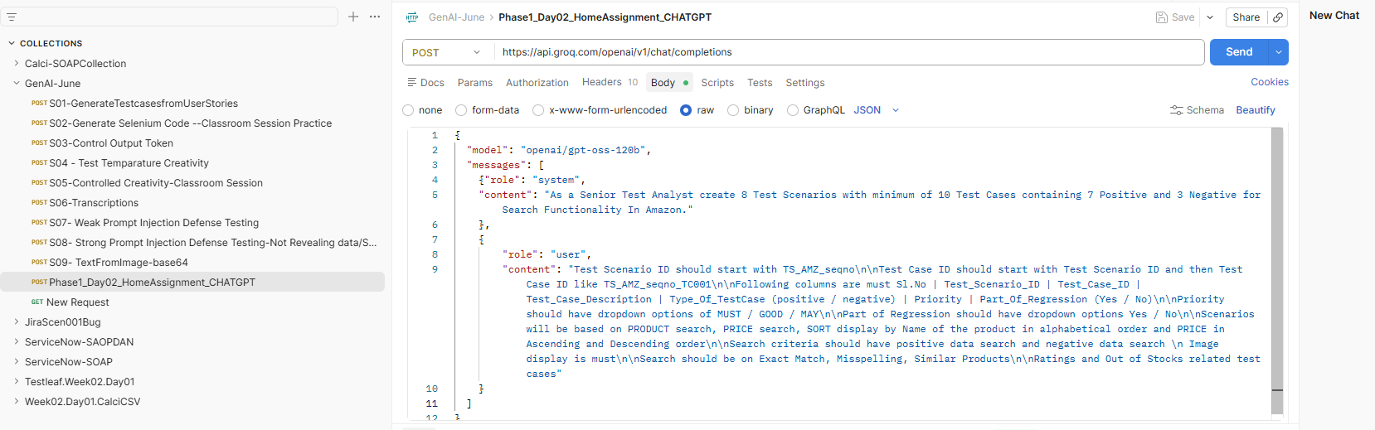

Slide 2
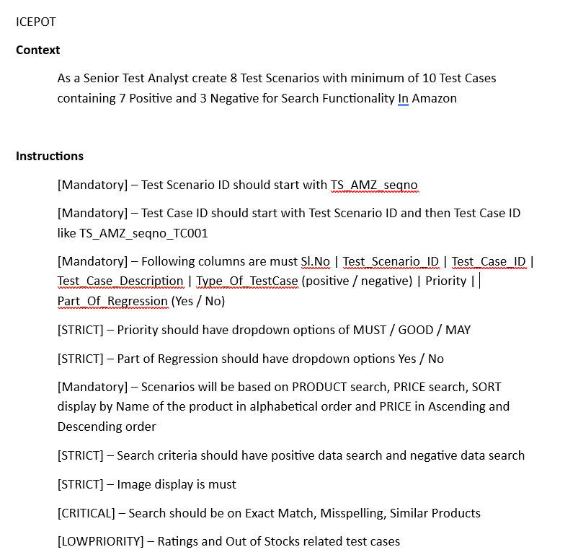
Week2Day1 Assignment used

Slide 3
{
"model": "openai/gpt-oss-120b",
"messages": [
{"role": "system",
"content": "As a Senior Test Analyst create 8 Test Scenarios with minimum of 10 Test Cases containing 7 Positive and 3 Negative for Search Functionality In Amazon."
},
{
"role": "user",
"content": "Test Scenario ID should start with TS_AMZ_seqno\n\nTest Case ID should start with Test Scenario ID and then Test Case ID like TS_AMZ_seqno_TC001\n\nFollowing columns are must Sl.No | Test_Scenario_ID | Test_Case_ID | Test_Case_Description | Type_Of_TestCase (positive / negative) | Priority | Part_Of_Regression (Yes / No)\n\nPriority should have dropdown options of MUST / GOOD / MAY\n\nPart of Regression should have dropdown options Yes / No\n\nScenarios will be based on PRODUCT search, PRICE search, SORT display by Name of the product in alphabetical order and PRICE in Ascending and Descending order\n\nSearch criteria should have positive data search and negative data search \n Image display is must\n\nSearch should be on Exact Match, Misspelling, Similar Products\n\nRatings and Out of Stocks related test cases"
}
]
}

Slide 4
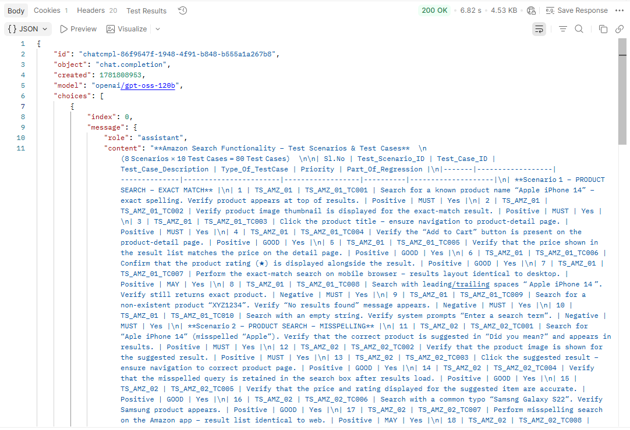

Slide 5
