Slide 1

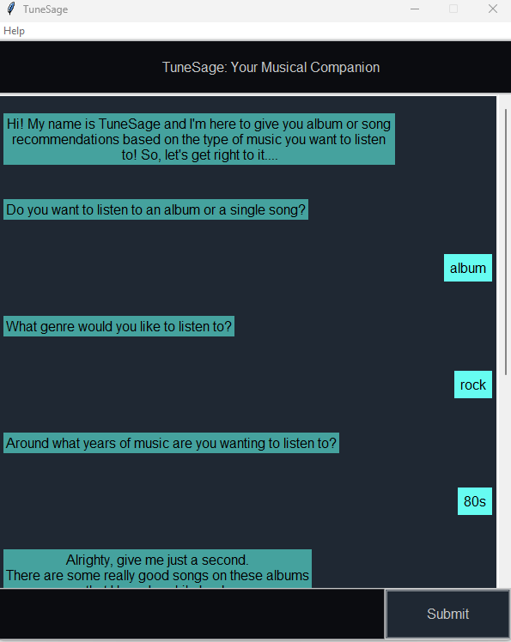
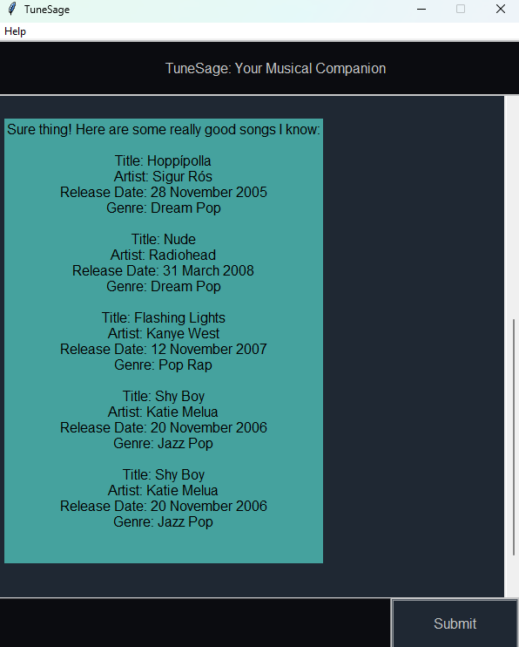
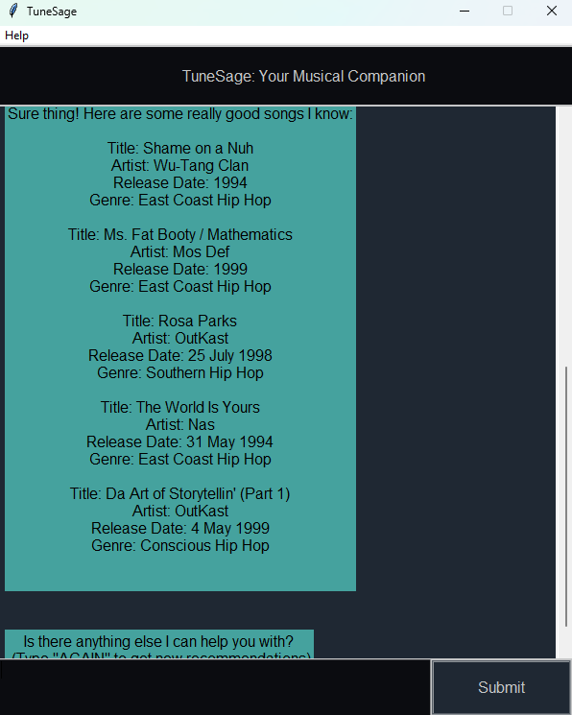
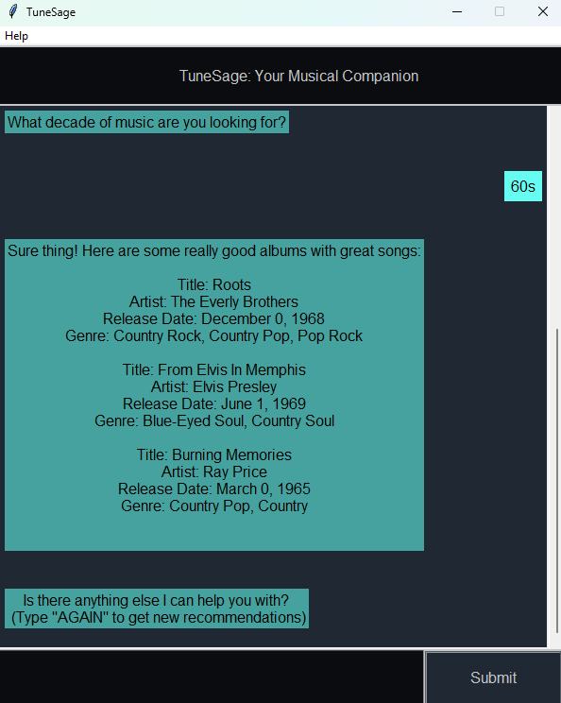
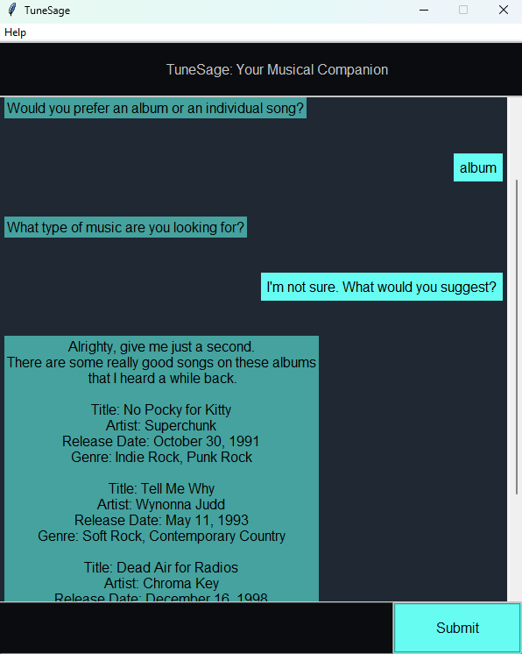
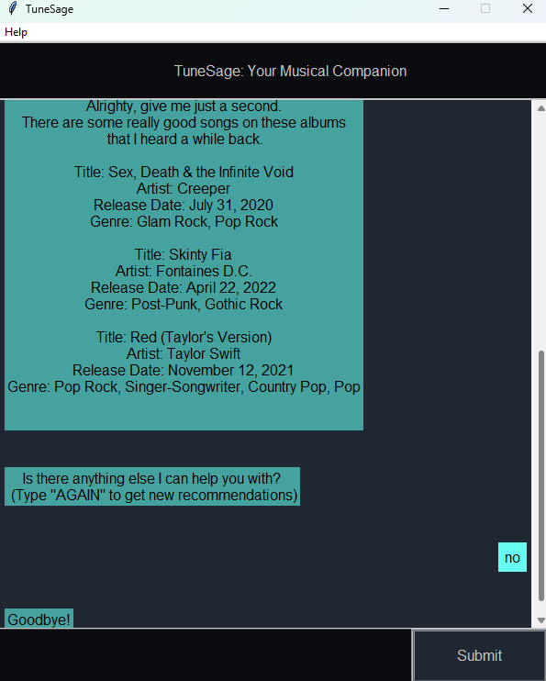
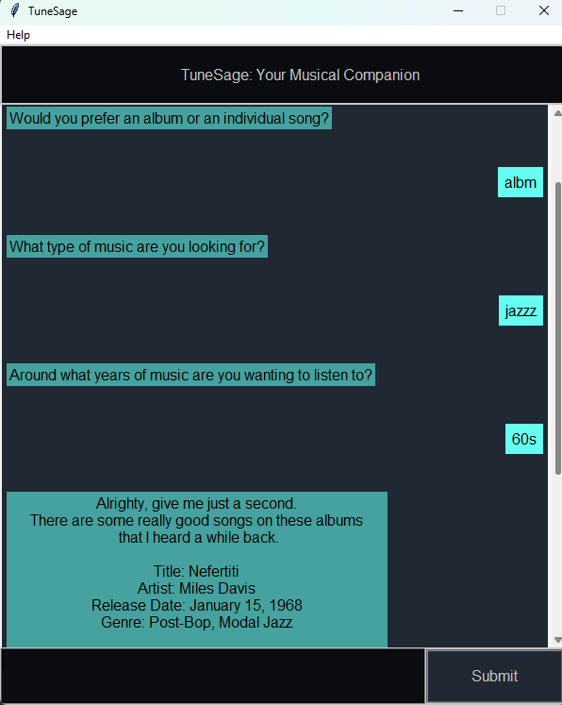
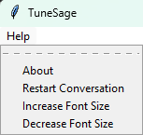
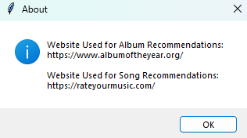
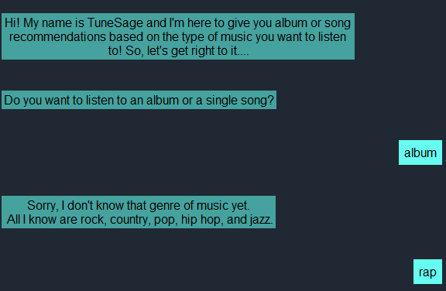
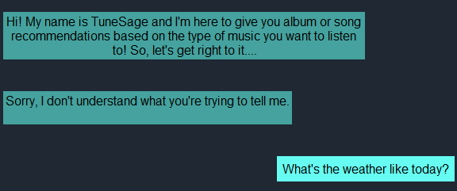
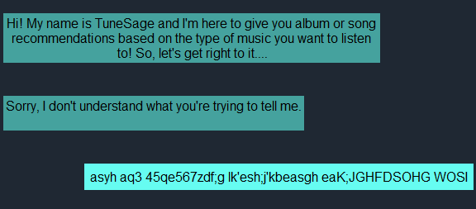
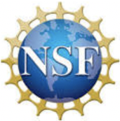
TuneSage: A Rule-Based Chatbot Using Natural Language Processing for Music Recommendations
Kolby Kinkade
Mentor: Dr. Ridwan Noel
Department of Math, Computer Science, and Data Science
Introduction
Implementation
Implementation Details
In this project, a rule-based chatbot was developed that recommends music to users based on their preferences. The user can choose from five genres: Rock, Country, Pop, Hip Hop, and Jazz and can choose to receive albums as a recommendation or individual songs. They are also able to specify the decade they would like the music to be from.
Stages of Implementation:
Selected a subject for the chatbot to cover (music)
Researched how to preprocess human language with the use of natural language processing and regular expression (RegEx)
Installed Jupyter Notebook, a web-based coding platform, to write out code and implement logic
Wrote pseudocode for a general guideline to follow
Implemented logic from pseudocode and using Python, programmed basic rules and conversations the chatbot would follow
Installed tokenization library NLTK (Natural Language Toolkit), regular expression library: re, and a spellchecker library
Implemented Selenium for web scraping albums and songs from https://www.albumoftheyear.org/ and https://rateyourmusic.com/
Implemented a WebDriver to automatically open, load, and close web pages
Developed a graphical user interface (GUI) using PyCharm and the tkinter library
Saved the dictionaries created from web scraping to JSON files for use in the GUI
Transferred logic from Jupyter Notebook to PyCharm and refactored as necessary
Objective
The motivation for this project stemmed from my interest in music and the growing influence that AI and chatbots have on our society. In recent years, AI has grown rapidly and become a common factor in most people’s lives. People use it for everything stemming from asking for its opinion (Siri and Alexa) to solving problems Chat GPT and Gemini). Similarly, people listen to music all the time and often look for new songs to listen to. This project aims to bridge this gap by recommending albums and songs to users based on their preferences and a predefined set of rules that the chatbot must follow.
Background
Rule-Based Chatbot: A chatbot that is simpler than an AI chatbot in that it follows a flow-based design similar to a decision tree flow chart. It solves problems with a predetermined outcome, is predictable, and is less expensive to deploy.
Natural Language Processing: The process of utilizing various methods such as text preprocessing and word tokenization to allow a computer to understand human language. A common library that is used for this is the Natural Language Toolkit (NLTK).
Word Tokenization: The process of breaking down a piece of text (corpus) into individual words (tokens) to make it easier for a computer to process human language
Text Preprocessing: A method to clean text data and make it ready to use. Ex: Spelling corrections and removing punctuation
Stop Words: Words that you want to be ignored or filtered out when processing text. Ex: “No”/ “Yes”
Regular Expression (RegEx): A sequence of characters that form a search pattern to find a string or set of strings
Web Scraping: Code is written to extract data from web pages / websites
Web Crawling: Used to index and find web pages based on hyperlinks
Dictionaries: A collection that is indexed by keys and does not allow for duplicates
Images 1 – 6 show normal functionality of the chatbot by recommending songs or albums based on the user input.
Summary & Future Work
In this project, a rule-based chatbot was developed for music recommendation. The most important lessons learned from this project were the process of NLP, the various techniques used to accomplish it, and how rule-based chatbots require a lot planning before their implementation. Another takeaway from this experience is that additional testing should be done before selecting the appropriate web scraping tool for collecting data from the source websites
In the future, I would like to add more genres and subgenres to the chatbot so that it encompasses a broader spectrum. I would also like to refactor some of the code to make the overall program more efficient.
Image 7 displays the spellchecker feature handling misspelled words.
Images 8 and 9 display the extra features included with the chatbot.
Acknowledgements
Images 10 – 12 show error handling done by the chatbot.
This work is funded under the NSF IUSE: HSI Award #1953561, the TLU VPAA Summer Research Fund, and the TLU Department of Math, Computer Science, and Data Science.

