Slide 1

The dependency inversion principle
Stefano Coluccia

Slide 2

The Dependency-Inversion Principle
Stefano Coluccia
29.09.2016
High-level modules should not depend on low-level modules. Both should depend on abstractions.
Abstractions should not depend upon details. Details should depend upon abstractions.
The DIP helps to decouple your code by ensuring that both high and low level modules depend on abstractions rather than concrete implementation.

Slide 3
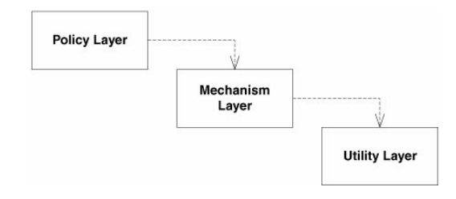
Layering
Stefano Coluccia
29.09.2016
All well structured object-oriented architectures have clearly-defined layers, with each layer providing some coherent set of services through a well-defined and controlled interface.
A naive interpratation of this statement leads to :

Slide 4
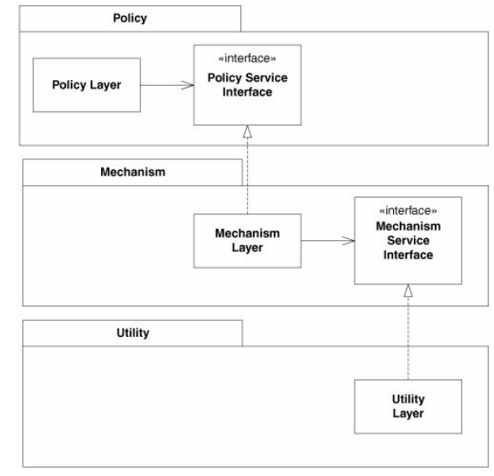
Layering
Stefano Coluccia
29.09.2016
A correct interpretation is :

Slide 5
Ownership inversion
Stefano Coluccia
29.09.2016
The lower-level modules provide the implementation for interfaces that are declared within, and called by, the upperlevel modules.
"Don't call us; we'll call you."

Slide 6
Dependence on Abstractions
Stefano Coluccia
29.09.2016
Simply stated, this heuristic recommends that you should not depend on a concrete class and that rather, all relationships in a program should terminate on an abstract class or an interface.
No variable should hold a reference to a concrete class.
No class should derive from a concrete class.
No method should override an implemented method of any of its base classes.

Slide 7
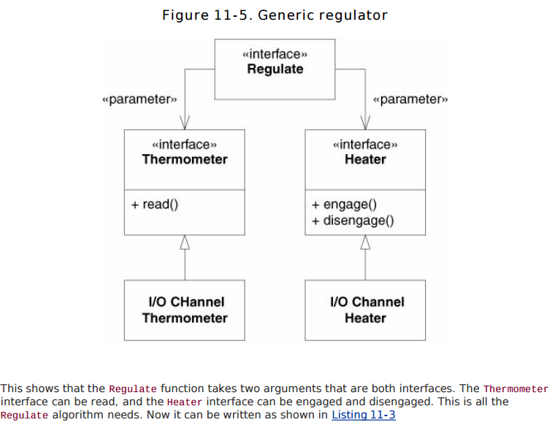
Dubbio ????
Stefano Coluccia
29.09.2016

Slide 8
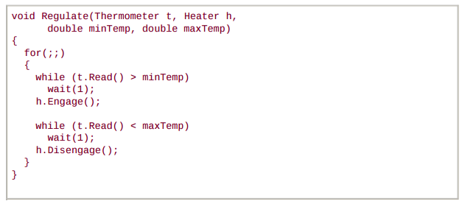
Dubbio ????
Stefano Coluccia
29.09.2016

