Slide 1

Bad Smells in code
Stefano Coluccia

Slide 2

Argomenti trattati
Stefano Coluccia
29.09.2016
Duplicated code
Long method
Large class and long parameters list
Divergent change and Shotgun surgery
Feauture envy

Slide 3
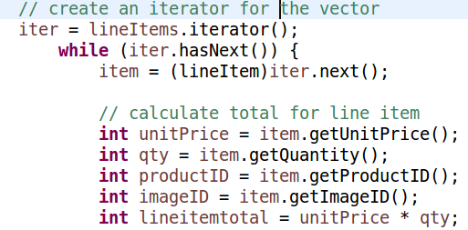
Duplicated code
Stefano Coluccia
29.09.2016
Stategies to use
Extract method : Same expressions in two methods in the same class
Pull up field : Two subclasses have the same field -----> Move the field to the superclass.
Substitute algorithm : You want to replace an algorithm with one that is clearer -----> Replace the body of the method with the new algorithm
Extract class : duplicated code in two unrelated classes -----> extract in one class and then use the new component in the other

Slide 4
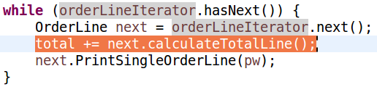
Long method
Stefano Coluccia
29.09.2016
Stategies to use
Extract method
Replace temp with query
Introduce parameter object : group of parameters that naturally go together -----> Replace them with an object
Preserve whole object : several values from an object and passing these values as parameters in a method call -----> Send the whole object instead

Slide 5
Large class and Long params list
Stefano Coluccia
29.09.2016
Stategies to use for Large class
The usual solution for a class with too much code it or that often shows up as too many instance variables is either to Extract Class or Extract Subclass.
Stategies to use for Long parameters list
Long parameter lists are hard to understand, because they become inconsistent and difficult to use. Then use :
Replace parameters with method
Preserve the whole object

Slide 6
Divergent change and Shotgun surgery
Stefano Coluccia
29.09.2016
Divergent change is one class that suffers many kinds of changes, and shotgun surgery is one change that alters many classes.
Stategies to use for Divergent change
The usual solution is to identify everything that changes for a particular cause and use Extract Class to put them all together.
Stategies to use for Shotgun Surgery
In this case you want to use Move Method and Move Field to put all the changes into a single class.

Slide 7

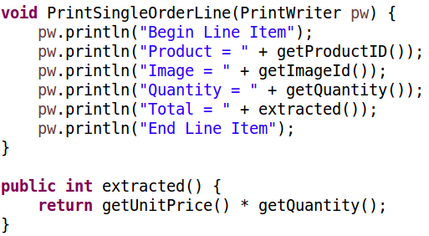
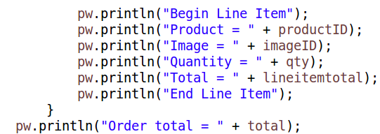
Feauture Envy
Stefano Coluccia
29.09.2016
A classic smell is a method that seems more interested in a class other than the one it actually is in.
Stategies to use
The usual solution is to use Extract method and Move method.

