Slide 1

Object Oriented Analysis and Design
Stefano Coluccia

Slide 2

Purposes
Stefano Coluccia
18.05.2017
Apply principles and patterns to create better object designs.
Iteratively follow a set of common activities in analysis and design, based on an agile approach.
Create frequently used diagrams in the UML notation.

Slide 3
Analysis and Design
Stefano Coluccia
18.05.2017
Analysis emphasizes an investigation of the problem and requirements, rather than a solution.
Design emphasizes a conceptual solution (in software and hardware) that fulfills the requirements, rather than its implementation.
Do the right thing (analysis), and do the thing right (design).

Slide 4
Analysis and Design : steps
Stefano Coluccia
18.05.2017
Define use cases
Play a Dice Game: Player requests to roll the dice. System presents results: If the dice face value totals seven, player wins; otherwise, player loses.

Slide 5
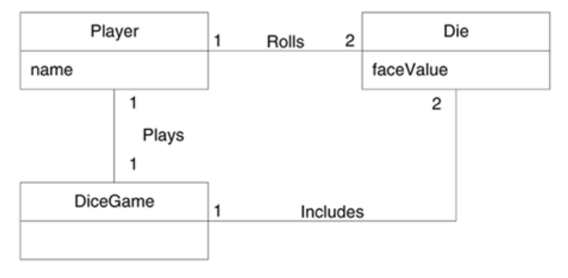
Analysis and Design : steps
Stefano Coluccia
18.05.2017
Define a domain model
Shows the noteworthy domain concepts or objects.

Slide 6
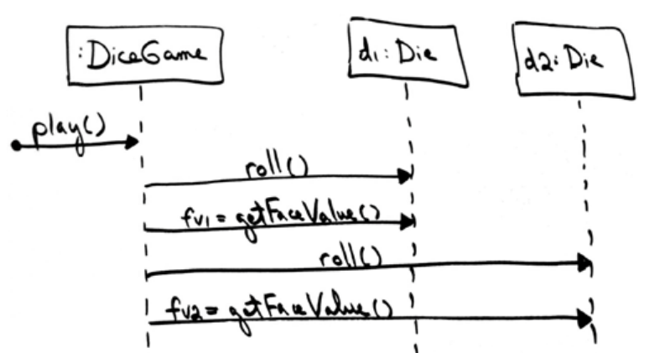
Analysis and Design : steps
Stefano Coluccia
18.05.2017
Assign Object Responsibilities and Draw Interaction Diagrams

Slide 7
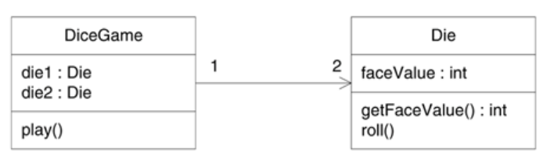
Analysis and Design : steps
Stefano Coluccia
18.05.2017
Define Design Class Diagrams
In contrast to the domain model showing real-world classes, this diagram shows software classes.

