Slide 1
TypeScript 2 WorkShop
// by programming mentor

Slide 2

Hello!
I am Vyacheslav Koldovskyy, programming mentor
You can find me at: programmingmentor.com
mentor@programmingmentor.com https://www.linkedin.com/in/koldovsky

Slide 3
Why TypeScript?
1

Slide 4
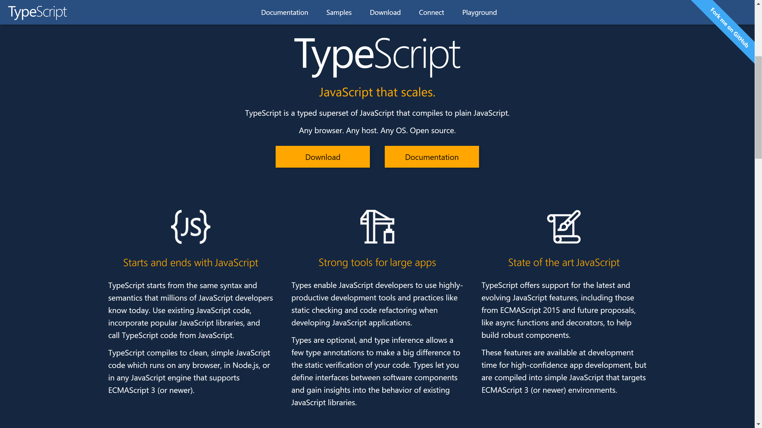

Slide 5
Everything is here:
2
https://github.com/programmingmentor/typescript-workshop

Slide 6
Some links:
3
http://www.typescriptlang.org/
https://www.gitbook.com/book/basarat/typescript/details
https://github.com/Microsoft/TypeScript/wiki/Coding-guidelines
http://stackoverflow.com/a/30357635

Slide 7
Thanks!
Any questions ?
You can find me at:
programmingmentor.com
mentor@programmingmentor.com
https://www.linkedin.com/in/koldovsky

