Slide 1
TypeScript 2 WorkShop
// by programming mentor

Slide 2

Hello!
I am Vyacheslav Koldovskyy, programming mentor
You can find me at: mentor@programmingmentor.com https://www.linkedin.com/in/koldovsky
programmingmentor.com

Slide 3
Why TypeScript?
1

Slide 4
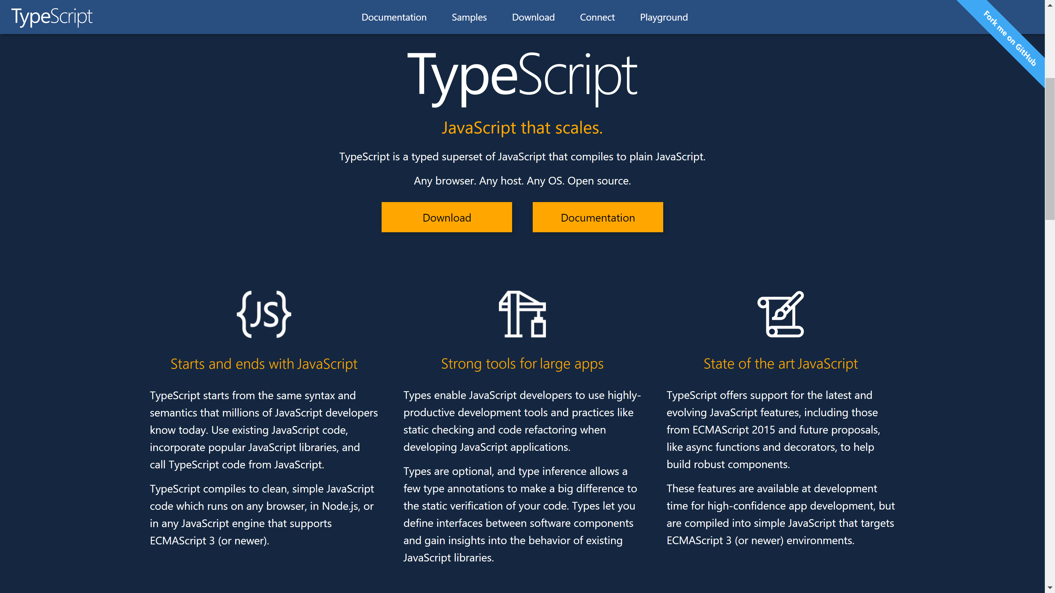

Slide 5
Everything is here:
2
https://github.com/programmingmentor/typescript-workshop

Slide 6
Some links:
3
http://www.typescriptlang.org/
https://www.gitbook.com/book/basarat/typescript/details
https://github.com/Microsoft/TypeScript/wiki/Coding-guidelines
http://stackoverflow.com/a/30357635

Slide 7
Thanks!
Any questions ?
You can find me at:
mentor@programmingmentor.com
https://www.linkedin.com/in/koldovsky
programmingmentor.com

Slide 8
SlidesCarnival icons are editable shapes.
This means that you can:
Resize them without losing quality.
Change line color, width and style.
Isn’t that nice? :)
Examples:

Slide 9
😉
Now you can use any emoji as an icon!
And of course it resizes without losing quality and you can change the color.
How? Follow Google instructions https://twitter.com/googledocs/status/730087240156643328
✋👆👉👍👤👦👧👨👩👪💃🏃💑❤😂😉😋😒😭👶😸🐟🍒🍔💣📌📖🔨🎃🎈🎨🏈🏰🌏🔌🔑 and many more...

