Slide 1
Interview Task
Luis Torres-Cisneros
13.01.2026

Slide 2
Visual Metrology: Edge Detection
Which state of the art approach will you use to detect relevant edges?
  The classical most used (and robust) algorithms are Sobel or Canny filters. The former computes the first derivatives in both x and y direction via kernel convolution and bases on magnitude of the gradient for edges. The later used a similar procedure but also include edge thinning.
Sketch how would you implement your solution. How would you validate your approach?
  Input Image
  Denoising + Edge Sharpening (i.e., bilateral filter)
  Sobel/Cany Filter
  Thresholding (in case of inhomogeneous regions apply adaptive method)
  Morphological transformation
  Labeling (for instance, Hoshen-Kopelman algorithm)
  Approach validation is done via synthetic ground truth.

Slide 3
How you envision the deployment into product C++ software?
  Packaging via package managers as Conan or vcpkg is the most stable way to achieve deployment and rapid integration. They provide already a stable API for CMake project generation.
How do you achieve best speed and leverage modern CPU/GPU hardware?
  Nowadays Multi-Core approaches are addressed via OpenMP. OpenMP is an API with easy-use directives that redistribute independent processes on single-thread execution and is supported by almost all compilers used in production.
  On the other hand, parallelization can be also achieved by subdiving a picture into ROIs that can be moved from host to graphic cards via CUDA. CUDA offers an API for managing execution on graphic cards depending on card architecture.
Where do you see challenges for your approach and how would you address those?
  The biggest challenge is thresholding corresponding edges without loosing connectivity producing spurious contours. To this issue, some other algorithms for curve prediction-correction can be used to look for dangling segments.

Slide 4
Visual Metrology: Geometry estimation
How do you approach the fitting of circles based on edge maps?
  Preprocessing (denoising and blurring for avoiding numerical jumps)
  Contour detection algorithm (we opt for findContours() method by OpenCV 4)
  Contour processing
    Contour softening
    Point selection
    Polynomial expression for second derivative computation (i.e., curvature)
    Local curvature computation
    Curvature statistics for curvature tolerance (i.e., mean curvature ans standard deviation)
    Circle centre computation
  Filter out circles by criteria (arch length, curvature distribution and radii size).
  Why?
  We chose this approach because of the features provided by the probability maps. These are gray scale images with almost well-defined contours. This will require some extra preprocessing in order to soften found contours and extra steps to filter out non-circular objects. Morever, this approach is high-parallelizable since at different levels we require solely loops.

Slide 5
What is the best way to enable a fit that is robust to spurious edges?
  Here, we need some way to fit and predict curve behaviour. There might be a good chance to combine (for instance) a Kalman Filter or a Velocity Verlet algorithm attached to Savitzky-Golay curve softener.
What are the runtime and memory requirements and limitations?
  The largest contour is limited by the image size cols*rows. In prod environment images are about 2000x1000. A desktop computer can achieve up to 200 threads per execution. Then, in the limit case the largest contour could be divided into 10’000 batches. The current implementation takes about 50 miliseconds. Then, a contour of this size would take around 500 seconds. However, contours represent in most of the case a very small space of the picture, let us say smaller than 1%. Then, in this case the whole process should be lesser than 5 seconds.
How would you address the memory limitations?
  Memory limitation can be adressed by analyzing countours by batches. That, is depending on memory the batches should be prepared such that one single batch fits into whole available memory.
How can you optimize runtime?
  Currently there is just one call to OpenMP-based parallelization, even though there are some other parallelizable parts within the implementation. OMP can be then applied to other parts of the code to decrease computation time.
How do you ensure correctness?
  We base the implementation on known synthetic data. Then, functionality is ensured/obtained via unit-tests. In the end, integration tests are also included to assure the whole workflow.

Slide 6
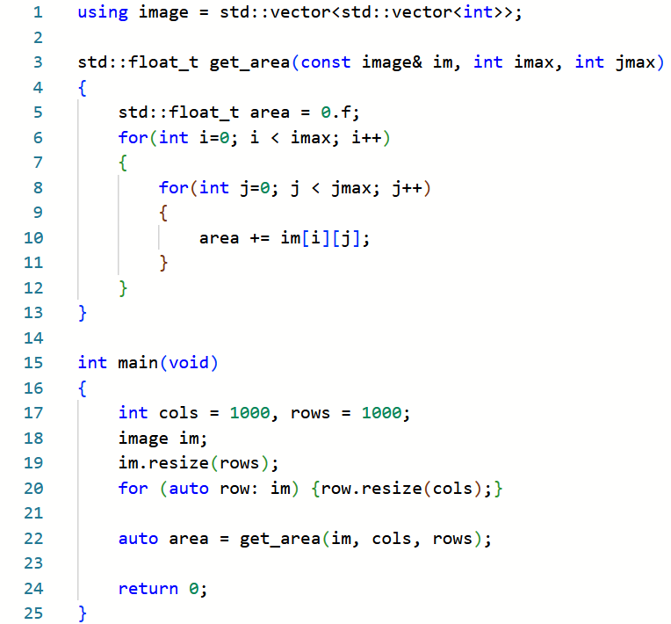
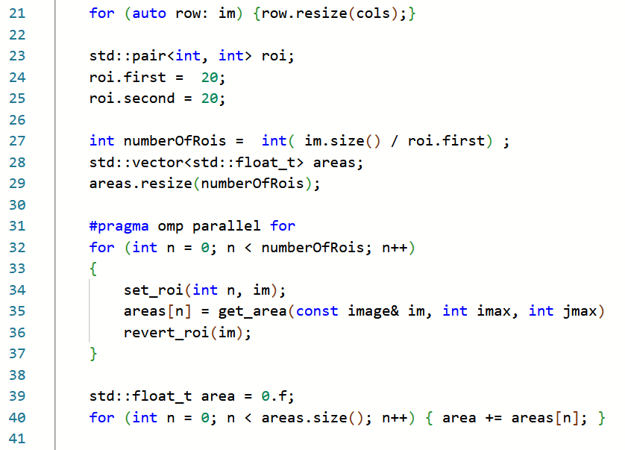
Integral Image
Sketch an implementation on single- and multi-core.
single
multi

Slide 7
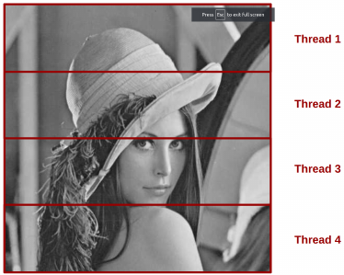
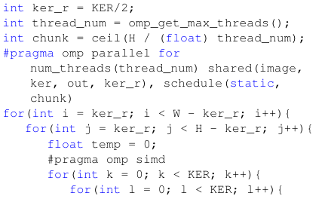
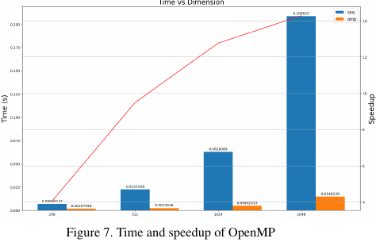
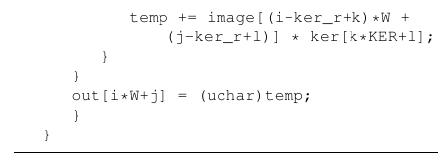
Convolution example of vectorization
Sketch an implementation on single- and multi-core.
https://github.com/DragosTana/image_processing.git

Slide 8
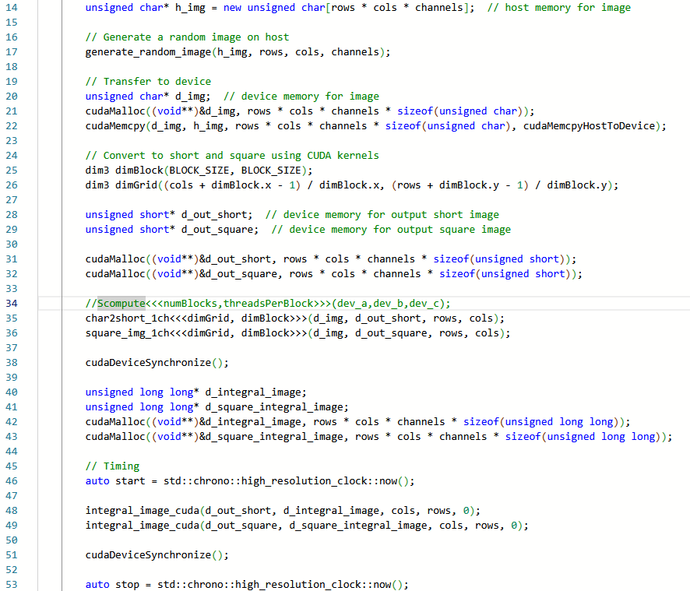
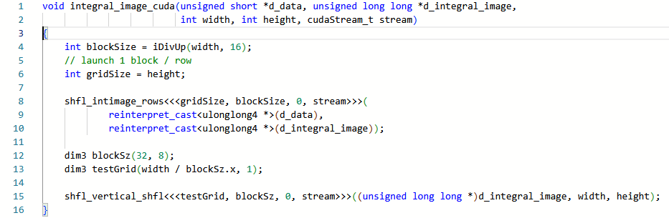
How would you parallelize the computation on GPU?
https://github.com/Plumess/Calculate-integral-image-using-cuda.git

Slide 9
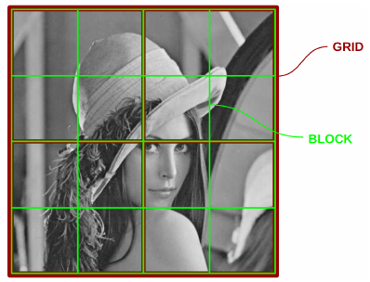
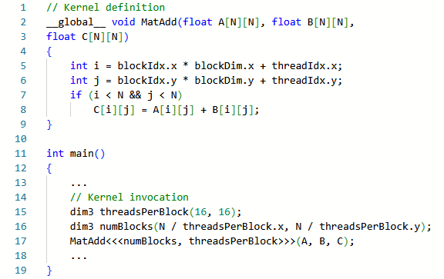
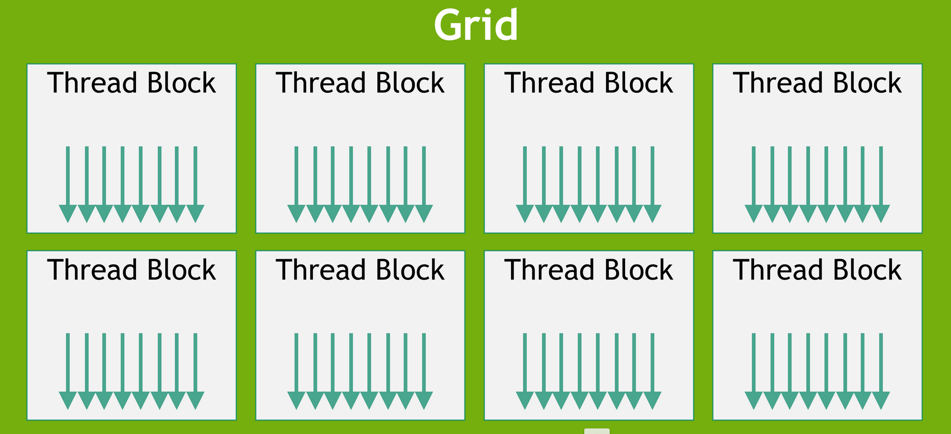
Reminder of threads and blocks CUDA
https://docs.nvidia.com/cuda/cuda-c-programming-guide/

