Slide 1

Large datasets. Processing and visualization
Nikolay Koldunov
Summer 2010

Slide 2
Climatologies and reanalysis
Good start is Real Climate page:
http://www.realclimate.org/index.php/data-sources/
Atmosphere:
ERA40 (1957-2001, from ECMWF)
ERA-Interim (1989 – present, ECMWF’s latest project)
NCEP/NCAR reanalysis (1948-present, NOAA)
JRA-25 (1979-2004, Japanese Met. Agency)
Ocean:
World Ocean Atlas 2009
Extended Reconstructed Sea Surface Temperature (ERSST, 1880-2010)
Polar science center Hydrographic Climatology (PHC)

Slide 3
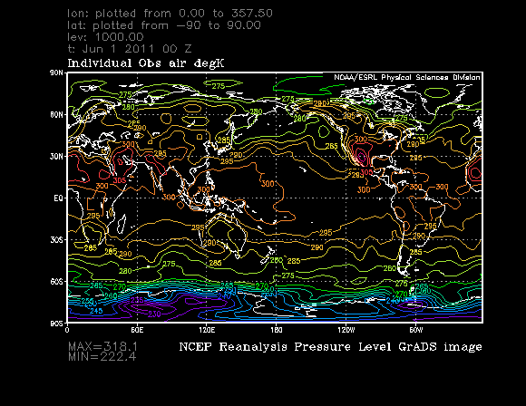
NCEP/NCAR reanalysis
http://www.esrl.noaa.gov/psd/data/reanalysis/reanalysis.shtml
Temporal Coverage:
4-times daily, daily and monthly values for 1948/01/01 to present
Long term monthly means, derived from data for years 1968 - 1996
These variables are instantaneous values at the reference time.
Spatial Coverage:
2.5 degree latitude x 2.5 degree longitude global grid (144x73)
90N - 90S, 0E - 357.5E
Quite often used as atmospheric forcing for ocean models.

Slide 4
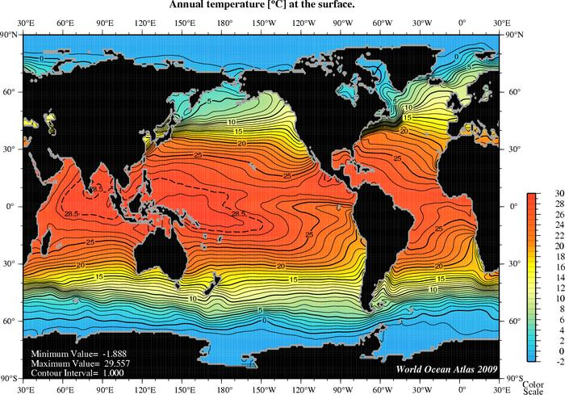
World Ocean Atlas 2009 (WOA09)
http://www.nodc.noaa.gov/OC5/WOA09/pr_woa09.html
Set of objectively analyzed (1° grid) climatological fields of in situ temperature, salinity and some other characteristics at standard depth levels for annual, seasonal, and monthly compositing periods for the World Ocean.
Often used as intialisation for ocean models

Slide 5

This data organized in matrixes or arrays
Columns
1 3 5 7
8 9 0 4
2 4 9 0
1 0 8 1
3 0 5 0
2 9 7 9
axis 1 (rows)
Rows
axis 2 (columns)
axis 3
a(axis1, axis2, axis3)

Slide 6
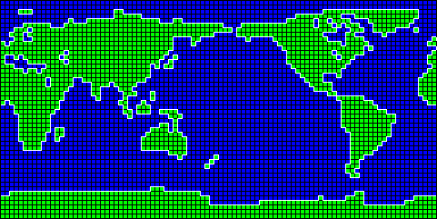
Why matrices?
Output of global circulation models (GCM):
http://www.cccma.ec.gc.ca/data/grids/geom_llg_96x48.shtml
Matrix 48x97
lat = 48
lon = 97
Example of 3d matrix?

Slide 7
Main data formats
ASCII data
binary data
self describing formats (e.g. netCDF)

Slide 8
ASCII data
The American Standard Code for Information Interchange is a character-encoding scheme based on the ordering of the English alphabet. ASCII codes represent text in computers.
Usually data presented in a form of columns with delimiter (coma, space …)
Relatively easy to import to Exel, IDL or Matlab

Slide 9
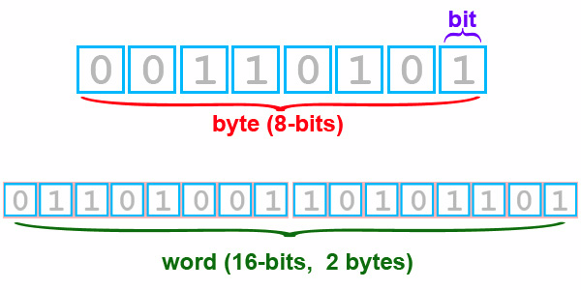
Binary data
Representation of information in computers:
http://isis.astrogeology.usgs.gov/IsisWorkshop/index.php/Understanding_Bit_Types
A binary file is a computer file which may contain any type of data, encoded in binary form for computer storage and processing purposes

Slide 10
Self describing format netCDF
NetCDF (Network Common Data Form) - machine-independent data format that support the creation, access, and sharing of array-oriented scientific data.
VARIABLES:
Names , Attributes, Coordinates
variables:
float lat(lat) ;
lat:long_name = "latitude" ;
lat:units = "degrees_north" ;
float lon(lon) ;
lon:long_name = "longitude" ;
lon:units = "degrees_east" ;
int time(time) ;
time:long_name = "time" ;
time:units = "Month of Year" ;
float T(time, lat, lon) ;
T:long_name = “Temperature”;
T:units = “C" ;
T:missing_value = 1.e+20f ;
T:_FillValue = 1.e+20f
DIMENSIONS:
dimensions:
lat = 64 ;
lon = 128 ;
time = 12 ;
FILE ATTRIBUTES:
global attributes:
:title = “Temp: 1999" ;
:source = “NCAR” ;
:conventions = "None" ;

Slide 11
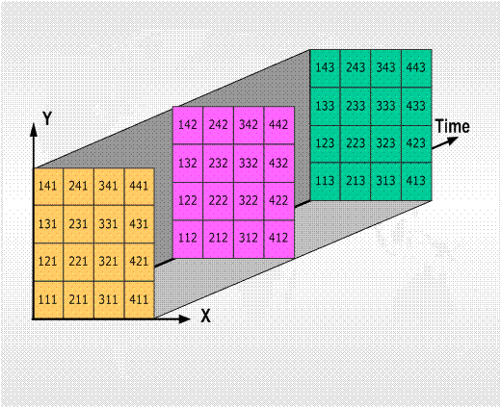
Self describing format netCDF

Slide 12
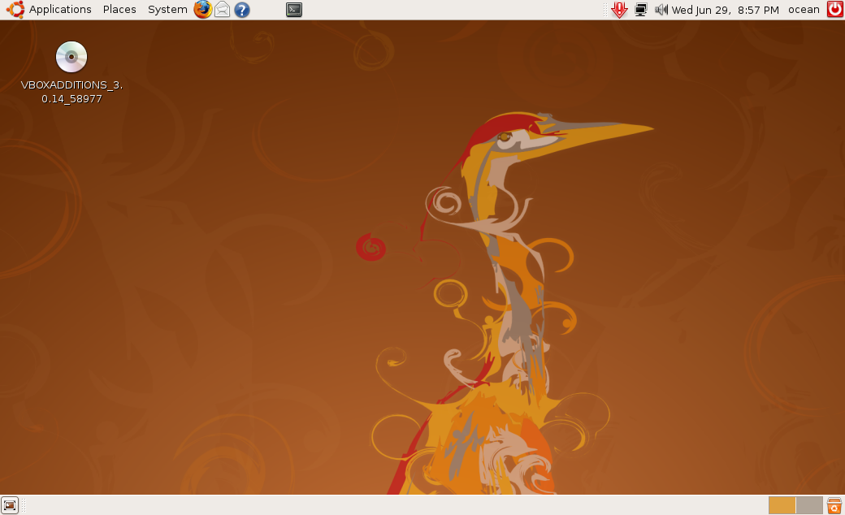
A 5 minute crush course in linux

Slide 13
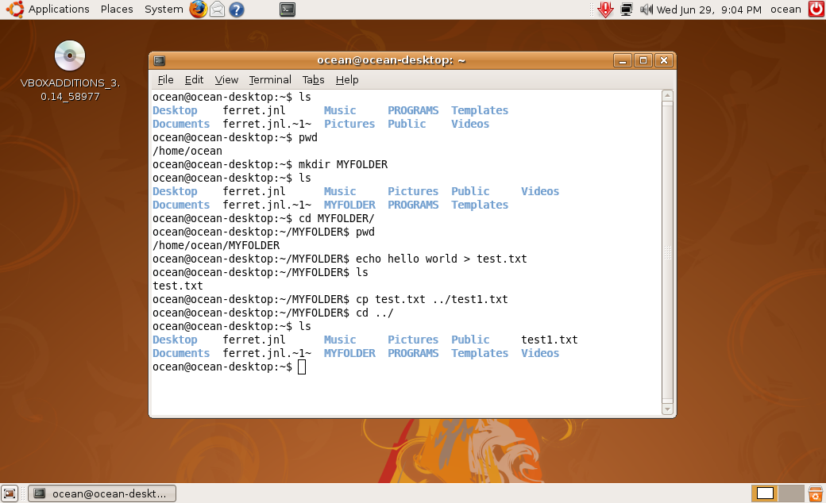
A 5 minute crush course in linux

Slide 14
A 5 minute crush course in linux
Basic linux shell commands
ls - list directory contents
pwd - print name of current/working directory
cd – change directory
echo - display a line of text
cp - copy files and directories
Exercise 0. A bit of shell
Create folder MYFOLDER in /home/ocean/
Create a file in MYFOLDER (you can use text editor if you wish)
Copy file from MYFOLDER to /home/ocean/

Slide 15
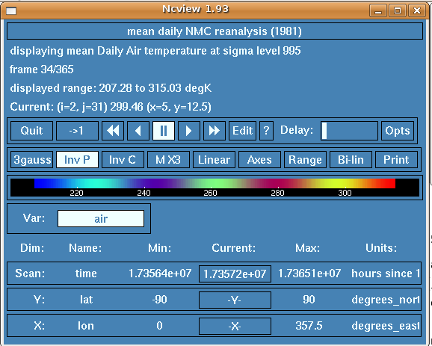
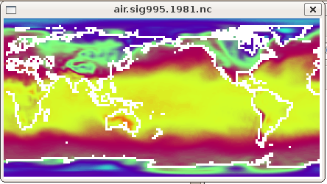
Ncview – the easiest way to look at netCDF

Slide 16
Exercise 1. Look at NCEP reanalysis netCDF file
Go to http://www.esrl.noaa.gov/psd/data/reanalysis/reanalysis.shtml (type “NCEP reanalysis” in Goolge).
Download daily surface (2m) air temperature for one year.
Open netCDF file with ncview
Change colorscale, data range, run a movie …

Slide 17
Climate data operators (cdo)
https://code.zmaw.de/projects/cdo
CDO is a collection of command line Operators to manipulate and analyze Climate and NWP model Data. Windows version as available.
Supported data formats are GRIB 1/2, netCDF 3/4, SERVICE, EXTRA and IEG. There are more than 400 operators available.
Convert Kelvins to Celsius with cdo:
cdo -b f32 subc,273.15 air.sig995.1981.nc air.sig995.1981_celsius.nc
Every cdo command strart with “cdo”
Set the number of bits for the output precision
Subtract constant (273.15) from every value
Input file
Output file

Slide 18
Exercise 2. Time statistics with cdo
Convert Kelvin to Celsius
cdo –b f32 subc,273.15 ifile ofile
Calculate time mean
(use file with values in Celsius created during previous step)
cdo timmean ifile ofile
Calculate monthly means
cdo monmean ifile ofile
Calculate standard deviation for one year and for every month
Find out how to do this in documentation https://code.zmaw.de/files/cdo/html/1.5.0/cdo.pdf

Slide 19
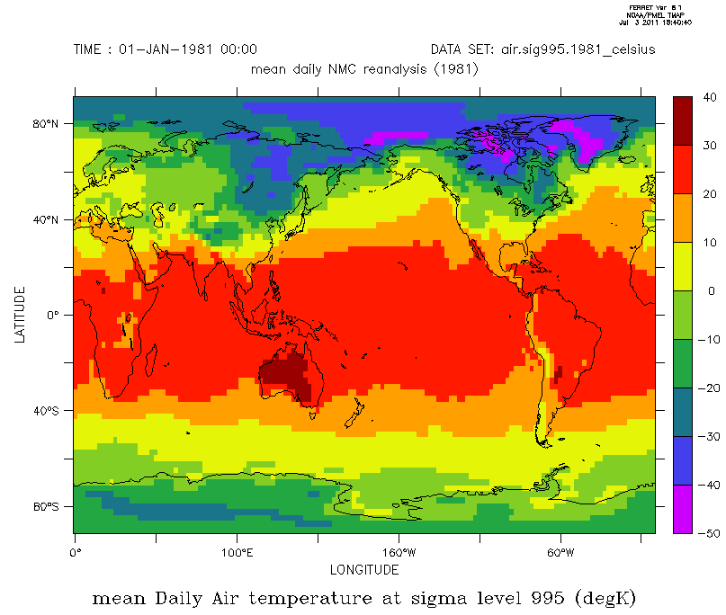
Data Visualization with Ferret
http://ferret.wrc.noaa.gov/Ferret/
Ferret is an interactive computer visualization and analysis environment designed to meet the needs of oceanographers and meteorologists analyzing large and complex gridded data sets.

Slide 20
How to plot a simple map in Ferret
yes? set data air.sig995.1981_celsius.nc ! open data
yes? show data ! look at the data
currently SET data sets:
1> ./air.sig995.1981_celsius.nc (default)
name title I J K L
AIR mean Daily Air temperature at s 1:144 1:73 ... 1:365
yes? shade/l=1 air !plot data for the first time step
yes? go land !plot coastlines

Slide 21
How to plot a region in Ferret
Subscripts: are specified by I=,J=,K=,L= for axes 1 through 4, respectively.
World coordinates: X(longitude), Y(latitude), Z(height/depth), T(time).
Example:
shade/l=1 air equivalent to shade/t="1-JAN-1981" air
Slices
I=4:9/J=3:7
22 | 33 | 15 | 22 | 13 | 14 | 17 | 17 | 15 | 15
14 | 15 | 10 | 10 | 17 | 10 | 10 | 12 | 13 | 14
13 | 13 | 10 | 10 | 14 | 10 | 10 | 18 | 19 | 13
14 | 17 | 13 | 12 | 18 | 14 | 13 | 12 | 14 | 14
12 | 10 | 14 | 15 | 17 | 13 | 19 | 10 | 13 | 15
13 | 17 | 10 | 13 | 18 | 19 | 10 | 13 | 17 | 19
18 | 15 | 13 | 10 | 10 | 10 | 14 | 15 | 14 | 13
19 | 13 | 15 | 13 | 18 | 12 | 11 | 18 | 19 | 12
J =3:7
I = 4:9

Slide 22
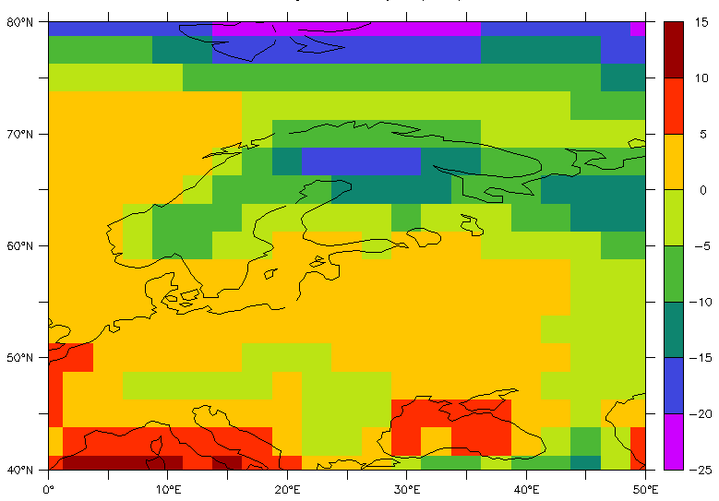
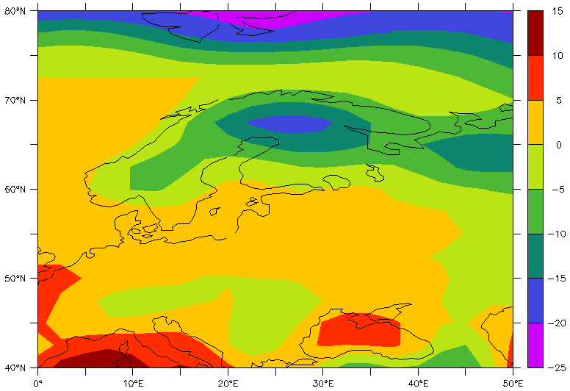
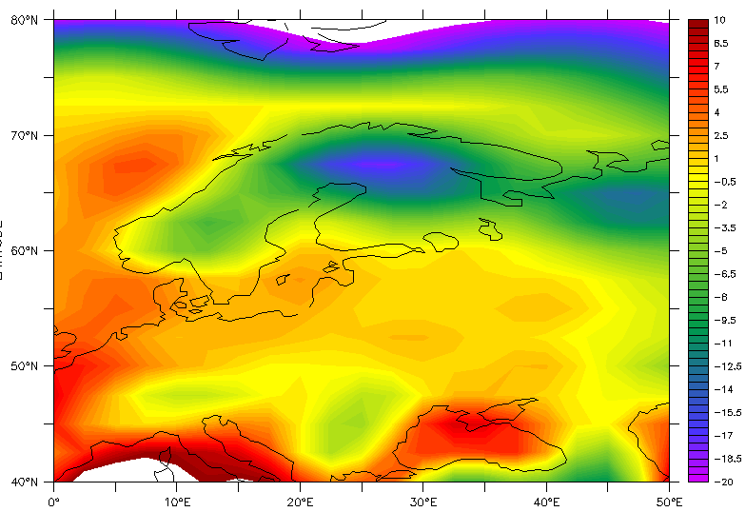
How to plot a region in Ferret
shade/l=1/x=0:50/y=40:80 air
go land
fill/l=1/x=0:50/y=40:80 air
go land
fill/l=1/x=0:50/y=40:80/levels=(-20,10,0.5) air
go land

Slide 23
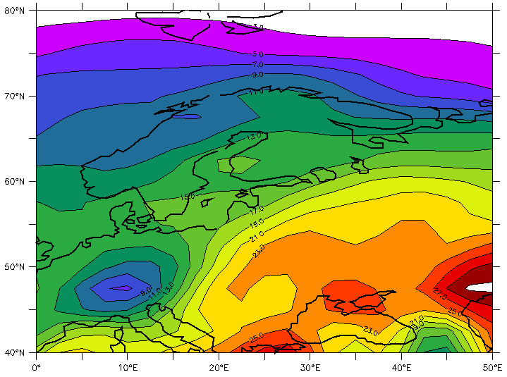
How to plot a region in Ferret
fill/l=200/x=0:50/y=40:80/levels=(3,32,2)/lines air
go land 7

Slide 24
Exercise 3. Play around with Ferret
Load file to Ferret and create several different maps for the globe and your home country.
set data air.sig995.1981_celsius.nc
shade/l=1/x=0:50/y=40:80 air
fill/l=1/x=0:50/y=40:80 air
fill/l=1/x=0:50/y=40:80/levels=(-20,10,0.5) air
fill/l=200/x=0:50/y=40:80/levels=(3,32,2)/lines air

Slide 25
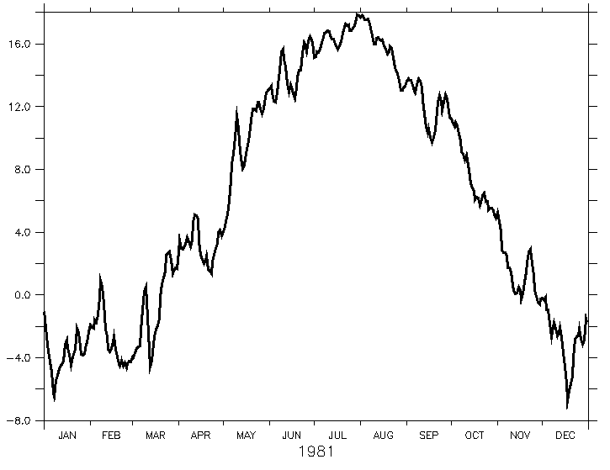
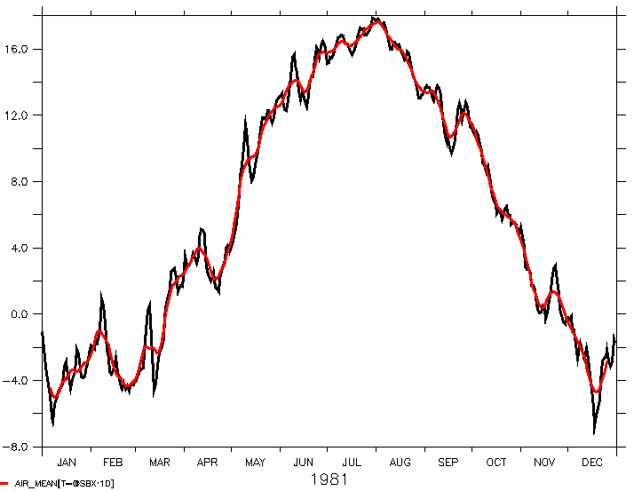
Ferret @ transformations
Mean daily temperature over the region:
let air_mean = air[x=0:50@AVE,y=40:80@AVE]
plot/THICK=3 air_mean
plot/overlay/thick=3 air_mean[l=@SBX:10]

Slide 26
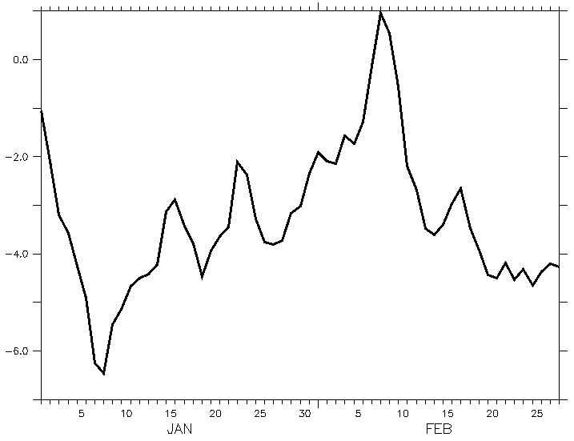
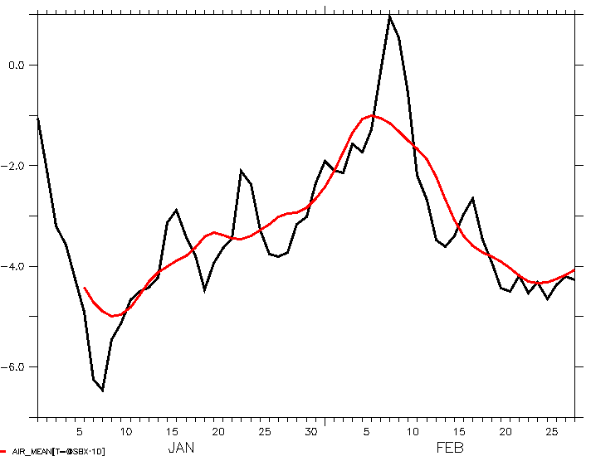
Ferret @ transformations
plot/THICK=3 air_mean[t="1-JAN-1981":"28-FEB-1981"]
plot/THICK=3/overlay air_mean[t="1-JAN-1981":"28-FEB-1981"@SBX:10]

Slide 27
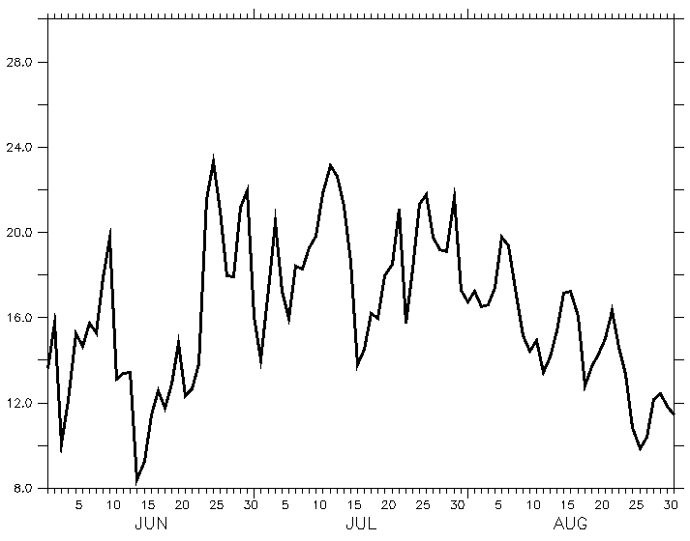
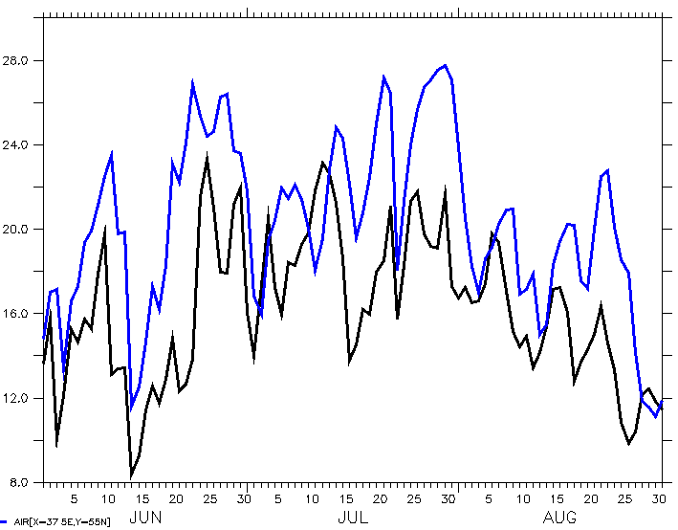
Ferret PLOT
plot/THICK=3/vlimits=8:30:2 air[t="1-JUN-1981":"31-AUG-1981",x=30, y=60]
plot/overlay/THICK=3/COLOR=blue air[t="1-JUN-1981":"31-AUG-1981",x=37, y=55]

Slide 28
Exercise 4. Transformations and PLOT in Ferret
Calculate daily mean temperature for your country (region).
Plot original and smoothed data together on one plot, use several windows.
Compare on one plot daily temperatures for two cities.
let air_mean = air[x=0:50@AVE,y=40:80@AVE]
plot/THICK=3 air_mean
plot/overlay/thick=3 air_mean[l=@SBX:10]
plot/THICK=3 air_mean[t="1-JAN-1981":"28-FEB-1981"]
plot/THICK=3/overlay air_mean[t="1-JAN-1981":"28-FEB-1981"@SBX:10]
plot/THICK=3/vlimits=8:30:2 air[t="1-JUN-1981":"31-AUG-1981",x=30, y=60]
plot/overlay/THICK=3/COLOR=blue air[t="1-JUN-1981":"31-AUG-1981",x=37, y=55]

Slide 29
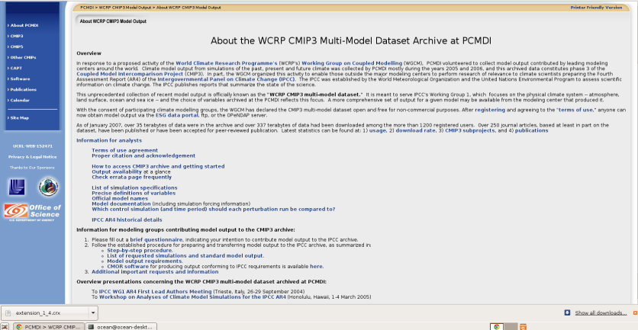
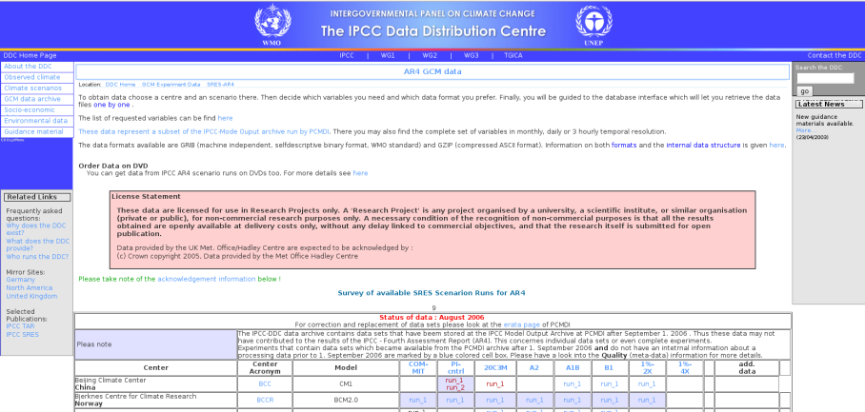
Data from IPCC climate models
Climate model intercomparison project (CMIP3)
http://www-pcmdi.llnl.gov/ipcc/about_ipcc.php
https://esgcet.llnl.gov:8443/ - data
IPCC data distribution center
http://www.mad.zmaw.de/IPCC_DDC/html/SRES_AR4/index.html

Slide 30
Information about dataset
IPCC-AR4 MPI-ECHAM5_T63L31 MPI-OM_GR1.5L40 SRESA1B run no.1
http://cera-www.dkrz.de/WDCC/ui/Entry.jsp?acronym=EH5-T63L31_OM-GR1.5L40_A1B_1_MM
The experiment has been initialized in year 2000 of the 20C_1 run and continues until year 2100 with anthropogenic forcings (CO2, CH4, N2O, CFCs, O3 and sulfate) according to A1B. The experiment is extended until year 2200 with all concentrations fixed at their levels of year 2100 (stabilization experiment).
Get information about a file with cdo
cdo sinfo EH5_OM_A1B_1_MM_TEMP2_1-2400.grb | more
cdo info EH5_OM_A1B_1_MM_TEMP2_1-2400.grb | more
cdo nyear EH5_OM_A1B_1_MM_TEMP2_1-2400.grb
cdo pardes EH5_OM_A1B_1_MM_TEMP2_1-2400.grb

Slide 31
Information about dataset
Convert from GRIB to netCDF
cdo -f nc copy EH5_OM_A1B_1_MM_TEMP2_1-2400.grb TEMP2_1-2400.nc
Select only years from 2000 to 2100
cdo selyear,2000/2100 TEMP2_1-2400.nc TEMP2_1-1200.nc
Calculate yearly means
cdo yearmean TEMP2_1-2400.nc TEMP2_1-2400_ym.nc
Select one month
cdo selmon,09 TEMP2_1-1200.nc TEMP2_1-1200_SEP.nc

