Slide 1
What is Routing ?
1.The routing in nothing but the navigating from one page to another page.
Does three things:
Goes to the location (hashed URL).
Gets new content (view / HTML).
Injecting into current page’s HTML/DOM.
Mainly used in SPA’S
1. Various parts of views.
- logical division of app.
2. Loading views individually / independently.
Note: Routing is available at server /client.

Slide 2


Routing in Angular js
Client – side Routing:
1.ngRoute
2. UI-Router.
Steps for ngRoute:
1.Include ngRoute module : angular-route.js after angular.js
2. Use ngRoute as module dependency.

Slide 3
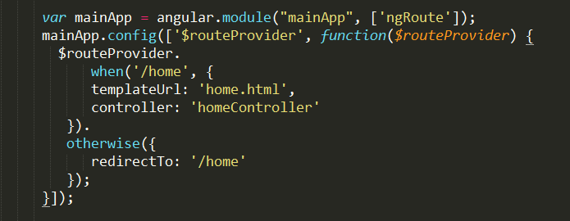

What is Routing ?
3. Use $routeProvider to configure routes.
Routing URLs (location)
View Content
Controller to br associated with Views etc.
4. Declare “ng-view” to hold or reject content
(view).

Slide 4
What is UI-ROUTING ?
It is similar to ng-routing.
In ui routing does three things
Mainly used in SPA’S
1. Various parts of views.
- logical division of app.
2. Loading views individually / independently.
Note: Routing is available at server /client.

Slide 5
UI-Routing in Angular js
Ui-router
1. Built by Angular UI team.
2. Fully replaces ngRoute.
3. It is more powerfull than ngRoute.
4. Developed on “states”.
State (in ui-router)
1. A bit more than route.
2. More comprehensive navigation criteria.
3. Describes how UI would look like.
i.when navigation occurs
ii.or when we switch to a different route/state.

Slide 6
UI-Routing in Angular js
Identified by its own (unique) name.
>> Possible to navigate through name (instead of route).
Configured using ‘$stateProvider’.
Top Avantages:
1.Multiple views
>> side-by-side
>> nested

Slide 7
UI-Routing in Angular js
Steps for ui-router:
Include ‘ui-router’ module.
Use ‘ui-router’ (as module dependency).

Slide 8
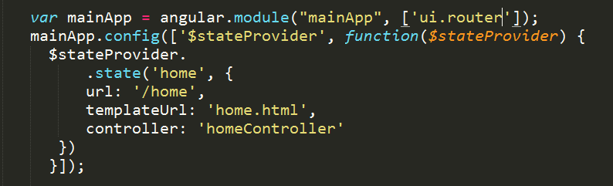
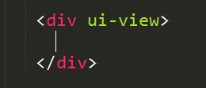
Use ‘$stateprovider’ to configure states and routes.
States.
Routing URLs (location).
Views (content).
Controllers to be associated with views.
Nested states / views.
Etc.
Declare ‘ui-view’ to hold the content view

