Slide 1






Native Cloud App Transformation Strategy
Benchmarking Existing UI/Workflow Services
Requirements
Craftout Baseline
New Workflow
SLA KPI Data
for POC
Architecture Design
Decision
Techstack POC
Cloud Native Serverless Roadmap Timeline & Budgeting
Retired On Prem
01
02
03
04
05
06
Measures & Capture On premise storage and compute load usage
Identify workflow & Techstack
Eg. Database DTU, API Request, Traffic & Load, FileStorage Size, IIS, Services and firewall/network data model design.
UI Response time performance
Storage & Compute Cost
Security & Network
Disaster Recovery Plan
Cloud Replacement Techstack
Devops- how quick to deploy the changes
Legal- Cloud Compliance/Government
Data Modeling
Serverless Event and Domain Driven Architecture
Start new or migrate component by component.
(UI/API/Database)
Hybird vs Fully Cloud?
Cloud Agnostic?
Low Code?
Github, Action for ci/cd
Secure code scanning
Restful API first
Paas, Saas or IAS Cloud solution first
Morden Auth
Enterprise language C#/Java/Swift/Angular/ Python( data ingestion)
SQL, NoSql, Serverless , App Service, ML
Devops/Automation Testing/IAC (infra-as-code)
Align with stakeholder and development team on the roadmap with timeline
Breakdown Budget 365k using cloud pricing calculator, Azure Advisor,
Retire or archive on prem resources into cold backup.
Notes:
© Copyright PresentationGO.com – The free PowerPoint and Google Slides template library

Slide 2
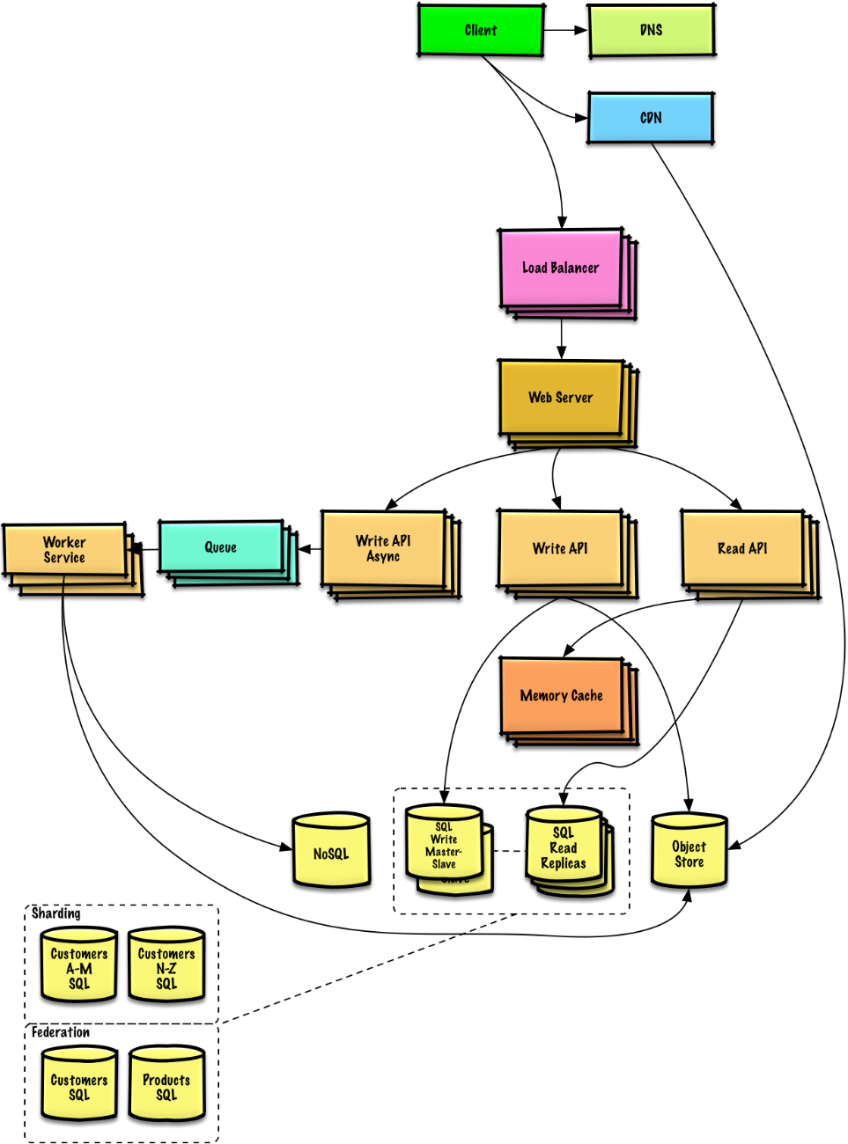


High-Level Architecture Design
Client Web/Mobile UI
Load Balancing
Serverless API/WebApp Host
API Logic and Queue for pub-sub even driven
Memory Cache for fast content delivery
Mix SQL and NoSQL implementation
Object store like Blob Storage
Split read write api, read uses cache for performance

Slide 3
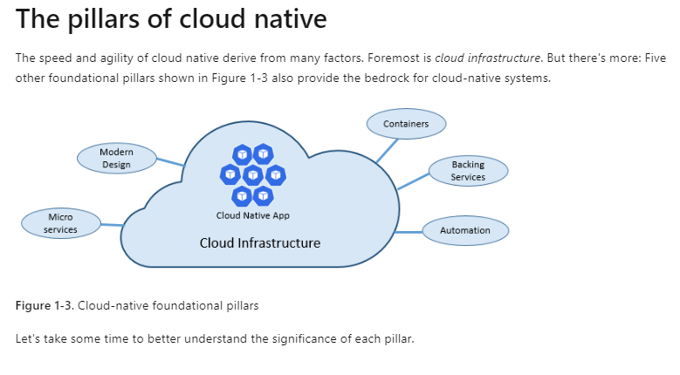
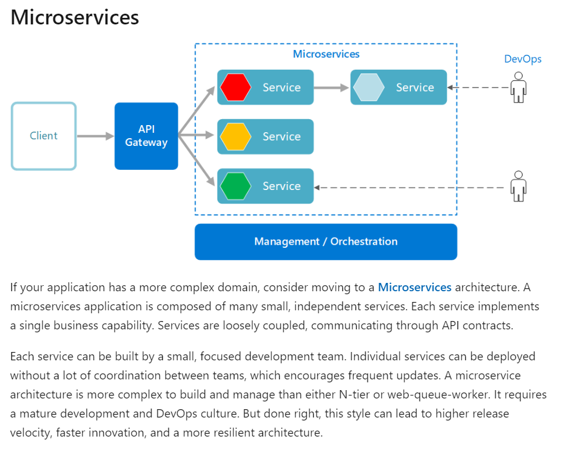
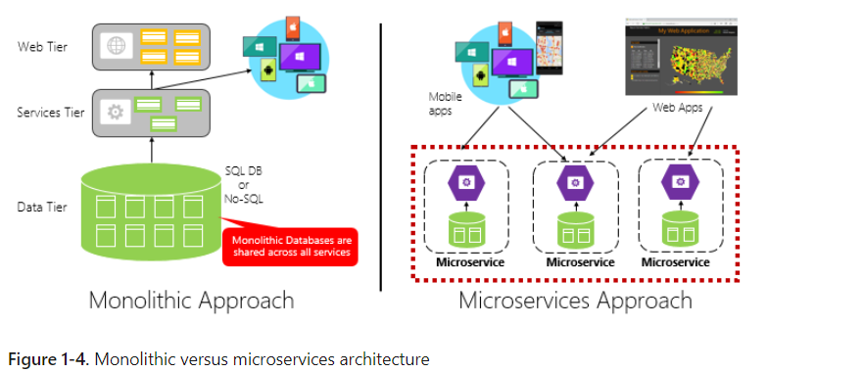
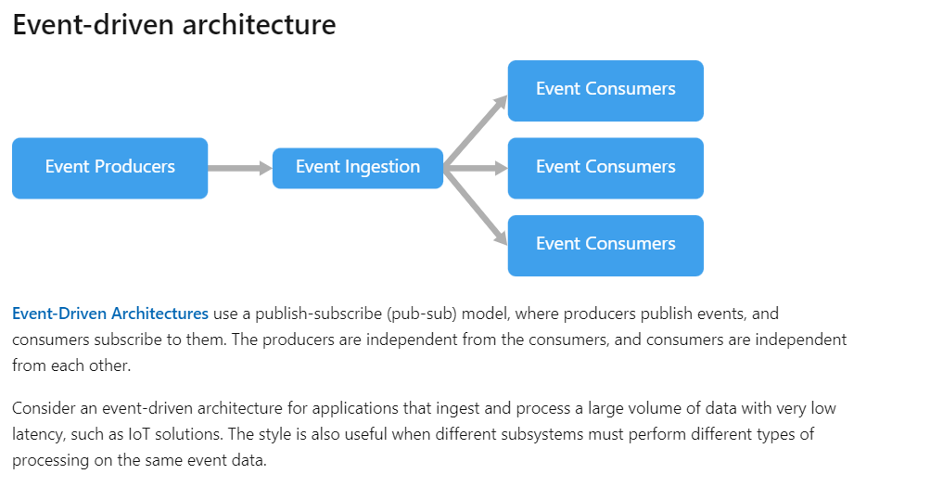

Serverless Cloud Native Micro-services App

Slide 4
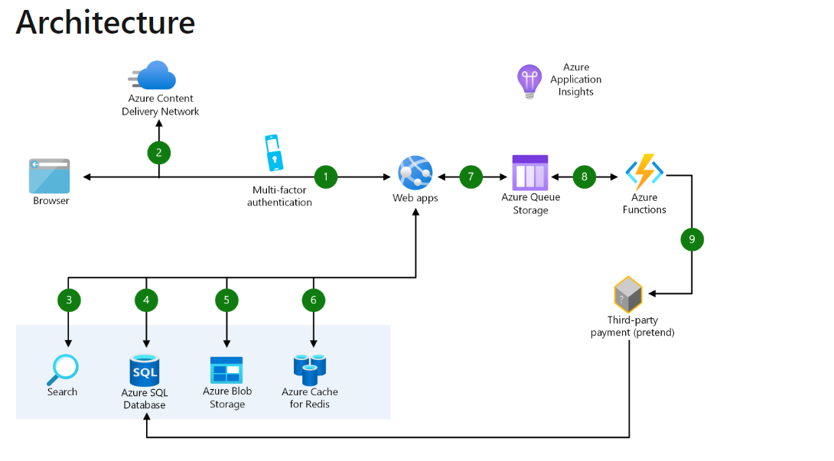
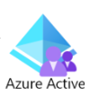

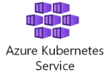






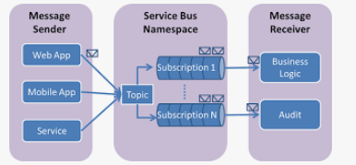
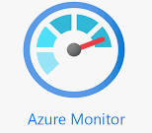
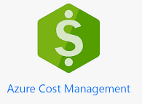
Azure Solution

Slide 5
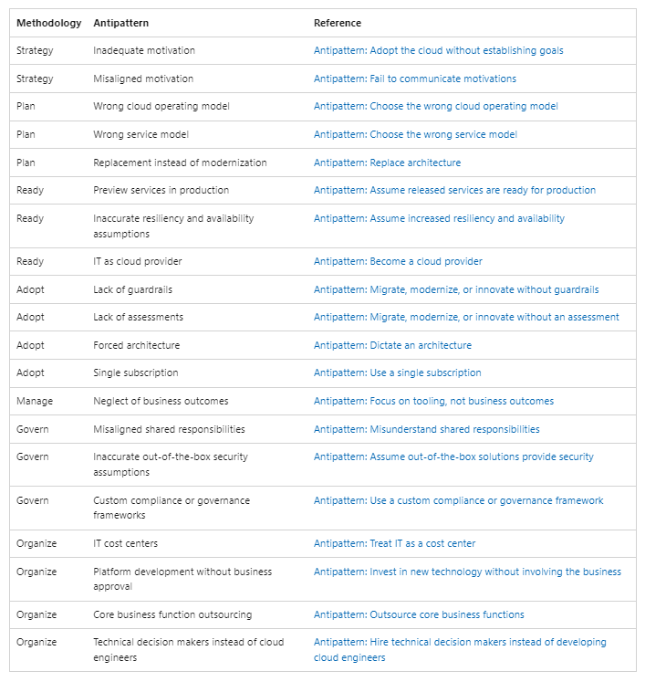
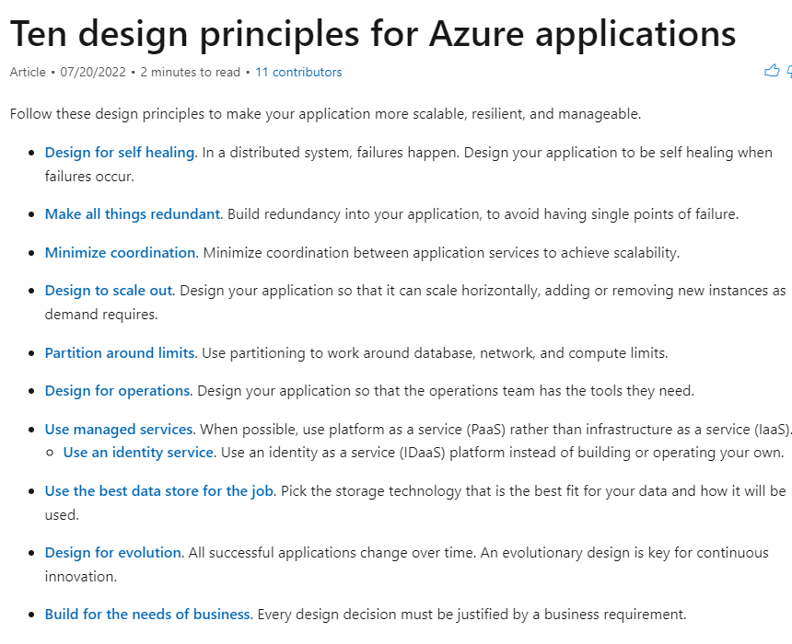

Azure Design Principle

Slide 6
Reference links
https://learn.microsoft.com/en-us/dotnet/architecture/cloud-native/definition
https://learn.microsoft.com/en-us/azure/cloud-adoption-framework/get-started/
https://learn.microsoft.com/en-us/azure/architecture/guide/architecture-styles/?source=recommendations
https://learn.microsoft.com/en-us/azure/architecture/microservices/design/compute-options
https://learn.microsoft.com/en-us/azure/architecture/solution-ideas/articles/scalable-ecommerce-web-app
https://learn.microsoft.com/en-us/azure/architecture/example-scenario/apps/ecommerce-scenario
https://learn.microsoft.com/en-us/azure/cloud-adoption-framework/get-started/
https://learn.microsoft.com/en-us/azure/cloud-adoption-framework/antipatterns/antipatterns-to-avoid
https://gist.github.com/vasanthk/485d1c25737e8e72759f
https://github.com/donnemartin/system-design-primer

