Slide 1

Tutoring app
By Snezhana Koleva, 223001

Slide 2
Project idea
The idea of this project is to allow the students of our faculty to hold/attend tutoring sessions
In the moment, tutoring isn’t a part of the faculty’s curricula
This solution offers time and resource management tools to help everyone start tutoring
Tutoring is proven to have helped students learn the material more easily

Slide 3






Technologies and
Libraries
In this solution, as discussed before, I have used the following technologies:
Express.js + MongoDB for backend
JWT + bcrypt.js + CORS for security
Vue.js 3 + Vite, Pinia, Axios, FullCalendar for frontend

Slide 4






Main features
User authentication and authorization
Availability management
Session management
Notification system
Statistics for the current application’s state
User management

Slide 5
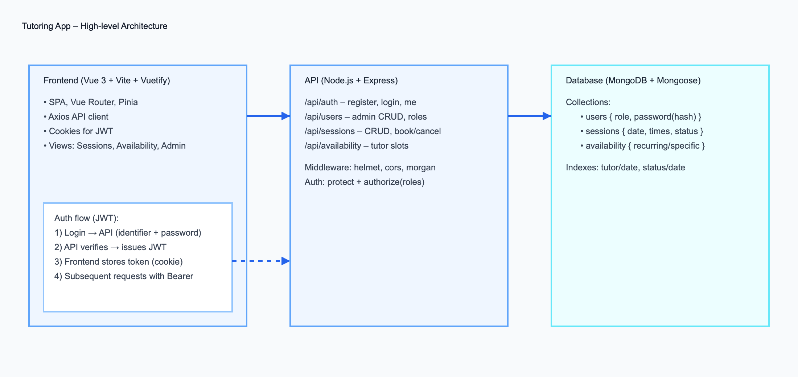
Architecture of the solution

Slide 6
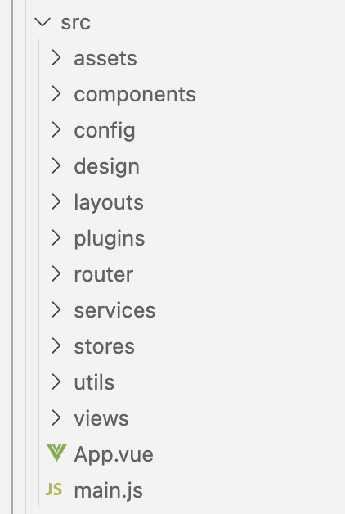
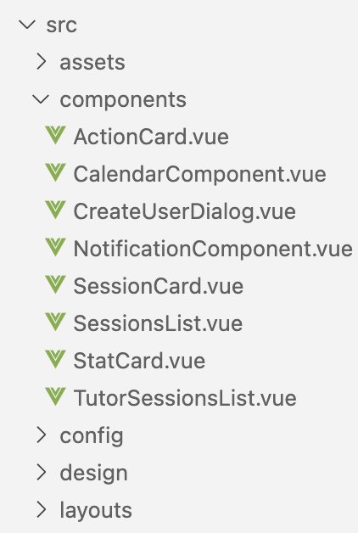
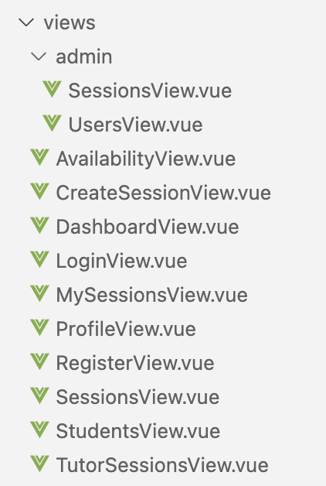
Architecture of the frontend

Slide 7
Future improvements
Real-time chat between students and tutors
Integration with other time management tools (like Google Calendar)
Rating & Review of the sessions
Scalability & Performance optimizations
Dark mode

Slide 8

Q & A

Slide 9
Thank you for your attention!

