Slide 1
TRADING Strategy
By – Bhaswati Koley

Slide 2
STRATEGY INTRODUCTION magic band
Magic Band is an indicator based on 20 moving average high and low – noting that buy call is taken if the RSI is above 60 and the price action is above 20 moving average higher band , and an exit necessary if the price is below the 20 moving average band .
It designed by individual traders to visualize overbought or oversold zones , potential reversal points , and market volatility for a specific trading strategy .
Its upper and lower bands help to identify the prevailing trend .
If price consistently stays above the band , it indicates a bullish trend , below suggests a bearish trend .
The bands often serve as dynamic support and resistance levels .
A price touching the lower band might be seen as an oversold condition ( potential buying opportunity ) while a touch of the upper band might signal an overbought condition (potential selling opportunity ) .
At the time of breakout support becomes resistance and resistance becomes support .

Slide 3
Relative Strength Index (RSI)
Relative Strength Index is an important indicator for determining stock views , noting that RSI above 60 suggests a bullish momentum for a particular stock across any frame time , while an RSI below 40 indicates a bearish view and an RSI between 40 and 60 signifies sideways trading.
The traditional measure of 70 and 30 for bullish and bearish views has been replaced , if RSI goes above 60 one can take a buying decision and if it falls below 40 , a bearish view should be adopted .
Traditionally , an RSI reading of 70 or above indicates an overbought condition , a reading of 30 or below indicates an oversold condition .
RSI typically measured over a 14 day time period .
RSI can be applied in intraday trading , swing trading , and long term investing , however traders can adjust the time frame and use it .

Slide 4
Fibonacci
Fibonacci Extension indicator is a technical analysisis tool used by traders to project potential future price targets or areas of support and resistance, beyond the initial price movement (trend).
Fibonacci retracement on intraday for an uptrend, a shallower retracement, particularly at the 38.2% level , suggests a higher probability of the trend continuing upward . Therefore, first retracement at 38.2% is crucial for trend intactness, while the golden ratio at 61.8% could indicate a reversal, and advised checking the risk reward ratio for 1-2 hours before considering a 30-40% exit and setting a final buying target at 20%.
A shallow pullback to the 38.2 % level suggests that the existing trend is strong and momentum is high.
Fibonacci is most effective when used in combination with other technical analysis tools (i.e. support and resistance zones , moving averages , volume analysis ) for confirmation .

Slide 5
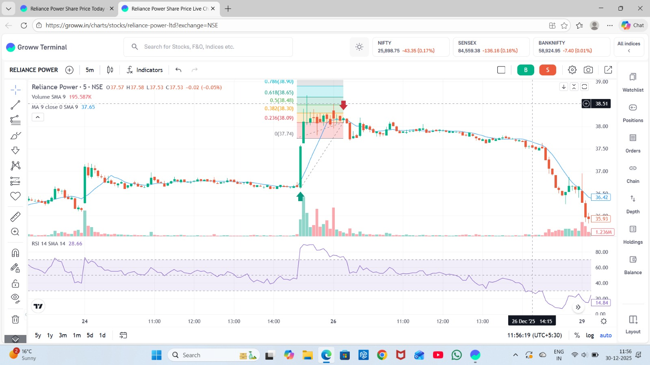
reliance power
Magic Band : Massive bullish candle confirmed Bullish Breakout as Price was above Magic band.
RSI Confirmation : It was above 60 during bullish breakout but fell to 37 indicating oversold.
Fibonacci Structure:
  HIgh: 38.51
  Low: 37.74
Marks:
  Entry – 36.65
  Stop Loss – 36.62
  Stop Loss – 0.618 Fib [ 38.65]
  Target 2 – 0.786 Fib [38.90]

Slide 6
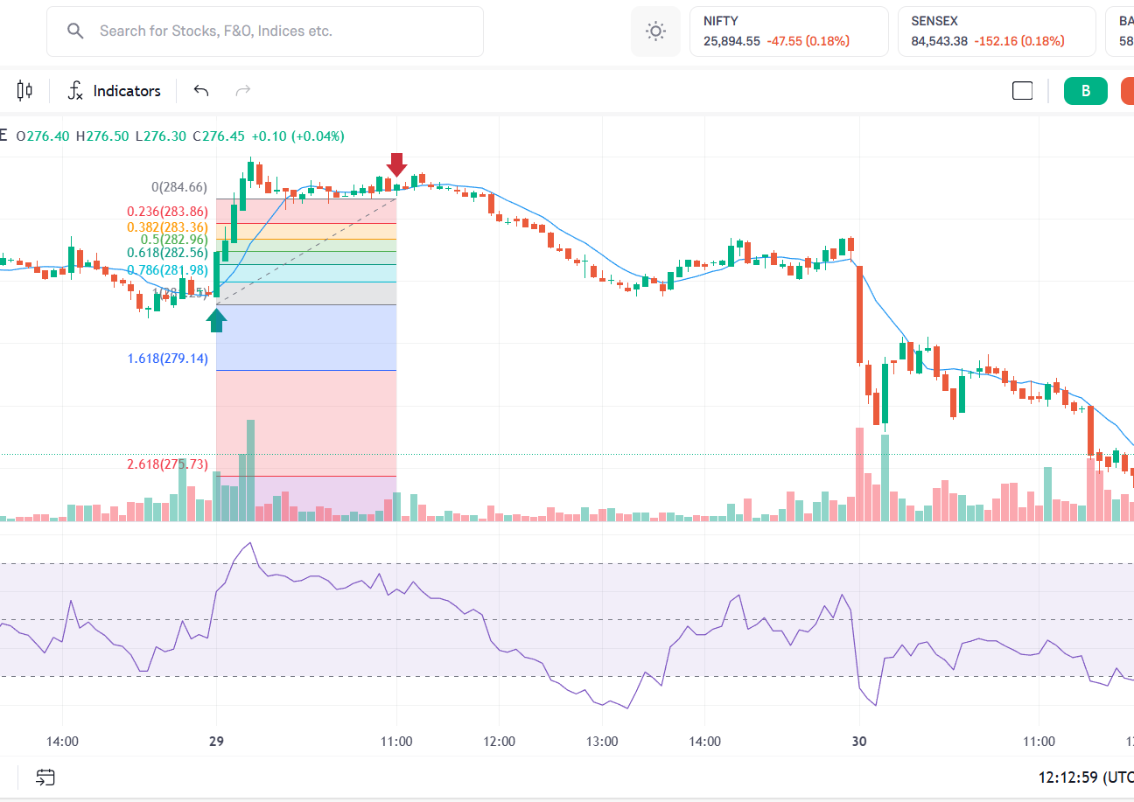
ETERNAL (ZOMATO)
Magic Band : Massive bullish candle confirmed Bullish Breakout as Price was above Magic band.
RSI Confirmation : It was above 60 during bullish breakout but fell to 37 indicating oversold.
Fibonacci Structure:
  High: 284.02
  Low: 282.93
Marks:
  Entry – 283.75
  Stop Loss – 283.67
  Target 1 – 0.618 Fib [ 282.56 ]
  Target 2 – 0.786 Fib [ 281.98 ]

Slide 7
Entry , exit , stop loss
ENTRY : Support & Resistance – enter near a support level , pullback – in an uptrend , wait for a minor drop to a fibonacci retracement level befpre entering (i.e. 38.2 % or 61.8% ) , RSI - RSI is above 60 .
STOP LOSS : If the price drops below a key support level or your entry signal is invalidated , exit immediately to cut your losses . In short , stop loss should be set below the low of the pervious candle , and that candle should have a big body .
TARGET / EXIT : Fibonacci Extensions help you predict how high a stock will go after it has finished its pullback . Minor resistance – 0.618 (61.8%) , the golden target 1.618(1.618%) [primary target]. Exit when the price reaches your predetermined fibonacci extension target , price starts falling after a strong uptrend . Therfore exit is a part of smart investing strategy rather than emotional decisions .

Slide 8
conclusion
Effectiveness of the combined strategy | 2. Observations | 3. Learning outcomes
Magic Band successfully identified the trend direction, while RSI's 40-60 strategy confirmed entry strength. | Reliance Power: There was a breakout but RSI failed to keep above 60 and declined to 37. However, Magic Band did work and a massive bullish candle confirmed Magic Band. | After observation I learned that using signals like Magic Band + RSI + Fibonacci Extension together is more reliable than using single signal/indicator.
By using RSI and Magic Band combined, it reduced false signals by ensuring price and momentum before entry. | Eternal [Zomato]: There was a big bullish candel which confirmed the Magic Band momentum. RSI did rised but declined afterwards. | Setting stop loss to avoid more losses or for capital protection which is necessary. It should be set on the low of previous candel
Fibonacci extension provided high probability [0.618 & 0.786 ] for both the stocks named Reliance Power and Eternal [Zomato] | Both stocks shows that Price respected Magic Band acted as structural floor during the initial phases of brreakout. | With this I also learned about various strategies and about indicators which are to be viewed before entry & exit.

Slide 9
Thank You

