Slide 1


Adventure Works
Group Member:
Mr. Sameer Ahmed
Mrs. Mayuri Kolhe
Mr.Tanzeem Shaikh
Chethana H P
Mr. Ruthvij Nilangekar
Mrs. Pooja Zagade
Mr. Tanmay Kumar
Group 3

Slide 2
Project Objective
During the course of this project named “Adventure Works” data which consist of regional sales, production cost and customers data, by utilizing this data we have to find insights such as most profitable year and other thing that can show some potential insights which will give decision makers to data to improve business.
Our aim was to collect the data from both the file & clean. After analyzing make visuals and give finding (insights) from data that we got.
We used MS-Excel, MySQL for analyzing & cleaning the datasets and prepared dashboards using Tableau and Power BI by using which we did calculations, merging and prepared interactive dashboards.

Slide 3
contents
Year wise sales.
Production Cost And Sales amount.
Quarterly sales.
Monthly Sales and Profit.
Country Wise Sales and Profit.
Category and Country Wise Sales.

Slide 4
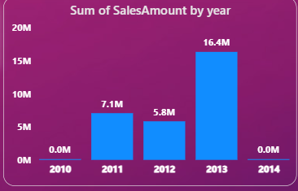
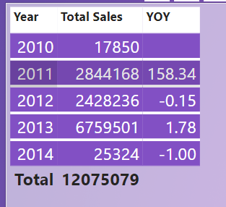
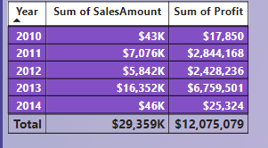
Year wise Sales And profit
In the year 2013 has maximum sales which is 16.4 Million Dollar and profit 6 Million Dollar.
In the year 2010 and 2014 having the minimum sales as compared to other because only one month of data is present respectively for each year same goes for profit as well.
If we look on Year over year growth, we can see that year 2011 and 2013 is 158- and 1.78-times growth, respectively.

Slide 5
In year 2010 and 2011 only mountain and road bikes were being sold which made total of $7.1M in revenue. But from year 2013 Touring bikes was also added along with various accessories and clothing suitable for bikers.
During years 2010,11and 12 road bikes were most sold making $26k, $5.7M and $3.5M respectively compared to other bikes but in 2013 mountain bikes took that spot and made $6.3M in sales for the company.
From 2010 to 2013 road bikes has been a consistent performer in terms of sales and profits
So according to our analysis 2013 has been the most successful year for the company as it gave the company most of its profits.

Slide 6
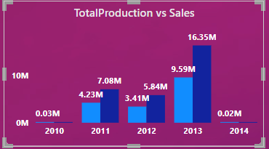
Production cost and sales Amount
As the chart shows year 2013 has maximum production cost as well as sales amount which is 16.35 and 9.59 Million dollar respectively
In the year 2010 and 2014 has lowest sales and production (data is present for only one month respectively)
the heights production margin is obtain is 41.3%

Slide 7
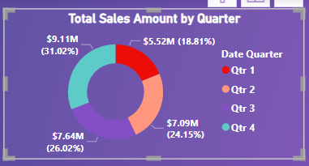
Quarterly Sales
As we see quarter 4 has maximum sales is 9.11 million dollar which is 31.08% of total sales
Which is having of production, sales and profit is 5.35,9.11 and 4 million dollar respectively for the total order are 17.83 K
Quarter 1 has minimum production sales and profit is 3.26, 5.52 and 2 Million Dollar respectively for the total order of 12.33K
As we see profit between Quarter 1 and quarter 4 is 2 times higher than quarter 1

Slide 8
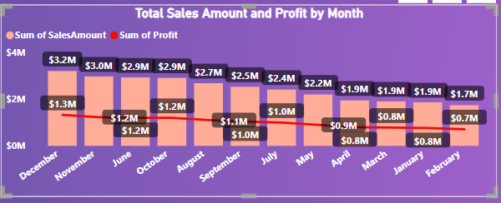
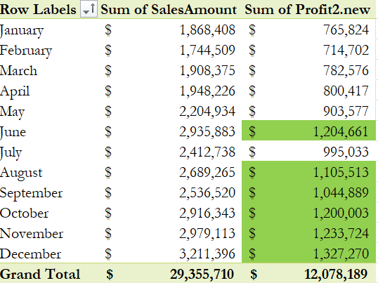
Monthly Sales and Profit
The total sales and profit amount is 29 and 12 million dollar over all profit margin is 41.38%
The bar graph shows having heights to lowest by profit in which February having lowest profit
In table you see that green shade which shoes profit is above and equal to average profit

Slide 9
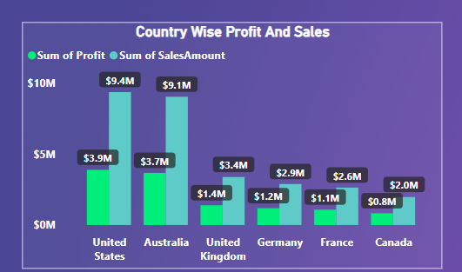
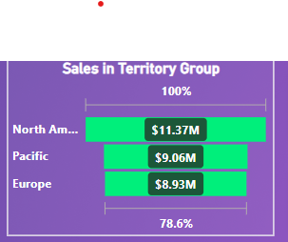
Country Wise sales and Profit
As per the graph which we obtain united states has maximum profit and sales 3.9 and 9.4 Million Dollar respectively and 41.49% is the profit margin for the united sates which is more among the others
Canada having lowest profit and sales over all years
also whole combine North America having 11.37 million dollar sales for pacific and Europe is 9.06 and 8.93 Million dollar.

Slide 10
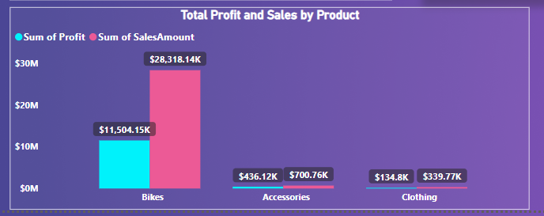
Category Wise Sales
As the graph indicates bikies having maximum sales and profit and profit margin is 39.29 % over all year
Clothing has less sales and profit
In year 2010 and 2011 only bikes were being sold
After 2012 bike accessories and bikers clothing were also added in product list.

Slide 11
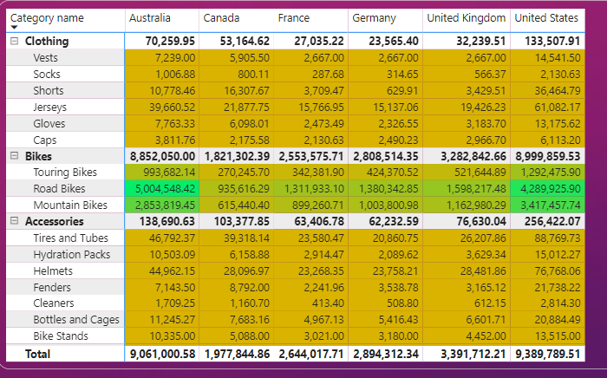
Category and Country wise sales
As we know that bike has maximum sales in which if we look road bikes and mountain bikes has maximum sales in Australia and the United States Of America among all other countries
Even though clothing and Accessories having large number of verity still sales is less

Slide 12
Business insights
To increase the sales in Clothing and Accessories we have to implement discount and Offer Schemes.
Customers are more interested in road bikes overall so company should focus more on its marketing
France and Canada have the most least sales and profits so if the company want to increase its global footprint these two markets should be focused.

Slide 13
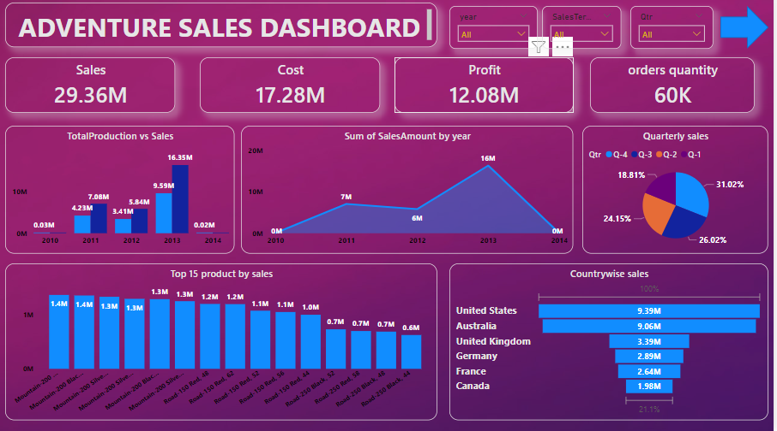
DASHBOARD

Slide 14
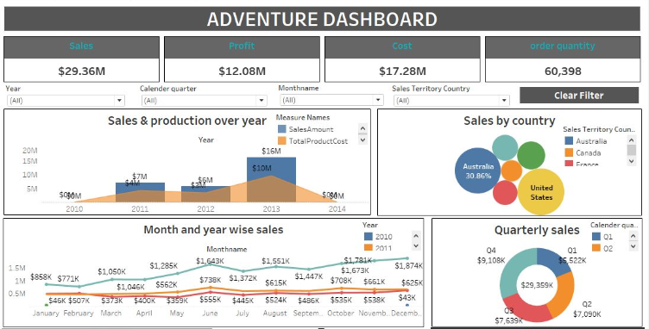

Slide 15
THANK YOU

