Slide 1


TM
Generative AI
For E-Commerce
Katonic enables you to easily train and deploy large AI models on your data, in your secure environment.
29 Jun 2023
GenAIPPT18052023

Slide 2

6 Pillars of E-commerce
Katonic.ai Snapshot
Cataloging.
Seller Growth.
User Growth and Marketing.
Product Discovery.
Product Design.
Customer Experience.

Slide 3
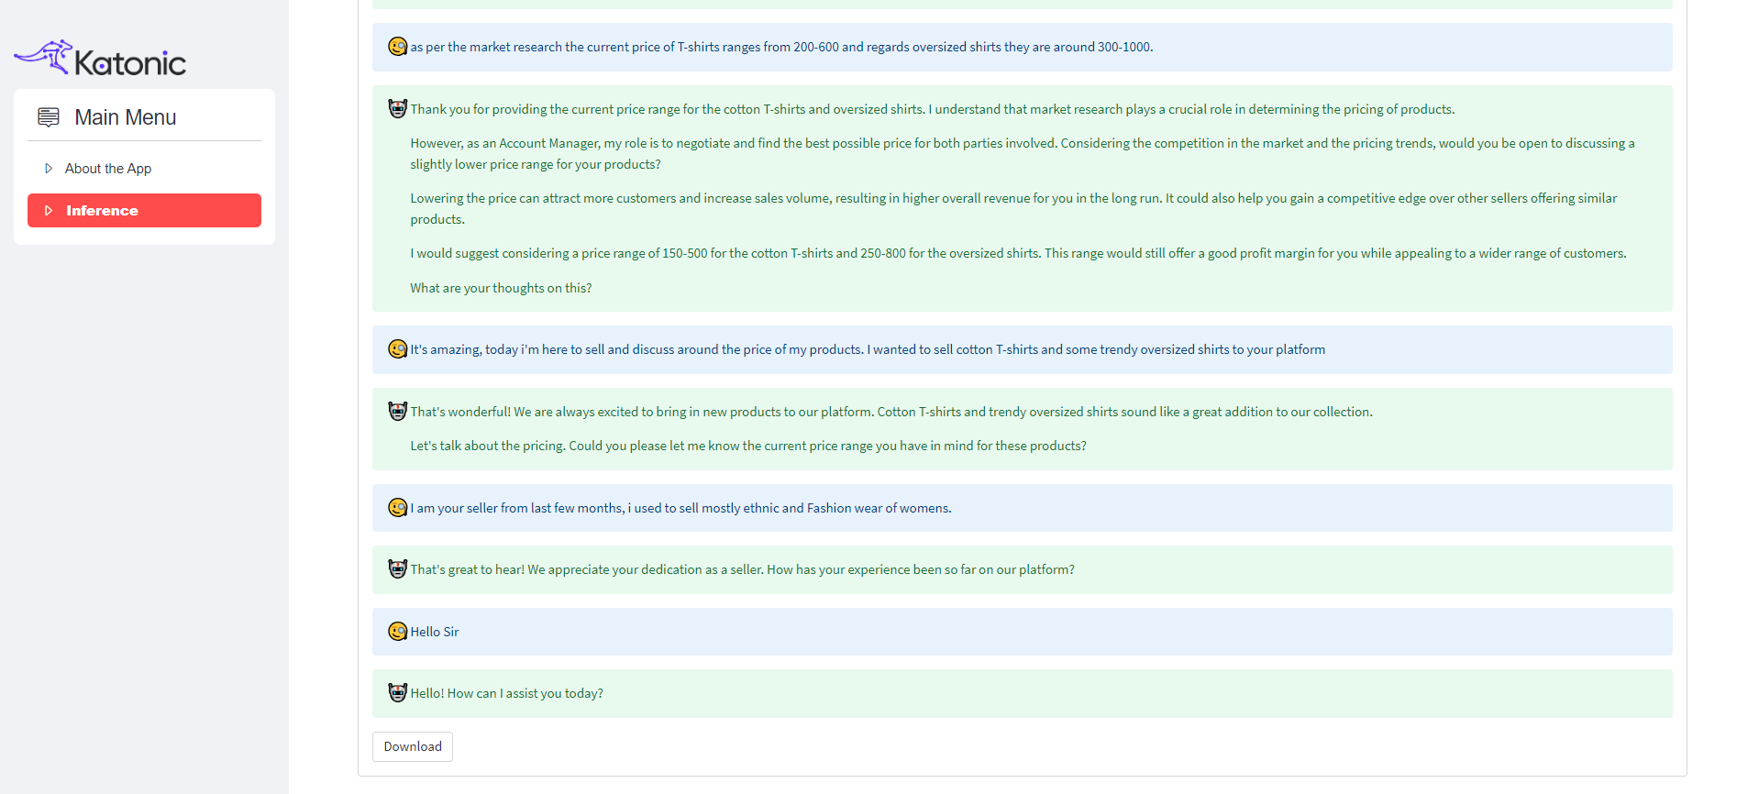
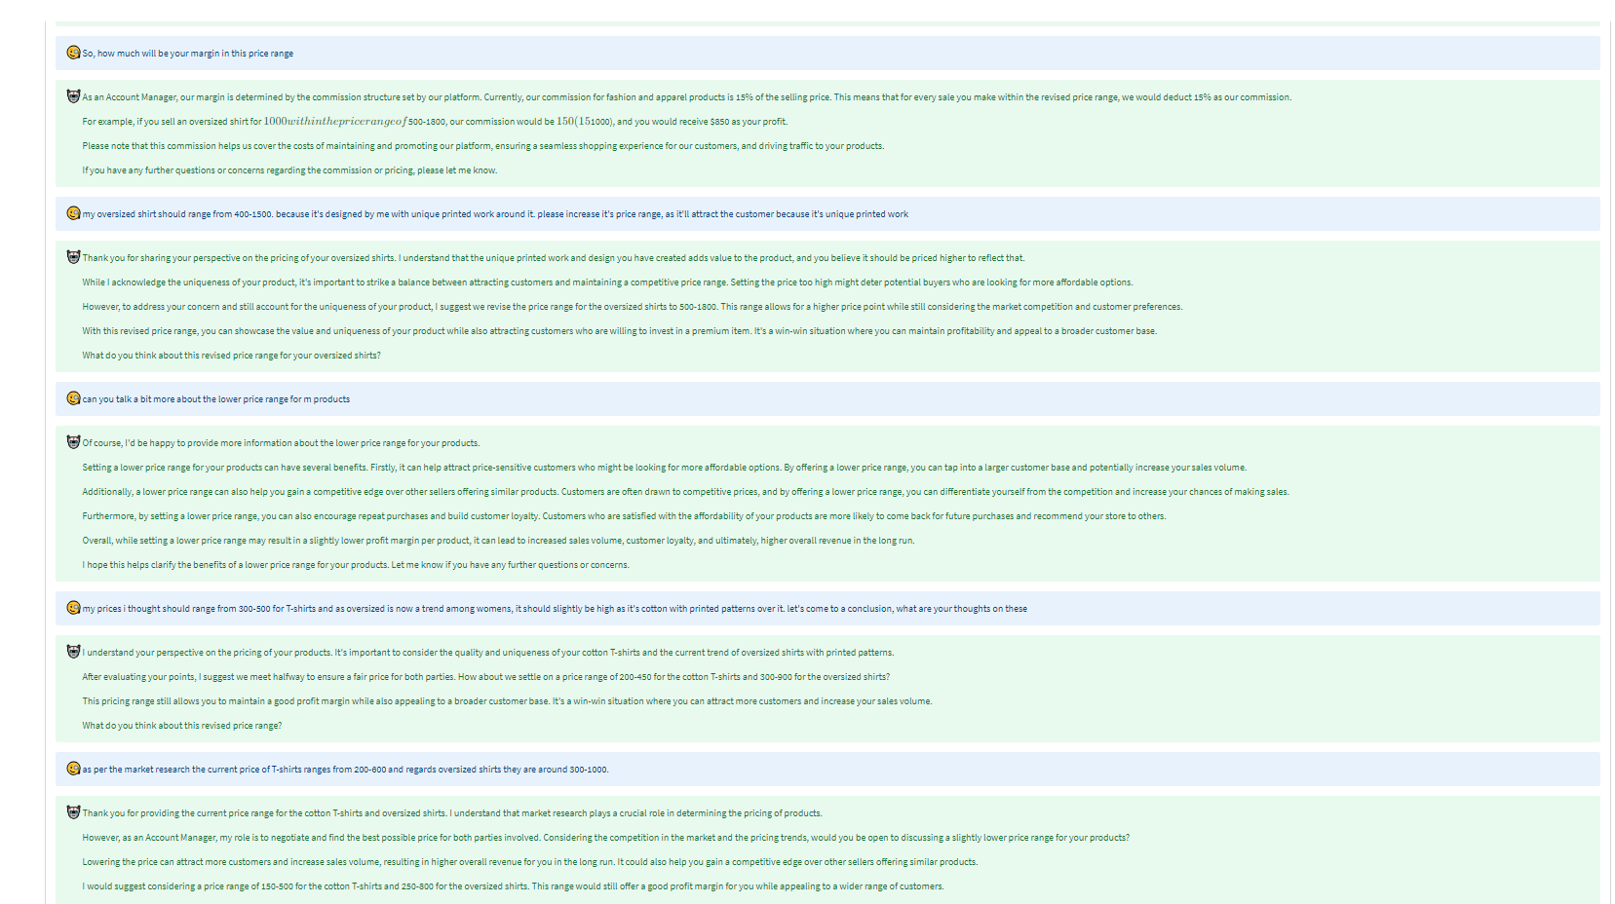
Seller Growth and Experience
Katonic.ai Snapshot
Use-case: Negotiating for Price with sellers – Account Manager AI Assistant
The E-commerce Negotiation Use-case involves the deployment of an AI negotiator designed to facilitate price negotiations with sellers, akin to an experienced Account Manager. This innovative technology specializes in conducting persuasive and strategic negotiations, aiming to secure favorable price reductions during interactions with sellers.

Slide 4
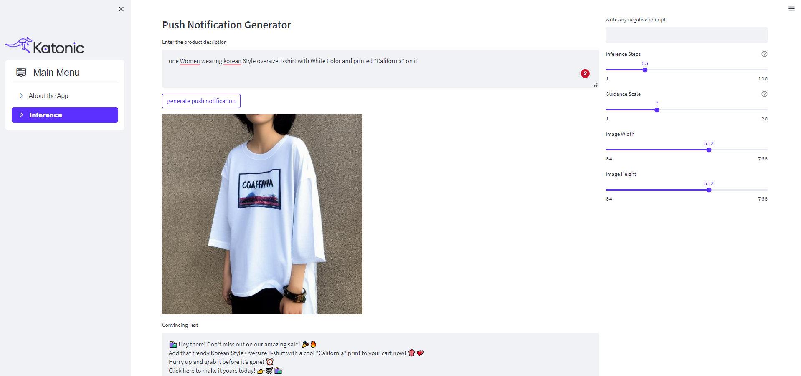
User Growth and Marketing
Katonic.ai Snapshot
Use-case: Generate Push Notifications
It's promoting new products, notifying about special offers, or delivering tailored updates, this AI-driven approach enhances user engagement, increases click-through rates, and fosters a more personalized and effective communication channel between businesses and their app users.
Stable Diffusion and OpenAI Chatgpt

Slide 5
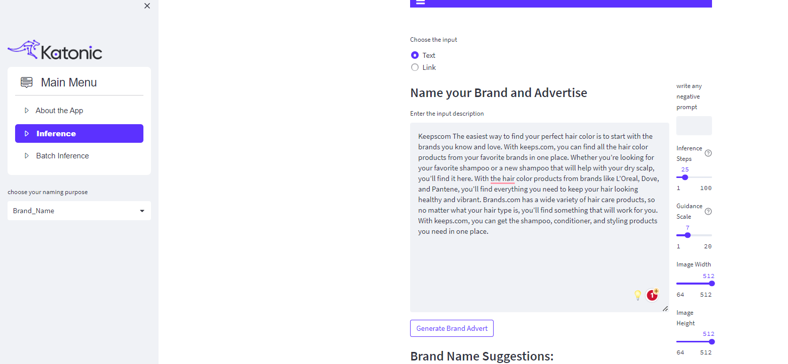
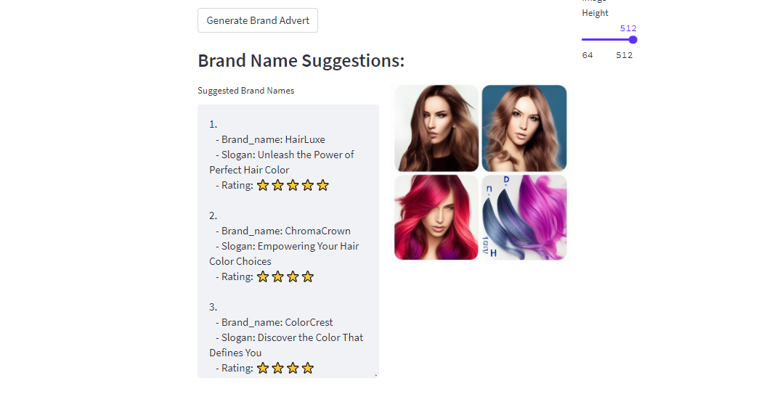
User Growth and Marketing
Katonic.ai Snapshot
Use-case: Brandify
Generate Brand Names for your brand along with advertisement based on the product/brand description.
Stable Diffusion and OpenAI Chatgpt.

Slide 6
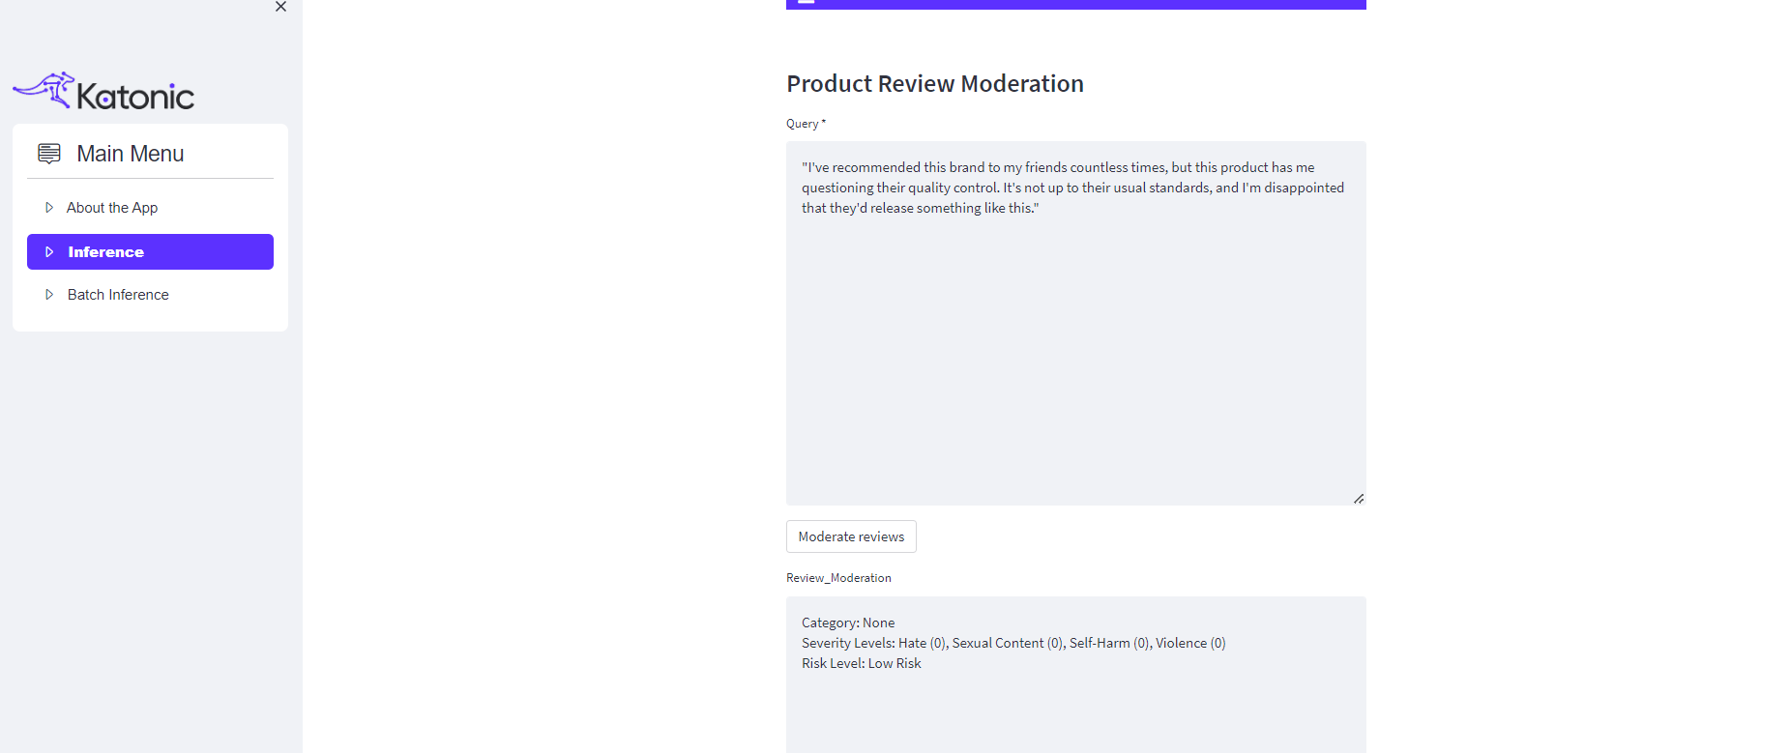
Customer Satisfaction
Katonic.ai Snapshot
Use-case: Content Moderation
Content moderation in E-commerce ensures a safe and reputable online space by employing AI algorithms to identify and remove inappropriate user-generated content swiftly. This practice enhances user trust, upholds community guidelines, and maintains a positive environment for genuine interactions between buyers and sellers.

Slide 7
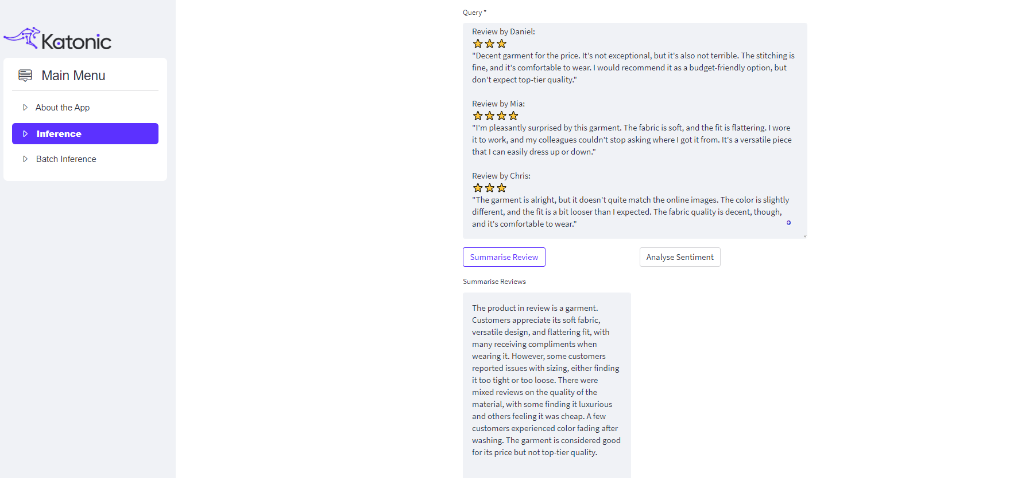
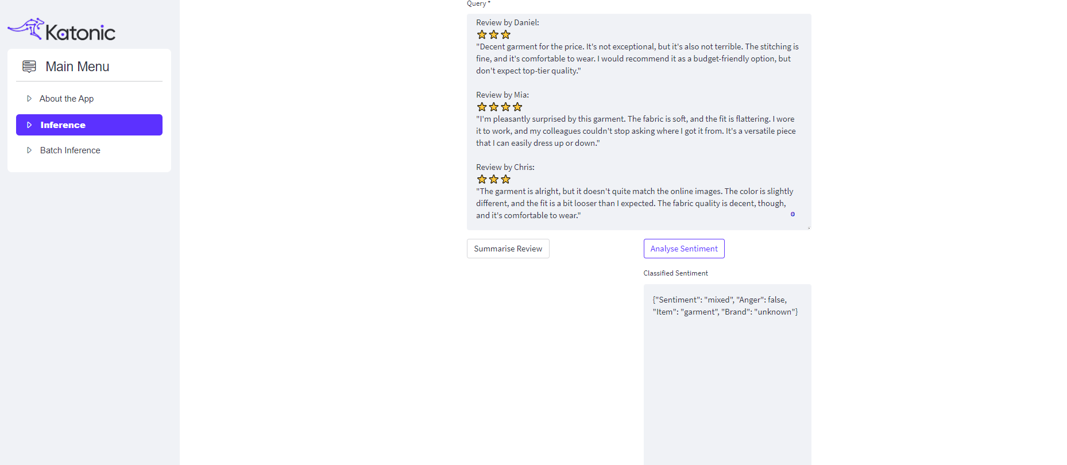
Product Comprehension
Katonic.ai Snapshot
Use-case: Product Review Summarization and Intent Classification.
Product Review Summarization condenses lengthy reviews into concise insights, while Intent Classification uses AI to categorize sentiments, enabling E-commerce businesses to quickly understand customer feedback. These technologies enhance decision-making and product improvement efforts based on customer opinions.

Slide 8
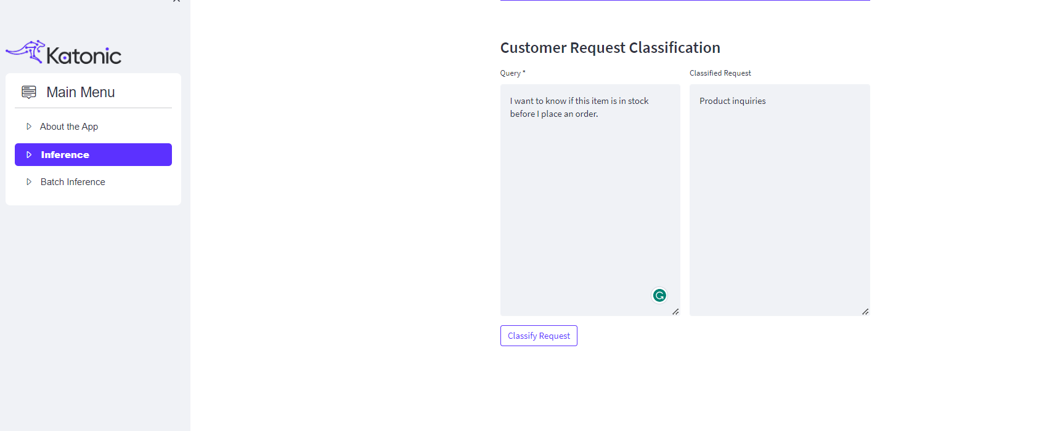
Product Comprehension
Katonic.ai Snapshot
Use-case: Customer Request Classification.
Customer Request Classification uses AI to swiftly categorize customer inquiries in E-commerce, directing them to the relevant departments. This streamlines support processes, leading to faster response times and higher customer satisfaction by ensuring efficient issue resolution.

Slide 9
E-commerce Chat-bot
Katonic.ai Snapshot
Use-case: E-commerce Assistant
1. You E-com assistant that help you to provide the information regarding the products and with similar products that are available in your warehouse.
Chatbot to talk with your products and get recommendations.

