Slide 1
Generative AI in
E-commerce
GenAIPPT18052023

Slide 2

6 Pillars of E-commerce
Cataloging.
Seller Growth.
User Growth and Marketing.
Product Discovery.
Product Design.
Customer Experience.

Slide 3
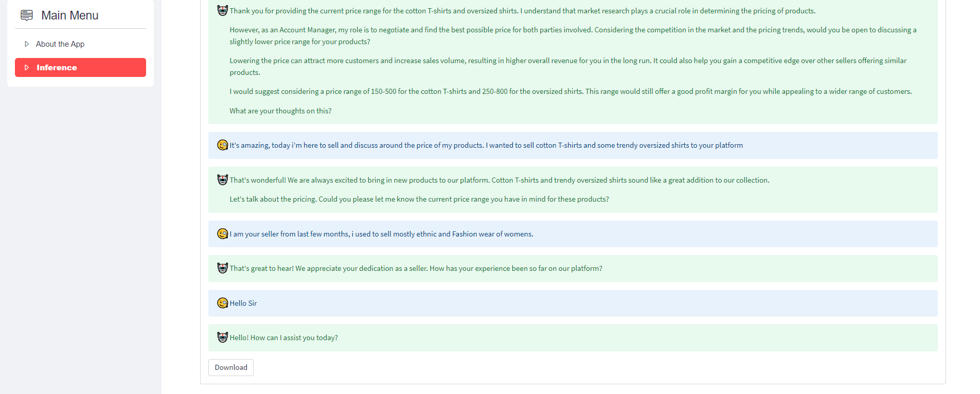
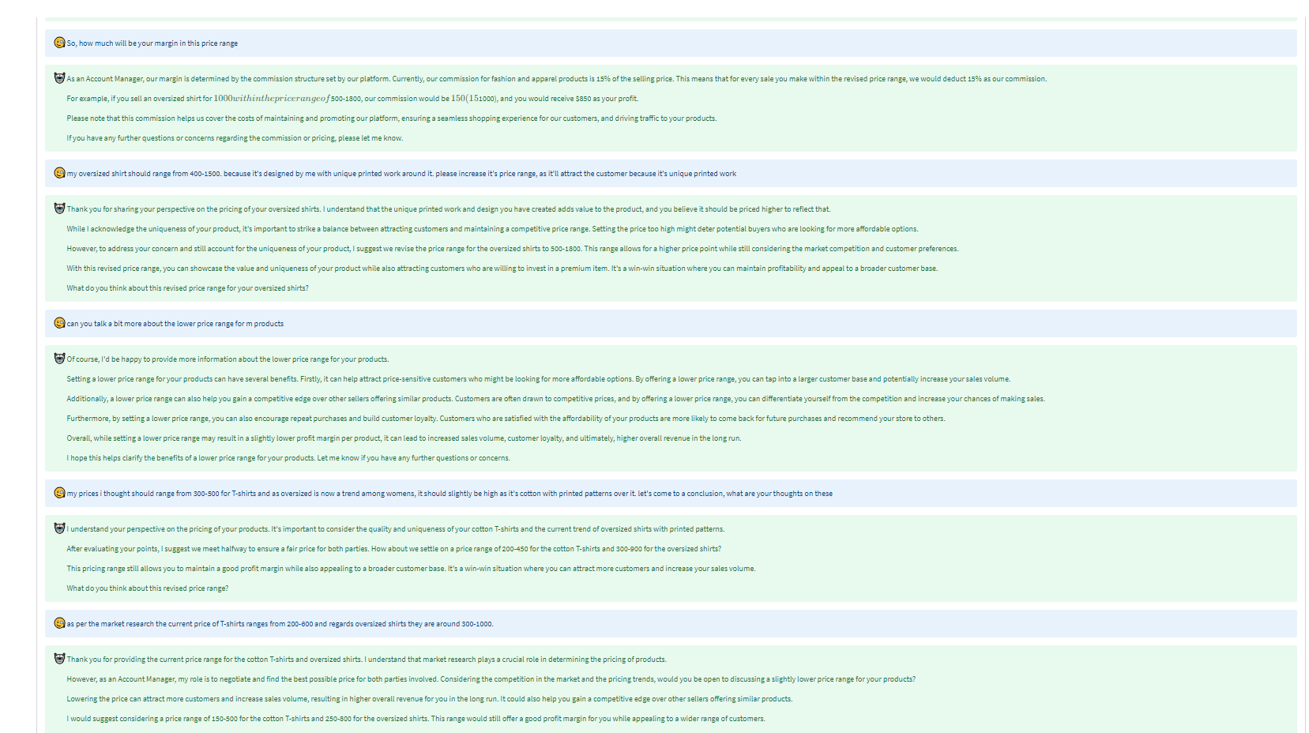
Seller Growth and Experience
Use-case: Negotiating for Price with sellers – Account Manager AI Assistant
The E-commerce Negotiation Use-case involves the deployment of an AI negotiator designed to facilitate price negotiations with sellers, akin to an experienced Account Manager. This innovative technology specializes in conducting persuasive and strategic negotiations, aiming to secure favorable price reductions during interactions with sellers.

Slide 4
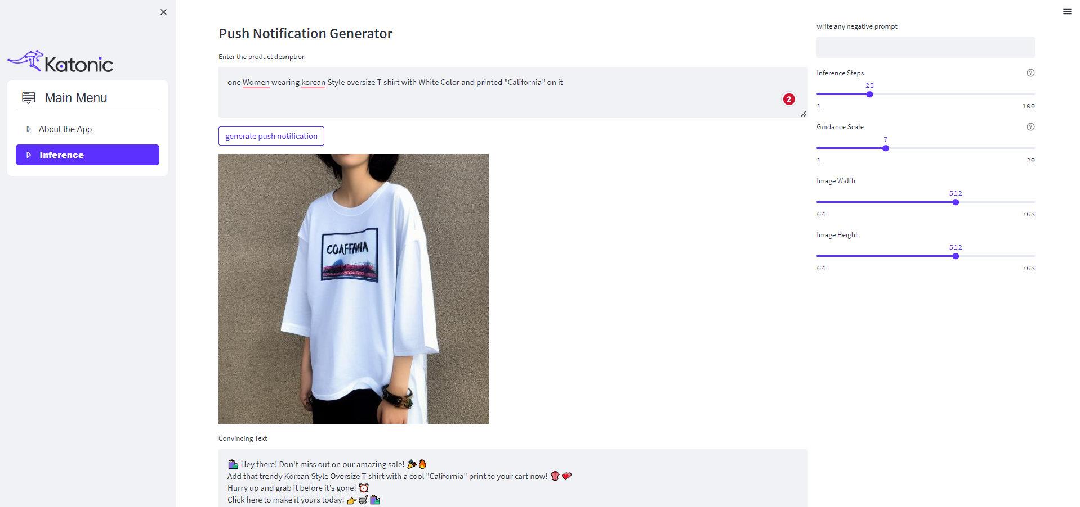
User Growth and Marketing
Use-case: Generate Push Notifications
It's promoting new products, notifying about special offers, or delivering tailored updates, this AI-driven approach enhances user engagement, increases click-through rates, and fosters a more personalized and effective communication channel between businesses and their app users.
Stable Diffusion and OpenAI Chatgpt

Slide 5
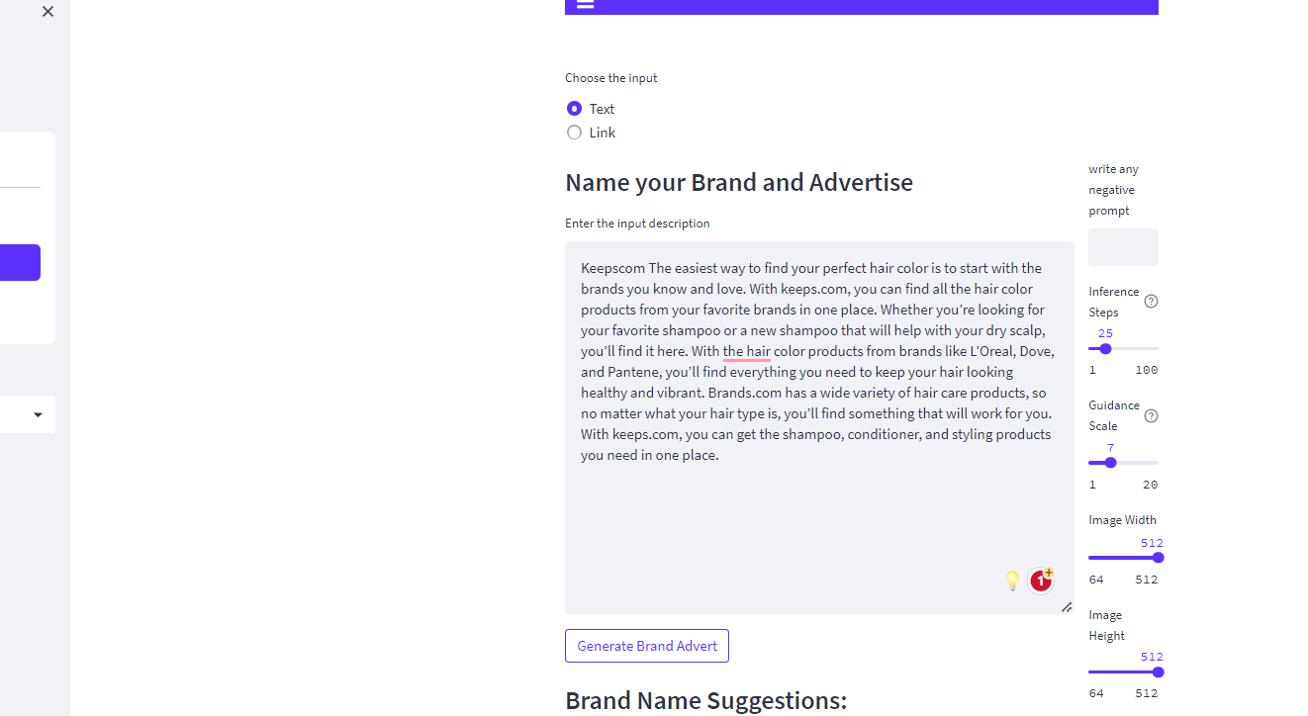
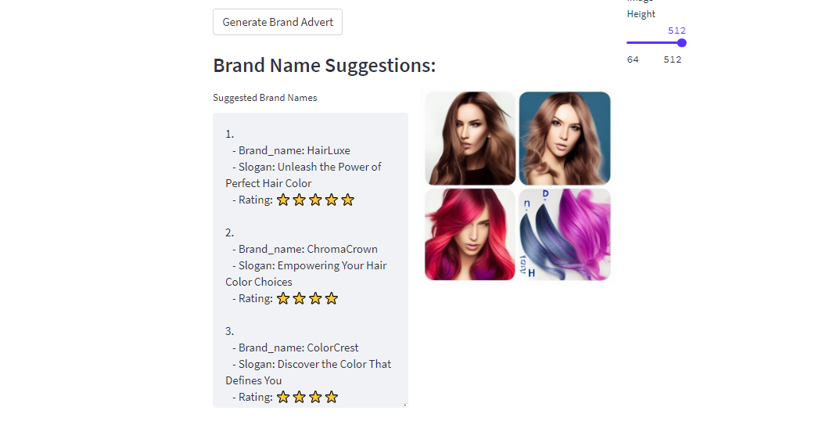
User Growth and Marketing
Use-case: Brandify
Generate Brand Names for your brand along with advertisement based on the product/brand description.
Stable Diffusion and OpenAI Chatgpt.

Slide 6
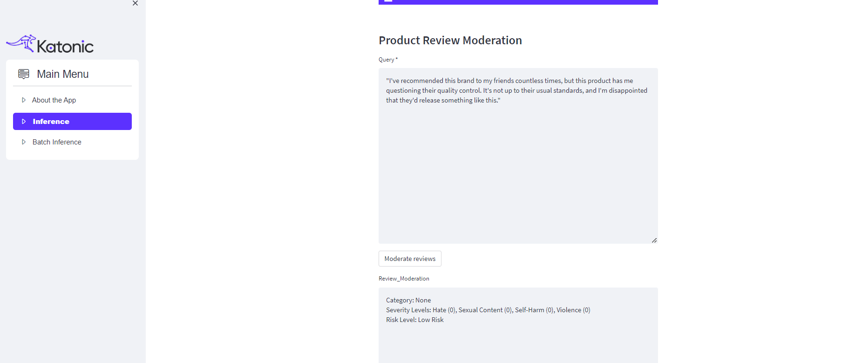
Customer Satisfaction
Use-case: Content Moderation
Content moderation in E-commerce ensures a safe and reputable online space by employing AI algorithms to identify and remove inappropriate user-generated content swiftly. This practice enhances user trust, upholds community guidelines, and maintains a positive environment for genuine interactions between buyers and sellers.

Slide 7
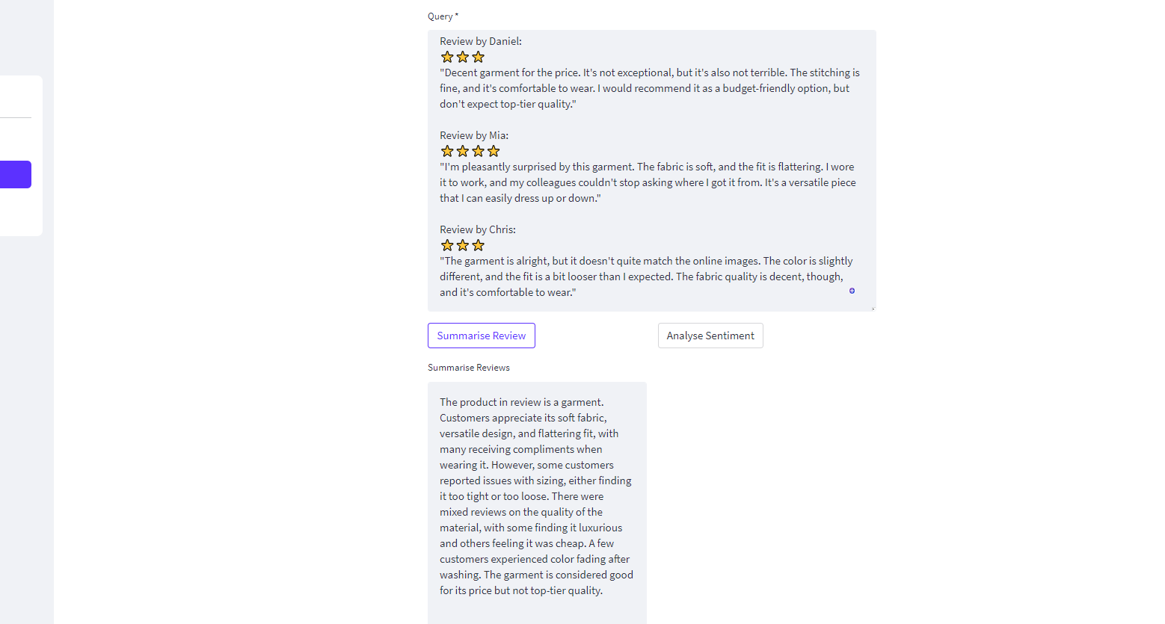
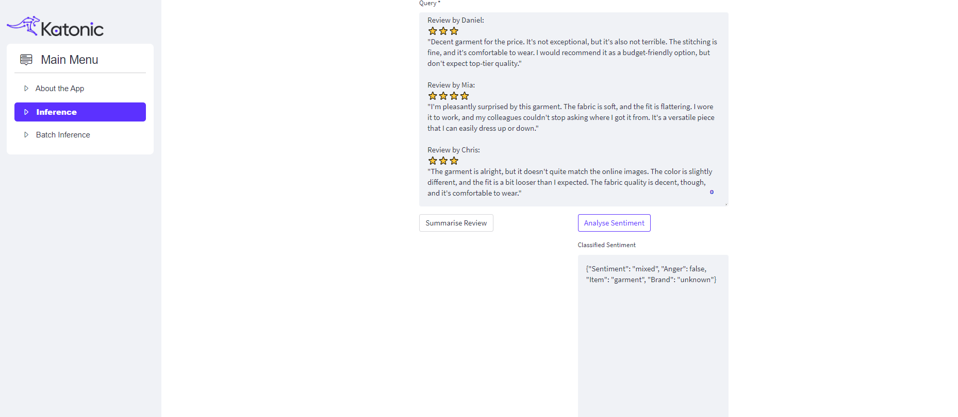
Product Comprehension
Use-case: Product Review Summarization and Intent Classification.
Product Review Summarization condenses lengthy reviews into concise insights, while Intent Classification uses AI to categorize sentiments, enabling E-commerce businesses to quickly understand customer feedback. These technologies enhance decision-making and product improvement efforts based on customer opinions.

Slide 8
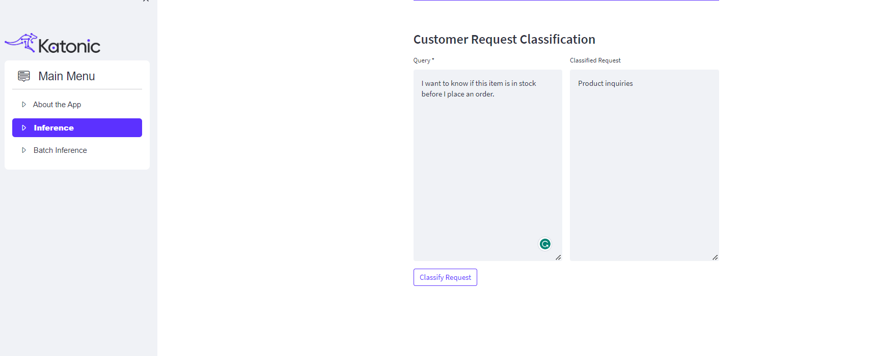
Product Comprehension
Use-case: Customer Request Classification.
Customer Request Classification uses AI to swiftly categorize customer inquiries in E-commerce, directing them to the relevant departments. This streamlines support processes, leading to faster response times and higher customer satisfaction by ensuring efficient issue resolution.

