Slide 1


Welcome
Trust
Trust - Trivago Hackathon 2017

Slide 2
The Problem
Language Detection
Code-Quality Analysis
Automatice Profiling
Natural Language Processing
Skill Aggregation
Trust - Trivago Hackathon 2017

Slide 3


The Solution
Natural Language Processing
Language Detection
Code-Quality Analysis
Automatic User-Profiling
Skill aggregation and validation
Video Interview
Trust - Trivago Hackathon 2017

Slide 4
Demo
Trust - Trivago Hackathon 2017

Slide 5



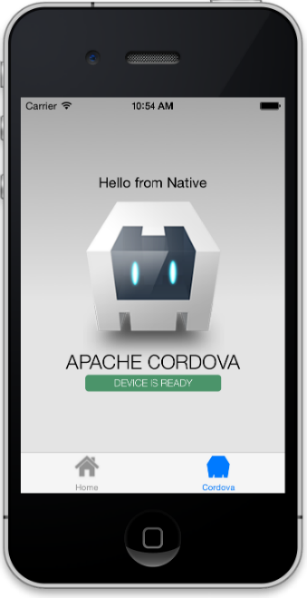




Thank You
Our Project on GitHub: kolja-esders/trust
A project by Trust Team @ Trivago Hackathon 2017
Trust - Trivago Hackathon 2017

