Slide 1

ML Algorithms for Diabetes Prediction
By:
Bandlamudi Srinivasa Rao,
Kollabathula Preetham,
Vaishali Tappeta Venkataramana

Slide 2
Introduction
Diabetes is a condition in which blood glucose, often known as blood sugar, is abnormally high.
The objective of our project is to perform exploratory data analysis on a diabetes dataset and predict diabetes in a patient based on the diagnostic measures by using multiple Machine Learning Algorithms

Slide 3
Dataset Description
The Pima Indians diabetic dataset which consists of 769 samples, out of which 500 are non-diabetic while 269 are diabetic people
The dataset has total 9 attributes of which 8 are independent variables and one is the dependent variable.(i.e. the target variable which determines whether the patient is having diabetics or not.

Slide 4
Approach
We are using Exploratory data analysis approach which is the use of summary statistics and graphical representations, exploratory data analysis refers to the crucial process of doing first investigations on data to uncover patterns, spot anomalies, test hypotheses, and check assumptions.

Slide 5
Data Classification
Our main objectives are as follows:
To use data mining techniques to preprocess and classify the data.
Comparing the accuracies of various Machine Learning models.
Determining the most appropriate model for predicting diabetes based on user input.

Slide 6
Algorithms
K-nearest neighbor's algorithm
Support Vector Machine
logistic regression
Decision Tree Classifier
Random Forest Algorithm
Gaussian Naive Bayes
Gradient boosting classifiers

Slide 7
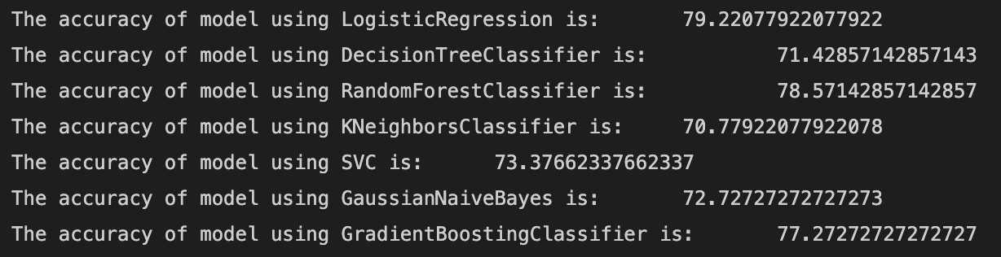
Experimental Setup

Slide 8
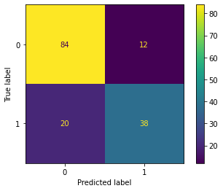
Evaluation
We are using confusion matrix as a performance measurement for machine learning classification problem where the predicted output is plotted with actual class labels.

Slide 9
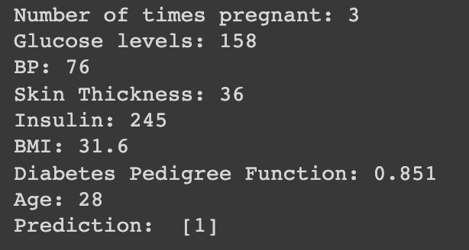

Diabetes Outcome Prediction

Slide 10
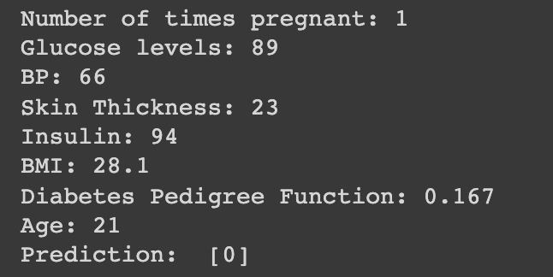
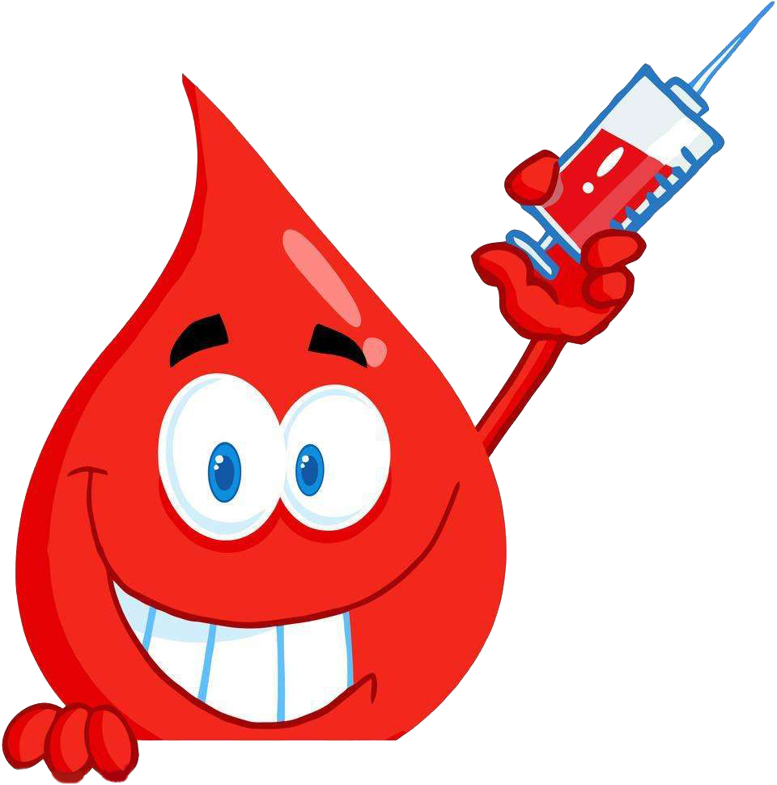

Non-Diabetic Outcome Prediction

Slide 11
Conclusion & Future Work
It is also very helpful for normal people to check whether they are prone to diabetics or not by just entering simple values of pregnancy, blood pressure, Glucose, age, etc. and determine if they are developing any early signs of diabetics using this.
Further, predicting this disease early leads to treating the patient before it becomes critical.

Slide 12

THANK YOU

