Slide 1

INSURE AI
-Online Corporate Insurance using AI
KOLLA SUMANTH

Slide 2
INTRODUCTION
Insure-AI is a full-stack Insurance Management System developed to simplify and automate the management of insurance policies, users, and agents through a secure and scalable digital platform.
The application is designed to address real-world challenges in traditional insurance systems by providing a centralized solution where administrators, agents, and customers can efficiently interact with the system based on their roles.
FEATURES
User authentication and authorization with role-based access control, Policy creation and management with full CRUD and soft delete functionality, Role-based workflows for Admin, Agent, and Customer operations, Centralized admin dashboard for system control and monitoring, Location-based agent and service handling using pincode-to-geolocation mapping, RESTful API architecture for seamless system communication, Secure backend implementation with Spring Security, Efficient data handling using MySQL database

Slide 3
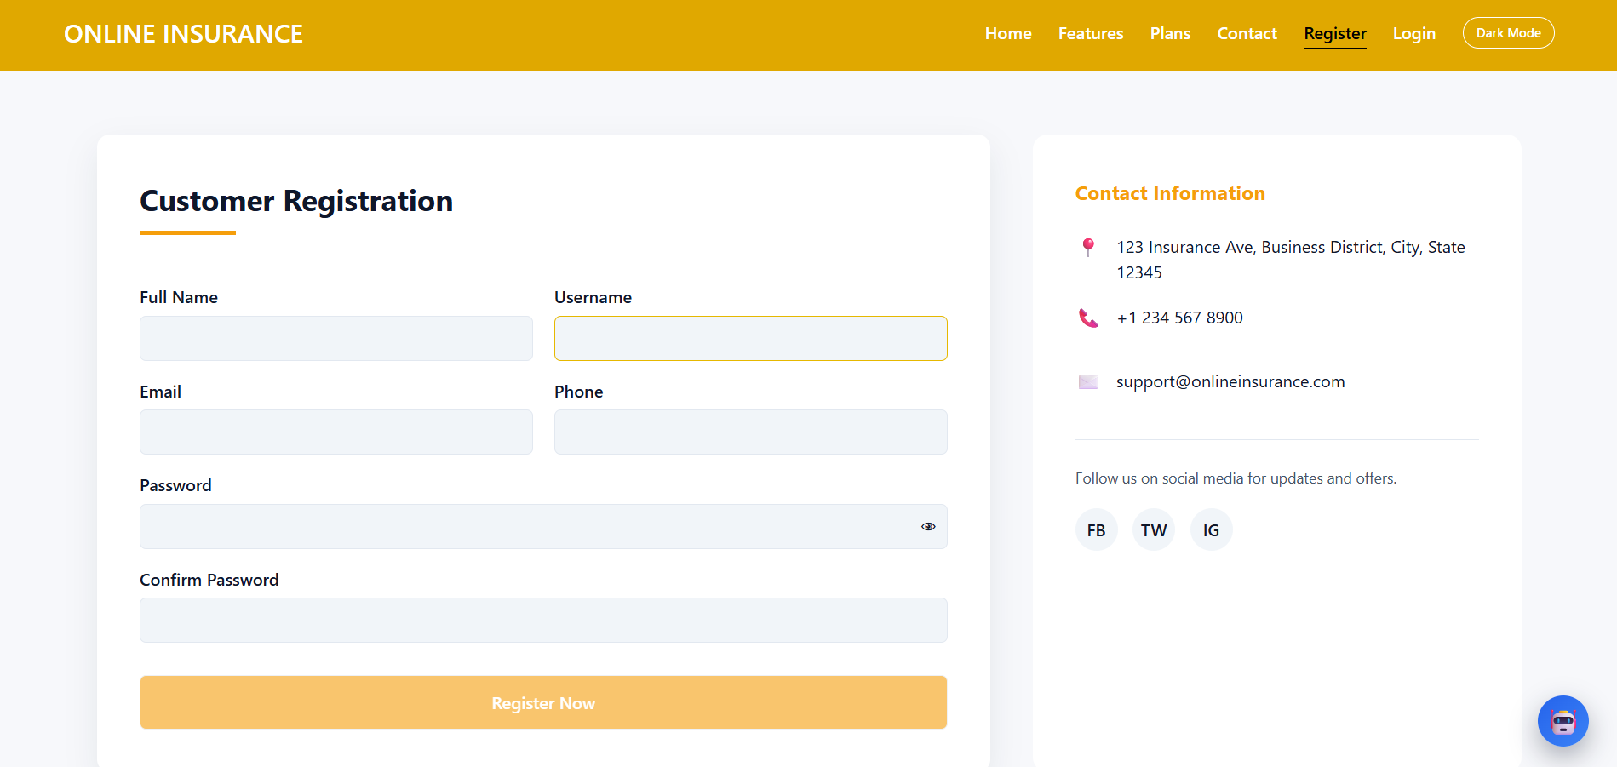
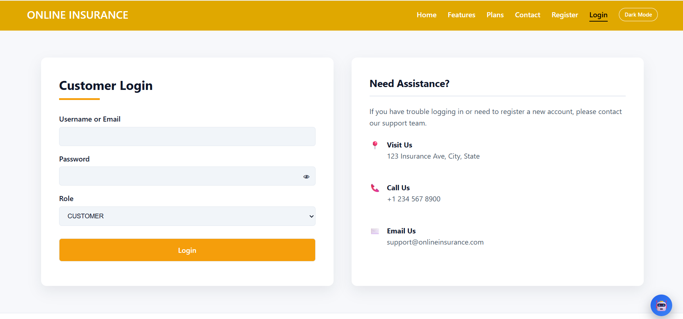
Customer login and registration system

Slide 4
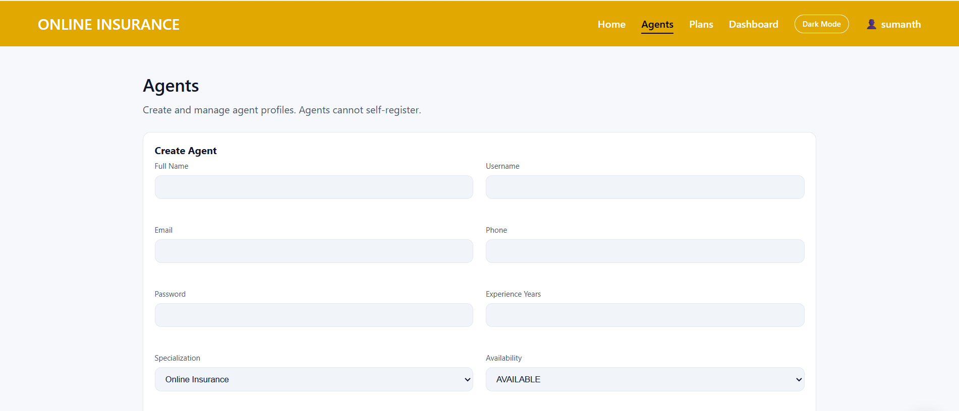
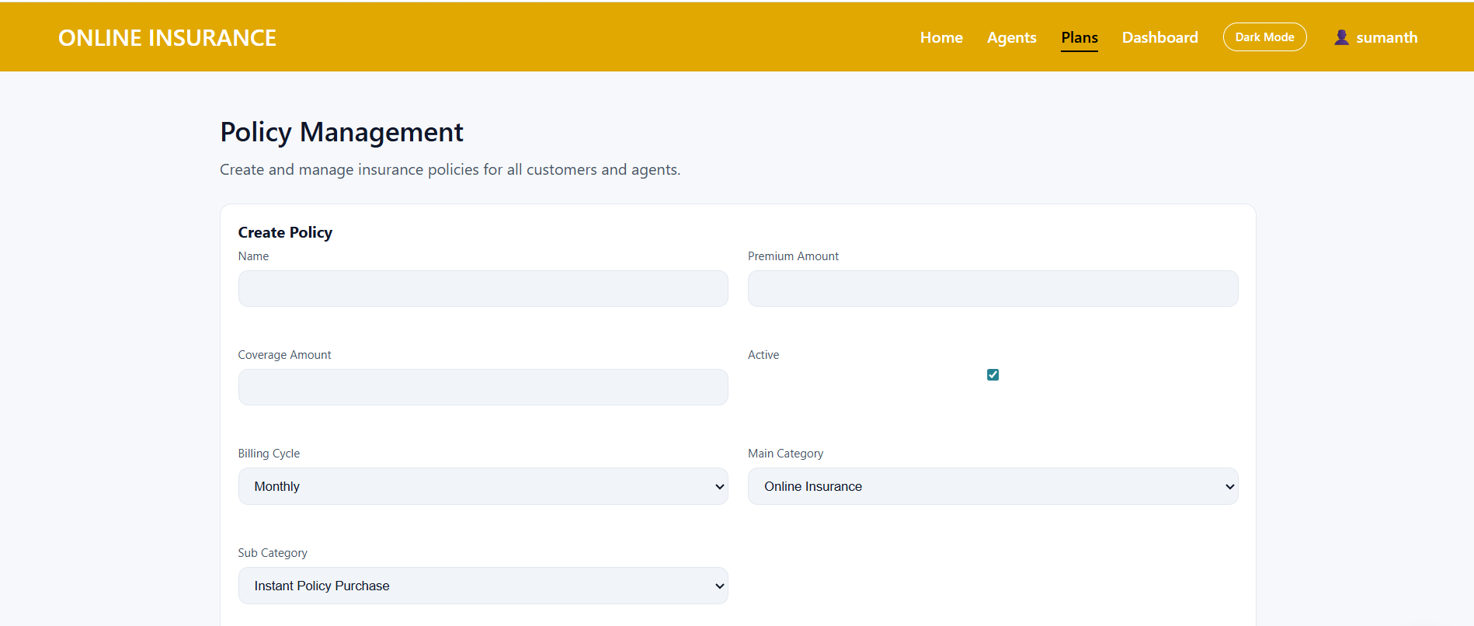
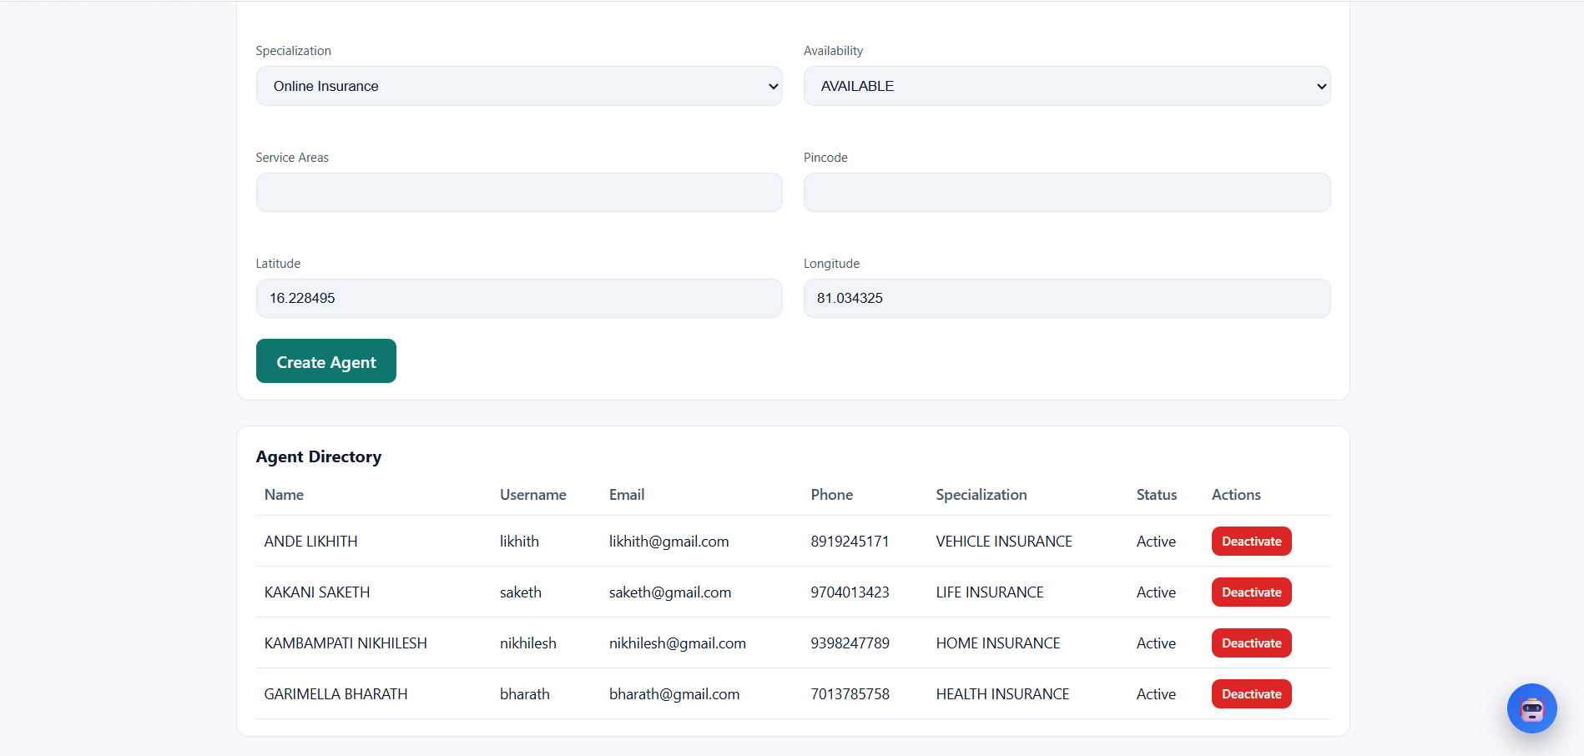
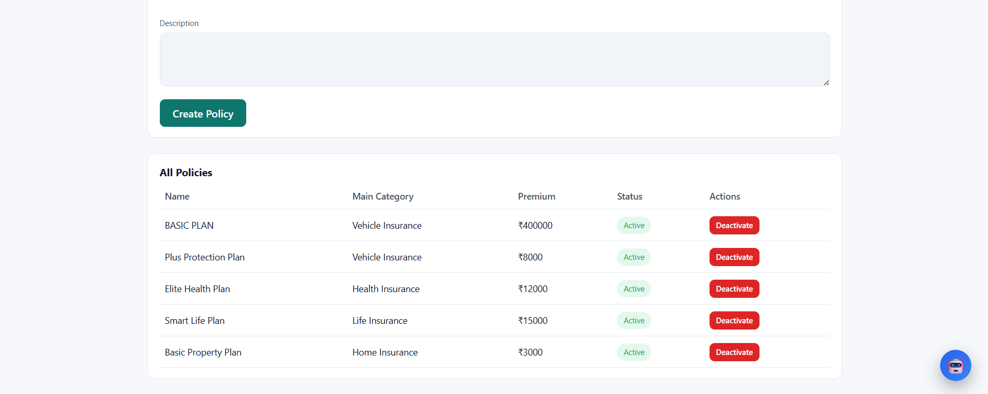
Admin dashboard and access control

Slide 5
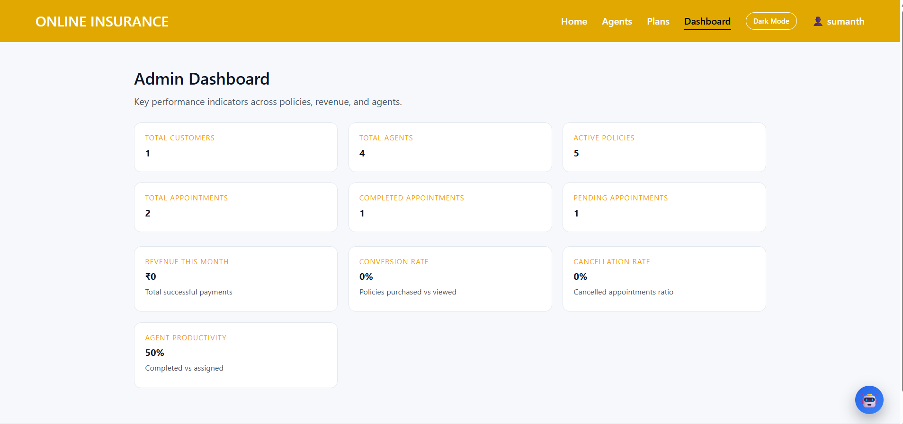
Admin dashboard and access control

Slide 6
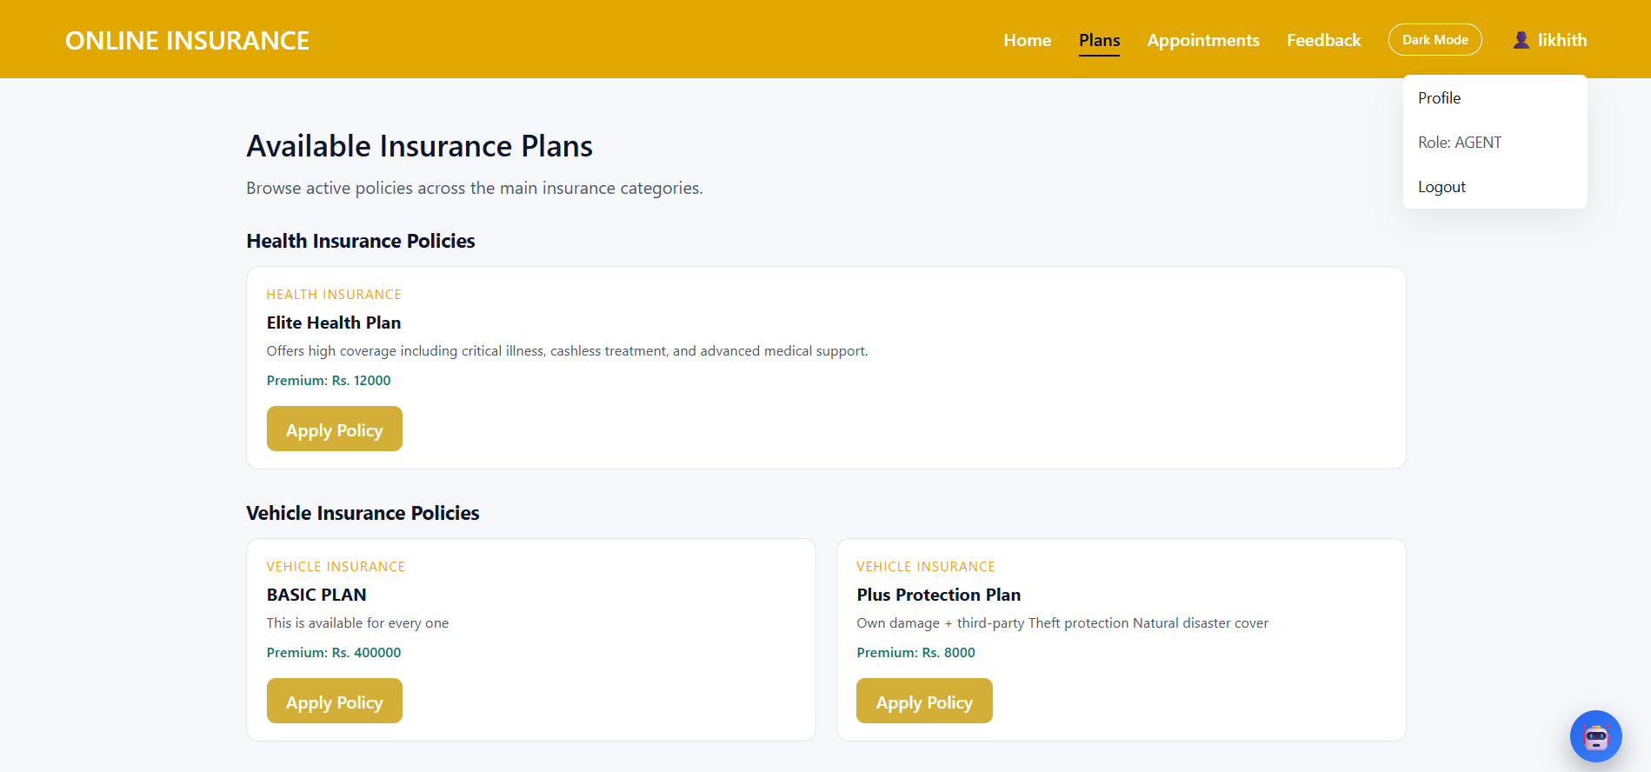
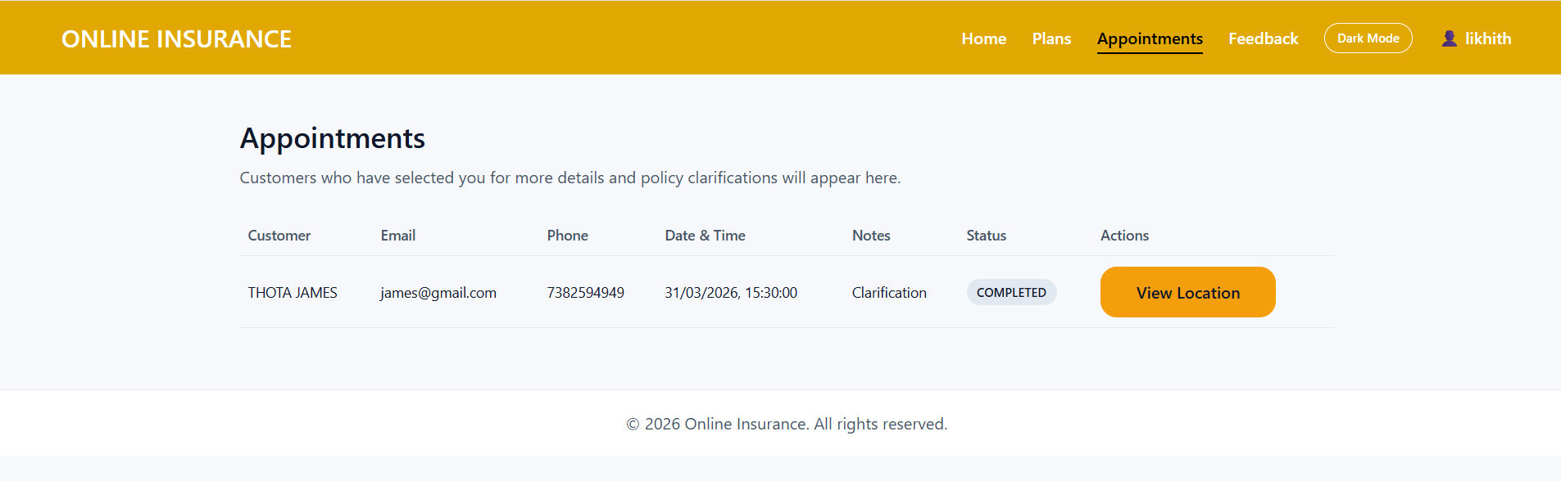
Agent availability and scheduling management

Slide 7
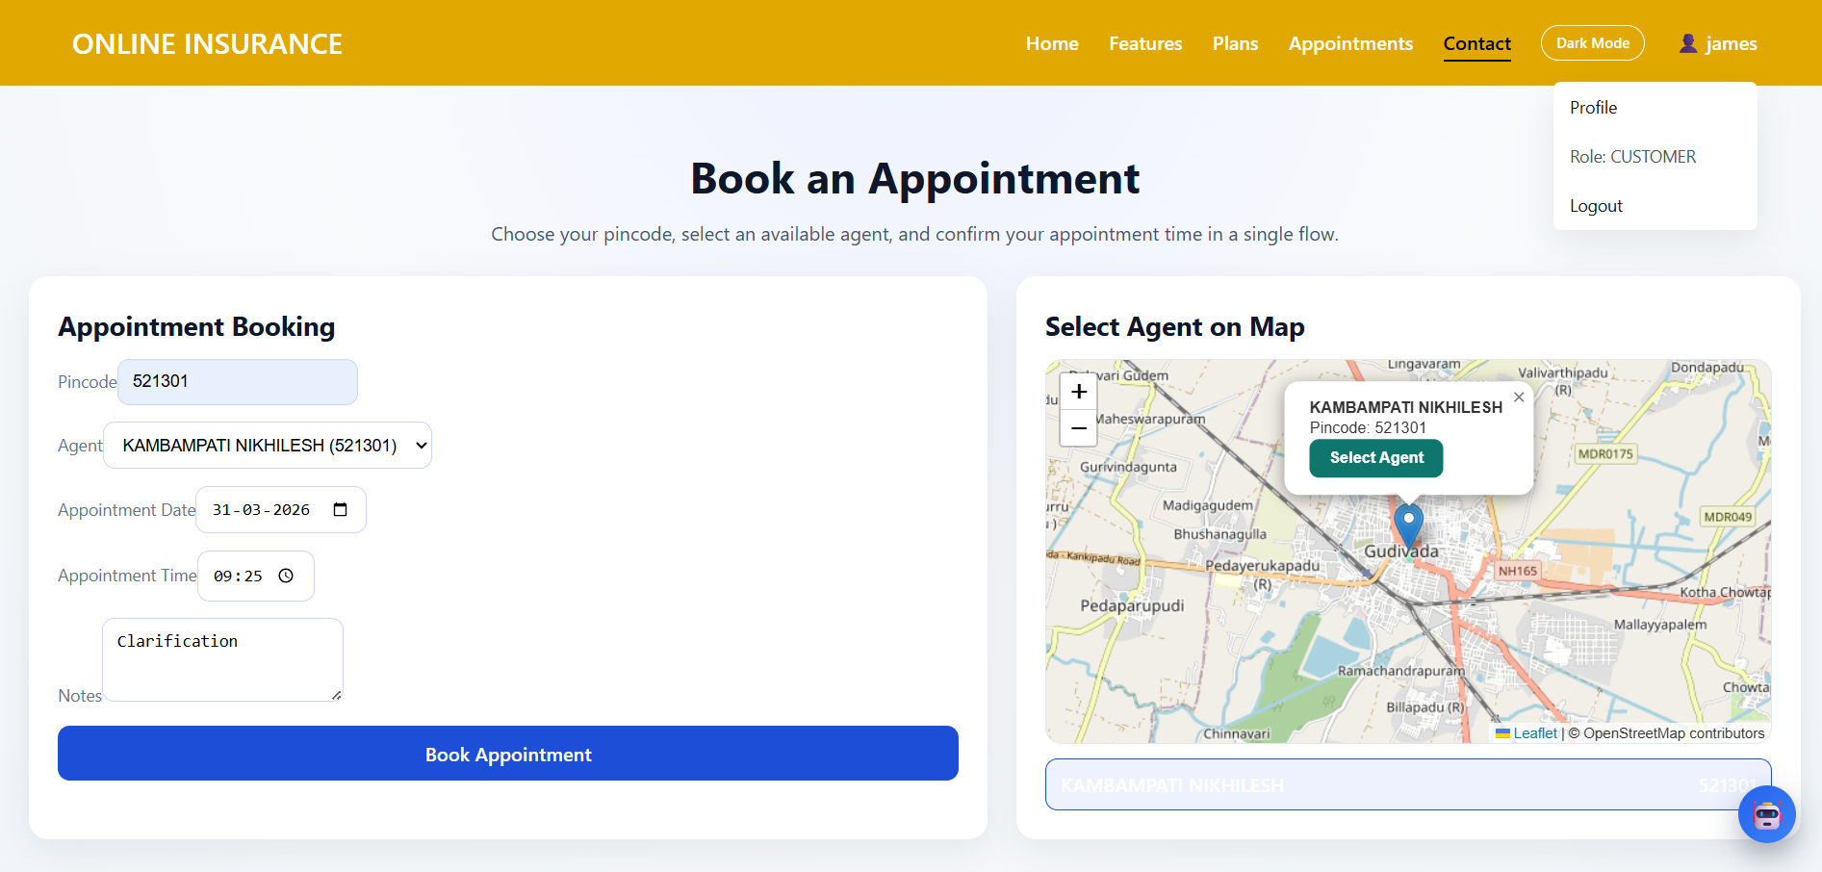

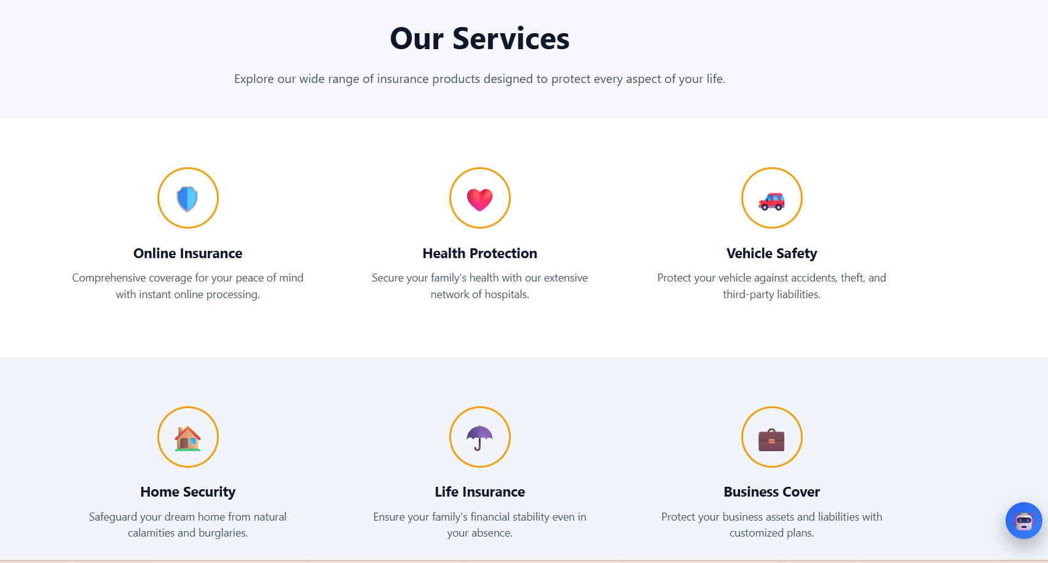
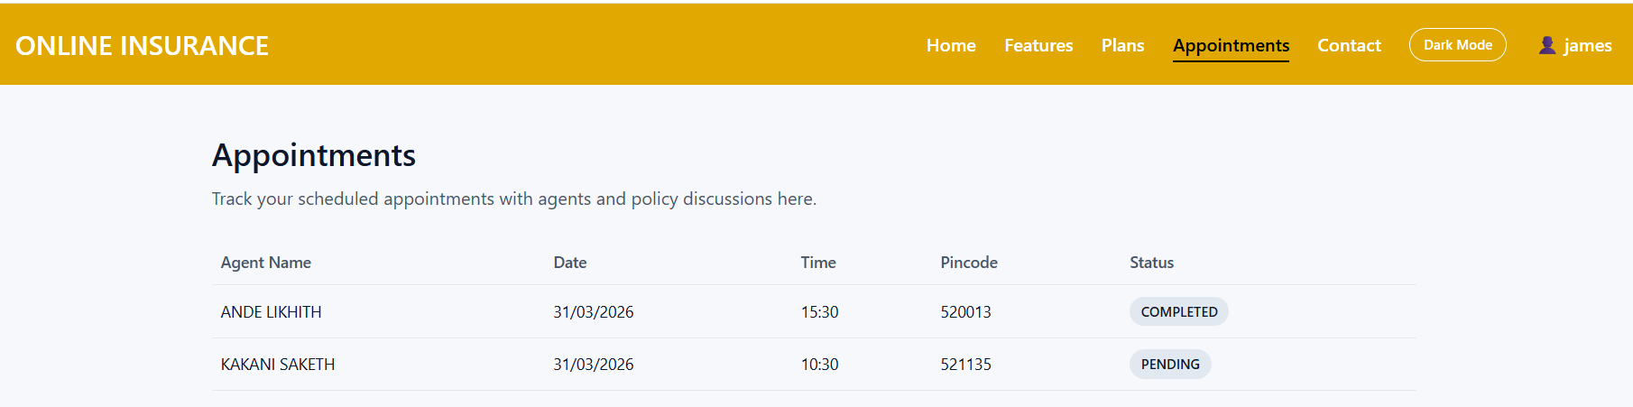
Customer appointment scheduling and management

Slide 8
THANK YOU

